Slide 1
Technologies
Node
Mongo
Angular
Bootstrap
Jquery
(Single Page)

Slide 2
Demo
Click me

Slide 3
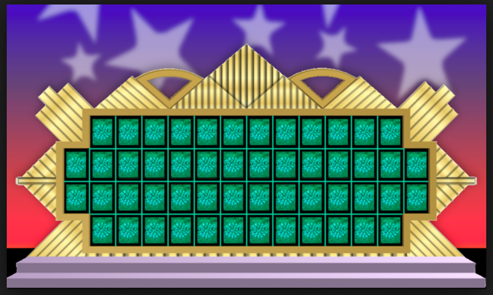
Before and After
username
Save
New Game
Exit
Enter Letter
Submit
Your letter matched!
Solve?
yes
no
Submit

Slide 4
Letter Submitted
Validate Letter
Letter Matched
Letter Not Valid
Letter Valid
Check for Phrase Completion
Letter Not Found
Completed. You Win!
Not Completed.
MSG Output -
Try Again!
Solve Puzzle?
Phrase Submitted
Yes
No. Go Again.
Validate Phrase
Phrase Not Valid
Phrase Valid
You Win!
Phrase Incorrect
Phrase Matched

Slide 5
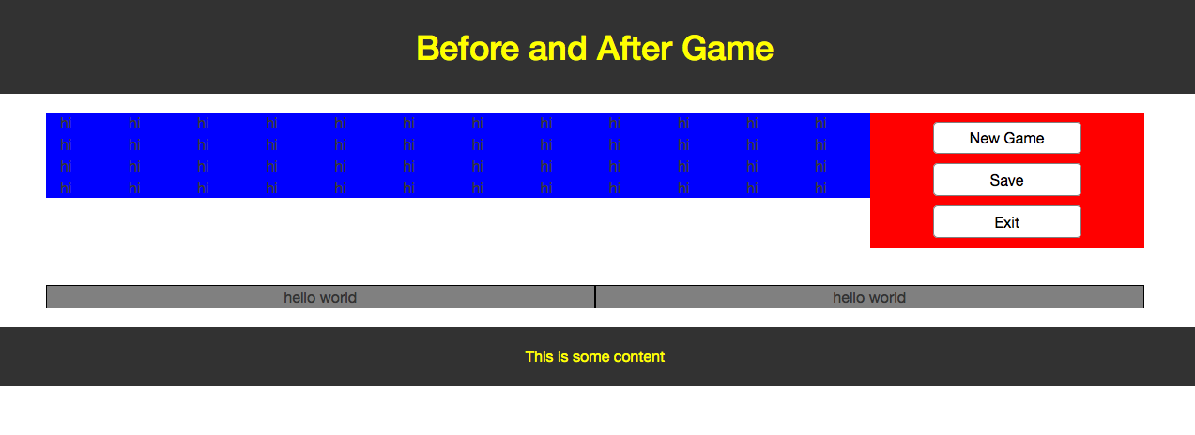
Day One

Slide 6
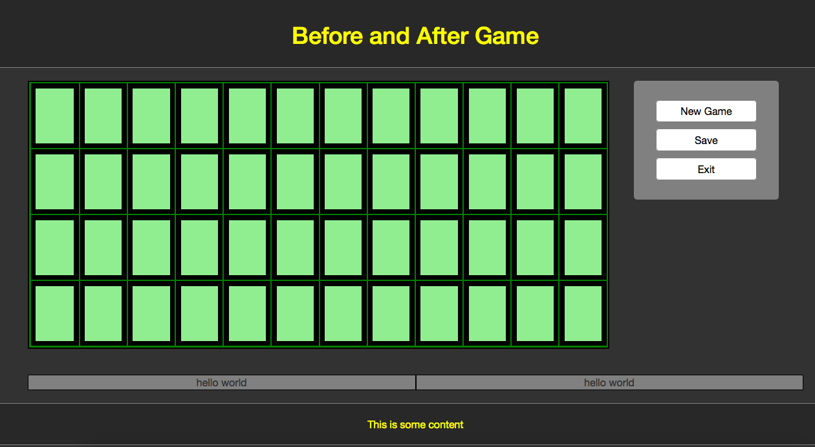
End of Day One – 12:20am

Slide 7
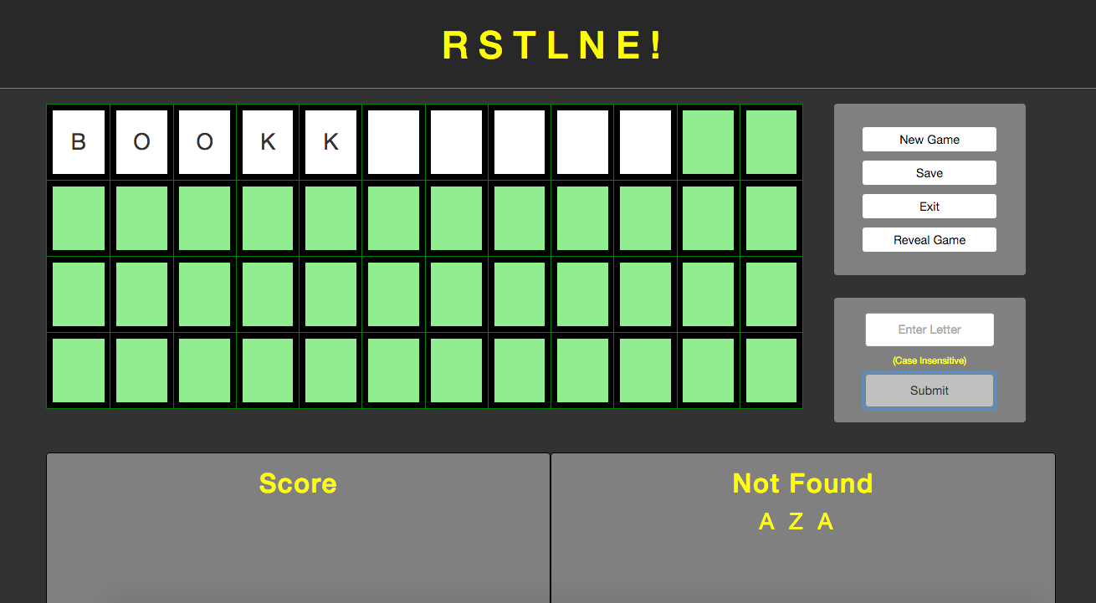

End of day 3 - 8pm

Slide 8
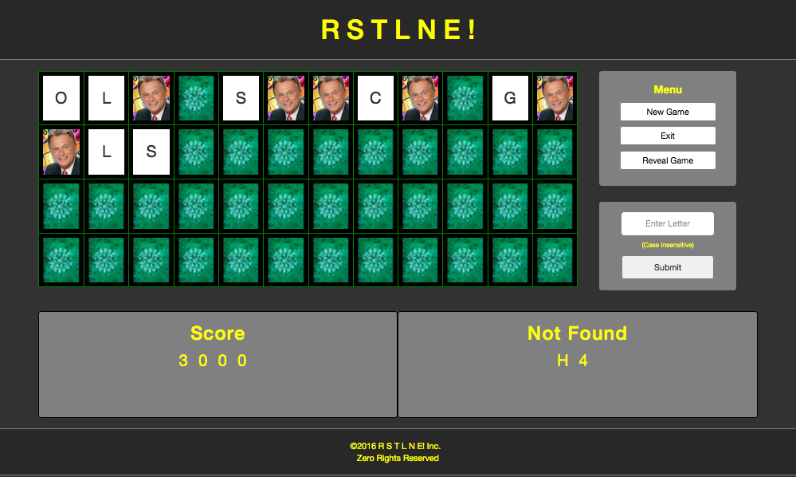
End of day 4: 5pm

Slide 9
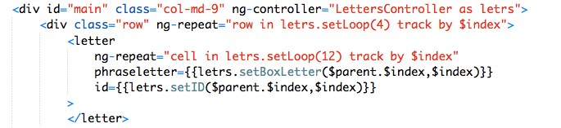
Index.ejs
The outer ng-repeat builds the rows and the inner one builds the columns.
I used 4 rows and 12 columns (bootstrap).
The letter tag is an angular 'custom directive'.
The values of the letter tag (cells in the grid) come from the phraseletter
  attribute (scope)

Slide 10
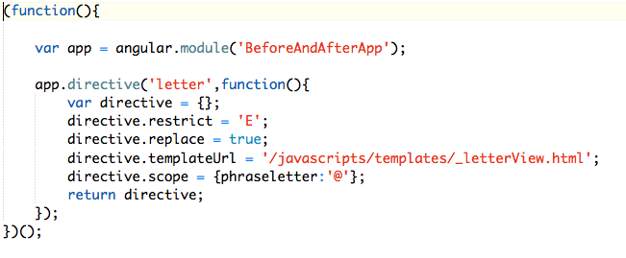

LetterView.js
_LetterView.html

Slide 11
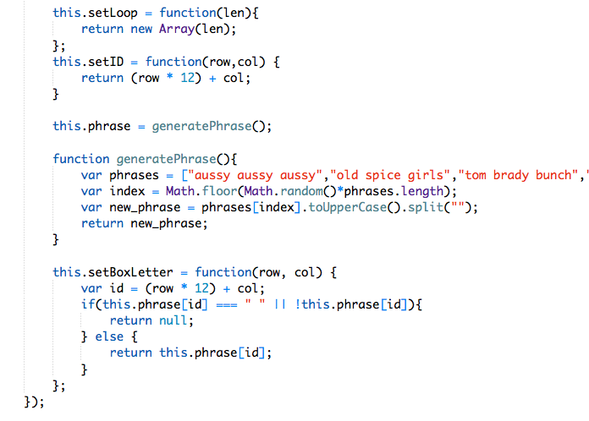
LettersController.js - Angular

