Slide 1

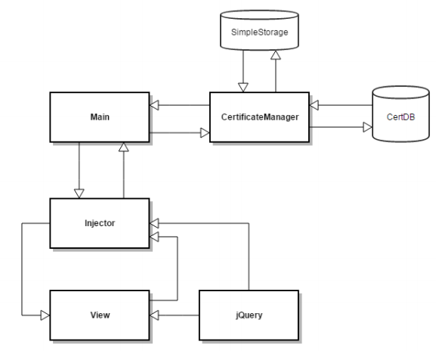
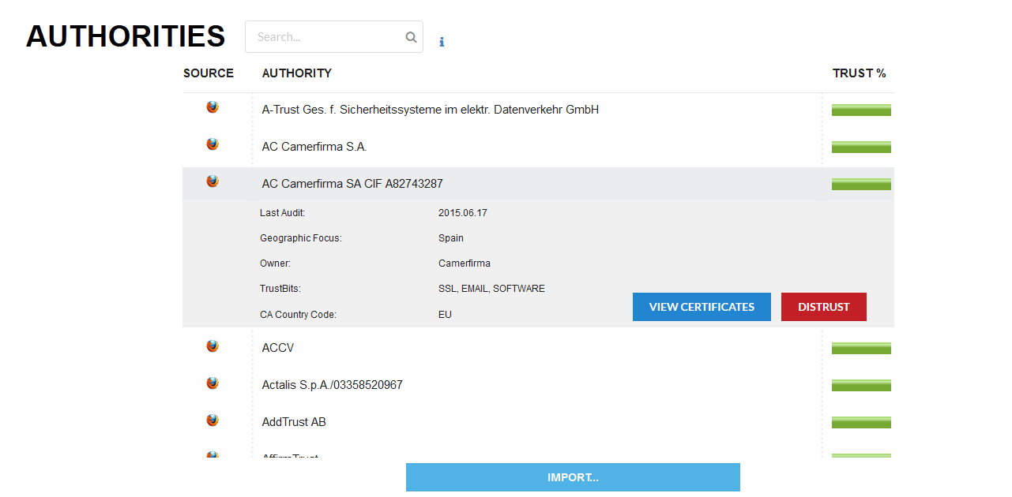
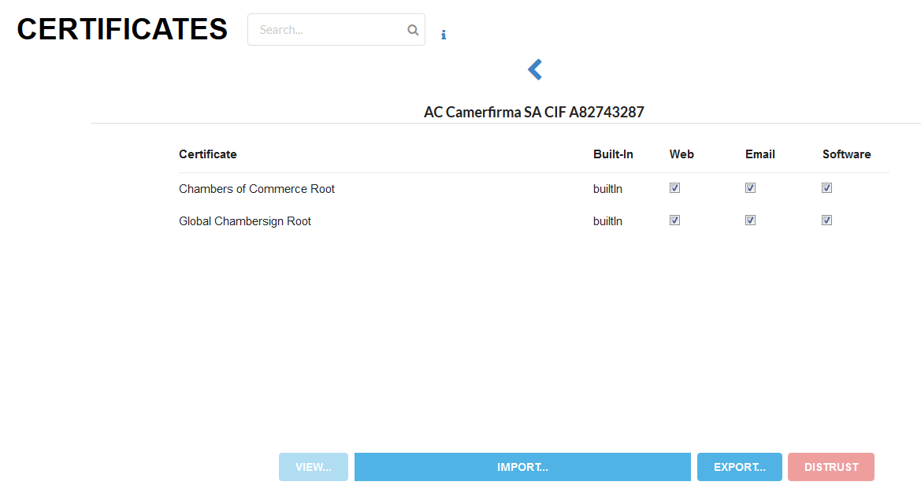




Certificate Manager
Dax Earl, Mason Schneider, Melissa Thai, Josh Wright
Problem
Firefox’s original Certificate Manager has been left by the wayside as the browser’s UI progressed over the years.
As a result, the average user is unable to understand or interact with their certificates.
Features
List authorities and certificates
Search based on name/owner/location
Mass Trust/Distrust all certificates of an authority
View Salesforce data for authorities (Country, Audit, Owner, etc.)
Import & Export certificates
Alter certificate trust bits
Solution
We redesigned the UI making it more modern and user friendly.
The core functionality of import, export, delete, trust ­bit manipulation, and viewing from the default certificate manager were implemented.
We also exposed the user to the Salesforce data that Mozilla collects on Authorities.
Architecture
Screenshots

