Slide 1

WILSON MOSES
DATA SCIENCE × AI ENGINEERING
DATA SCIENCE FIELD NOTES / 01
EMPLOYEE ATTRITION
ANALYSIS
Patterns associated with workforce turnover in 1,470 employee records
AnalystLab Africa | Data Science Internship | Week 1
Learning. Building. Applying.
Notes:
[Sources]
- data/raw/abc_employee_attrition.csv (metrics computed in the repository notebooks)
- README.md (project framing and responsible-use boundaries)
[/Sources]

Slide 2
WILSON MOSES
DATA SCIENCE FIELD NOTES
BUSINESS CONTEXT
Understand the pattern before predicting it
THE BRIEF
QUESTIONS
ABC Manufacturing wants to understand where attrition is concentrated before investing in predictive modelling. The analysis examines workforce structure, overtime, departments, job roles, age, income and tenure.
01
What does the workforce look like?
02
Which departments exceed the baseline?
03
How strongly is overtime associated with attrition?
DATASET
04
Which roles show the highest turnover?
1,470 employees • 35 variables • 0 missing values • 0 complete duplicates
05
How do age, income and tenure differ between groups?
EMPLOYEE ATTRITION / BUSINESS CONTEXT
01
Notes:
[Sources]
- data/raw/abc_employee_attrition.csv (metrics computed in the repository notebooks)
- README.md (project framing and responsible-use boundaries)
[/Sources]

Slide 3
WILSON MOSES
DATA SCIENCE FIELD NOTES
WORKFORCE OVERVIEW
R&D dominates headcount; three roles anchor staffing
EMPLOYEE ATTRITION / WORKFORCE OVERVIEW
02
Notes:
[Sources]
- data/raw/abc_employee_attrition.csv (metrics computed in the repository notebooks)
- README.md (project framing and responsible-use boundaries)
[/Sources]

Slide 4
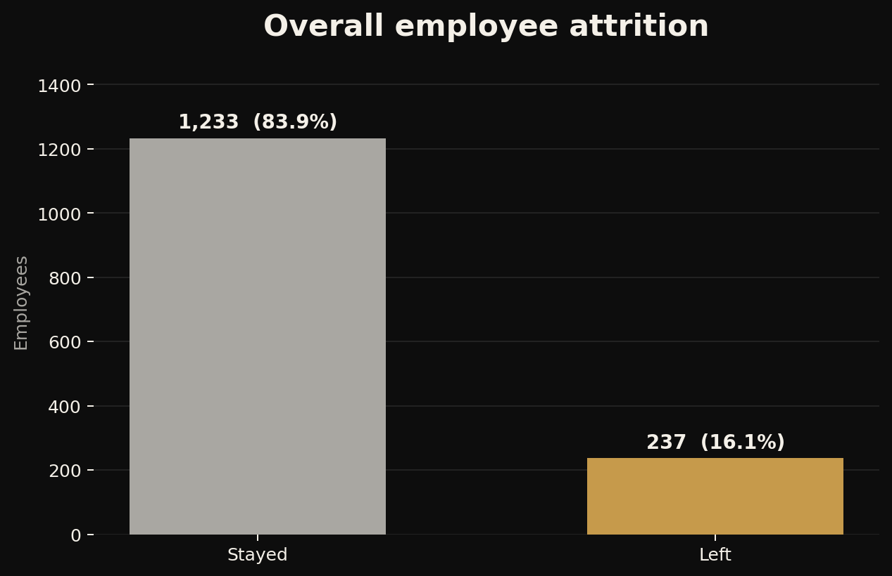
WILSON MOSES
DATA SCIENCE FIELD NOTES
BASELINE
One in six employees left in this dataset
16.12%
237 of 1,470 employees
This company-wide rate is the reference point for every subgroup. A department, role or condition is considered elevated only when its observed rate sits meaningfully above the 16.12% baseline.
EMPLOYEE ATTRITION / BASELINE
03
Notes:
[Sources]
- data/raw/abc_employee_attrition.csv (metrics computed in the repository notebooks)
- README.md (project framing and responsible-use boundaries)
- images/overall-attrition.png (repository-generated chart)
[/Sources]

Slide 5
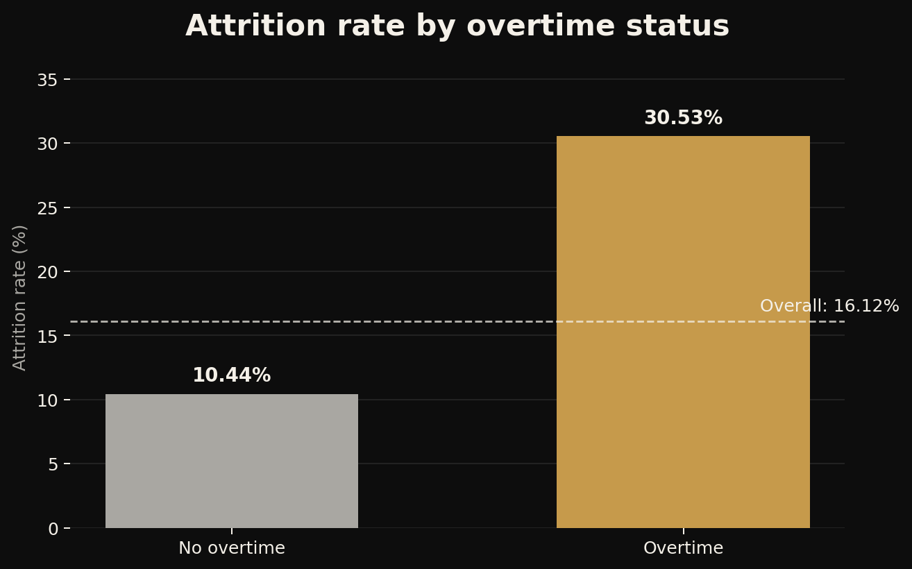
WILSON MOSES
DATA SCIENCE FIELD NOTES
STRONGEST DESCRIPTIVE SIGNAL
Overtime nearly triples the attrition rate
30.53%
Works overtime
10.44%
No overtime
+20.09 percentage points
Priority for investigation, not proof of causation.
EMPLOYEE ATTRITION / OVERTIME
04
Notes:
[Sources]
- data/raw/abc_employee_attrition.csv (metrics computed in the repository notebooks)
- README.md (project framing and responsible-use boundaries)
- images/overtime-attrition-rate.png (repository-generated chart)
[/Sources]

Slide 6
WILSON MOSES
DATA SCIENCE FIELD NOTES
DEPARTMENT CONCENTRATION
Sales and HR exceed the company baseline
READING THE GAP
Sales: 20.63%
HR: 19.05%
Overall: 16.12%
R&D: 13.84%
HR contains only 63 employees, so its rate is less stable. Department results should be interpreted with role mix and headcount in view.
EMPLOYEE ATTRITION / DEPARTMENTS
05
Notes:
[Sources]
- data/raw/abc_employee_attrition.csv (metrics computed in the repository notebooks)
- README.md (project framing and responsible-use boundaries)
[/Sources]

Slide 7
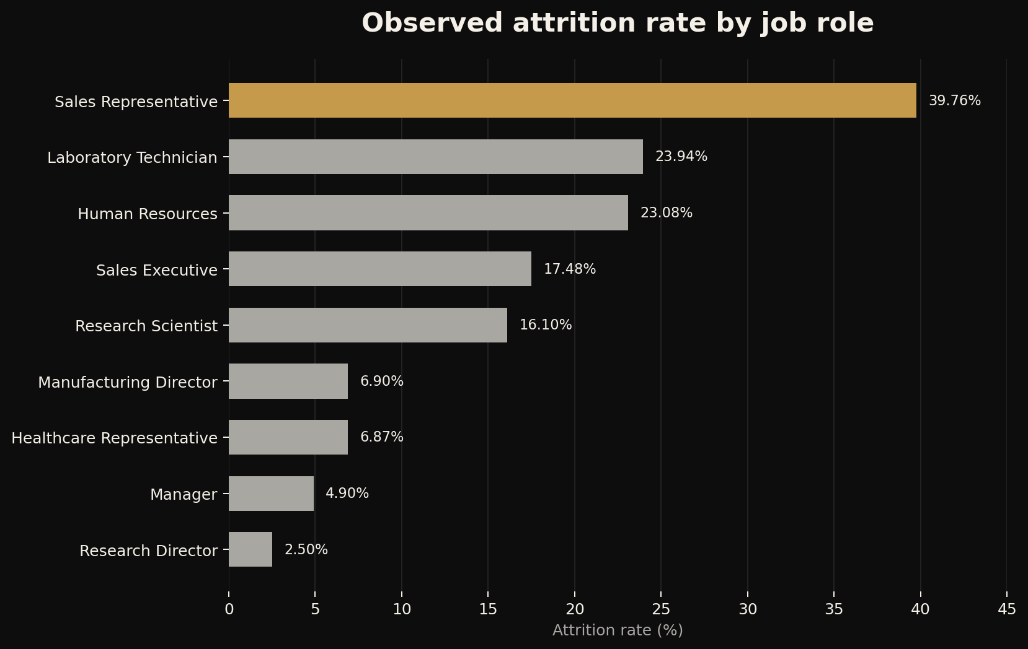
WILSON MOSES
DATA SCIENCE FIELD NOTES
SHARPEST DIVIDE
Attrition concentrates in specific roles
39.76%
Sales Representatives
23.94%
Laboratory Technicians
Role-specific investigation matters more than a single company-wide conclusion.
EMPLOYEE ATTRITION / JOB ROLES
06
Notes:
[Sources]
- data/raw/abc_employee_attrition.csv (metrics computed in the repository notebooks)
- README.md (project framing and responsible-use boundaries)
- images/job-role-attrition-rate.png (repository-generated chart)
[/Sources]

Slide 8
WILSON MOSES
DATA SCIENCE FIELD NOTES
WHO IS LEAVING?
Leavers skew younger, lower-paid and less experienced
AGE
MONTHLY INCOME
TOTAL WORKING YEARS
33.6
4,787
8.2
Left company
Left company
Left company
37.6
6,833
11.9
Stayed
Stayed
Stayed
years
average
years
These averages overlap between groups. They are candidate signals to assess jointly with overtime and role, not standalone explanations.
EMPLOYEE ATTRITION / EMPLOYEE PROFILE
07
Notes:
[Sources]
- data/raw/abc_employee_attrition.csv (metrics computed in the repository notebooks)
- README.md (project framing and responsible-use boundaries)
[/Sources]

Slide 9
WILSON MOSES
DATA SCIENCE FIELD NOTES
WHAT HR SHOULD INVESTIGATE NEXT
Five evidence-led priorities from the exploratory analysis
01
Overtime
30.53% attrition versus 10.44% without overtime.
02
Role concentration
Sales Representatives and Laboratory Technicians stand out.
03
Department context
Sales and HR exceed the 16.12% company baseline.
04
Career stage
Leavers are younger and less experienced on average.
05
Compensation
Lower average income travels with attrition, but does not prove cause.
EMPLOYEE ATTRITION / BUSINESS INSIGHTS
08
Notes:
[Sources]
- data/raw/abc_employee_attrition.csv (metrics computed in the repository notebooks)
- README.md (project framing and responsible-use boundaries)
[/Sources]

Slide 10
WILSON MOSES
DATA SCIENCE FIELD NOTES
CONTINUE FROM EVIDENCE TO RESPONSIBLE MODELLING
Four steps protect the quality of the next phase
01
02
03
04
Test the differences
Build a feature plan
Model carefully
Design HR action
Add statistical tests and effect sizes to the descriptive findings.
Separate predictors, identifiers, constants and potential fairness risks.
Use leakage-safe splits, transparent baselines and class-sensitive metrics.
Pair quantitative evidence with interviews, workload context and human review.
The strongest descriptive pattern is a starting point for investigation - not proof of causation.
EMPLOYEE ATTRITION / NEXT STEPS
09
Notes:
[Sources]
- data/raw/abc_employee_attrition.csv (metrics computed in the repository notebooks)
- README.md (project framing and responsible-use boundaries)
[/Sources]

