Slide 1

编译原理
陈明帅
m.chen@zju.edu.cn
浙江大学 · 计算机科学与技术学院
Slides partially credited to Zhongxin Liu

Slide 2
Overview
1
Introduction
2
3
4
5
6
Lexical Analysis
Parsing
Abstract Syntax
Semantic Analysis
Activation Records
9
8
7
Instruct. Selection
Blocks & Traces
Interm. Code
10
11
Liveness Analysis
Register Allocation
Fundamentals
13
18
14
Garbage Collection
Loop Optimizations
Obj.-Ori. Languages
Advanced Topics

Slide 3
Overview
Some characteristics of object-oriented languages
Information hiding or encapsulation
A module may provide values of a given type, but the representation of that type is known only to the module.
Clients may manipulate the values only through operations provided by the module.
values -> objects, operations -> methods
Extension or inheritance
If some program context (such as the formal parameter of a function or method) expect an object that supports methods m1, m2, m3, then it will also accept an object that supports m1, m2, m3, m4.
int foo(A a1) {
a1.m1(); a1.m2(); a1.m3();
}

Slide 4
Outline
Classes
Single Inheritance of Data Fields
Multiple Inheritance
Testing Class Membership
Private Fields and Methods

Slide 5
Outline
Classes
Single Inheritance of Data Fields
Multiple Inheritance
Testing Class Membership
Private Fields and Methods

Slide 6
Object-Tiger
Extend the Tiger language with new declaration syntax to create classes:
dec → classdec
classdec → class class-id extends class-id { {classfield} }
classfield → vardec
classfield → method
method → method id(tyfields) = exp
method → method id(tyfields) : type-id = exp

Slide 7
Object-Tiger
class B extends A { ... }
declares a new class B that extends class A
must be in the scope of the let-expression that declares A
All the fields and methods of A implicitly belong to B.
Some of the A methods may be overridden (have new declarations) in B. The parameter and result types mut be identical.
But the fields may not be overridden.
There is a predefined class identifier Object with no fields or methods.
Each method within class B has an implicit formal parameter self of type B.
self: an identifier automatically bound in each method

Slide 8
Object Tiger
New expression syntax to create objects and invoke methods
new B: create a new object of type B
b.x: the field x of object b
b.f(x, y): call to the f method of b with explicit actual parameters x and y, and the value b for the implicit self parameter of f
exp → new class-id
→ lvalue . id()
→ lvalue . id(exp{, exp})

Slide 9
An Object-Oriented Program
let start := 10
class Vehicle extends Object {
var position := start
method move(int x) = (position := position +x)
}
class Truck extends Vehicle {
method move(int x) =
if x <= 55
then position := position + x
}
class Car extends Vehicle {
var passengers :=0
method await(v: Vehicle) =
if(v.position < position)
then v.move(position - v.position)
else self.move(10)
}
...
in
...
end
What are the variables in scope on entry to await?

Slide 10
An Object-Oriented Program
let start := 10
class Vehicle extends Object {
var position := start
method move(int x) = (position := position +x)
}
class Truck extends Vehicle {
method move(int x) =
if x <= 55
then position := position + x
}
class Car extends Vehicle {
var passengers :=0
method await(v: Vehicle) =
if(v.position < position)
then v.move(position - v.position)
else self.move(10)
}
...
in
...
end
What are the variables in scope on entry to await?

Slide 11
An Object-Oriented Program (Cont)
let start := 10
...
class Car extends Vehicle {
var passengers :=0
method await(v: Vehicle) =
if(v.position < position)
then v.move(position - v.position)
else self.move(10)
}
var t := new Truck
var c := new Car
var v : Vehicle := c
in
c.passengers := 2;
c.move(60);
v.move(70);
c.await(t)
end

Slide 12
Generate Code to Fetch Fields
v.position
v belongs to class Vehicle
To evaluate it, the compiler must generate code to fetch the field position from the object (record) that v points to.
How?
Simple idea:
Get the class descriptor of Vehicle from the environment entry of variable v
Get the offset of position from this descriptor
But at run time:
v could contain a pointer to a Car or Truck.
Where will the position field be?

Slide 13
Outline
Classes
Single Inheritance of Data Fields
Multiple Inheritance
Testing Class Membership
Private Fields and Methods

Slide 14
Single Inheritance
Single-inheritance languages:
Each class extends just one parent class
For single-inheritance languages, how to generate code to fetch fields?

Slide 15
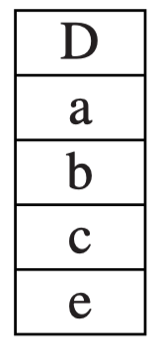
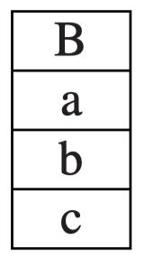
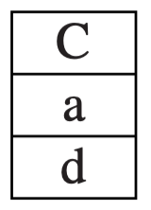
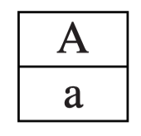
Fields
Prefixing
Where B extends A, those fields of B that are inherited from A are laid out in a B record at the beginning, in the same order they appear in A records.
Fields of B not inherited from A are placed afterward.
class A extends Object { var a := 0 }
class B extends A { var b := 0; var c := 0 }
class C extends A { var d := 0 }
class D extends B { var e := 0 }

Slide 16
Methods
A method instance is compiled much like a function
It turns into machine code that resides at a particular address in the instruction space
For example, the method instance Truck_move has an entry point at machine-code label Truck_move.
Each class descriptor contains a pointer to its parent class, and also a list of method instances.
Truck_move
Instruction Space

Slide 17
Static Methods
Some object-oriented languages allow some methods to be declared static (cannot be overridden by subclasses, determined at compile time).
To compile a method call of the form c.f(), the compiler:
finds the class of c, suppose it is class C
searches in class C for a method f, suppose none is found
searches the parent class of C, suppose it is class B, and so on
Suppose in some ancestor class A it finds a static method f, then it can compile a function call to label A_f
Class A extends Object {
var x := 0
static method f() }
Class B extends A {
method g() }
Class C extends B {
method g() }
c.f()
A_f

Slide 18
Dynamic Methods
What if method f in A is a dynamic method?
f may be overridden in some class D which is a subclass of C.
There is no way to tell at compile time if c is pointing to an object of class D (D_f should be called) or class C (A_f should be called)
How to solve this problem?
Class A extends Object {
var x := 0
method f() }
Class B extends A {
method g() }
Class C extends B {
method g() }
Class D extends C {
var y := 0
method f() }
c.f()

Slide 19
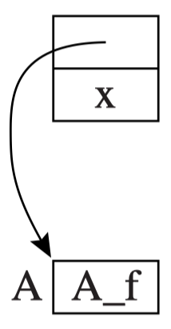
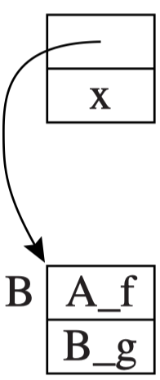
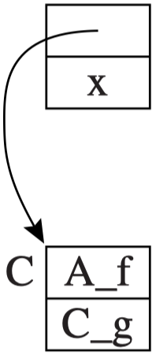
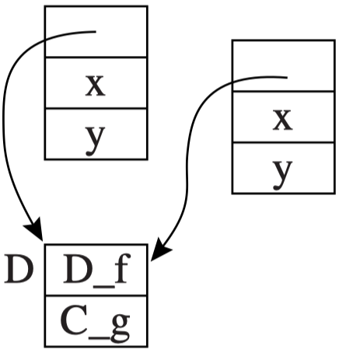
Dynamic Methods
The class descriptor must contain a vector (method table) with a method instance for each (nonstatic) method name.
When class B inherits from A, the method table starts with entries for all method names known to A, and then continues with new methods declared by B.
Just like the arrangement of fields in objects with inheritance.
Class A extends Object {
var x := 0
method f() }
Class B extends A {
method g() }
Class C extends B {
method g() }
Class D extends C {
var y := 0
method f() }

Slide 20
Dynamic Methods
To execute c.f(), where f is a dynamic method, the compiled code must execute these instructions:
Fetch the class descriptor d at offset 0 from object c.
Fetch the method-instance pointer p from the (constant) f offset of d.
Jumps to address p, saving return address (that is, call p).

Slide 21
Outline
Classes
Single Inheritance of Data Fields
Multiple Inheritance
Testing Class Membership
Private Fields and Methods

Slide 22
Multiple Inheritance
In languages that permit a class D to extend several parent classes A, B and C, finding field offsets and method instances is more difficult.
it is impossible to put all the A fields at the beginning of D and to put all the B fields at the beginning of D.
How to solve this problem?

Slide 23
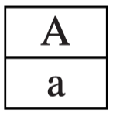
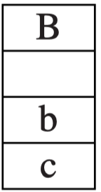
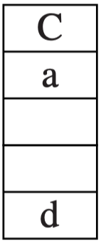
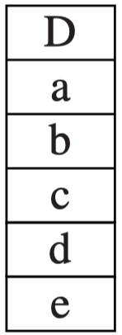
Global Graph Coloring - Fields
One Solution to this problem is to statically analyze all classes at once (using graph-coloring algorithm), finding some offset for each field name that can be used in every record containing that field.
class A extends Object { var a := 0 }
class B extends Object { var b:=0; var c:= 0 }
class C extends A { var d:=0 }
class D extends A,B,C { var e:=0 }
Graph-coloring
node: a distinct field name
edge: two fields coexist in a class
colors: offsets (0, 1, 2 ...)

Slide 24
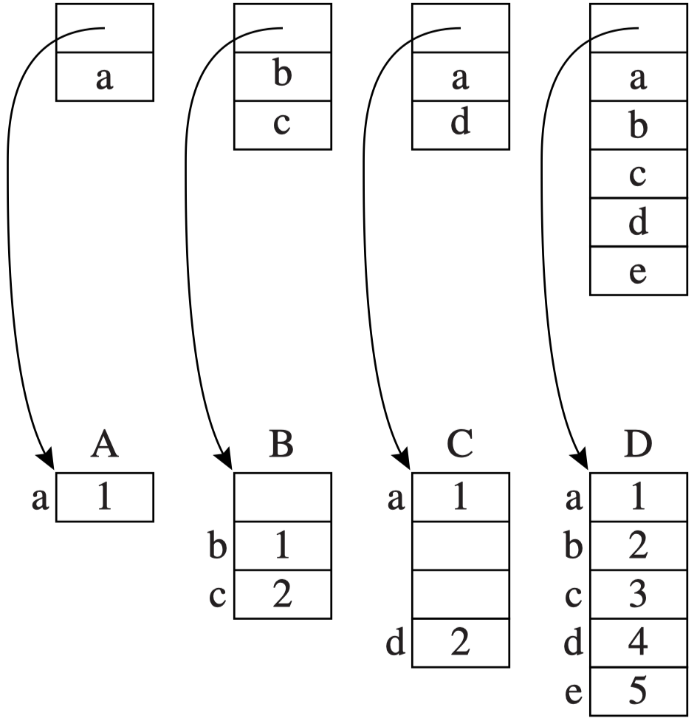
Global Graph Coloring - Fields
The problem with this approach is that it leaves empty slots in the middle of objects.
Solution: Pack the fields of each object and have the class descriptor tell where each filed is.
objects
class descriptors

Slide 25
Global Graph Coloring - Fields
In this scheme, class descriptors have empty slots, but the objects do not.
Acceptable: #objects >> #class descriptors
But each data fetch (or store) requires three instructions instead of one:
Fetch the descriptor-pointer from the object.
Fetch the ﬁeld-offset value from the descriptor.
Fetch (or store) the data at the appropriate offset
in the object.

Slide 26
Global Graph Coloring – Method Lookup
How to find method instances in a language with multiple inheritance?
The global graph-coloring approach works well:
The method names can be mixed with the ﬁeld names to form nodes of a large interference graph.
Descriptor entries for ﬁelds give locations within the objects
Descriptor entries for methods give machine-code addresses of method instances.

Slide 27
Global Graph Coloring - Problem
Problems with dynamic linking:
The global coloring can be done only at link-time.
However, many object-oriented systems have the capability to load new classes into a running system.
Link-time graph coloring poses many problems for a system that allows dynamic incremental linking.

Slide 28
Hashing
Put a hash table in each class descriptor, mapping field names to offsets and method names to method instances
This works well with separate compilation and dynamic linking
Ftab: contains field-offsets and method instances
Ktab: contains field-name pointers (for purposes of collision detection)
To fetch a field x of object c, the compiler generates code to:
Fetch the class descriptor d at offset 0 from object c.
Fetch the ﬁeld-name f from the address offset
d + Ktab + hash_{x}.
Test whether f = ptr_{x}; if so
Fetch the ﬁeld offset k from d + Ftab + hash_{x}.
Fetch the contents of the ﬁeld from c + k.

Slide 29
Outline
Classes
Single Inheritance of Data Fields
Multiple Inheritance
Testing Class Membership
Private Fields and Methods

Slide 30
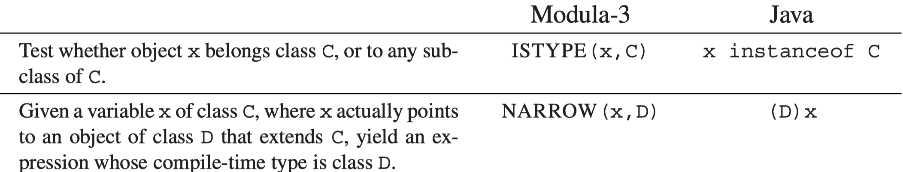
Testing Class Membership
Some object-oriented languages allow the program to test membership of an object in a class at run time
For example
TABLE 14.6 Facilities for type testing and safe casting

Slide 31
Testing Class Membership
Assuming there is no multiple inheritance, a simple way to implement x instanceof C is to generate code that performs the following loop at run time:
t1 ← x.descriptor
L1: if t1 = C goto true
t1 ←t1.super
if t1 = nil goto false
goto L1
Can be slow
where t1.super is the superclass (parent class) of class t1.

Slide 32
Testing Class Membership - Display
A faster approach: using a display of parent classes
Assume that the class nesting depth is limited to some constant, such as 20. Reserve a 20-word block in each class descriptor.
Suppose the nesting depth of class D is j (which can be known at compile time)
In D’s descriptor,
display[j] = D
display[j-1] = D.super
display[j-2] = D.super.super,
...,
display[0] = Object
display[k] = nil, where k > j

Slide 33
Testing Class Membership - Display
Now, if x is an instance of D, or of any subclass of D, in x’s class descriptor, display[j] = D. Otherwise it will not.
So x instanceof D requires:
Fetch the class descriptor d at offset 0 from object x.
Fetch the jth class-pointer slot from d.
Compare with the class descriptor D.

Slide 34
Type Coercions
Given a variable c of type C
Treat c as any supertype of C: legal and safe
e.g., var b : B := c, where C extends B
The reverse is not true.
The assignment c ← b is safe only if b is really (at run time) an instance of C, which is not always the case.
b ← new B
c ← b
c.some_field_of_C_but_not_B
Unpredictable behavior

Slide 35
Type Coercions
Some object-oriented languages (such as Modula-3 and Java) accompany any coercion from a superclass to a subclass with a run-time type-check:
raises an exception unless the run-time value is really an instance of the subclass (e.g., unless b instanceof C)
Example
Modula-3:
IF ISTYPE(b,C)
THEN f(NARROW(b,C))
ELSE . . .
Java:
if (b instanceof C)
f((C)b)
else . . .
C++ has a static cast mechanism without run-time checking
=> unsafe

Slide 36
Typecase
Module-3 has a typecase facility that makes the test-then-narrow idiom more beautiful and efficient.
TYPECASE expr
OF C1 (v1) => S1
| C2 (v2) => S2
.
.
.
| Cn (vn) => Sn
ELSE S0
END
If more than one of the Ci match (e.g., one is a superclass of another), then only the first matching clause is taken.
If none of the Ci match, then the ELSE clause is take.

Slide 37
Typecase
Typecase can be converted straightforwardly to a chain of else-ifs, with each if doing:
an instance test
a narrowing
a local variable declaration
TYPECASE expr
OF C1 (v1) => S1
| C2 (v2) => S2
.
.
.
| Cn (vn) => Sn
ELSE S0
END

Slide 38
Outline
Classes
Single Inheritance of Data Fields
Multiple Inheritance
Testing Class Membership
Private Fields and Methods

Slide 39
Private Fields and Methods
True object-oriented languages can protect fields of objects from direct manipulation by other objects’ methods.
A private field is one that cannot be fetched or updated from any function or method declared outside the object
A private method is one that cannot be called from outside the object.
Privacy is enforced by the type-checking phase of the compiler statically.
In the symbol table of a class, along with each ﬁeld offset and method offset, is a Boolean ﬂag indicating whether the ﬁeld is private.
Notes:
后面一页删除了，因为是完全在OOP课程中讲过的内容

Slide 40
Summary
Classes
Single Inheritance of Data Fields
Multiple Inheritance
Testing Class Membership
Private Fields and Methods

