Slide 1

编译原理
陈明帅
m.chen@zju.edu.cn
浙江大学 · 计算机科学与技术学院
Slides partially credited to Zhongxin Liu

Slide 2
课程内容
1
Introduction
2
3
4
5
6
Lexical Analysis
Parsing
Abstract Syntax
Semantic Analysis
Activation Records
9
8
7
Instruct. Selection
Blocks & Traces
Interm. Code
10
11
Liveness Analysis
Register Allocation
Fundamentals
13
18
Garbage Collection
Loop Optimizations
Advanced Topics

Slide 3
Overview
se-man-tic: of or relating to meaning in language
The semantic analysis phase of a compiler:
connects variable definitions to their uses
checks that each expression has a correct type
translates the abstract syntax into a simpler representation suitable for generating machine code (in Chapter 7)

Slide 4
5.1 Symbol Tables
The semantic analysis phase is characterized by the maintenance of symbol tables (also called environments) mapping identiﬁers to their types and locations.
Declarations of identifiers v.s. uses of identifiers
An environment is a set of bindings denoted by ‘↦’:
E.g., σ0 = {g ↦ string, a ↦ int}
line 1: σ1 = σ 0 + {a ↦ int, b ↦ int, c ↦ int}
1 function f (a:int, b:int, c:int) =
2 (print_int (a+c);
3 let var j := a+b
4 var a := “hello”
5 in print(a); print_int(j)
6 end;
7 print_int(b)
8 )
how does the compiler know the type of j?
line 3: σ2 = σ1 + {j ↦ int}
line 4: σ3 = σ2 + {a ↦ string}
Notes:
这里的let-in结构可能需要给学生解释一句，课程安排里面没有涉及过有这种的表达的语言

Slide 5
Symbol Tables
line 4: σ3 = σ2 + {a ↦ string}
1 function f (a:int, b:int, c:int) =
2 (print_int (a+c);
3 let var j := a+b
4 var a := “hello”
5 in print(a); print_int(j)
6 end;
7 print_int(b)
8 )
σ2 contains a ↦ int
What is the binding of a in σ3?
Bindings in the right-hand table override those in the left.
X + Y for tables is not the same as Y + X.

Slide 6
Symbol Tables
Each local variable in a program has a scope in which it is “visible”. In other words, it is defined in that scope.
As the semantic analysis reaches the end of each scope, the identiﬁer bindings local to that scope are discarded.
1 function f (a:int, b:int, c:int) =
2 (print_int (a+c);
3 let var j := a+b
4 var a := “hello”
5 in print(a); print_int(j)
6 end;
7 print_int(b)
8 )
line 6: discard σ3, go back to σ1 (line 1)
line 7: look up b in σ1
line 8: discard σ1, go back to σ0
How should symbol tables be implemented?

Slide 7
Symbol Tables
Functional Style
Keep σ1 in pristine condition while creating σ2 and σ3
Easy to restore σ1
Imperative Style
modify σ1 until it becomes σ2
while σ2 exists, we cannot look things up in σ1
when we are done with σ2, we can undo the modification to get σ1 back again
how?
a single global environment σ + an undo stack
Either style can be used.

Slide 8
Multiple Symbol Tables
In some languages there can be several active environments at once: Each module, or class, or record in the program has a symbol table σ of its own.
package M;
class E {
static int a = 5;
}
class N {
static int b = 10;
static int a = E.a + b;
}
class D {
static int d = E.a + N.a;
}
σ1 = { a ↦ int }
σ2 = { E ↦ σ1 }
σ3= {b ↦ int , a ↦ int }
σ4= { N ↦ σ3 }
σ5= { d ↦ int }
σ6= { D ↦ σ5 }
σ7 = σ2 +σ4+ σ6
In Java, forward reference is allowed. So E, N, and D are all compiled in the environment σ7. The result of the analysis is {M ↦ σ7}.
Java

Slide 9
Multiple Symbol Tables
structure M = struct
structure E = struct
val a = 5;
end
structure N = struct
val b = 10
val a = E.a + b
end
structure D = struct
val d = E.a + N.a
end
end
σ1 = { a ↦ int }
σ2 = { E ↦ σ1 }
σ3= {b ↦ int , a ↦ int }
σ4= { N ↦ σ3 }
σ5= { d ↦ int }
σ6= { D ↦ σ5 }
σ7 = σ2 +σ4+ σ6
N is compiled using environment σ0 + σ2. D is compiled using σ0 + σ2 + σ4.
The result of the analysis is also {M ↦ σ7}.
ML

Slide 10
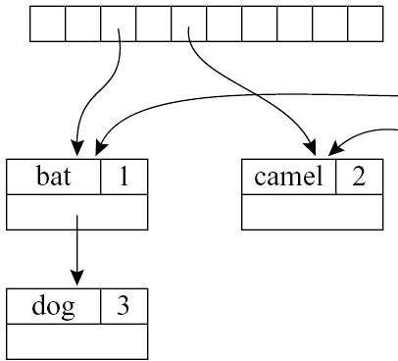
Efficient Imperative Symbol Tables
Imperative Style
Because a large program may contain thousands of distinct identiﬁers, symbol tables must permit efﬁcient lookup.
How?
Hash Table
σ’ = σ + {a ↦ int}
insert <a, int> in the hash table
Symbol tables need to support deletion easily.
How?
Hash Table with external chaining
e.g., hash(a) -> <a, int> -> <a, string>

Slide 11
Efficient Imperative Symbol Tables
struct bucket { string key; void *binding; struct bucket *next; };
#define SIZE 109
struct bucket *table[SIZE];
unsigned int hash(char *s0) {
unsigned int h=0; char *s;
for(s=s0; *s; s++)
h=h*65599 + *s;
return h;
}
struct bucket *Bucket (string key, void *binding, struct bucket *next) {
struct bucket *b=checked_malloc(sizeof(*b));
b->key = key; b->binding = binding; b->next = next;
return b;
}
h = (α^{n-1}c₁+α^{n-2}c₂ +…..+ α c_{n-1}+ c_{n})

Slide 12
Efficient Imperative Symbol Tables
void insert(string key, void *binding) {
int index=hash(key)%SIZE;
table[index]=Bucket(key, binding, table[index]);
}
void *lookup(string key) {
int index=hash(key)%SIZE
struct bucket *b;
for (b = table[index]; b; b=b->next)
if (0==strcmp(b->key,key))
return b->binding;
return NULL;
}
void pop(string key) {
int index=hash(key)%SIZE
table[index]=table[index].next;
}

Slide 13
Effective Imperative Symbol Tables
Consider σ + {a ↦ τ2} when σ contains a ↦ τ1 already. The insert function leaves a ↦ τ1 in the bucket and puts a ↦ τ2 earlier in the list.
hash(a) -> <a, τ2 > -> <a, τ1>
when pop(a) is done at the end of a's scope, σ is restored. (insertion and pop work in a stack-like fashion.)
hash(a) -> <a, τ1>

Slide 14
Efficient Functional Symbol Tables
Functional Style
We wish to compute σ′ = σ + {a ↦ τ} in such a way that we still have σ available to look up identifiers.
We create a new table by computing the "sum" of an existing table and a new binding.
Can we achieve this with hash tables?

Slide 15
Efficient Functional Symbol Tables
m2 = m1 + {mouse ↦ 4}
m1 = {bat ↦ 1,camel ↦ 2,dog ↦ 3}, suppose index(camel) = index(mouse) = 5
Hash(mouse) -> <mouse, 4>: m1 is destroyed
X
mouse | 4

Slide 16
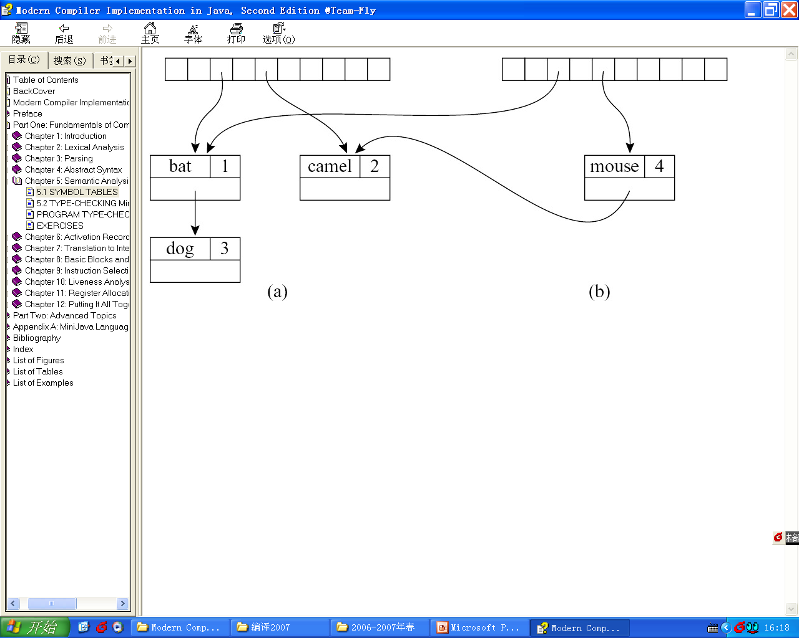
Efficient Functional Symbol Tables
m2 = m1 + {mouse ↦ 4}
m1 = {bat ↦ 1,camel ↦ 2,dog ↦ 3}, suppose index(camel) = index(mouse) = 5
Hash(mouse) -> <mouse, 4>: m1 is destroyed
Copy the array, but share all the old buckets: not efficient
The array in a hash table should be quite large

Slide 17
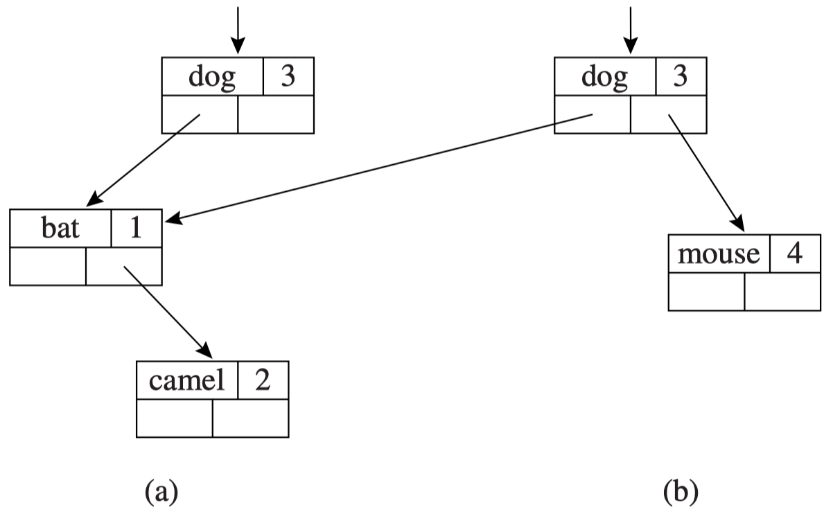
Efficient Functional Symbol Table
We can perform such “functional” additions to Search Trees efﬁciently via binary search trees (instead of Hash Tables).
If we add a new node at depth d of the tree, we must create d new nodes – but we don’t need to copy the whole tree.
Copy the nodes from the root to the parent of the inserted node.
m1 keeps unchanged.
Looking up an element: log(n) for a balanced tree of n nodes.

Slide 18
Symbols in The Tiger Compiler
unsigned int hash(char *s0) {
unsigned int h=0; char *s;
for(s=s0; *s; s++)
h=h*65599 + *s;
return h;
}
void *lookup(string key) {
int index=hash(key)%SIZE
struct bucket *b;
for (b = table[index]; b; b=b->next)
if (0==strcmp(b->key,key))
return b->binding;
return NULL;
}
Must examine every character of string s for hashing
Each time it compares s against a string in the i-th bucket
How to improve?

Slide 19
Symbols in The Tiger Compiler
Convert each string to a symbol
The Symbol module has these important properties:
Extracting an integer hash-key is very fast: use the Symbol-pointer itself as the integer hash-key. (for hash tables)
Comparing symbols for equality is fast (just pointer or integer comparison).
Comparing two symbols for “greater-than” (in some arbitrary ordering) is very fast (for binary search trees)

Slide 20
Symbols in The Tiger Compiler
The interface of symbols and symbol tables
void *: We want different notions of binding for different purposes in the compiler – type bindings for types, value bindings for variables and functions
typedef struct S_symbol_ *S_symbol;
S_symbol S_symbol (string); // string -> symbol
string S_name(S_symbol); // symbol -> string
typedef struct TAB_table_ *S_table;
S_table S_empty(void); // create an empty symbol table
void S_enter(S_table t, S_symbol sym, void *value); // enter binding
void *S_look(S_table t, S_symbol sym); // look up symbol
void S_beginScope(S_table t); // remember current table state
void S_endScope(S_table t); // restore to most recent beginScope
that is not closed yet

Slide 21
The Implementation of Symbols
static S_symbol mksymbol (string name , S_symbol next) {
S_symbol s = checked_malloc(sizeof(*s));
s->name = name; s->next = next;
return s;
}
S_symbol S_symbol (string name) {
int index = hash(name)%SIZE;
S_symbol syms = hashtable[index], sym;
for ( sym = syms; sym; sym = sym->next)
if (0 == strcmp(sym->name, name)) return sym;
sym = mksymbol(name,syms);
hashtable[index] = sym;
return sym;
}
string S_name (S_symbol sym) {
return sym->name;
}

Slide 22
The Implementation of Symbol Tables
The Tiger compiler in C uses destructive-update env. .
An imperative table is implemented using a hash table.
// make a new S_Table
S_table S_empty(void) {
return TAB_empty();
}
// insert a binding
void S_enter(S_table t, S_symbol sym, void *value){
TAB_enter(t,sym,value);
}
// look up a symbol
void *S_look(S_table t, S_symbol sym) {
return TAB_look(t,sym);
}

Slide 23
The Implementation of Symbol Tables
For destructive-update environments:
S_beginScope: Remembers the current state of the table.
S_endScope: Restores the table to where it was at the most recent beginScope that has not already been ended.
static struct S_symbol_ marksym = { “<mark>”, 0 };
void S_beginScope (S_table t) {
S_enter(t, &marksym, NULL);
}
void S_endScope(S_table t) {
S_symbol s;
do
s= TAB_pop(t);
while (s != &marksym);
}

Slide 24
The Implementation of Symbol Tables
Auxiliary stack:
Showing in what order the symbols were “pushed” into the symbol table.
As each symbol is popped, the head binding in its bucket is removed.
beginScope: pushes a special marker onto the stack
endScope: pops symbols off the stack until finds the topmost marker.

Slide 25
The Implementation of Symbol Tables
The auxiliary stack can be integrated into the Binder by having a global variable top showing the most recent Symbol bound in the table.
Pushing: copy top into the prevtop field of the Binder.
struct TAB_table_ {
binder table[TABSIZE];
void *top;
};
static binder Binder(void *key, void *value, binder next, void *prevtop) {
binder b = checked_malloc(sizeof(*b));
b->key = key; b->value=value; b->next=next;
b->prevtop = prevtop;
return b;
}

Slide 26
Bindings for the Tiger Compiler
Tiger has two separate name spaces (symbol tables):
Types
Functions and variables——Values
let type a = int
var a := 1
in ...
end
Both a’s can be used
let function a (b: int) = ...
var a := 1
in ...
end
var a overwrites function a

Slide 27
Bindings for the Tiger Compiler
tydec → type type-id = ty
ty → type-id
→ ‘{’ tyfields ‘}’
→ array of type-id
tyfields → ε
→ id: type-id {, id:type-id}
A type can be:
type x = int;
type y = {a: int, b: string};
type z = array of int;
The built-in (primitive) type: int, string
The constructed type: using records and arrays from other types (primitive, record, or array)
What is the binding of a type identifier?

Slide 28
Bindings for the Tiger Compiler
tydec → type type-id = ty
ty → type-id
→ ‘{’ tyfields ‘}’
→ array of type-id
tyfields → ε
→ id: type-id {, id:type-id}
typedef struct Ty_ty_ *Ty_ty;
struct Ty_ty_ {
enum {Ty_record, Ty_nil, Ty_int, Ty_string,
Ty_array, Ty_name, Ty_void} kind;
union {
Ty_fieldList record;
Ty_ty array;
struct {S_symbol sym; Ty_ty ty;} name;
} u; };

Slide 29
Bindings for the Tiger Compiler
For array and record types, there is another implicit piece of information carried by the Ty_array or Ty_record object: the address of the object itself.
Every Tiger-language “record type expression” creates a new (and different) record type.地址也是record参考信息
let type a = {x: int; y: int}
type b = {x: int; y: int}
var i : a := ...
var j : b := ...
in i := j
end
Illegal in Tiger
let type a = {x: int; y: int}
type b = a
var i : a := ...
var j : b := ...
in i := j
end
Legal in Tiger
Notes:
标记了i :=j

Slide 30
Bindings for the Tiger Compiler
nil: Ty_Nil
void: Ty_Void
When processing mutually recursive types: Ty_Name(sym, NULL)
a place-holder for the type-name sym
type list = {first: int, rest: list}
typedef struct Ty_ty_ *Ty_ty;
struct Ty_ty_ {
enum {Ty_record, Ty_nil, Ty_int, Ty_string,
Ty_array, Ty_name, Ty_void} kind;
union {
Ty_fieldList record;
Ty_ty array;
struct {S_symbol sym; Ty_ty ty;} name;
} u;
};

Slide 31
Environments
Two separate name spaces
Two environments mapping from symbols to bindings: Type environment Value environment
How to know which a is a type and which a is a variable?
based on syntactic contexts
let type a = int
var a: a:= 5
var b: a:= a
in b+a
end
What are bindings in type env and value env?
Type environment:
symbol -> Ty_ty
Value environment:
variable: symbol -> Ty_ty
function: symbol -> struct {Ty_tyList formals, Ty_ty result;}

Slide 32
Environments
typedef struct E_enventry_ *E_enventry;
struct E_enventry_ {
enum {E_varEntry, E_funEntry} kind;
union {
struct {Ty_ty ty;} var;
struct {Ty_tyList formals; Ty_ty result;} fun;
} u;
};
E_enventry E_VarEntry(Ty_ty ty);
E_enventry E_FunEntry(Ty_tyList formals, Ty_ty result);
S_table E_base_tenv(void); // Ty_ty environment
S_table E_base_venv(void); // E_enventry environment

