Slide 1

编译原理
陈明帅
m.chen@zju.edu.cn
浙江大学 · 计算机科学与技术学院

Slide 2
Overview
1
Introduction
2
3
4
5
6
Lexical Analysis
Parsing
Abstract Syntax
Semantic Analysis
Activation Records
9
8
7
Instruct. Selection
Blocks & Traces
Interm. Code
10
11
Liveness Analysis
Register Allocation
Fundamentals
13
18
Garbage Collection
Loop Optimizations
Advanced Topics

Slide 3
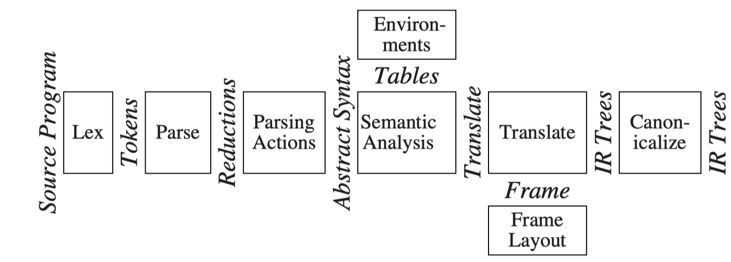
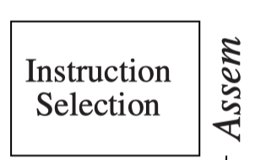
Overview
Our goal:
a source language program → a target language program
Previous lectures:
a source language program → a list of canonical trees
This lecture: Instruction Selection
a canonical tree → Assembly

Slide 4
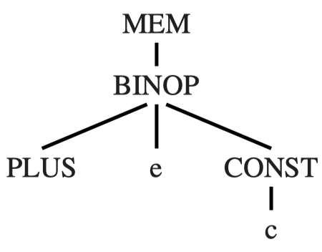
Why and What
The intermediate representation (Tree) language expresses only one operation in each tree node.
fetch, store, addition, subtraction, conditional jump, ...
A real machine instruction can often perform several primitive operations.
LOAD ri ← M[rj + c]
The instruction selection phase: Finding the appropriate machine instructions to implement a given IR tree.

Slide 5
Tree Patterns
Each machine instruction can be expressed as a fragment of an IR tree, called a tree pattern.
Instruction selection: tiling the tree with a minimal set of tree patterns.
Tiling: cover the tree with non-overlapping tree patterns
To illustrate instruction selection, we invent an instruction set: the Jouette architecture (Jouette means toy in French).
LOAD ri ← M[rj + c]

Slide 6
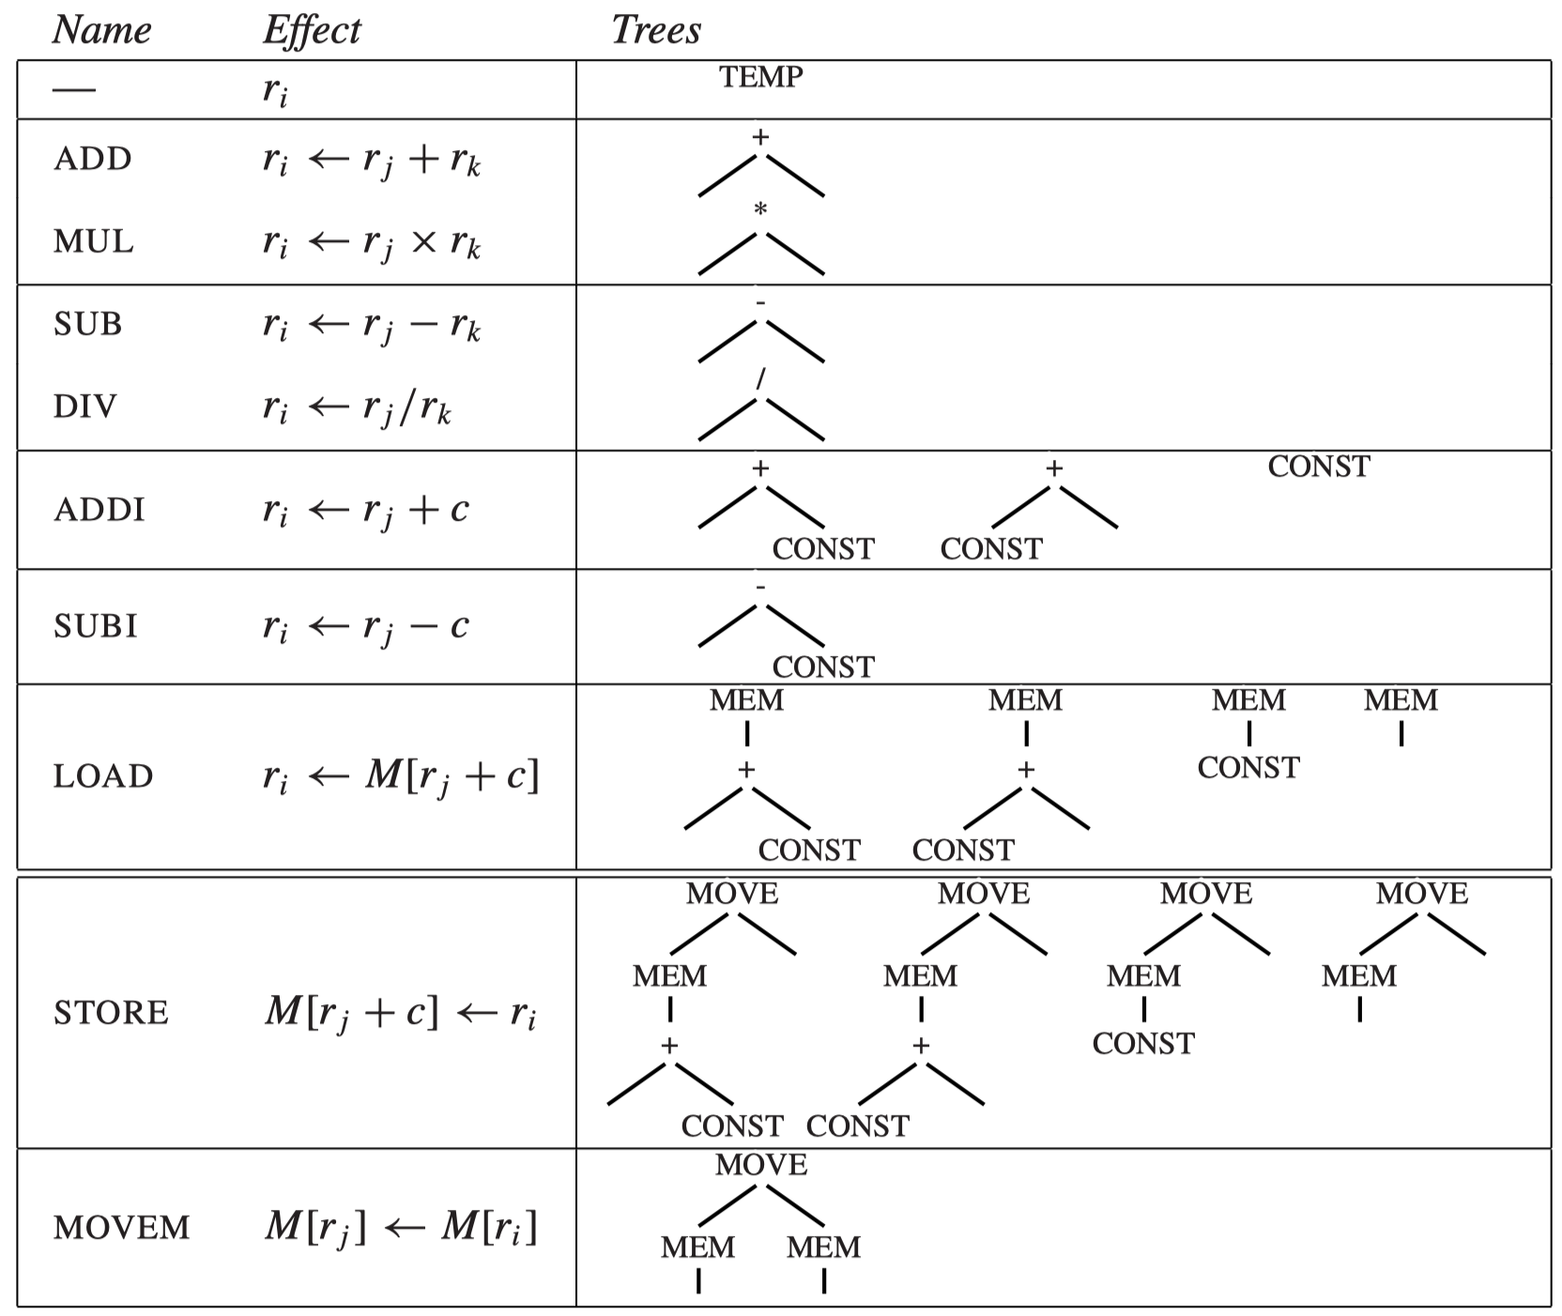
The Jouette architecture
BINOP(PLUS, x, y) => +(x, y)
r0 = 0
c can be 0
The actual values of CONST and TEMP nodes will not always be shown.

Slide 7
Tree Patterns
Some instructions correspond to more than one tree pattern
The fundamental idea of instruction selection using a tree-based intermediate representation is tiling the IR tree.
The tiles are the set of tree patterns corresponding to legal machine instructions
For example: a[i] := x
MOVE
MEM
MEM
+
+
MEM
*
FP
CONST x
+
TEMP i
CONST 4
FP
CONST a

Slide 8
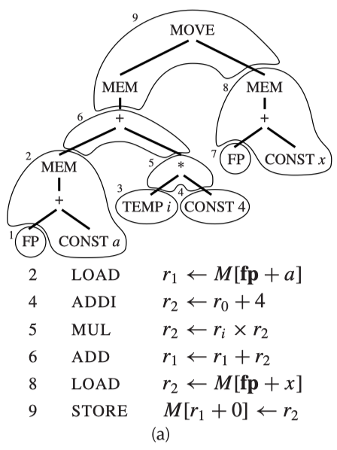
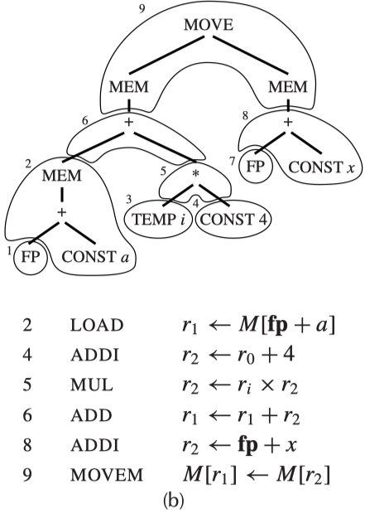
Tree Patterns - Example
The tree of a[i] := x tiled in two ways:
Tiles 1, 3, and 7 do not correspond to any machine instructions, because they are just registers (TEMPs).

Slide 9
Tree Patterns - Example
It is always possible to tile the tree with tiny tiles, each covering only one node (except for MOVE).
For a[i]:=x, such a tiling looks like:
MOVE
ADDI r1 ← r0 + a
ADD r1 ← fp + r1
LOAD r1 ← M[r1 + 0]
ADDI r2 ← r0 + 4
MUL r2 ← ri × r2
ADD r1 ← r1 + r2
ADDI r2 ← r0 + x
ADD r2 ← fp + r2
LOAD r2 ← M[r2 + 0]
STORE M[r1 + 0] ← r2
MEM
MEM
+
+
MEM
*
FP
CONST x
+
TEMP i
CONST 4
FP
CONST a

Slide 10
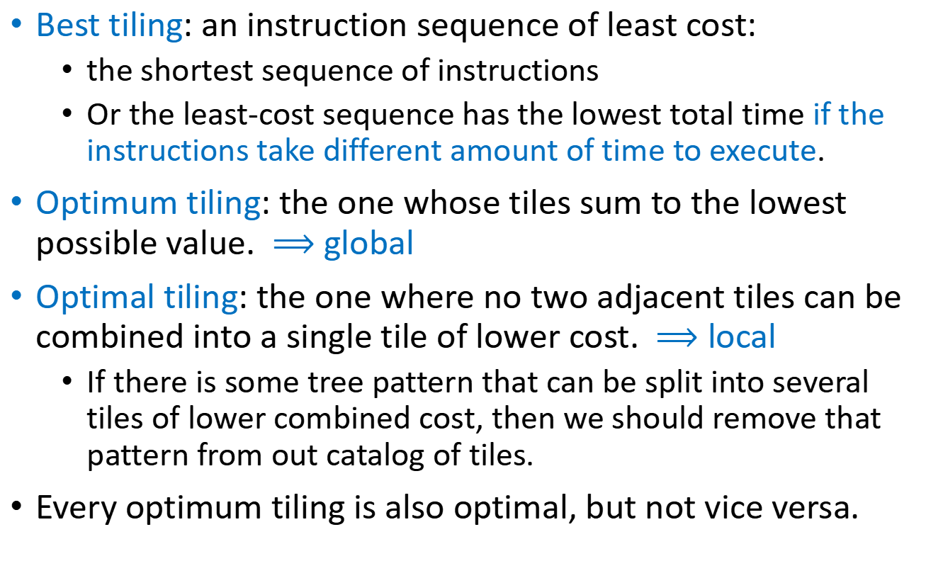
Optimal and Optimum Tilings
Best tiling: an instruction sequence of least cost:
the shortest sequence of instructions
Or the least-cost sequence has the lowest total time if the instructions take different amount of time to execute.
Optimum tiling: the one whose tiles sum to the lowest possible value. $⟹$ global
Optimal tiling: the one where no two adjacent tiles can be combined into a single tile of lower cost. $⟹$ local
If there is some tree pattern that can be split into several tiles of lower combined cost, then we should remove that pattern from out catalog of tiles.
Every optimum tiling is also optimal, but not vice versa.

Slide 11
Optimal and Optimum Tilings - Example
Suppose every instruction costs 1 unit, except for MOVEM which costs m units.
Both optimal.
Optimum depends on m
6 units
Optimum? Optimal?
5+m units

Slide 12
Outline
Algorithms for Instruction Selection
CISC (Complex Instruction Set Computer) Machines
Instruction Selection for the Tiger Compiler

Slide 13
Outline
Algorithms for Instruction Selection
CISC (Complex Instruction Set Computer) Machines
Instruction Selection for the Tiger Compiler

Slide 14
Algorithms for Instruction Selection
Algorithms for optimal tilings are simpler than optimum tilings.
For CISC, the difference between optimum and optimal tilings is noticeable.
Some instructions accomplish several operations each.
For RISC (Reduced Instruction Set Computer), there is usually no difference at all between optimum and optimal tilings.
The tiles are small and of uniform cost.
Thus, for RISC, the simpler tiling algorithms suffice.

Slide 15



Maximal Munch
Maximal Munch: the (greedy) algorithm for optimal tiling
Main idea:
starting at the root of the tree, find the largest tile that fits.
cover the root node – and perhaps several other nodes near the root – with this tile, leaving several subtrees.
Repeat the same algorithm for each subtree.
Largest tile: the one with the most nodes.
one node
two nodes
three nodes
The maximal munch algorithm generates the instructions in reverse order.
If two tiles of equal size match at the root, then the choice between them is arbitrary.

Slide 16
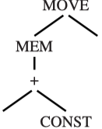
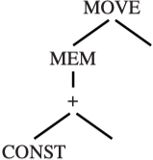


Maximal Munch - Implementation
Two recursive functions:
munchStm for statements; munchExp for expressions
Munch in order of tile preference (biggest tiles first):
1
e2
munchExp(e1);
munchExp(e2);
emit("STORE");
e2
e1
e1
2
3
munchExp(e1); munchExp(e2); emit("MOVEM");
munchExp(e1); munchExp(e2); emit("STORE");
e2
e1
e2
e1
Operands of instructions will be determined later

Slide 17
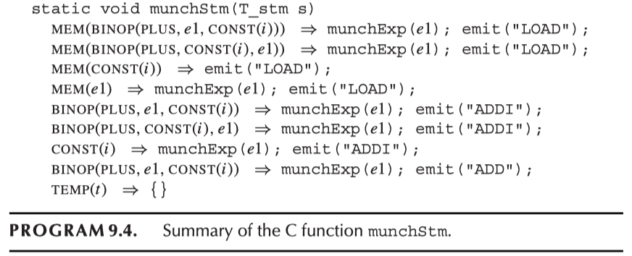
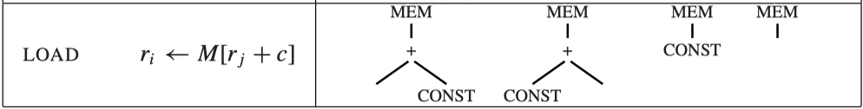
Maximal Munch - Implementation
munchExp
munchExp

Slide 18
Dynamic Programming
Maximal munch: always finds an optimal tiling, but not necessarily the optimum one.
It works top-down
Dynamic programming (DP): can find the optimum based on the optimum solution of each subproblem
It works bottom-up
Assign a cost to every node in the tree.
The cost of a node is the sum of the instruction-costs of the best instruction sequence that can tile the subtree rooted at that node.

Slide 19
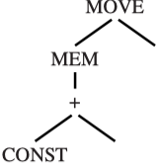

Dynamic Programming - Details
Given the IR Tree with root node n
First, the costs of all the children (and grandchildren, etc.) of node n are found recursively.
Then, each tree-pattern (tile kind) is matched against node n
Each tile has zero or more leaves, which are places where subtrees can be attached.
For each tile t of cost c_{t} that matches at node n, the cost of matching tile t is: (c_{i} has already been computed)
$$c_{t} +\sum_{all leaves i of t}{c_{i}}$$
leaf1
The tree pattern leading to minimum cost is chosen
leaf2

Slide 20
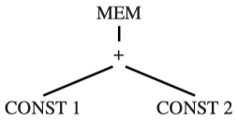
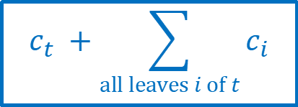
Dynamic Programming - Example
(a, b): a is minimum cost, b is corresponding pattern number.
$$c_{t} +\sum_{all leaves i of t}{c_{i}}$$
Bottom-Up
(1, 8)
(1, 8)
Consider CONST node:
Pattern (Tile) | Cost | Leaves Cost | Total
(8) CONST | 1 | 0 | 1

Slide 21
Dynamic Programming - Example
(a, b): a is minimum cost, b is corresponding pattern number.
$$c_{t} +\sum_{all leaves i of t}{c_{i}}$$
(2, 6/7)
(1, 8)
(1, 8)
Consider + node:
Pattern (Tile) | Cost | Leaves Cost | Total
(2) +(e1, e2) | 1 | 2 | 3
(6) +(CONST, e1) | 1 | 1 | 2
(7) +(e1, CONST) | 1 | 1 | 2

Slide 22
Dynamic Programming - Example
(a, b): a is minimum cost, b is corresponding pattern number.
(2, 10/11)
$$c_{t} +\sum_{all leaves i of t}{c_{i}}$$
(2, 6/7)
(1, 8)
(1, 8)
Consider MEM node:
Pattern (Tile) | Cost | Leaves Cost | Total
(13) MEM(e1) | 1 | 2 | 3
(10) MEM(+(e1, CONST)) | 1 | 1 | 2
(11) MEM(+(CONST, e1)) | 1 | 1 | 2

Slide 23
Dynamic Programming – Instruction Emission
Once the cost of the root node (and thus the entire tree) is found, the instruction emission phase begins.
The algorithm is as follows:
Emission(node n):
For each leaf li of the tile selected at node n, perform Emission(li).
Emit the instruction matched at node n.
Emission(li): perform on the leaves of the tile that matched at n
(2, 10)
ADDI r1 ← r0 + 1
LOAD r1 ← M[r1 + 2]
(2, 6)
(1, 8)
(1, 8)

Slide 24
Tree Grammars
For machines with complex instruction sets and several classes of registers and addressing modes, there is a useful generalization of the dynamic programming algorithm.

Slide 25
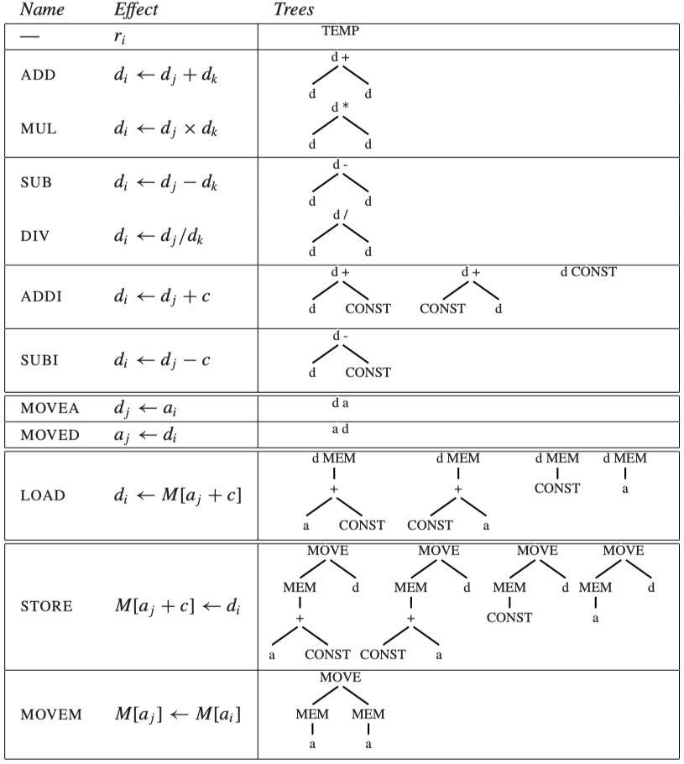
The brain-damaged version of Jouette:
a registers for addressing
d registers for “data”
The root and leaves of each tile must be marked with a or d.
The DP algorithm must keep track, for each node, of the min-cost match as an a register and as a d register

Slide 26
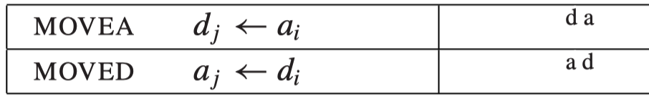
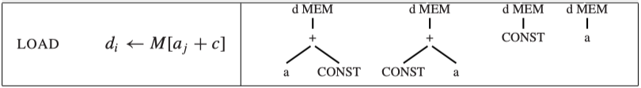
Tree Grammars
It is useful to use a context-free grammar to describe tiles. The grammar will have nonterminals:
s: for statements
a: for expressions calculated into an a register
d: for expressions calculated into a d register
The grammar rules for the LOAD, MOVEA and MOVED instructions might look like this:
d → MEM(+(a, CONST))
d → MEM(+(CONST, a))
d → MEM(CONST)
d → MEM(a)
d → a
a → d

Slide 27
Tree Grammars
Such a grammar is highly ambiguous: there are many different instruction sequences implementing the same expression.
The parsing techniques described in Chapter 3 are not very useful.
However, a generalization of the dynamic programming algorithm works quite well:
the minimum-cost match at each node for each nonterminal of the grammar is computed.

Slide 28
Fast Matching
Maximal munch and the dynamic-programming algorithm examine all the tiles that match a node.
A tile matches if each nonleaf node of the tile is labeled with the same operator (MEM, CONST, etc.) as the corresponding node of the tree.
To match a tile at node n of the tree, the label at n can be used in a case statement (i.e., decision tree):
Goal: each node in an IR tree will not be looked twice
match(n) {
switch (label(n)) {
case MEM: ...
case BINOP: ...
case CONST: ...
}

Slide 29
Efficiency of Tiling Algorithms
How expensive are maximal munch and DP?
Suppose:
T: the number of different tiles
K: the average matching tile contains K nonleaf nodes.
K’: the largest number of nodes that ever need to be examined to see which tiles match at a given subtree
T’: the average number of different patterns (tiles) match at each tree node
N: the number of nodes in the input tree
Maximal munch: proportional to (K’ + T’) N / K
Dynamic programming: proportional to (K’ + T’) N
K, K’ and T’ are constant, the running time of all of these algorithms are linear.

Slide 30
Outline
Algorithms for Instruction Selection
CISC (Complex Instruction Set Computer) Machines
Instruction Selection for the Tiger Compiler

Slide 31
RISC machine | CISC machine
32 registers | few registers (16, or 8, or 6)
only one class of integer/pointer register | registers divided into different classes, with some operations available only on certain registers;
arithmetic operations only between registers | arithmetic operations can access registers or memory through "addressing modes";
“three-address” instructions of the form r1 ← r2 ⊕ r3 | "two-address" instructions of the form r1 ← r1 ⊕ r2;
load and store instructions with only the M[reg+const] addressing mode | several different addressing modes;
Every instruction exactly 32 bits long | variable-length instructions, formed from variable-length opcode plus variable-length addressing modes;
one result or effect per instruction | instructions with side effects such as "autoincrement" addressing modes.

Slide 32
Problems and Solutions of CISC
Few registers:
Solution: generate TEMP nodes freely, and assume that the register allocator will do a good job.
Classes of registers:
Multiply on Pentium: left operand must be eax, the high-order bits of the result are put into edx (low-order bits in eax)
The high-order bits are useless to a Tiger program
Solution: move the operands and result explicitly.
Example: to implement t1 ← t2 × t3:
mov eax, t2 eax ← t2
mul t3 eax ← eax × t3; edx ← garbage
mov t1, eax t1 ← eax

Slide 33
Problems and Solutions of CISC
Two-address instructions:
The destination register must be the same as the first source register
Solution: Adding extra move instructions
Example: to implement t1 ← t2 + t3
Then we hope that the register allocator will be able to allocate t1 and t2 to the same register, so that the move instruction will be deleted.
mov t1,t2 t1 ← t2
add t1, t3 t1 ← t1 + t3

Slide 34
Problems and Solutions of CISC
Arithmetic operations can address memory:
The instruction selection phase turns every TEMP node into a “register” reference. Many of these “registers” will actually turn out to be memory locations.
Solution: Fetch all the operands into registers before operating and store them back to memory afterwards.
Example: these two sequences compute the same thing:
mov eax, [ebp - 8]
add eax, ecx or add [ebp - 8], ecx
mov [ebp - 8], eax
The sequence on the right is more concise, but the two sequences are equally fast.
The sequence on the left has one significant disadvantage: It trashes the value in register eax.

Slide 35
Problems and Solutions of CISC
Several addressing modes:
An addressing mode that accomplishes six things typically takes six steps to execute.
Two advantages:
They “trash” fewer registers
shorter instruction encoding
With some work, tree-matching instruction selection can be made to select CISC, but programs can be just as fast using the simple RISC-like instructions
Variable-length instructions:
Not really a problem for the compiler;
Once the instructions are selected, it is a trivial (though tedious) matter for the assembler to emit the encodings.

Slide 36
Problems and Solution of CISC
Instructions with side effects:
Problem: some machines have an “autoincrement” memory fetch instruction whose effect is:
Difficult to model using tree patterns, since it produces two results.
There are three solutions:
Ignore the autoincrement instructions, and hope they go away.
Try to match special idioms in an ad hoc way, within the context of a tree pattern-matching code generator.
Use a different instruction algorithm entirely, one based on DAG patterns (cf. Dragon book) instead of tree patterns.
r2 ← M[r1]; r1 ← r1 + 4

Slide 37
Outline
Algorithms for Instruction Selection
CISC (Complex Instruction Set Computer) Machines
Instruction Selection for the Tiger Compiler

Slide 38
Instruction Selection for Tiger
In a tree tiled by instruction patterns, the root of each tile will correspond to some intermediate result held in a register.
Which register to use?
The task of register allocation is to assign register-numbers to each such node.
Many aspects of register allocation are independent of the particular target-machine instruction set.
Should come either before or after instruction selection:
Before instruction selection: it is not even known which tree nodes will need registers to hold their results
since only the roots of tiles (and not other labeled nodes within tiles) require explicit registers
cannot be very accurate.
We will do register allocation after instruction selection.

Slide 39
Abstract Assembly Language Instructions
typedef struct {Temp_labelList labels;} *AS_targets; typedef struct {
enum {I_OPER, I_LABEL, I_MOVE} kind;
union {
struct {string assem; Temp_tempList dst, src; AS_targets jumps;} OPER;
struct {string assem; Temp_label label;} LABEL;
struct {string assem; Temp_tempList dst, src;} MOVE;
} u;
} *AS_instr;
An OPER holds:
assem: an assembly language instruction
src: a list of operand registers (may be empty)
dst: a list of result registers (may be empty)
jumps: a list of “target” labels to which they may jump
Operations that always fall through to the next instruction have jumps=NULL

Slide 40
Abstract Assembly Language Instructions
typedef struct {Temp_labelList labels;} *AS_targets; typedef struct {
enum {I_OPER, I_LABEL, I_MOVE} kind;
union {
struct {string assem; Temp_tempList dst, src; AS_targets jumps;} OPER;
struct {string assem; Temp_label label;} LABEL;
struct {string assem; Temp_tempList dst, src;} MOVE;
} u;
} *AS_instr;
A LABEL is a point in a program to which jumps may go.
assem: how the label will look in the assembly language program
label: which label symbol was used

Slide 41
Abstract Assembly Language Instructions
typedef struct {Temp_labelList labels;} *AS_targets; typedef struct {
enum {I_OPER, I_LABEL, I_MOVE} kind;
union {
struct {string assem; Temp_tempList dst, src; AS_targets jumps;} OPER;
struct {string assem; Temp_label label;} LABEL;
struct {string assem; Temp_tempList dst, src;} MOVE;
} u;
} *AS_instr;
void AS_print(FILE *out, AS_instr i, Temp_map m);
A MOVE is like an OPER, but must perform only data transfer
AS_print(f, i, m) formats an assembly instruction i as a string and prints it to the file f:
m: a temp mapping that tells the register assignment of every temp

Slide 42
Abstract Assembly Language Instructions
/* temp.h */
...
typedef struct Temp_map_ *Temp_map;
Temp_map Temp_empty(void); /* create a new, empty map */
Temp_map Temp_layerMap(Temp_map over, Temp_map under);
void Temp_enter(Temp_map m, Temp_temp t, string s);
string Temp_look(Temp_map m, Temp_temp t);
Temp_map Temp_name(void);
A Temp_map is just a table whose keys are Temp_temps and whose bindings are strings.
One mapping can be layered over another.
if σ3= layerMap(σ1, σ2), this means that look(σ3, t) will ﬁrst try look(σ1, t), and if that fails it will try look(σ2, t)
The primary users of these Temp_map operations will be the register allocator.

Slide 43
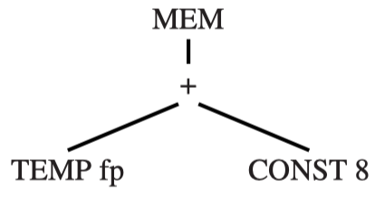
Machine-Independence
The AS_instr type is independent of the chosen target-machine assembly language.
Use Jouette assembly language for illustration
AS_Oper(
"LOAD ‘d0 <- M[‘s0+8]",
Temp_TempList(Temp_newtemp(), NULL),
Temp_TempList(T_Temp(F_FP()), NULL),
NULL)
assem
dst
src
jumps
Jouette assembly language
The actual assembly language of Jouette, after register allocation, might be:
LOAD r1 <- M[r27+8]
The Assem instruction does not know about register assignments. It refer to the first source register as `s0 and the destination register as `d0

Slide 44
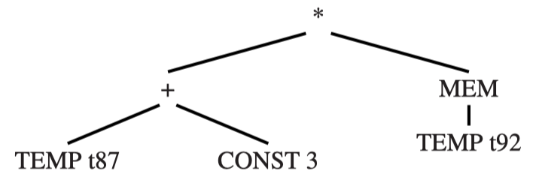
Machine-Independence
Another example:
t910
t908
t909
assem | dst | src
ADDI `d0 <- `s0 + 3 | t908 | t87
LOAD `d0 <- M[`s0 + 0] | t909 | t92
MUL `d0 <- `s0 * `s1 | t910 | t908, t909
where t908, t909 and t910 are temporaries newly chosen by the instruction selector.
After register allocation, the assembly language might look like:
ADDI r1 <- r12+3
LOAD r2 <- M[r13+0]
MUL r1 <- r1 * r2

Slide 45
Two-Address Instructions
Some machines have arithmetic instructions with two operands, where one of the operands is both a source and a target.
For example, the instruction add t1, t2, which has the effect of t1 <- t1 + t2, can be described as
where ‘s0 is implicitly, but not explicitly, mentioned in the assem string.
assem | dst | src
add `d0, `s1 | t1 | t1, t2

Slide 46
Producing Assembly Instructions
Now, how to “munch” Tree expressions into Assem instructions?
The function munchStm and munchExp will produce Assem instructions, bottom-up, as side effects. munchExp returns the temporary in which the result is held.
static Temp_temp munchExp(T_exp e);
switch( e ) //switch tree tiles
case MEM(BINOP(PLUS,e1,CONST (i))): {
Temp_temp r = Temp_newtemp(); //generate a new reg. name
emit(AS_Oper(“LOAD ‘d0 <- M[‘s0+” + i + “]\n”, L(r,NULL), L(munchExp(e1),NULL), NULL))
//generate instruction text, dst reg. list, src reg. list
static void munchStm(T_stm s);
case MOVE(MEM(BINOP(PLUS,e1,CONST(i))),e2): //switch tiles
emit(AS_Oper(“STORE M[‘s0+” + i + “] <- ‘s1\n”, NULL, L(munchExp(e1), L(munchExp(e2), NULL)), NULL));
//almost same as munchExp, but no new reg.

Slide 47
Producing Assembly Instructions
/* codegen.c */
...
static AS_instrList iList=NULL, last=NULL;
static void emit(AS_instr inst) {
if (last!=NULL)
last = last->tail = AS_InstrList(inst,NULL);
else
last = iList = AS_InstrList(inst,NULL);
}
The emit function just accumulates a list of instructions to be returned later.

Slide 48
Procedure Calls
Procedure calls: EXP(CALL(f, args)), Function calls: MOVE(TEMP t, CALL(f, args))
These trees can be matched by the tiles such as
case EXP(CALL(e,args)) {
Temp_temp r = munchExp(e);
Temp_tempList l = munchArgs(0,args);
emit(AS_Oper(“CALL ‘s0\n”, calldefs, L(r,l), NULL));}
munchArgs generates code to move all the arguments to their correct positions (in registers or in memory).
The integer parameter of munchArgs is I for the ith argument
munchArgs will recur with i+1 for the next argument, and so on
A CALL is expected to “trash” certain registers (caller-save registers, return-address register, return-value register). This lis of calldefs should be listed as “destinations” of the CALL.
In general, any instruction that has the side effect of writing to another register requires this treatment.

Slide 49
If There’s No Frame Pointer
Use frame pointer: at each procedure call,
The stack pointer reg is copied to the frame pointer reg
The stack pointer is incremented by the size of the new frame
Virtual frame pointer
Saves time (no copy instruction) and space (one more register usable for other purposes)
The codegen function must replace any reference to FP + k with SP + k + fs, where fs is the frame size.

Slide 50
Homework
9.1

