Slide 2
Unity Game Hub with leaderboard system to increase interaction between student in IT&B Campus
Final year project proposal

Slide 3

Background study
Industry game is one of the biggest industries in this era. There are a lot of platform in Game industry such as WebGL, android, IOS, PC and etc. but mobile phone is the most and biggest device use in game industry.

Slide 4
Objective
The objective of this study is to provide an entertainment media for student in IT&B Campus. This research also aims to increase or improve game development in IT&B campus.
It provides a source of information on the latest market developments and trends that can be useful for a number of individuals and organizations, including school and university.

Slide 5

Scope Of study
IT&B student and environment, Game and source made for only IT&B student and school.

Slide 6
Analysis and design
Flowchart first scene of the game.
Main point :
Checking the internet connection
Checking device id and compare to server
Notes:
SystemInfo.deviceUniqueIdentifier

Slide 7
Analysis and design
Flowchart Log In Scene

Slide 8
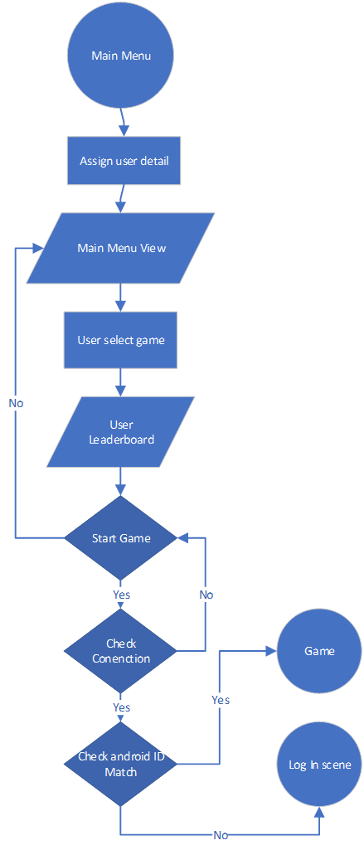
Analysis and design
Flowchart Main Menu
Main point:
Game view
User information
Leaderboard
Change password
Logout

Slide 9
Analysis and design
Flowchart Game
Main point:
Gameplay
High score

Slide 10

Analysis and design
User ID and password for default is using student Id.

Slide 11
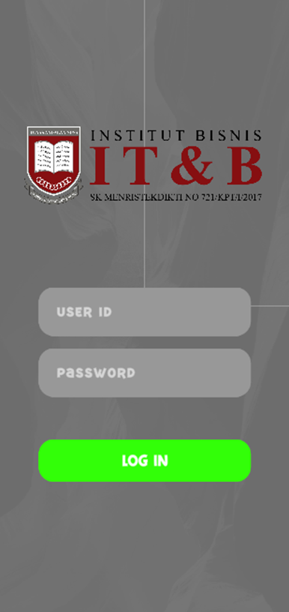
Analysis and design
User ID and password for default is using student Id.

Slide 12
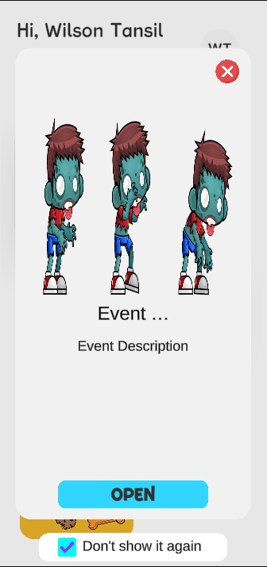
Analysis and design
Event system , allow IT&B campus to add an event and announcement to been announce from the Game Hub.
It contain Event Title , Event Description , Event Picture, Event link.

Slide 13
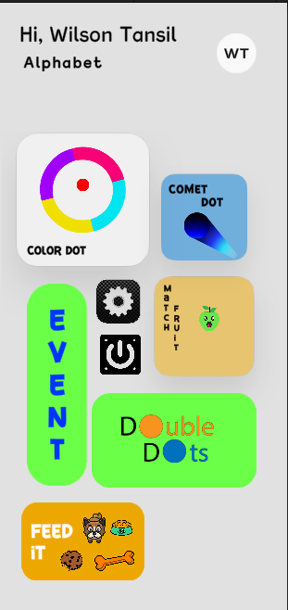
Analysis and design
Main Menu , contain game view and the user information.
Setting button , for the game setting example sound and change user password.
Event button , contain event , similar with the first popup event , if user need to look again for the event and announcement.
Quit button to quit application
Initial button, on top right contain user information.

Slide 14
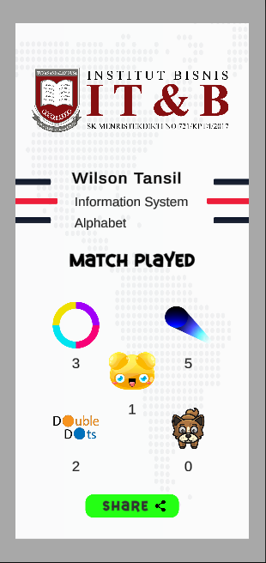
Analysis and design
User information , contain the user name , user major and user class for the main information
Match played , is additional information to get the most favorite game the user has played.
Share , user can share the information to social media , it also allow IT&B attach link to it.

Slide 15
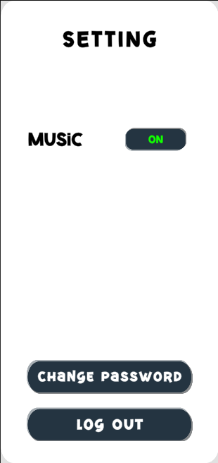
Analysis and design
Music , set music to on or off.
Change password
Logout.

Slide 16
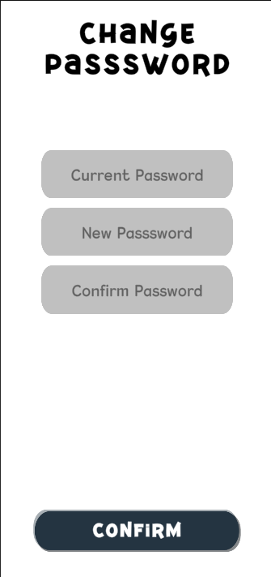
Analysis and design
Change Password , similar with another app for change password. Contain current password to make sure it contain.
Very recommend for the user to change their password.

Slide 17
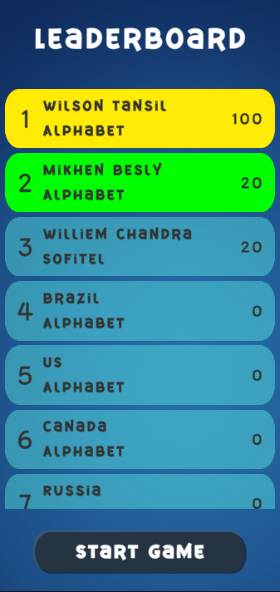
Analysis and design
Leaderboard , contain top 10 user with the high scores in every game.
Card leaderboard , contain username and user class.

Slide 18
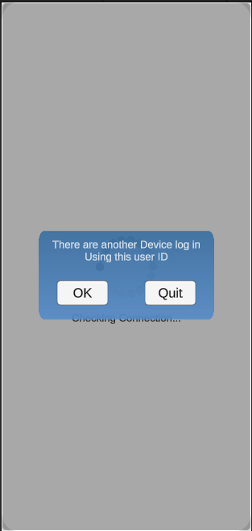
Analysis and design
Warning message , contain error because there are another device log in with the user id.
Ok button , will leads user to login scene.
Quit button , will quit the application.

Slide 19
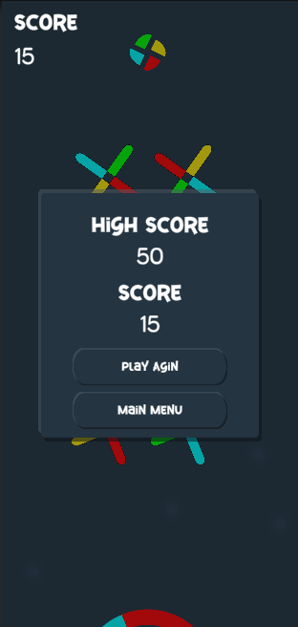
Analysis and design
Game play , contain user score and high score. Update to database will only execute if score is greater than the high score.

Slide 20
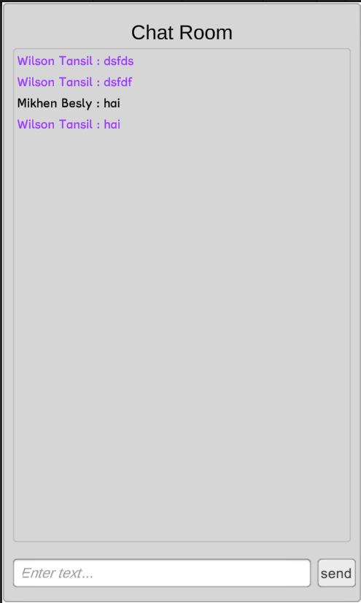
Analysis and design
Chat room, is a feature that base on the title of research “to increase interaction between IT&B Student”.

Slide 21
Suggestion
Team work in game programming is very important, every individual have their own talent. To gather every talent into one group base on the requirement in conclusion will increase their ability.
Learning Game programming is new step for IT&B campus, but the market of game programming is very big , a lot of competitor and a lot of requirement to be success in this field.

