Slide 1
Customer Dissatisfaction and Commitment Projections - By Wilton Santhosh D Souza
Supervisor: Gowthami Konakanchi
Examiner: Abhishek Kumar

Slide 2
Problem Statement
The most valuable asset of any business is its customers
Keeping these customers happy can increase revenue and foster meaningful long-term relationships with them
One of the most well-known issues in business is customer attrition or loss
Getting a new customer is five times more expensive than keeping an existing one.
Company needs to make an investment in gaining new customers if you want your business to expand.
Every time a customer goes, a sizable investment is lost.
Understanding what keeps customers engaged is therefore very important information
Since it may help create retention strategies and implement operational procedures

Slide 3
Example for Customer Attrition
Let’s say that any SaaS company acquired 1,000 customers during the month of May.
Let’s also say that your company lost 100 customers because they were not informed that they needed to renew their subscriptions.
If we take the churned customers (100) and divide it by the acquired customers (1,000), then multiply that number by 100%, we get a 10% churn rate.
Although churn is most often associated with the percentage of customers lost, there are a few other ways to calculate churn:
Value of recurring business lost
Percentage of recurring value lost

Slide 4
Solution Proposed
Predicting which customers are most likely to leave your business or end a subscription to a service
Three algorithms:
Linear Discriminant Analysis (LDA),
Support Vector Machines
Decision Trees.
Based on the models developed from these algorithms, the best data will be chosen out of it.
The user is given access to a dashboard that displays all the insights obtained through the algorithms
Enables users to take swift action on the insights.
The activity comprises delivering a feedback form, offering additional discounts to customers who are purchasing frequently and notifying them of loyalty discounts.

Slide 5
Scope and Benefits
Every business aspires to have a deeper understanding of its client so that it may base strategic decisions on that understanding.
With the aid of this service, businesses can utilise the client data at their disposal to enhance sales and build enduring operations.
The company will really profit from this, and competitors will adopt it more widely and gain market share.
Scope of Work:
Pre-processing the customer dataset to avoid outliers in the data
Applying Linear Discriminant Analysis, Support Vectors Machines and Decision Trees to train the machine learning models
Providing the customer, a dashboard with a full analysis so they can take appropriate action

Slide 6
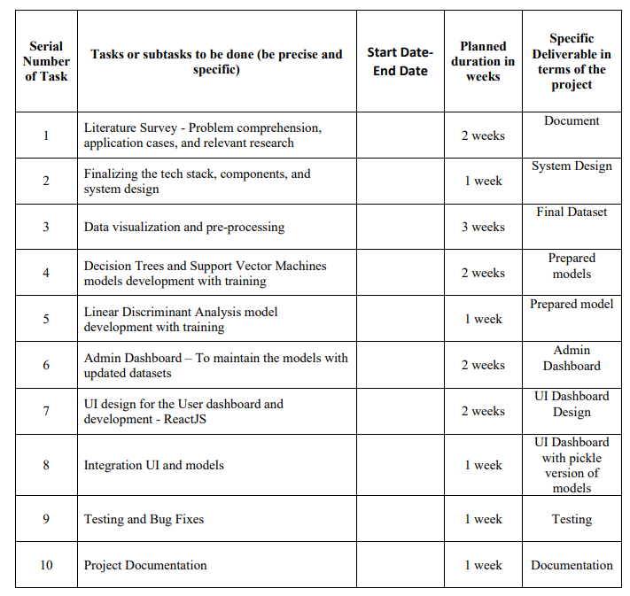
Detailed Plan Work

Slide 7
Thank You

