Slide 1
Archeological Technical Report: Fort Amsterdam NAA Analysis
Elemental Analysis of Ceramic Specimens
January 2026

Slide 2
Executive Summary
Context: ~500 Years Post-Deposition (17th Century Colonial)
Findings:
  Specimens are confirmed Ceramic Pottery, not biological remains.
  High Al, Fe, K signatures indicate terrestrial clay matrix.
  High Ca levels consistent with shell tempering and coastal burial.
  Sodium (Na) infusion confirms long-term proximity to sea salt.

Slide 3
Methodology
Neutron Activation Analysis (NAA):
  Non-destructive technique measuring elemental composition via neutron bombardment.
  Provides precise quantification of trace elements (ppm-level accuracy).
Computational Analysis Workflow:
  Data extraction: Parsed NAA intensity values from Excel, removing uncertainty ranges (±).
  Visualization: Generated comparative histograms using Python (matplotlib/seaborn).
  Statistical correlation: Calculated Pearson correlation coefficients between sample elemental profiles to identify geochemical consistency.

Slide 4
Historical Context & Speculation
Original Speculation (Slice Analysis):
  High Al, Ca, K, and Na were initially attributed to human remains (bones, coffins, grave goods).
  Heavy metals (Ti, Fe) suggested agricultural/industrial contamination.
NAA Revelation:
  3D rendering confirmed pottery shapes, not biological material.
  Chemical profile matches coastal ceramic production, not burial remains.

Slide 5
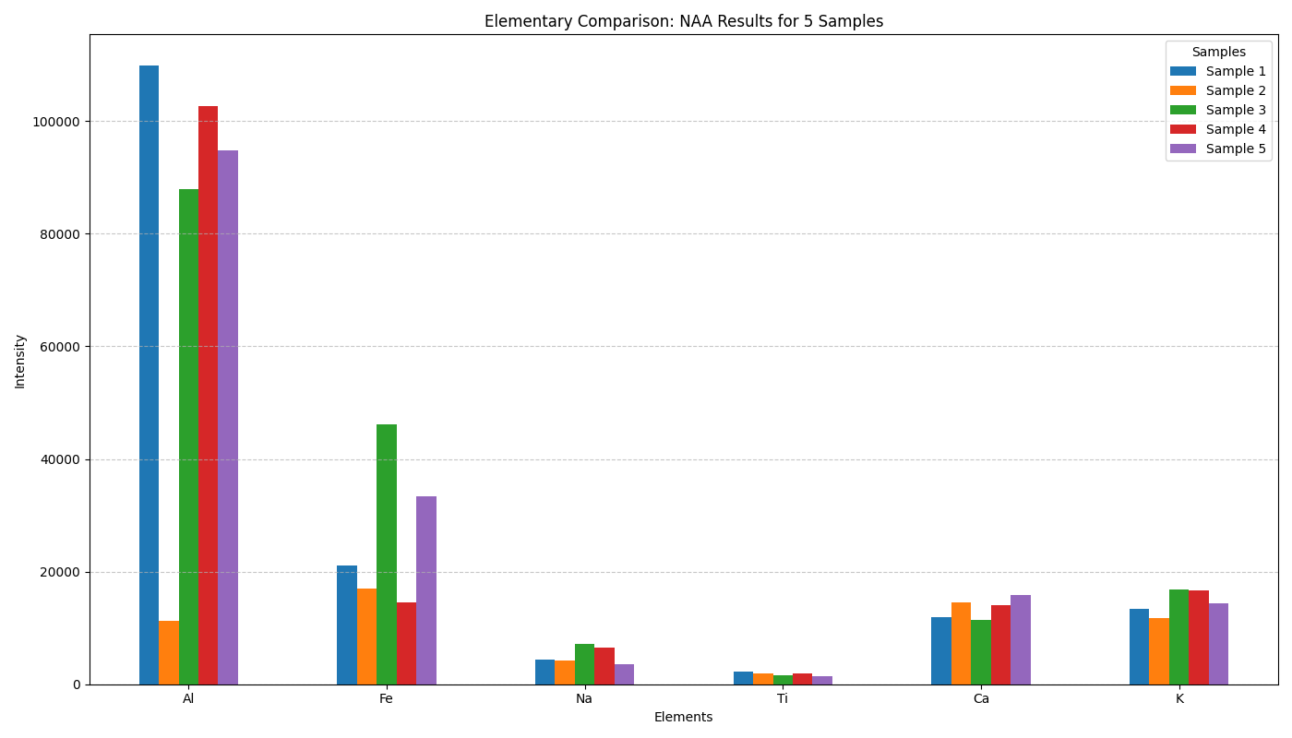
Chemical Profile: Element Intensities
Consistent Al/Fe/K/Ca profile across samples indicates shared provenance.

Slide 6
Intensity Data (NAA Results)
Element | Sample 1 | Sample 2 | Sample 3 | Sample 4 | Sample 5
Al | 109900 | 11190 | 87850 | 102700 | 94810
Fe | 21080 | 16990 | 46090 | 14530 | 33380
Na | 4411 | 4147 | 7168 | 6468 | 3511
Ti | 2197 | 1869 | 1610 | 1916 | 1432
Ca | 11860 | 14560 | 11490 | 14120 | 15910
K | 13450 | 11800 | 16770 | 16660 | 14390

Slide 7
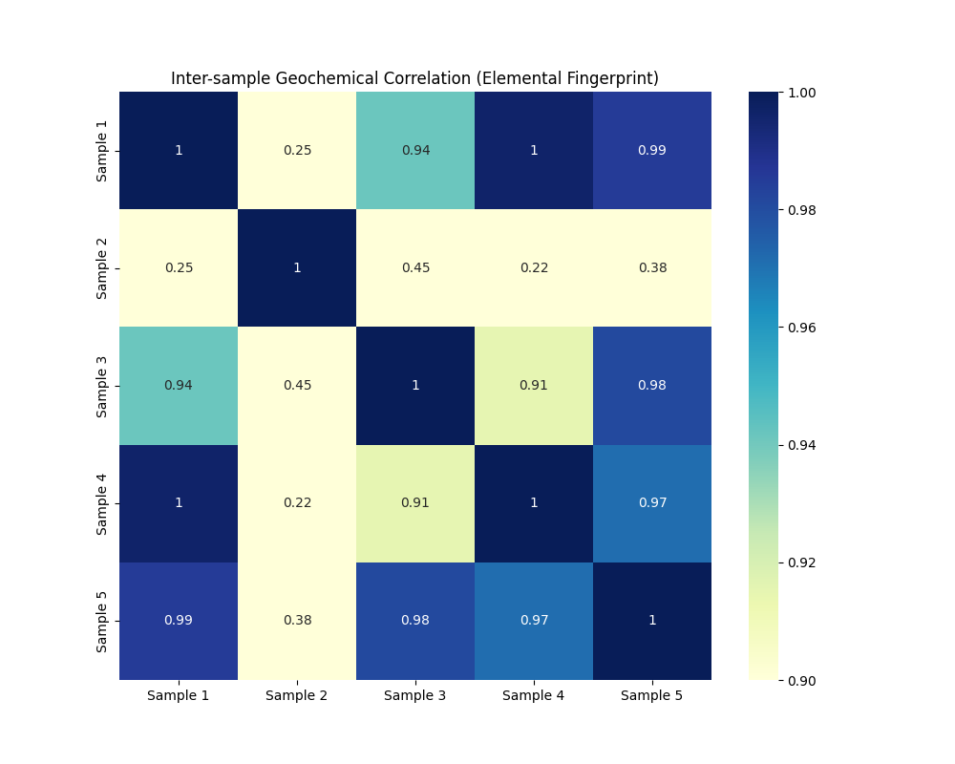
Geochemical Correlation Matrix
Sample 2 is a significant outlier (Correlation 0.22 - 0.45).
This suggests it originates from a different vessel, workshop, or has undergone isolated contamination compared to the main group (1, 3, 4, 5).

Slide 8
Conclusion & Archaeological Implications
Interpretation: The artifacts are a single set of colonial-era utility ware (Main Group), with one anomalous piece (Sample 2).
Coastal Context: Validated by ubiquitous Sodium presence.
Material: Local or imported volcanic-clay pottery (High Fe/Al) with shell temper (Ca).
Historical Significance: Reflects Fort Amsterdam's role as a 17th-century hub with diverse pottery sources (local production + imports).
Result: Speculations of human remains are chemically refuted.

