Slide 1


HEROPEDIA
WILY MAYO
https://github.com/WilyMayo

Slide 2

Have you ever watch a super hero movie or show and wondered, I wonder how he got his powers?
This is where I found myself thinking. So, I decided create Heropedia, a web application where you can quickly look up a hero, learn about their background story, and how they gained their powers.

Slide 3





Being a fan of comic book heroes, I always find myself wanting to know more about them. I think many people would benefit from this app and how simple it is to use. With a click you can move from one category to another and easily search for a character...
User Stories

Slide 4
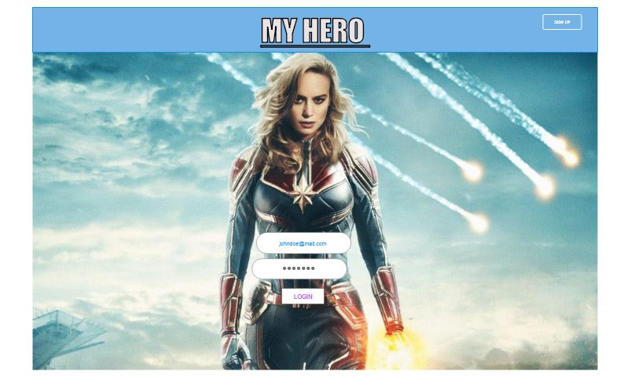
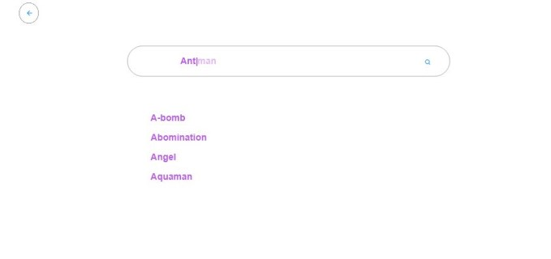
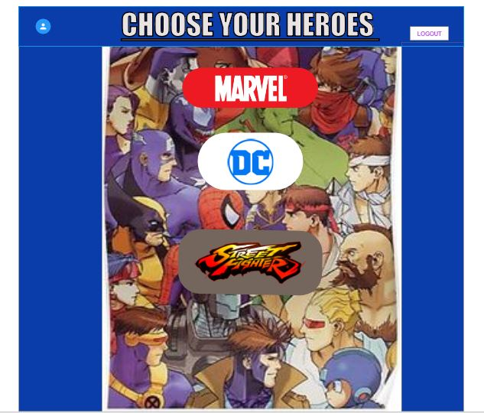
Features
Users can login or register and have their own profile.
Users can browse through the search library and find their favorite heroes.
The main page allows the users to choose from 3 main brands of hero comics.

Slide 5

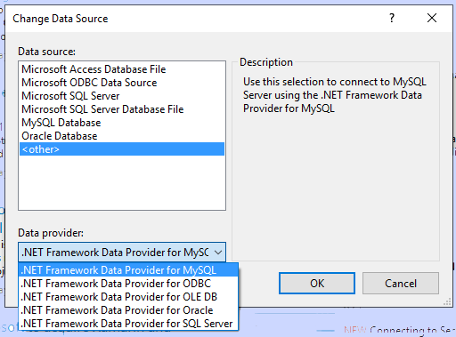
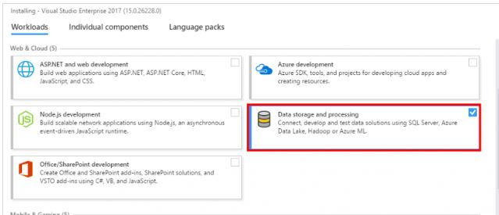
SQL ServerDatabase
I’m using SQL Server Database and the built-in .NET Framework Data Provider for MySQL to connect my data to my tables. The ddatabase will hold three tables for the username , password, address and date of birth. This way you can quickly monitor age groups, locations, and give each user a induvial id. For query propose.

Slide 6



Technology
C# with Visual studio 2017
ASP.NET Framework
Bootstrap
Adobe DX

Slide 7
What I Learned?
Using NuGet Package Manager.
ASP.NET core authentications
Some HTML and CSS
Lots of useful keyboard shortcuts

Slide 8
Demo

Slide 9
What’s Next?
Continue working on my app and improve it as much as possible.
I want to continue learn more C# and the .net framework. The more I learn, the more I find it pretty incredible.
Another goal of mine is to also learn Java using MOCCS courses or other online sources.

