Slide 1
Final presentation Group 3
Arnaud Van Mieghem
Wim Kunnen
Yrjo Koyen

Slide 2
Design decisions
Trade off in a triangle
FLEXIBILITY
AREA
TIME

Slide 3


Design decisions
SECURITY
Trade off in a tetrahedron
FLEXIBILITY
TIME
AREA

Slide 4
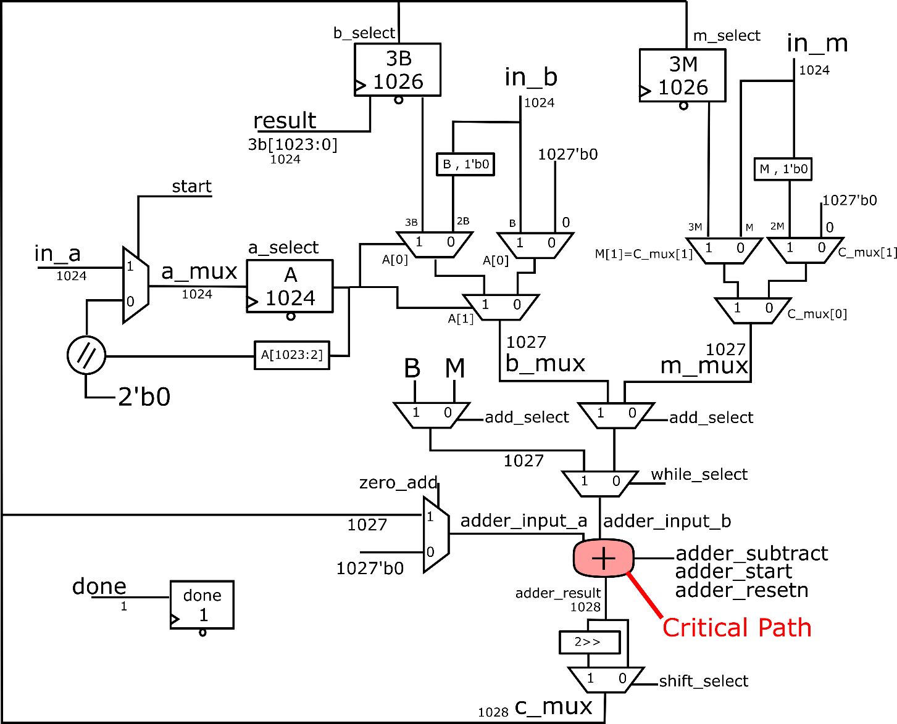
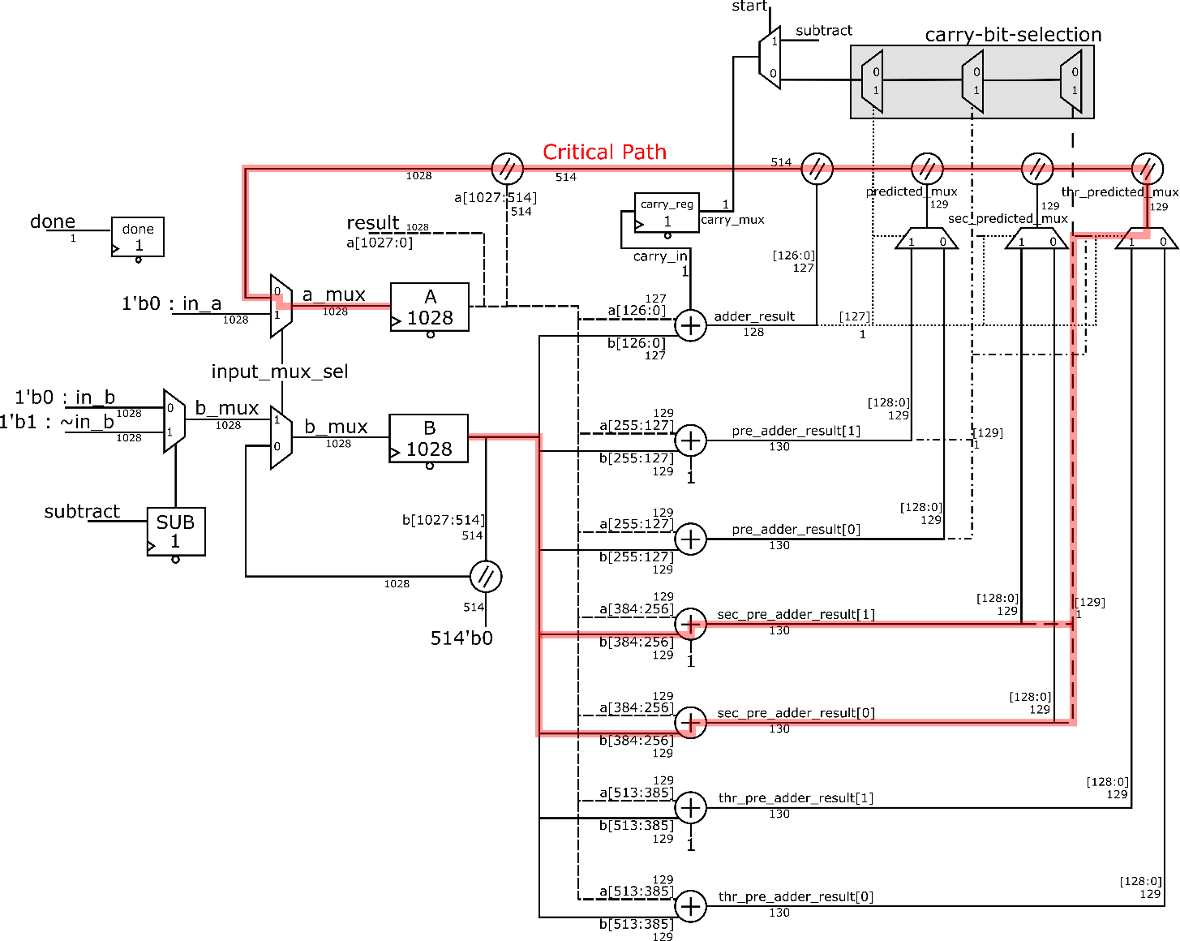
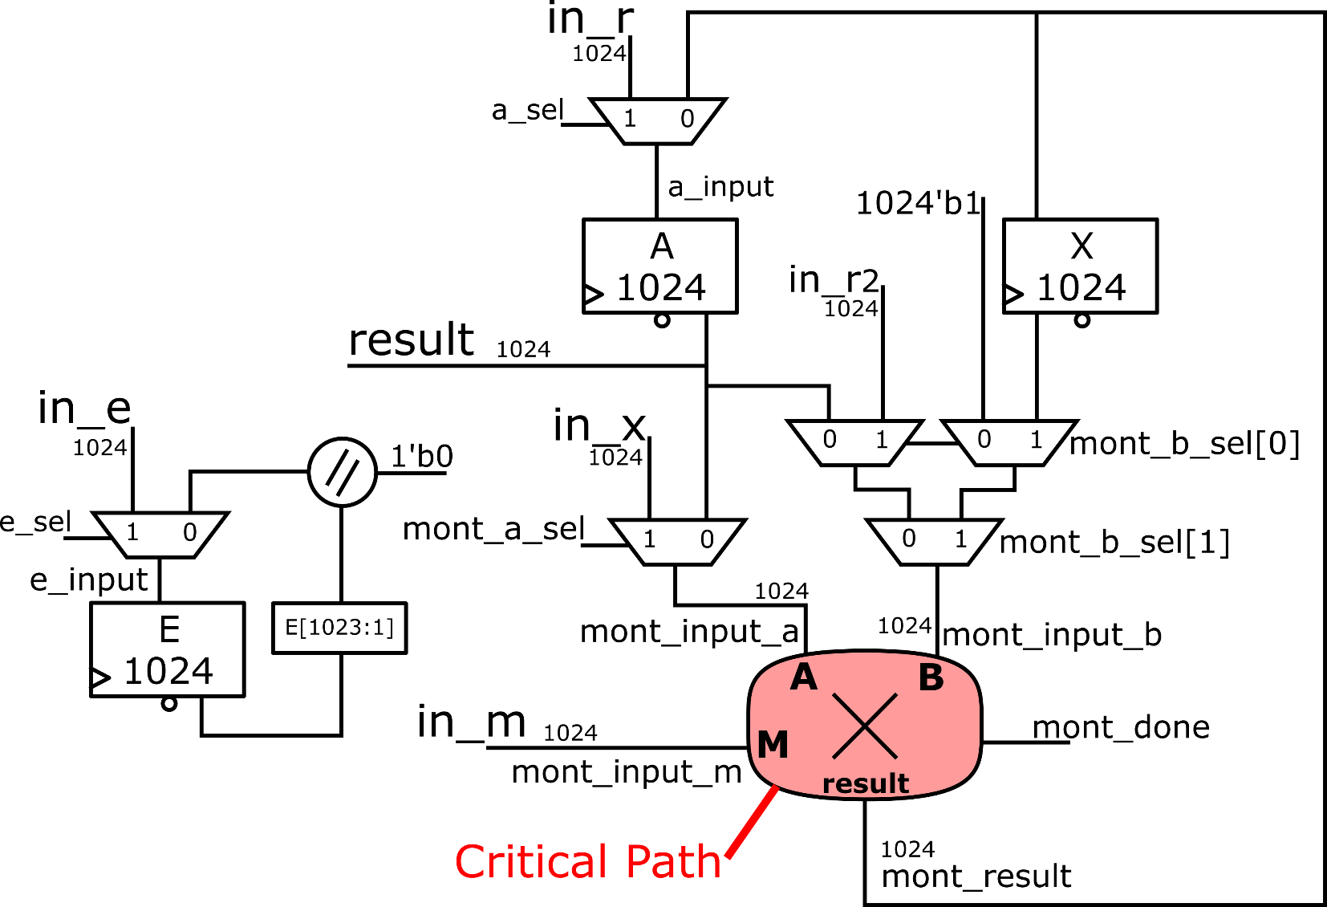
Architecture of hardware design

Slide 5
Hardware-Software interface
XXXXXXXXXXXXXXXXXXXXXXXXXXXXX
HW/SW boundaries
Drawing of your architecture
Critical path
HW/SW interface
List of commands
How commands and data transferred
XXXXXXXXXXXXXXXXXXXXXXXXXXXXXXXXX

Slide 6
Overview of implementation
ADDER | Add-width | WNS | LUT’s | Flip Flops | Cycles
1 | 129 | 1,884 | 2352 | 5183 | 9
1 | 206 | 0,127 | 2332 | 4159 | 6
3 | 172 | 0,104 | 2636 | 2082 | 4
7 | 129 | 0,066 | 3639 | 4148 | 3
MONTGOMERY | Adder | WNS | LUT’s | Flip Flops | Cycles
Split algorithm | 7 // 129 | 0,174 | 6554 | 7210 | 3103
Merged algorithm | 7 // 129 | 0,095 | 10883 | 16514 | 1607
RSA | Montgomery | Adder | WNS | LUT’s | Flip Flops | Cycles
 | Split algorithm | 7 // 129 | 0,174 | 14 490 | 20 995 | 131 350

Slide 7
Further improvements
Adding even more test vectors
More edge cases
Security further improved
Optimized code for less Area usage
Other FPGA for faster Montgomery
Instance : | Adder | Montgomery | RSA
Number of testvectors | XX | XX | XX

Slide 8
Questions?

Slide 9
Deze mag weg
• Mandatory to include:
o 1 slide: design decisions
o 1 slide: HW/SW boundaries and interface
o 1 slide: Architecture diagram showing critical path
o 1 slide: results table

Slide 10
Deze mag weg
HW/SW boundaries
Drawing of your architecture
Critical path
HW/SW interface
List of commands
How commands and data transferred

Slide 11
Architecture of hardware design

Slide 12
Architecture of hardware design

Slide 13
Architecture of hardware design

Slide 14
Deze mag weg
Table with results of your implementation
Area
Slice LUTs and flip-flop count
Time
Cycles
Flexibility
Explain how flexible is your design

Slide 15
Deze mag weg
Feel free to fill the rest of slides at will:
Interesting design decisions
Optimizations
etc …
… but remember you only have 5 minutes !

