Slide 1

Validation procedures,
over-fitting
Introduction to Intelligent Systems
Michael Biehl

Slide 2
validation
key problems in supervised learning
model selection: LVQ, Neural Networks, Support Vector Machine,… ?
how many prototypes, neurons, which kernel,… ?
data representation: coding, normalization, transformation, … ?
algorithm, (hyper-) parameters:
which training prescription ?
how many training epochs, which learning rate, … ?
training: based on performance with respect to training data
aim : low error with respect to new data generalization
how can we test the generalization performance ?

Slide 3
validation
Validation procedures
basic idea: split available data
(randomly) into disjoint sets
→ estimate of test error (e.g. number of misclassifications)
→ comparison/choice of different models, algorithms, parameter settings
→ prediction of performance with respect to novel data ( ? )

Slide 4
validation
problems:
- lack of data
can we afford to waste example data only for validation ?
- representative results ?
lucky / unlucky set composition can give misleading outcome !
- variation of results ?
how safe is the prediction ? error bars of the estimates ?

Slide 5
cross-validation
example strategy: " n-fold cross-validation "
split data
(randomly) into n disjoint sets
all data training data (i) test data (i)
- repeat training n times
- calculate average training / test errors ( and variances )
- repeat cross-validation for different models, parameter settings, etc.
- select the best system with respect to test errors
(model, number of units, learning rate, … )

Slide 6
cross-validation
remarks:
- which n in n-fold cross-validation ?
larger n → larger fraction of D used in each training run
→ more estimates of E_{test} / smaller test sets
→ higher computational effort
extreme case: n = P
use all but one examples for training, test on single example,
repeat P times " leave-one-out estimate "
- statistics ?
n results are not statistically independent
highly overlapping training sets! → difficult to estimate variances
with respect to training set dependence

Slide 7
over-fitting
test / training errors (e.g. observed in cross-validation)
vs. complexity of the model (e.g. # of prototypes, neurons, … )
E
in general:
E_{train} < E_{test}
"complexity“ (e.g.: number of prototypes, hidden units… )
- expect: better classification ( of D_{train} ) with increasing complexity
- classifier / regression can become over-specific to training set !
over-fitting ( low training, high test error )

Slide 8
bias / variance
the bias / variance dilemma (qualitative discussion)
competing aims in training:
low bias = small systematic deviation from the "true solution"
on average over all possible data sets of the same size
low variance = weak dependence on the actual training set,
robustness of the hypothesis
dilemma:
small variance: simple model, under-fitting → large bias
small bias: complex model, over-fitting → large variance

Slide 9
bias / variance
illustrative example: curve fitting to noisy data points (regression)
data set 1
data set 2
low variance
high bias
best generalization,
matching complexity
low bias
high variance

Slide 10
over-fitting
Remarks
- in a potentially overfitting learning system, we can use
algorithm parameters to control effective complexity
i.e. the degree to which the training error can be minimized
e.g. number of training epochs
learning rates
- validation procedures can overfit !!!
example: selection of parameters based on E_{test} by cross-validation
does depend on the entire data set D
unclear performance with respect to entirely new data
strategies: - second level of validation (extra data?)
- base selection only on training error, if possible

Slide 11
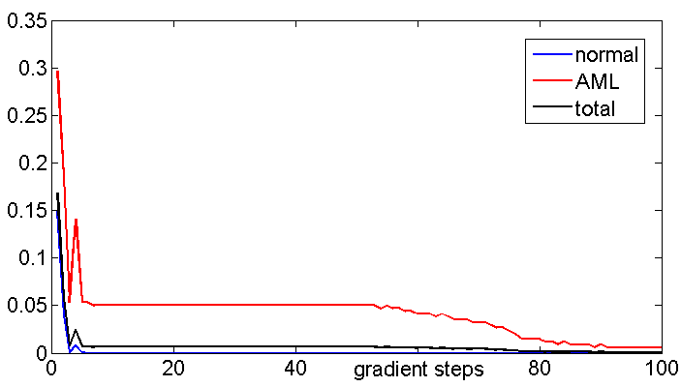
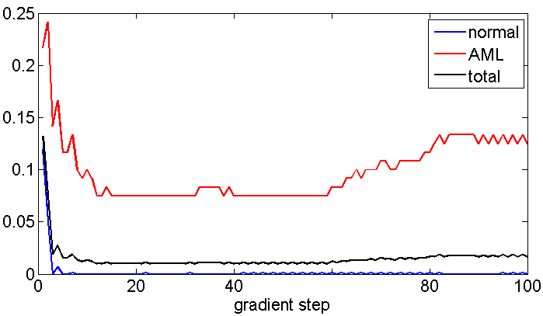
real world example
Leukaemia diag-
nosis from flow
cytometry data”
over-fitting
(here: due to
mislabelled
example data)
training set
errors
validation set
errors
:early stopping”
as a method
of regularization

