Slide 1
Adaptive Cognitive Load and Style Prediction System for Online Learning Using Behavioral Patterns
R26-SE-004

Slide 2
Adaptive Cognitive Load & Cognitive Style Prediction System for Online Learning Using Behavioral Patterns
The problem
Current online learning systems do not effectively adapt to individual learners’ cognitive styles, study behaviors, and cognitive load, which can lead to inefficient learning and student frustration.
  Existing Solutions and Their Limitations
Existing System | Limitations
MATHia (Carnegie Learning) | • Mainly uses performance data • Does not consider cognitive style • No real-time cognitive load detection
Knewton Alta | • Focuses mainly on quiz and performance results • Limited behavioral learning analysis • Limited explainability for instructors
Impact of the problem to User and Society (Stakeholders)
Stakeholder | Issue
Teachers / Tutors | Difficult to identify student learning difficulties
Students / Undergraduates | Experience confusion or cognitive overload
System Administrators | Limited visibility of learner behavior
Researchers | Lack of behavioral data for research
R26-SE-004

Slide 3
The Proposed Solution
Current online learning systems do not effectively adapt to individual learners’ cognitive styles, study behaviors, and cognitive load, which can lead to inefficient learning and student frustration.
  Solution Overview and how it overcomes the limitations
Limitation in Existing Systems | Proposed System Solution
Adaptation based only on quiz scores | Uses learner profiling and cognitive load prediction
No understanding of learner processing | Detects cognitive styles from interaction behavior
No real-time cognitive load monitoring | Predicts load using behavioral data
Limited personalization | Generates adaptive learning content
Lack of transparency | Uses Explainable AI (XAI)
Individual students’ components
Cognitive Style Detection Module
Cognitive Load Prediction Module
Cognitive-Adaptive Content Personalization Engine (CACPE)
Explainable AI (XAI) Module
R26-SE-004

Slide 4
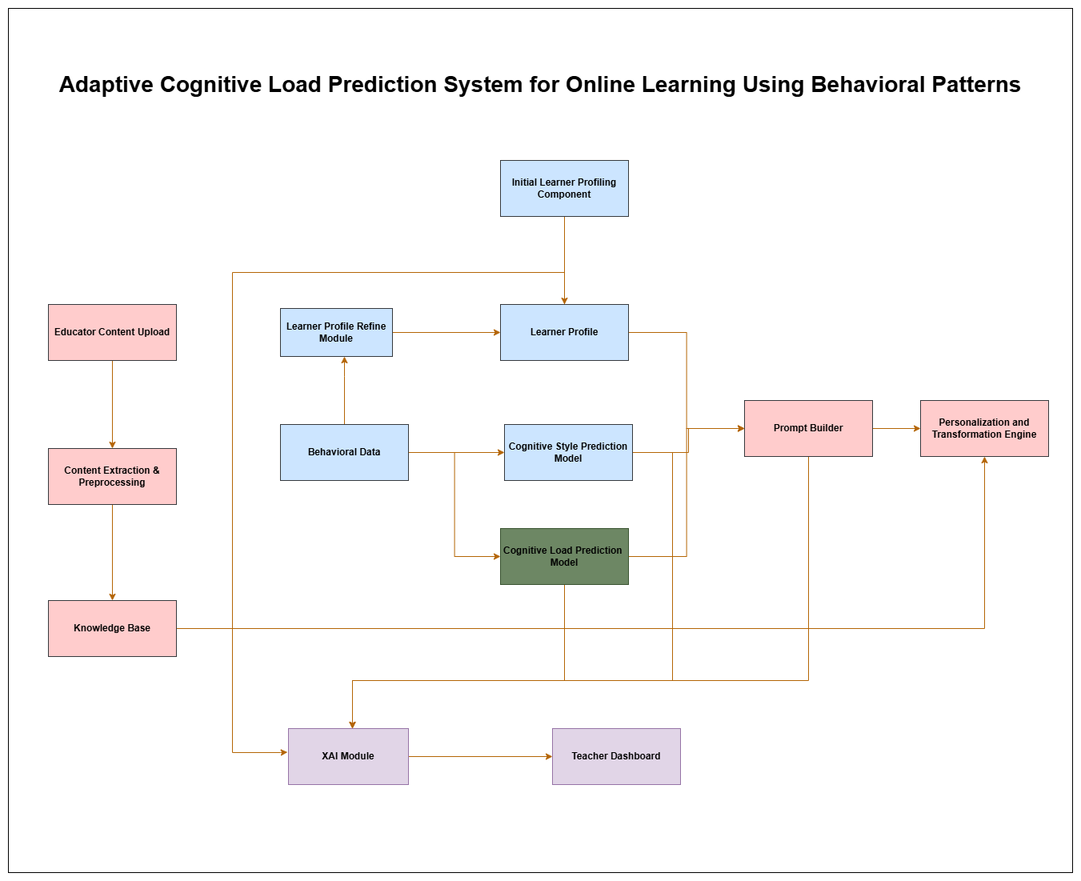

Slide 5

IT22281364 | Imesh L.a.r
Student Must add a professional photo to this cage
Learner Profile Based Cognitive Style Detection System
Contribution for the overall system
• ASSIST questions–based learner profile prediction at system entry
• Cognitive style detection using behavioral interaction data
• Learner profile verification and refinement using behavioral evidence
• Provide learner profile and cognitive style information to the adaptive content generation module
IT22281364 | Imesh L.A.R |R26-SE-004

Slide 6
Learner Profile Based Cognitive Style Detection
Problem Statement
• Existing systems rely on simple LMS interaction data that does not fully represent learner cognition.
• Self-reported questionnaires may not accurately reflect real learning behavior.
• Learner profiles are often treated as static and not updated during learning.
• Single data sources are commonly used, limiting accurate learner modeling.
Existing Systems and their Limitations
Existing Approach | Limitation
LMS interaction log–based models (page visits, time spent) | Provides low-resolution data and does not accurately reflect learner cognitive processes
Self-reported questionnaires (e.g., ASSIST, ILS) | Responses may not represent actual learning behavior due to bias or misunderstanding
Static learner profile models | Assume learner characteristics remain constant and ignore behavioral changes during learning
Single data source learner modeling | Using only one type of data limits the accuracy of cognitive style or learner behavior detection
IT22281364 | Imesh L.A.R. |R26-SE-004
Notes:
F. L. Gambo, G. M. Wajiga, E. J. Garba, A. A. Abdullahi, and D. B. Bisandu, "A Deep Learning Solution for Learning Style Detection using Cognitive - Affective Features," Advances in Communication Technology, Computing and Engineering, pp. 32–43, 2021.
C. Lwande, L. Muchemi, and R. Oboko, "Identifying learning styles and cognitive traits in a learning management system," Heliyon, vol. 7, no. 7, p. e07701, 2021.
R. R. Dhote, "A Framework for Automatic Student Profiling Using Artificial Neural Network," International Journal of Trend in Research and Development, vol. 3, no. 3, pp. 177-181, 2016.
S. Graf and Kinshuk, "Learner Modelling Through Analyzing Cognitive Skills and Learning Styles," in IT Education and Training, pp. 381-406, 2008.
L. X. Li and S. S. Abdul Rahman, "Students’ learning style detection using tree augmented naive Bayes," Royal Society Open Science, vol. 5, no. 7, p. 172108, 2018.
H. Asikainen, K. Salmela-Aro, A. Parpala, and N. Katajavuori, "Learning profiles and their relation to study-related burnout and academic achievement among university students," Learning and Individual Differences, vol. 78, p. 101781, 2020.
B. Mertens, S. De Maeyer, and V. Donche, "Exploring learner profiles among low-educated adults in second-chance education: individual differences in quantity and quality of learning motivation and learning strategies," European Journal of Psychology of Education, 2024.
Google Drive Link --> https://drive.google.com/drive/folders/1tdfSsCugdKFYO_tj-O7XR9mfNjQQcln3?usp=sharing

Slide 7
Learner Profile Based Cognitive Style Detection
Research Gap | Proposed Novelty / Solution
Lack of systems that combine validated learner profile initialization with real behavioral interaction data | Hybrid learner profiling combining ASSIST questionnaire responses with behavioral interaction data
Existing models rarely update learner profiles dynamically during learning sessions | Dynamic refinement of learner profiles using continuous behavioral interaction analysis
Limited use of multi-source behavioral signals such as cursor movement, video interaction, and webcam attention together | Multimodal behavioral analysis integrating cursor movement, video interaction, and gaze attention
IT22281364 | Imesh L.A.R. |R26-SE-004
Notes:
[22] N. Herbig et al., “Investigating Multi-Modal Measures for Cognitive Load Detection in E-Learning,” in ACM UMAP, 2020.
[2] T. Weiß and T. Pfeiffer, “Consumer Decisions in Virtual Commerce Predict Good Help-Timing,” 2024.
[16] A. Siddique et al., “Developing Adaptive E-Learning Environment Using Cognitive Parameters,” Journal of Educational Computing Research, 2018.
[8] J. Sweller, “Cognitive Load Theory,” Psychology of Learning and Motivation, vol. 55, pp. 37–76, 2011.

Slide 8
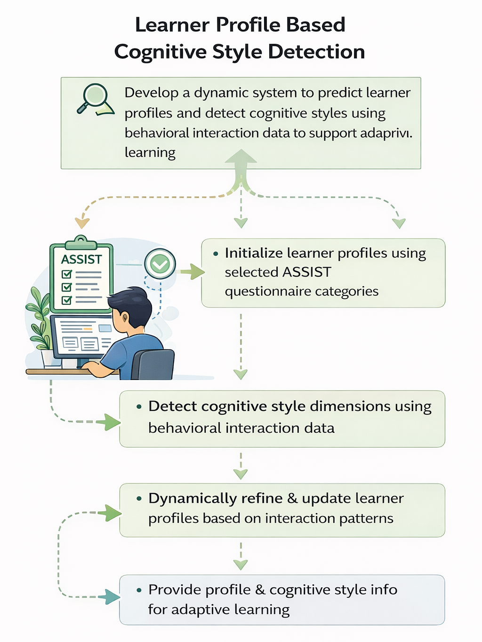
Learner Profile Based Cognitive Style Detection
Research Objective
Develop a dynamic system to predict learner profiles and detect cognitive styles using behavioral interaction data to support adaptive learning.
Sub-Objectives
• Initialize learner profiles using selected ASSIST questionnaire categories.
• Detect cognitive style dimensions (Visual–Verbal and Wholistic–Analytic) using behavioral interaction data such as cursor movements, video interaction patterns, and webcam-based attention signals.
• Refine and update learner profiles dynamically by analyzing behavioral interaction patterns collected during learning sessions.
• Provide learner profile and cognitive style information to the adaptive content generation module to enable personalized learning.
IT22281364 | Imesh L.A.R |R26-SE-004
Notes:
[13] M. I. Ahmad et al., “A Framework to Estimate Cognitive Load Using Physiological Data,” Personal and Ubiquitous Computing, vol. 27, no. 6, pp. 2027–2041, 2023.
[20] H. M. Šola et al., “AI Eye-Tracking Technology for Managing Cognitive Load in Online Learners,” Education Sciences, vol. 14, no. 9, 2024.
[22] N. Herbig et al., “Investigating Multi-Modal Measures for Cognitive Load Detection in E-Learning,” in ACM UMAP, 2020.

Slide 9
Learner Profile Based Cognitive Style Detection
Methodology
Step 1 — Data Collection
Learner data is collected through the ASSIST questionnaire and behavioral interactions such as cursor movements, video interactions, and webcam gaze tracking.
Step 2 — Initial Learner Profiling
Latent Profile Analysis (LPA) is applied to questionnaire responses to classify learners into initial profiles (Deep–Organized, Unorganized Deep, Unreflective, Dissonant).
Step 3 — Feature Extraction
Behavioral data is processed to extract relevant features such as movement speed, hover duration, pause count, replay count, and gaze focus stability.
Step 4 — Cognitive Style Prediction
A Support Vector Machine (SVM) is used to predict learners’ cognitive styles (Visual vs Verbal, Wholistic vs Analytic).
Step 5 — Profile Validation and Refinement
Learner interaction behaviors such as course completion, navigation patterns, and video engagement are used to validate and refine the predicted learner profile.
IT22281364 | Imesh L.A.R. |R26-SE-004

Slide 10
Learner Profile Based Cognitive Style Detection
Domain knowledge used
• Learning Approaches Theory (ASSIST – Deep, Strategic, Surface learning)
• Cognitive Style Theory (Visual–Verbal, Wholistic–Analytic dimensions)
• Learning Analytics for behavioral pattern analysis
• Human–Computer Interaction (HCI) for interpreting learner interactions
• Machine Learning for behavioral classification and prediction
Key technologies
• Python (Scikit-learn, NumPy, Pandas)
• MediaPipe for webcam attention detection
• MySQL/ NoSQL for learner model storage
• Web learning interface (HTML / JavaScript / Flask)
• REST APIs for data collection and module communication
• Modular machine learning architecture for learner modeling
IT22281364 | Imesh L.A.R. |R26-SE-004

Slide 11
Learner Profile Based Cognitive Style Detection
Validation and Evaluation of Proposed Solution
Model evaluated using machine learning metrics
  Accuracy
  Precision
  Recall
  F1-score
Cross-validation used to ensure stability
Compare multiple algorithms
  Random Forest
  Support Vector Machine (SVM)
  Logistic Regression
Test with different learning difficulty levels
Verify real-time prediction performance
Data Availability, Security & Ethical Clearance
Behavioral interaction data (cursor movements, navigation logs, video interactions, and gaze indicators) and ASSIST questionnaire responses are used for model training and validation.
All collected data is anonymized and securely stored in an encrypted database, and no raw video or facial images are saved.
Participants provide informed consent before data collection, and the study follows institutional ethical guidelines for privacy and responsible data usage.
IT22281364 | Imesh L.A.R |R26-SE-004

Slide 12
Learner Profile Based Cognitive Style Detection
System Overview of Individual Component
1.Learner Profile Initialization
Initialization of learner profiles using the ASSIST questionnaire.
2.Behavioral Data Collection Module
Interaction data such as cursor movements, video interactions, and navigation behavior are collected from the learning platform.
3.Feature Extraction Module
Behavioral and attention data are processed to extract relevant features for analysis.
4.Learner Profile Refinement Module
Learner profiles are dynamically updated based on observed behavioral patterns.
Dependencies & Common Components
• Web-based learning interface for interaction logging
• Central database for storing learner profiles and behavioral data
• Shared feature extraction and behavioral data pipeline
• Machine learning libraries (Python, Scikit-learn / TensorFlow)
• REST API communication for integration with other system modules
111
IT22281364 | Imesh L.A.R. |R26-SE-004

Slide 13

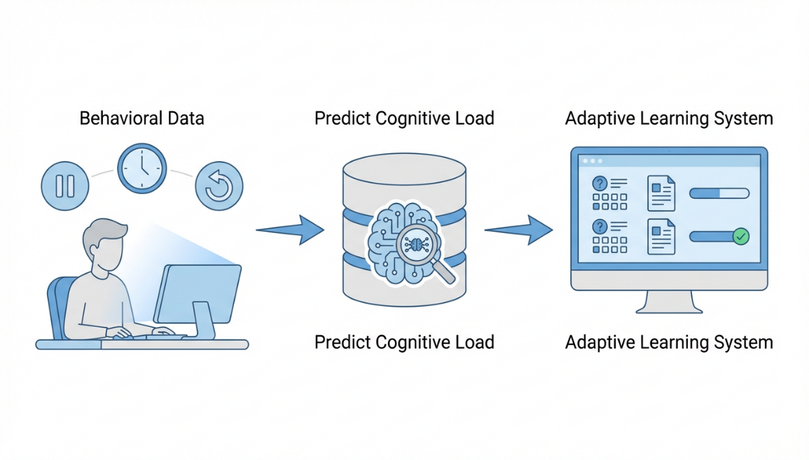
IT22089786 | Subasinghe m.h.r.i.
Real-time Cognitive Load Prediction
Contribution for the overall system
Real-time cognitive load prediction using behavioral interaction data
Extract clickstream features (pause, navigation, idle time, response time etc.)
Machine learning model for multi-level cognitive load classification
Provide load level to adaptive learning module
IT22089786 | Subasinghe M.H.R.I. |R26-SE-004
Notes:
Papers –
https://mysliit.sharepoint.com/:f:/s/RPProjectGroup_lqmyol/IgC_KHYzTPVxT67kGwWusuO_AbalE-p5uYqT-VCYsZkyJdM?e=VxXtjF
Gap Finding Matrix –
https://mysliit.sharepoint.com/:x:/s/RPProjectGroup_lqmyol/IQC2yyAwOayuTr0RbtUGfaeIAfbhhQMzz4wR_p3VjebvyKg?e=gQIo7k

Slide 14
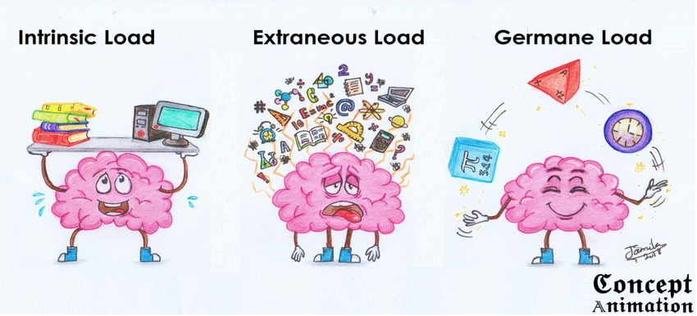
Real-time Cognitive Load Prediction
Problem Statement
Problem Statement
Online learning systems use static content for all learners
Learner cognitive load is not monitored during learning process
High or low cognitive load reduces learning effectiveness.
Physiological sensors are expensive and impractical
Need real-time prediction using behavioral data
Existing Systems
Research Gap
Existing Systems
Cognitive load measured using EEG, eye-tracking, and heart-rate signals.
Learning analytics uses clickstream and interaction data.
Adaptive systems adjust content based on performance or rules.
Most systems do not support real-time prediction.
Research Gap
Existing methods depend on sensors or offline analysis.
Behavioral data not fully used for cognitive load prediction.
Limited real-time prediction during learning session.
Many models use only low / high load classification.
IT22089786 | Subasinghe M.H.R.I. |R26-SE-004
Notes:
[22] N. Herbig et al., “Investigating Multi-Modal Measures for Cognitive Load Detection in E-Learning,” in ACM UMAP, 2020.
[2] T. Weiß and T. Pfeiffer, “Consumer Decisions in Virtual Commerce Predict Good Help-Timing,” 2024.
[16] A. Siddique et al., “Developing Adaptive E-Learning Environment Using Cognitive Parameters,” Journal of Educational Computing Research, 2018.
[8] J. Sweller, “Cognitive Load Theory,” Psychology of Learning and Motivation, vol. 55, pp. 37–76, 2011.

Slide 15
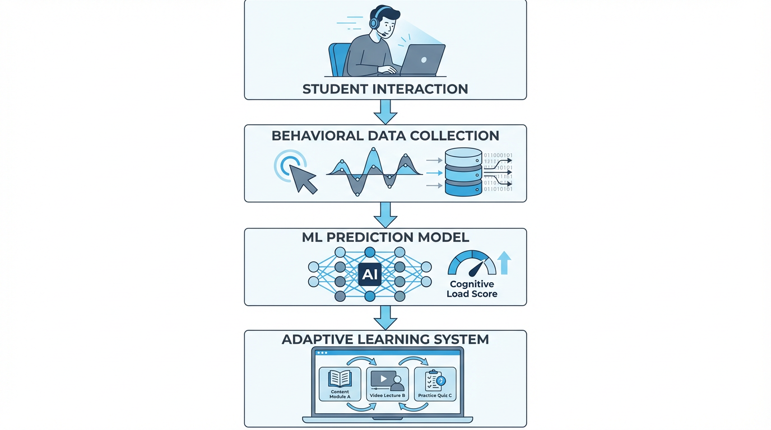
Real-time Cognitive Load Prediction
Proposed Novelty
Proposed Novelty
Real-time cognitive load prediction using behavioral clickstream data
No physiological sensors required (non-intrusive and scalable)
Continuous prediction during learning session
Multi-level cognitive load classification
Objectives
Main Objective
To develop a real-time cognitive load prediction system for online learning using behavioral interaction data without physiological sensors.
Specific Objectives
Identify behavioral features (pause, navigation, time-on-task, idle time, errors, response time)
Design real-time prediction model for continuous monitoring
Develop non-intrusive behavior-based prediction method
Implement multi-level cognitive load classification
Evaluate accuracy using online learning interaction data
IT22089786 | Subasinghe M.H.R.I. |R26-SE-004
Notes:
[13] M. I. Ahmad et al., “A Framework to Estimate Cognitive Load Using Physiological Data,” Personal and Ubiquitous Computing, vol. 27, no. 6, pp. 2027–2041, 2023.
[20] H. M. Šola et al., “AI Eye-Tracking Technology for Managing Cognitive Load in Online Learners,” Education Sciences, vol. 14, no. 9, 2024.
[22] N. Herbig et al., “Investigating Multi-Modal Measures for Cognitive Load Detection in E-Learning,” in ACM UMAP, 2020.

Slide 16
Real-time Cognitive Load Prediction
Methodology
Methodology
Phase 1 – Behavioral Data Collection
Collect clickstream interaction data from the learning platform (pause, navigation, time, scroll, quiz).
Phase 2 – Feature Extraction
Convert raw logs into behavioral features for machine learning input.
Phase 3 – Dataset Preparation
Clean, normalize, and prepare datasets for training and testing.
Phase 4 – Machine Learning Model
Train models (Random Forest, SVM, Logistic Regression) to predict cognitive load.
Phase 5 – Real-Time Prediction
Process interaction data continuously and predict cognitive load during learning with Multi-Level Classification
Phase 6 – Validation
Evaluate model using Accuracy, Precision, Recall, and F1-score.
Domain knowledge used
Domain knowledge used
Cognitive Load Theory (CLT)
Learning Analytics
Human–Computer Interaction (HCI)
Machine Learning for behavior analysis
Key technologies
Key technologies
Python (Scikit-learn, NumPy, TensorFlow)
MySQL / Database for interaction logs
Web learning interface (HTML / JS / Flask)
REST API for data logging
NLP / Speech-to-text for quiz generation
Modular system architecture
IT22089786 | Subasinghe M.H.R.I. |R26-SE-004
Notes:
[10] M. Cai and C. D. Epp, “Modeling Cognitive Load and Affect to Support Adaptive Online Learning,” in Educational Data Mining Conference, 2022.
[14] I. H. Ajayi and E. Avksentyeva, “Machine Learning Methods for Predicting Cognitive Load Using Eye-Tracking Data,” Pakistan Journal of Life and Social Sciences, 2024.
[12] J. V. R. Jaisoorya et al., “Social Network-Integrated Machine Learning for Prediction Models,” 2023.
[5] M. Suryani et al., “Role, Methodology, and Measurement of Cognitive Load in Computer Science and Information Systems Research,” IEEE Access, vol. 12, pp. 138096–138115, 2024.

Slide 17
Real-time Cognitive Load Prediction
Validation and Evaluation of Proposed Solution
Model evaluated using machine learning metrics
  Accuracy
  Precision
  Recall
  F1-score
Cross-validation used to ensure stability
Compare multiple algorithms
  Random Forest
  Support Vector Machine (SVM)
  Logistic Regression
Test with different learning difficulty levels
Data Availability, Security & Ethical Clearance
Behavioral interaction data collected from learning platform
Data includes
  navigation actions
  pause events
  time-on-task
  scroll behavior
  quiz responses
No physiological / biometric data collected
Data anonymized before analysis
Data stored securely in database
IT22089786 | Subasinghe M.H.R.I. |R26-SE-004
Notes:
[14] I. H. Ajayi and E. Avksentyeva, “Machine Learning Methods for Predicting Cognitive Load Using Eye-Tracking Data,” Pakistan Journal of Life and Social Sciences, 2024.
[12] J. V. R. Jaisoorya et al., “Social Network-Integrated Machine Learning for Prediction Models,” 2023.
[5] M. Suryani et al., “Role, Methodology, and Measurement of Cognitive Load in Computer Science and Information Systems Research,” IEEE Access, vol. 12, pp. 138096–138115, 2024.
[22] N. Herbig et al., “Investigating Multi-Modal Measures for Cognitive Load Detection in E-Learning,” in ACM UMAP, 2020.

Slide 18
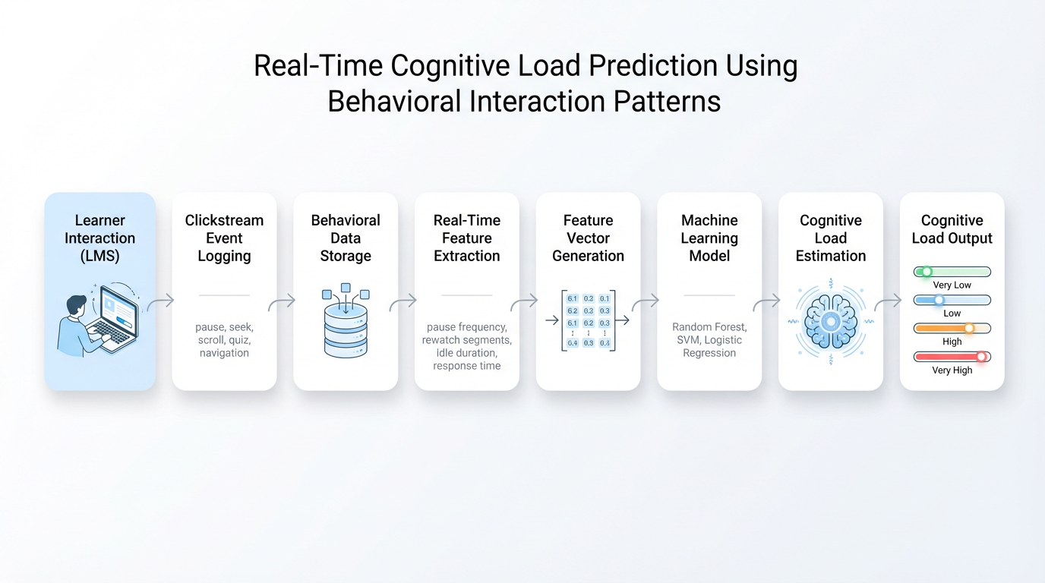
Real-time Cognitive Load Prediction
System Overview of Real-time Cognitive Load Prediction
Modular learning analytics architecture
Behavioral data collected from learning platform
Shared data pipeline, central database
Feature extraction from interaction logs
Real-time cognitive load prediction module
Machine learning classification model
Multi-level cognitive load output
Dependencies & Common Components
Web-based learning interface (interaction logging)
Shared data pipeline for behavioral logs
Central database (MySQL / relational DB)
Machine learning libraries (Python, Scikit-learn)
Adaptive learning support module
REST / API communication between modules
IT22089786 | Subasinghe M.H.R.I. |R26-SE-004
Notes:
[1] G. Pal, K. Atkinson, and G. Li, “Real-time user clickstream behavior analysis based on Apache Storm streaming,” Electronic Commerce Research, vol. 23, no. 4, pp. 1829–1859, 2023.
[2] T. Weiß and T. Pfeiffer, “Consumer Decisions in Virtual Commerce Predict Good Help-Timing,” 2024.
[3] Y. Yi and X. Wu, “Cognitive Load Early Warning Based on Behavioral Data,” in Proc. Int. Conf. Big Data Anal. Artificial Intelligence Applications, 2025.
[5] M. Suryani et al., “Role, Methodology, and Measurement of Cognitive Load in Computer Science and Information Systems Research,” IEEE Access, vol. 12, pp. 138096–138115, 2024.

Slide 19

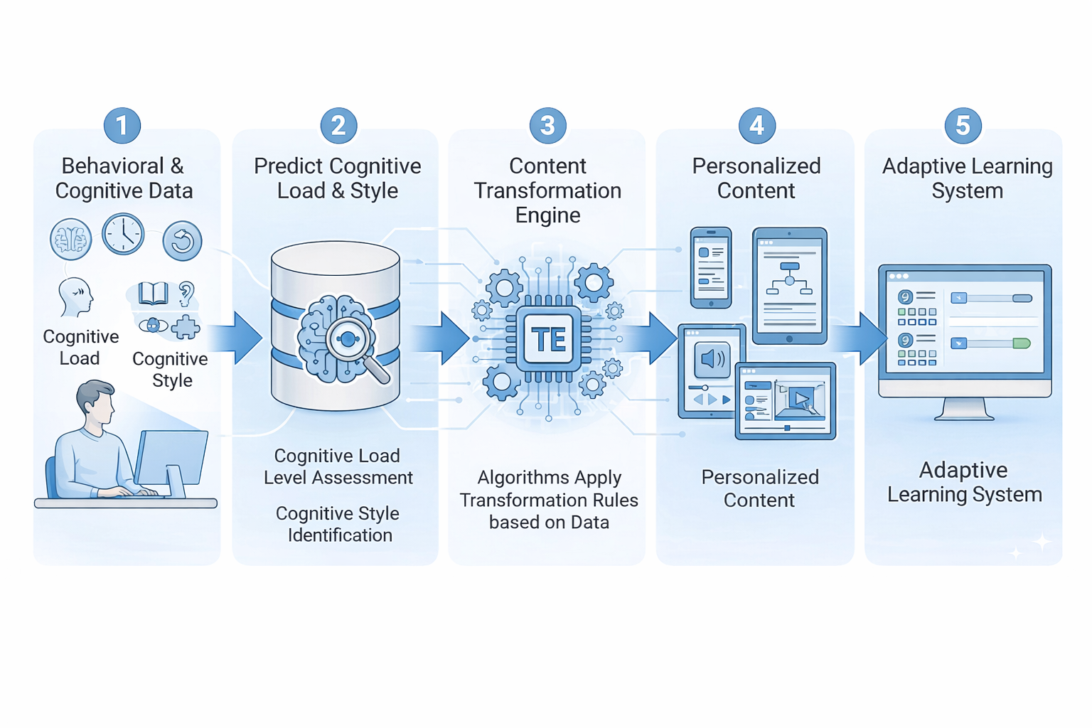
IT22166074 | Jayasinghe j m s n
Cognitive-Adaptive Content Personalization Engine (CACPE)
Contribution to the Overall System
Resource Upload: Upload structured learning materials (PDFs, PPTs, images, videos).
Content Processing: Extract and clean content.
Knowledge Base: Store chunked learning content.
Prompt Builder (RAG): Combine learner profile, cognitive style, load, and knowledge.
Content Generation: Generate personalized content using GPT-4.
Cognitive Load Optimization: Adapt content to reduce learner overload.
IT22166074| Jayasinghe J.M.S.N. | R26-SE-004
Notes:
[1] T. Kabudi, I. Pappas, and D. H. Olsen, “AI-enabled adaptive learning systems: A systematic mapping of the literature,” Comput. Educ. Artif. Intell., vol. 2, Art. no. 100017, 2021. doi: 10.1016/j.caeai.2021.100017.
[2] J. J. Y. Lim et al., “Learning in Context: Personalizing Educational Content with Large Language Models to Enhance Student Learning,” [Publication Title], vol. 1, no. 1, pp. 1–19, Sep. 2025. doi: 10.1145/XXXXXXXXXXXXX.
[3] L. Nouraei Yeganeh, Y. Chen, N. S. Fenty, A. Simpson, and M. Hatami, “STREAM: A Semantic Transformation and Real-Time Educational Adaptation Multimodal Framework in Personalized Virtual Classrooms,” Future Internet, vol. 17, no. 12, Art. no. 564, Dec. 2025. doi: 10.3390/fi17120564.
[4] W. Hu and Z. Shao, “Design and evaluation of a GenAI-based personalized educational content system tailored to personality traits and emotional responses for adaptive learning,” Comput. Hum. Behav. Rep., vol. 19, Art. no. 100735, 2025. doi: 10.1016/j.chbr.2025.100735.
[5] Z. Hu, “A method for generating personalized learning content based on AIGC,” Sustain. Futur., vol. 7, Art. no. 100735, 2025. doi: 10.1016/j.sftr.2025.100735.
[6] B. L. Reddy, Nirmala, V. Lathika, M. Vidhyasree, V. Manimegalai, and K. Kavya, "Personalized Learning Systems Using AI for Adaptive Educational Content Delivery Based on Reinforcement Learning Algorithms," in 2025 3rd Int. Conf. Commun. Security Artif. Intell. (ICCSAI), 2025, pp. 960–964. doi: 10.1109/ICCSAI64074.2025.11064584.
[7] B. Ogunleye, O. S. Okonkwo, O. O. Ajayi, O. E. Olaniyi, S. O. Oladipo, and T. A. Adeyemi, "Artificial intelligence in education: A review of personalized learning and educational technology," GSC Adv. Res. Rev., vol. 18, no. 2, pp. 261–271, 2024. doi: 10.30574/gscarr.2024.18.2.0062.
[8] M. Y. Al Balushi and A. S. Al Harthi, "Adaptive Learning Pathways: Advancing Personalization in Online Education Platforms," Int. J. Virtual Pers. Learn. Environ., vol. 13, no. 1, pp. 1–15, 2023. doi: unavailable.

Slide 20
Cognitive-Adaptive Content Personalization Engine (CACPE)
Problem Statement
Statistical Evidence
Many e-learning systems use a one-size-fits-all approach.
They ignore cognitive style, learner profile, and cognitive load.
This causes cognitive overload and low learning effectiveness.
Student Performance: Adaptive learning improves scores by ~15%.
Instructional Effectiveness: AI personalization (20.26%) vs traditional methods (10.04%).
Dropout Reduction: 24% → 12% with adaptive systems.
Learner Engagement: 65% → 92% with intelligent models.
Learning Efficiency: Time-to-mastery reduced from 12h → 6h.
IT22166074| Jayasinghe J.M.S.N. | R26-SE-004
Notes:
[4] W. Hu and Z. Shao, “Design and evaluation of a GenAI-based personalized educational content system tailored to personality traits and emotional responses for adaptive learning,” Comput. Hum. Behav. Rep., vol. 19, Art. no. 100735, 2025. doi: 10.1016/j.chbr.2025.100735.
[5] Z. Hu, “A method for generating personalized learning content based on AIGC,” Sustain. Futur., vol. 7, Art. no. 100735, 2025. doi: 10.1016/j.sftr.2025.100735.
[6] B. L. Reddy, Nirmala, V. Lathika, M. Vidhyasree, V. Manimegalai, and K. Kavya, "Personalized Learning Systems Using AI for Adaptive Educational Content Delivery Based on Reinforcement Learning Algorithms," in 2025 3rd Int. Conf. Commun. Security Artif. Intell. (ICCSAI), 2025, pp. 960–964. doi: 10.1109/ICCSAI64074.2025.11064584.
[8] M. Y. Al Balushi and A. S. Al Harthi, "Adaptive Learning Pathways: Advancing Personalization in Online Education Platforms," Int. J. Virtual Pers. Learn. Environ., vol. 13, no. 1, pp. 1–15, 2023. doi: unavailable.

Slide 21
Cognitive-Adaptive Content Personalization Engine (CACPE)
Existing Systems
Research Gap
Standard LMS
Examples: Blackboard, Moodle, Canvas
Focus: Content delivery and course management
Limitation: Little personalization; no adaptation to learner profile or cognitive load
Commercial AI Learning Platforms
Examples: Khan Academy, Duolingo, ALEKS, Knewton
Focus: Adaptive learning using performance data
Limitation: Limited consideration of cognitive style and real-time cognitive load
Research Frameworks
Examples: STREAM, PAGE, Tamaxtil, ACPLOLS
Focus: Adaptation using factors like modality, personality, or learning styles
Limitation: Usually consider only one learner factor, not multiple together
1.Core Gap – No Integrated Personalization:
Existing systems do not combine key learner factors in a single adaptive model:
Cognitive Style
Real-Time Cognitive Load
Academic Profile
2.Psychological Blind Spot:
Most adaptive learning systems rely on quiz performance, ignoring mental workload and processing preferences.
3.Lack of Multidimensional Integration:
Research exists separately for cognitive load detection, learning styles (ACPLOLS), and personality models (PAGE), but no unified AI system integrates them.
IT22166074| Jayasinghe J.M.S.N. | R26-SE-004
Notes:
[2] J. J. Y. Lim et al., “Learning in Context: Personalizing Educational Content with Large Language Models to Enhance Student Learning,” [Publication Title], vol. 1, no. 1, pp. 1–19, Sep. 2025. doi: 10.1145/XXXXXXXXXXXXX.

Slide 22

Cognitive-Adaptive Content Personalization Engine (CACPE)
Research Novelty
Develop an AI-based adaptive learning system that generates personalized content using:
Cognitive Style
User Academic Profile
Real-Time Cognitive Load
Goal: Improve learning performance and reduce cognitive overload.
Extract content from PDFs, PPTs, images, and videos
Clean & preprocess text for LLM input
Store knowledge chunks in a knowledge base
Generate personalized content using RAG , GPT-4
Main Objective
Main Innovation:
Dynamic within-lesson content conversion based on User Profile, Cognitive Style, and Real-Time Cognitive Load.
Key Contributions:
Personalized Adaptation – content matches learner profile & style
Continuous Monitoring – cognitive load tracked and adjusted in real time
Content Processing Pipeline – extraction and cleaning of materials
AI Generation & Knowledge Base – GPT-4 and RAG with source traceability
Specific Objectives
IT22166074| Jayasinghe J.M.S.N. | R26-SE-004
Notes:
[1] T. Kabudi, I. Pappas, and D. H. Olsen, “AI-enabled adaptive learning systems: A systematic mapping of the literature,” Comput. Educ. Artif. Intell., vol. 2, Art. no. 100017, 2021. doi: 10.1016/j.caeai.2021.100017.
[2] J. J. Y. Lim et al., “Learning in Context: Personalizing Educational Content with Large Language Models to Enhance Student Learning,” [Publication Title], vol. 1, no. 1, pp. 1–19, Sep. 2025. doi: 10.1145/XXXXXXXXXXXXX.
[3] L. Nouraei Yeganeh, Y. Chen, N. S. Fenty, A. Simpson, and M. Hatami, “STREAM: A Semantic Transformation and Real-Time Educational Adaptation Multimodal Framework in Personalized Virtual Classrooms,” Future Internet, vol. 17, no. 12, Art. no. 564, Dec. 2025. doi: 10.3390/fi17120564.
[4] W. Hu and Z. Shao, “Design and evaluation of a GenAI-based personalized educational content system tailored to personality traits and emotional responses for adaptive learning,” Comput. Hum. Behav. Rep., vol. 19, Art. no. 100735, 2025. doi: 10.1016/j.chbr.2025.100735.
[5] Z. Hu, “A method for generating personalized learning content based on AIGC,” Sustain. Futur., vol. 7, Art. no. 100735, 2025. doi: 10.1016/j.sftr.2025.100735.
[6] B. L. Reddy, Nirmala, V. Lathika, M. Vidhyasree, V. Manimegalai, and K. Kavya, "Personalized Learning Systems Using AI for Adaptive Educational Content Delivery Based on Reinforcement Learning Algorithms," in 2025 3rd Int. Conf. Commun. Security Artif. Intell. (ICCSAI), 2025, pp. 960–964. doi: 10.1109/ICCSAI64074.2025.11064584.
[7] B. Ogunleye, O. S. Okonkwo, O. O. Ajayi, O. E. Olaniyi, S. O. Oladipo, and T. A. Adeyemi, "Artificial intelligence in education: A review of personalized learning and educational technology," GSC Adv. Res. Rev., vol. 18, no. 2, pp. 261–271, 2024. doi: 10.30574/gscarr.2024.18.2.0062.
[8] M. Y. Al Balushi and A. S. Al Harthi, "Adaptive Learning Pathways: Advancing Personalization in Online Education Platforms," Int. J. Virtual Pers. Learn. Environ., vol. 13, no. 1, pp. 1–15, 2023. doi: unavailable.
[9] Z. C. da Silva, A. R. Pimentel, and L. R. Ferreira, "Learning Objects Content Presentation Adaptation Model Considering Students' Learning Styles," Int. J. Educ. Pedagog. Sci., vol. 15, no. 8, pp. 783–790, 2021. doi: 10.5281/zenodo.10012193.

Slide 23
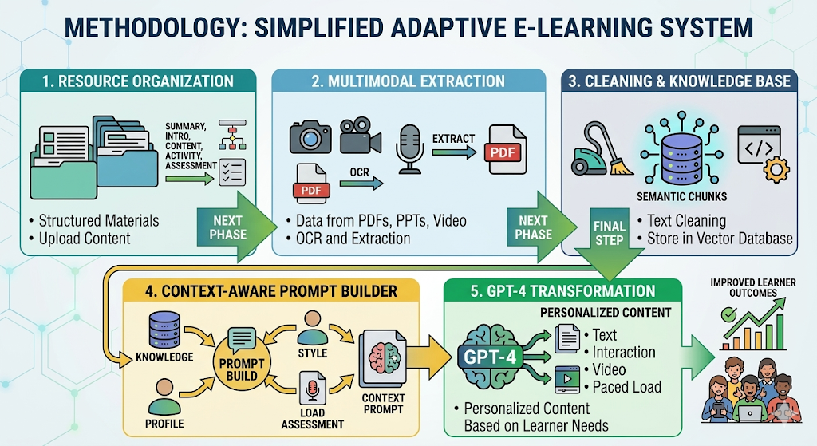
Cognitive-Adaptive Content Personalization Engine (CACPE)
Methodology
Domain Knowledge Used
Phase 1 – Resource Organization (Extended ACPLOLS)
Upload learning materials structured as Summary, Introduction, Content, Activity, Assessment, including diagrams and images.
Phase 2 – Multimodal Extraction
Extract data from PDFs, PPTs, videos, and images using extraction and OCR tools.
Phase 3 – Cleaning & Knowledge Base
Clean text and store semantic knowledge chunks in a vector database.
Phase 4 – Context-Aware Prompt Builder (RAG)
Combine user profile, cognitive style, cognitive load, and retrieved knowledge.
Phase 5 – GPT-4 Content Transformation
Generate personalized instructional content based on learner needs.
Design-Based Research (DBR)
Cognitive Theory of Multimedia Learning (CTML)
ACPLOLS Adaptive Learning Method
Retrieval-Augmented Generation (RAG)
Universal Design for Learning (UDL)
IT22166074| Jayasinghe J.M.S.N. | R26-SE-004
Notes:
[1] T. Kabudi, I. Pappas, and D. H. Olsen, “AI-enabled adaptive learning systems: A systematic mapping of the literature,” Comput. Educ. Artif. Intell., vol. 2, Art. no. 100017, 2021. doi: 10.1016/j.caeai.2021.100017.
[2] J. J. Y. Lim et al., “Learning in Context: Personalizing Educational Content with Large Language Models to Enhance Student Learning,” [Publication Title], vol. 1, no. 1, pp. 1–19, Sep. 2025. doi: 10.1145/XXXXXXXXXXXXX.
[3] L. Nouraei Yeganeh, Y. Chen, N. S. Fenty, A. Simpson, and M. Hatami, “STREAM: A Semantic Transformation and Real-Time Educational Adaptation Multimodal Framework in Personalized Virtual Classrooms,” Future Internet, vol. 17, no. 12, Art. no. 564, Dec. 2025. doi: 10.3390/fi17120564.
[4] W. Hu and Z. Shao, “Design and evaluation of a GenAI-based personalized educational content system tailored to personality traits and emotional responses for adaptive learning,” Comput. Hum. Behav. Rep., vol. 19, Art. no. 100735, 2025. doi: 10.1016/j.chbr.2025.100735.
[5] Z. Hu, “A method for generating personalized learning content based on AIGC,” Sustain. Futur., vol. 7, Art. no. 100735, 2025. doi: 10.1016/j.sftr.2025.100735.
[6] B. L. Reddy, Nirmala, V. Lathika, M. Vidhyasree, V. Manimegalai, and K. Kavya, "Personalized Learning Systems Using AI for Adaptive Educational Content Delivery Based on Reinforcement Learning Algorithms," in 2025 3rd Int. Conf. Commun. Security Artif. Intell. (ICCSAI), 2025, pp. 960–964. doi: 10.1109/ICCSAI64074.2025.11064584.
[7] B. Ogunleye, O. S. Okonkwo, O. O. Ajayi, O. E. Olaniyi, S. O. Oladipo, and T. A. Adeyemi, "Artificial intelligence in education: A review of personalized learning and educational technology," GSC Adv. Res. Rev., vol. 18, no. 2, pp. 261–271, 2024. doi: 10.30574/gscarr.2024.18.2.0062.
[8] M. Y. Al Balushi and A. S. Al Harthi, "Adaptive Learning Pathways: Advancing Personalization in Online Education Platforms," Int. J. Virtual Pers. Learn. Environ., vol. 13, no. 1, pp. 1–15, 2023. doi: unavailable.

Slide 24
Cognitive-Adaptive Content Personalization Engine (CACPE)
Key Technologies
Validation & Evaluation
Multimodal Extraction: pdfminer, BeautifulSoup, pydub, OpenVoice, Tesseract OCR
Text Processing & NLP: clean-text, pyspellchecker, BERT
Knowledge Management: Vector Database, Embedding Models
Generative AI Model: GPT-4 Large Language Model
Semantic Knowledge Storage: Vector Database with Embedding Models
Core Metric – Cognitive Load Reduction: Verify that personalized resources reduce cognitive load over time.
Expert Review: Evaluate accuracy, clarity, and personalization quality.
Learner Evaluation: A/B testing with pre–post tests for learning improvement.
User Feedback: UEQ surveys and interviews for usability and satisfaction.
Data Availability Security & Ethical Clearance
Data Sourcing: Materials collected using the ACPLOLS structure.
Privacy: Student data protected via encryption and anonymization.
IT22166074| Jayasinghe J.M.S.N. | R26-SE-004
Notes:
[1] T. Kabudi, I. Pappas, and D. H. Olsen, “AI-enabled adaptive learning systems: A systematic mapping of the literature,” Comput. Educ. Artif. Intell., vol. 2, Art. no. 100017, 2021. doi: 10.1016/j.caeai.2021.100017.
[2] J. J. Y. Lim et al., “Learning in Context: Personalizing Educational Content with Large Language Models to Enhance Student Learning,” [Publication Title], vol. 1, no. 1, pp. 1–19, Sep. 2025. doi: 10.1145/XXXXXXXXXXXXX.
[3] L. Nouraei Yeganeh, Y. Chen, N. S. Fenty, A. Simpson, and M. Hatami, “STREAM: A Semantic Transformation and Real-Time Educational Adaptation Multimodal Framework in Personalized Virtual Classrooms,” Future Internet, vol. 17, no. 12, Art. no. 564, Dec. 2025. doi: 10.3390/fi17120564.
[4] W. Hu and Z. Shao, “Design and evaluation of a GenAI-based personalized educational content system tailored to personality traits and emotional responses for adaptive learning,” Comput. Hum. Behav. Rep., vol. 19, Art. no. 100735, 2025. doi: 10.1016/j.chbr.2025.100735.
[5] Z. Hu, “A method for generating personalized learning content based on AIGC,” Sustain. Futur., vol. 7, Art. no. 100735, 2025. doi: 10.1016/j.sftr.2025.100735.
[6] B. L. Reddy, Nirmala, V. Lathika, M. Vidhyasree, V. Manimegalai, and K. Kavya, "Personalized Learning Systems Using AI for Adaptive Educational Content Delivery Based on Reinforcement Learning Algorithms," in 2025 3rd Int. Conf. Commun. Security Artif. Intell. (ICCSAI), 2025, pp. 960–964. doi: 10.1109/ICCSAI64074.2025.11064584.
[7] B. Ogunleye, O. S. Okonkwo, O. O. Ajayi, O. E. Olaniyi, S. O. Oladipo, and T. A. Adeyemi, "Artificial intelligence in education: A review of personalized learning and educational technology," GSC Adv. Res. Rev., vol. 18, no. 2, pp. 261–271, 2024. doi: 10.30574/gscarr.2024.18.2.0062.
[8] M. Y. Al Balushi and A. S. Al Harthi, "Adaptive Learning Pathways: Advancing Personalization in Online Education Platforms," Int. J. Virtual Pers. Learn. Environ., vol. 13, no. 1, pp. 1–15, 2023. doi: unavailable.

Slide 25
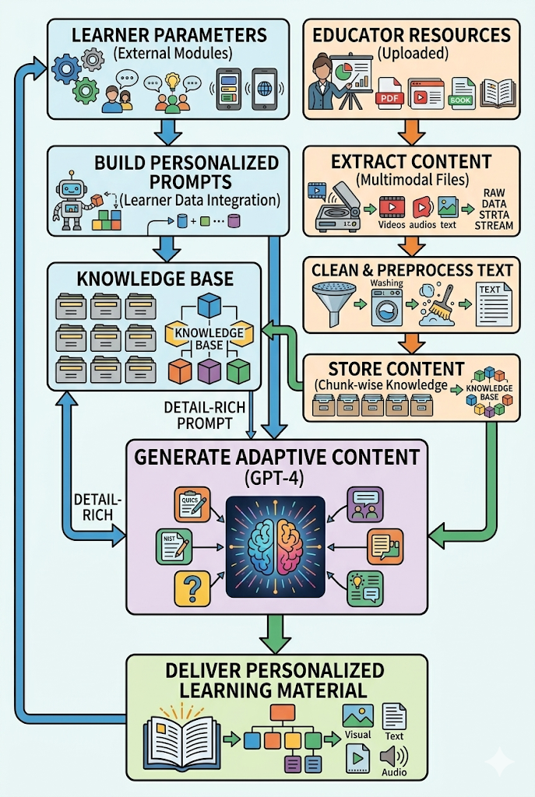
Cognitive-Adaptive Content Personalization Engine (CACPE)
System Overview of Individual Component
Receive learner parameters from external modules
Accept educator-uploaded learning resources
Extract content from multimodal files
Clean and preprocess extracted text
Store processed content in chunk-wise knowledge base
Build personalized prompts using learner data
Generate adaptive content with GPT-4
Deliver personalized learning material
Dependencies & Common Component
Cognitive Load Detection Component
Cognitive Style Detection Component
User Profile Component
GPT-4 Language Model
Content Processing Libraries (pdfminer, BeautifulSoup, OCR, pydub, OpenVoice)
Text Processing Libraries (clean-text, pyspellchecker)
IT22166074| Jayasinghe J.M.S.N. | R26-SE-004

Slide 26

IT22055712 | Dilshan W.G.W
Student Must add a professional photo to this cage
Teacher-Centered Explainable AI Framework for Content Adaptation
Contribution for the Overall System
This research introduces an Explainable AI (XAI) module that explains why learning content is adapted for students.
The module:
• Uses LIME and SHAP to analyze which student features influence adaptation decisions.
• Generates teacher-friendly explanations for AI decisions.
• Integrates outputs from cognitive load, cognitive style, and content adaptation modules.
• Provides class-level cognitive load visualization using boxplots to help teachers monitor students.
IT22055712 | Dilshan W.G.W | R26-SE-004

Slide 27
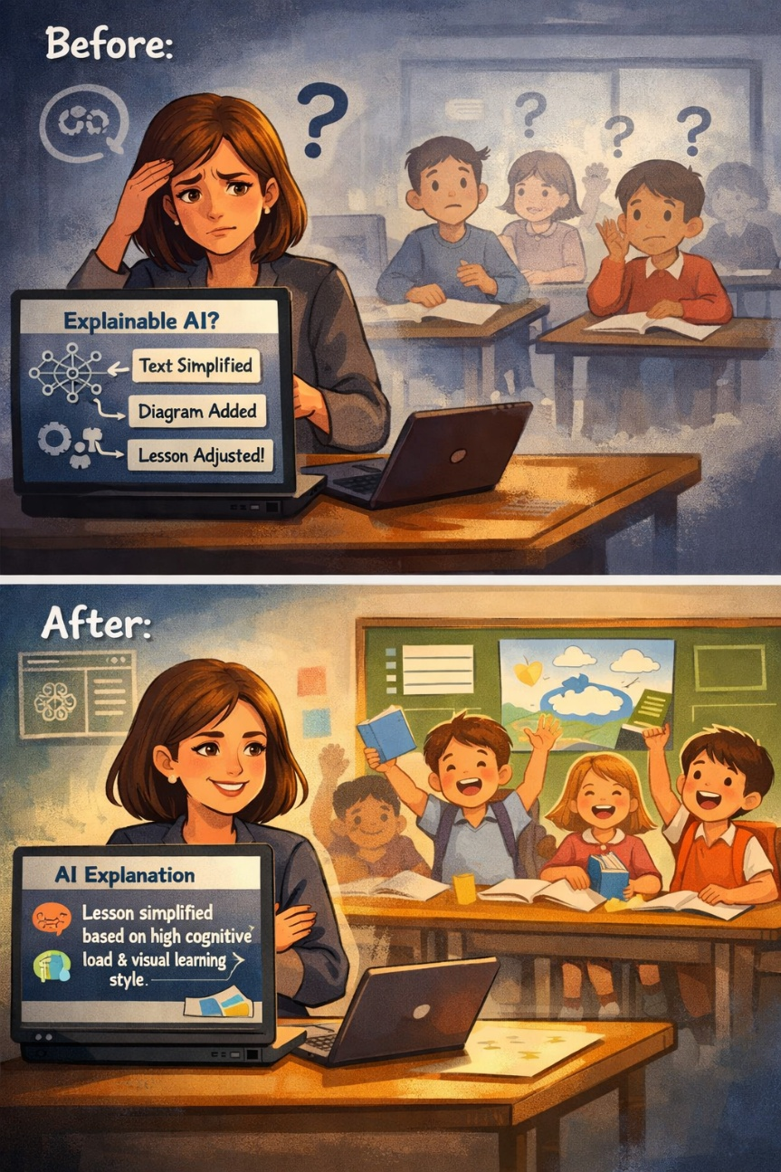
Teacher-Centered Explainable AI Framework for Content Adaptation
Problem Statement
Adaptive Learning Systems personalize learning using AI and student behavioral data
However, these systems act as black boxes, meaning teachers cannot understand why content was adapted
This reduces teacher trust, transparency, and Educational verification

Slide 28
Teacher-Centered Explainable AI Framework for Content Adaptation
Existing System / Related Works
Existing System Category | Representative Name / Research | What it Covers (Focus Area) | The Gap (What's Missing)
1. Teacher-Facing XAI (Explainable AI) | Wang et al. (2024) | Explains classroom dialogue to teachers (e.g., student discussion patterns). | Does NOT explain content adaptation decisions.
2. Student-Facing XAI | iLLuMinaTE (Swamy et al., 2025) | Explains assessment feedback directly to students. | Teachers are left out of the loop; not designed for teacher understanding.
3. Teacher Dashboards | Lee-Cultura et al. (2024) | Visualizes student data (e.g., attention, performance) for teachers. | Shows "what" is happening, but NOT "why" the AI adapted the content.
4. AI Explanations for Dashboards | RIXA (Fraunhofer, 2025) | Explains dashboard visuals/data using AI (e.g., what a chart means). | Explains the data, but NOT the Educational decisions behind content adaptation.

Slide 29
Teacher-Centered Explainable AI Framework for Content Adaptation
Research Gap
No system explains AI-driven content adaptation decisions to teachers
No research combines cognitive load + cognitive style explanations for teachers
Proposed Novelty
• Teacher-facing XAI for explaining content adaptation decisions
• Integration of cognitive load + cognitive style explanations
• Hybrid LIME–SHAP explanation aggregation for stable explanations
• Educational explanation prioritization mechanism
• Human-readable explanations for teachers
• Boxplot visualizations for class-level insights

Slide 30
Teacher-Centered Explainable AI Framework for Content Adaptation
Main Objective
To develop an Explainable AI module that explains content adaptation decisions to teachers in a human-readable format, improving teacher understanding and trust.
Sub Objectives
To apply explainable AI techniques (LIME and SHAP) to identify which student characteristics influence content adaptation decisions.
To develop a Hybrid Explanation Aggregation mechanism that combines LIME and SHAP outputs to improve explanation stability.
To design an educational explanation prioritization mechanism that selects the most meaningful explanatory factors for teachers.
To generate teacher-friendly natural language explanations based on the prioritized explanatory factors.
To design a teacher dashboard that presents individual student explanations and class-level visualizations such as boxplots.

Slide 31
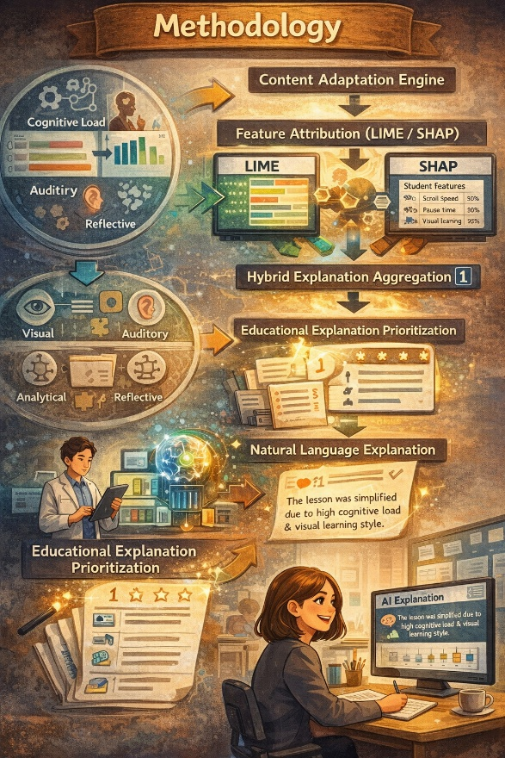
Teacher-Centered Explainable AI Framework for Content Adaptation
Methodology
Domain Knowledge
Cognitive Load Theory (CLT)
Cognitive Style Theory
Explainable Artificial Intelligence (XAI)
Key Technologies
Python
LIME / SHAP Libraries
Flask / FastAPI
React.js
Chart.js / D3.js
REST APIs
Student Behavioral Data
(Cognitive Load + Cognitive Style)
↓
Content Adaptation Engine
↓
Feature Attribution (LIME / SHAP)
↓
Hybrid Explanation Aggregation[1]
↓
Educational Explanation Prioritization
↓ (scrool speed, pause time ,
error rate, attention score etc)
Natural Language Explanation
↓
Teacher Dashboard Visualization
[1]Salih et al., 2024 – SHAP & LIME Paper

Slide 32
Teacher-Centered Explainable AI Framework for Content Adaptation
Validation and Evaluation of Proposed Solution
The proposed XAI module will be evaluated using quantitative and qualitative methods.
Participants
10–15 teachers from Sri Lankan schools/universities
50 university student
Minimum 2 years teaching experience
Evaluation Methods
Pre-test & post-test questionnaires (teacher understanding)
System Usability Scale (SUS) for usability
Trust questionnaire (Likert scale)
Semi-structured interviews for feedback
Data, Security & Ethics
Data Sources
Cognitive Load data (Member 1)
Cognitive Style data (Member 2)
Security & Ethics
Student data anonymized before storage
Secure data transmission using HTTPS

Slide 33
Adaptive Cognitive Load Prediction System for Online Learning using Behavioral Interaction
Ability of Commercialization
Target Market / Customer / Value
Can be integrated with LMS platforms
Suitable for universities, schools, online learning providers
No special hardware required → low cost deployment
Can support adaptive learning and analytics systems
Useful for Undergraduate, EdTech companies and training platforms
Target market:
Universities
Online learning platforms
Training institutes
EdTech companies
Customer profile:
LMS administrators
Teachers / instructors
Educational companies
Value proposition:
Real-time learner monitoring
Improved learning performance
Adaptive content support
Low-cost behavior-based prediction
IP Rights:
Software system design
Data processing pipeline
Can be protected as research software / IP
Investment
Cost includes:
Software development labour
Server / database hosting
ML model training & testing
Learning platform integration
Cost recovery:
Subscription model for institutions
License per LMS / per user
Cloud-based service pricing
Premium analytics features
Notes:
[10] M. Cai and C. D. Epp, “Modeling Cognitive Load and Affect to Support Adaptive Online Learning,” in Educational Data Mining Conference, 2022.
[14] I. H. Ajayi and E. Avksentyeva, “Machine Learning Methods for Predicting Cognitive Load Using Eye-Tracking Data,” Pakistan Journal of Life and Social Sciences, 2024.
[12] J. V. R. Jaisoorya et al., “Social Network-Integrated Machine Learning for Prediction Models,” 2023.
[5] M. Suryani et al., “Role, Methodology, and Measurement of Cognitive Load in Computer Science and Information Systems Research,” IEEE Access, vol. 12, pp. 138096–138115, 2024.

Slide 34
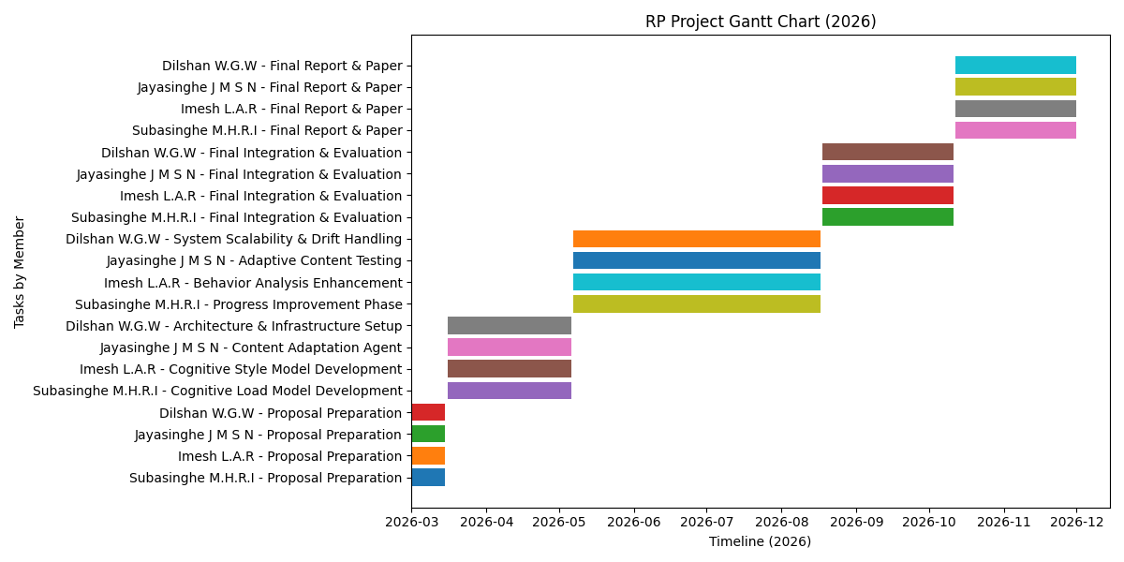
Adaptive Cognitive Load Prediction System for Online Learning Using Behavioral Patterns
Gannt Chart

Slide 35
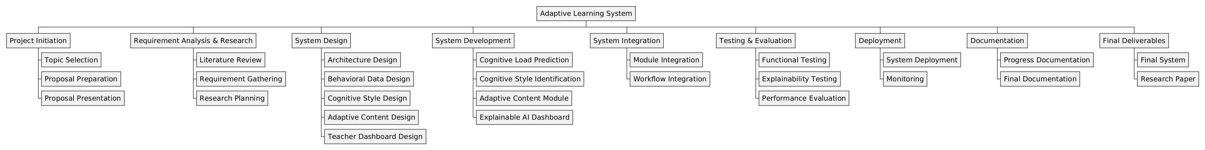
Work breakdown structure
Adaptive Cognitive Load Prediction System for Online Learning Using Behavioral Patterns

Slide 36
References
N. Herbig et al., “Investigating Multi-Modal Measures for Cognitive Load Detection in E-Learning,” in ACM UMAP, 2020.
T. Weiß and T. Pfeiffer, “Consumer Decisions in Virtual Commerce Predict Good Help-Timing,” 2024.
A. Siddique et al., “Developing Adaptive E-Learning Environment Using Cognitive Parameters,” Journal of Educational Computing Research, 2018.
Sweller, “Cognitive Load Theory,” Psychology of Learning and Motivation, vol. 55, pp. 37–76, 2011.
M. I. Ahmad et al., “A Framework to Estimate Cognitive Load Using Physiological Data,” Personal and Ubiquitous Computing, vol. 27, no. 6, pp. 2027–2041, 2023.
H. M. Šola et al., “AI Eye-Tracking Technology for Managing Cognitive Load in Online Learners,” Education Sciences, vol. 14, no. 9, 2024.
N. Herbig et al., “Investigating Multi-Modal Measures for Cognitive Load Detection in E-Learning,” in ACM UMAP, 2020.
I. H. Ajayi and E. Avksentyeva, “Machine Learning Methods for Predicting Cognitive Load Using Eye-Tracking Data,” Pakistan Journal of Life and Social Sciences, 2024.
J. V. R. Jaisoorya et al., “Social Network-Integrated Machine Learning for Prediction Models,” 2023.
Z. C. da Silva, A. R. Pimentel, and L. R. Ferreira, "Learning Objects Content Presentation Adaptation Model Considering Students' Learning Styles," Int. J. Educ. Pedagog. Sci., vol. 15, no. 8, pp. 783–790, 2021. doi: 10.5281/zenodo.10012193.
F. L. Gambo, G. M. Wajiga, E. J. Garba, A. A. Abdullahi, and D. B. Bisandu, "A Deep Learning Solution for Learning Style Detection using Cognitive - Affective Features," Advances in Communication Technology, Computing and Engineering, pp. 32–43, 2021.
C. Lwande, L. Muchemi, and R. Oboko, "Identifying learning styles and cognitive traits in a learning management system," Heliyon, vol. 7, no. 7, p. e07701, 2021.

