Slide 1
Adaptive Cognitive Load and Style Prediction System for Online Learning Using Behavioral Patterns
R26-SE-004

Slide 2
Problem and Overall Solution
The problem
Current online learning systems do not effectively adapt to individual learners’ cognitive styles, study behaviors, and cognitive load, which can lead to inefficient learning and student frustration.
Impact
Students may experience overload and frustration
Instructors cannot detect learner difficulty in real time
Institutions lack intelligent adaptive support
Stakeholders
Students
Teachers / Tutors
Universities / LMS providers
Researchers
Overall Solution
A non-intrusive adaptive learning framework that uses behavioral interaction data to predict cognitive load and support personalized learning decisions.
R26-SE-004

Slide 3

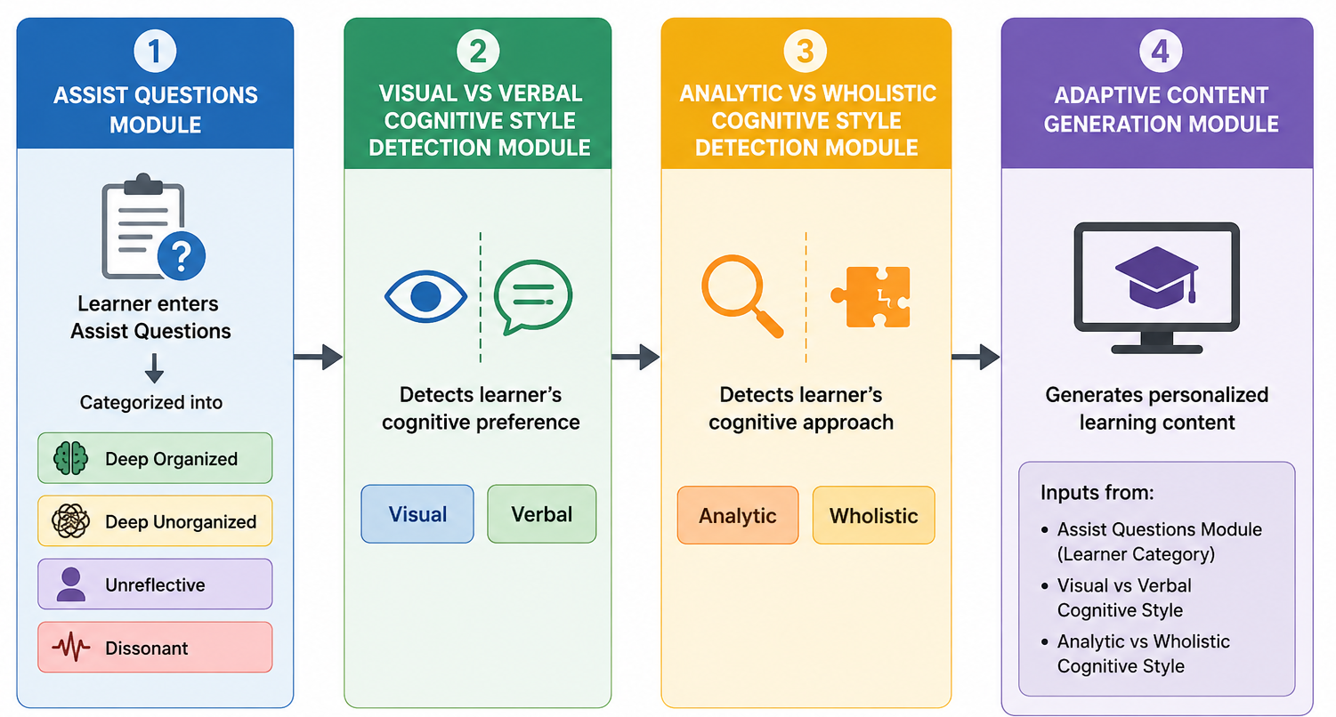
IT22281364 | L A R IMESH
Adaptive Learner Profiling and Cognitive Style Detection
IT22281364 | Imesh L.A.R |R26-SE-004

Slide 4
Adaptive Learner Profiling and Cognitive Style Detection
Sub-Problem
Difficulty in accurately identifying how learners learn in e-learning environments, including their learner profile such as organized, unorganized, unreflective, or dissonant, and their cognitive style such as Visual, Verbal, Analytic, or Wholistic.
Proposed Solution
Develop an adaptive learner profiling system that identifies the learner profile using assistive questions and detects cognitive styles using gaze tracking, cursor behaviour, GEFT questions, and learner interaction data.
Core Technical Contribution​
Learner profile module using rule-based questions.
Visual vs Verbal module using split-screen behaviour data and Random Forest.
Analytic vs Wholistic module using GEFT responses, behaviour data, and Random Forest.
Developed the system using React, FastAPI, and Google Colab for interface development, backend processing, and model training.
R26-SE-004

Slide 5
Adaptive Learner Profiling and Cognitive Style Detection
Implementation Checklist (PP1 Progress)
Completed
Built the end-to-end flow for learner profiling and cognitive style detection
Implemented MediaPipe-based gaze tracking
Implemented cursor behaviour tracking and other behavioural data collection
Developed and integrated the cognitive style prediction modules
Future Improvements
Replace the current rule-based learner profile module with a machine learning model
Update learner profiles dynamically using course completion behaviour
Train the models using real user data instead of only synthetic data
User Feedback on Prototype
Users suggested improving UI design and responsiveness for smoother interaction
Some users experienced slight delays in the GEFT module when moving from one question to another
Some female users were uncomfortable using the webcam-based gaze tracking feature
Users suggested adding optional webcam enable/disable controls for better comfort and usability
R26-SE-004

Slide 6

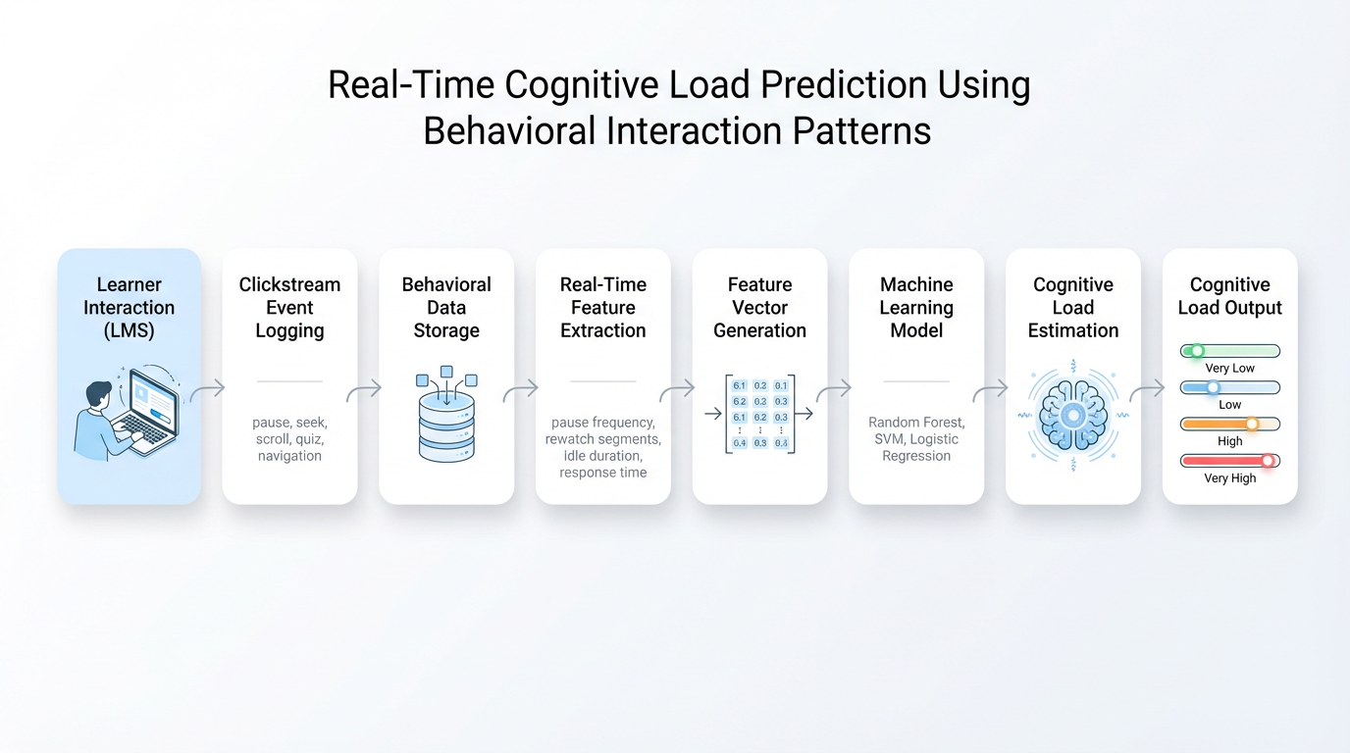
IT22089786 | Subasinghe M.H.R.I.
Real-time Cognitive Load Prediction
IT22089786 | SubasiNghe M.H.R.I |R26-SE-004
Notes:
Papers –
https://mysliit.sharepoint.com/:f:/s/RPProjectGroup_lqmyol/IgC_KHYzTPVxT67kGwWusuO_AbalE-p5uYqT-VCYsZkyJdM?e=VxXtjF
Gap Finding Matrix –
https://mysliit.sharepoint.com/:x:/s/RPProjectGroup_lqmyol/IQC2yyAwOayuTr0RbtUGfaeIAfbhhQMzz4wR_p3VjebvyKg?e=gQIo7k

Slide 7
Real-time Cognitive Load Prediction
Sub-Problem
Online learners may experience cognitive overload during video-based learning, but the system cannot identify their cognitive load in real time using learner behavior.
Proposed Solution
Develop a real-time cognitive load prediction model that collects learner behavioral patterns during video learning and predicts the learner’s cognitive load level.
Core Technical Contribution
Uses a Random Forest model to classify cognitive load levels.
Developed a real-time cognitive load prediction API.
Collects learner behavioral patterns during video-based learning.
Extracts features such as pause frequency, rewatch count, navigation count, idle duration, and time on content.
Predicts cognitive load as Very Low, Low, Medium, High, or Very High.
Displays predicted load, and raw event count.
Saves prediction records for later analysis and explainability.
Provides prediction outputs to LIME/SHAP and content adaptation components.
R26-SE-004

Slide 8
Real-time Cognitive Load Prediction
Implementation Checklist (PP1 Progress)
Completed
✅ Prediction model developed
✅ FastAPI prediction service implemented
✅ Video behavior tracking implemented
✅ Feature window generation implemented
✅ CourseDetail live prediction panel integrated
✅ Prediction records saved for explainability
Remaining
⬜ Collect real learner data
⬜ Retrain and validate with real data
⬜ Develop the cognitive load detection for content
adaptation area
⬜ Add questionnaire-based labels
⬜ Improve live panel and feature extraction
In Progress
🔄 Full-system testing
🔄 Explainability integration support
🔄 Dataset collection refinement
User Feedback on Prototype
Real learner behavior data should be collected through the prototype.
Cognitive load labels should be collected using a short questionnaire.
Prediction result should be clearly visible in the learning interface.
Need a clear method to collect the required dataset.
Reduce the latency for taking to prediction.
R26-SE-004

Slide 9

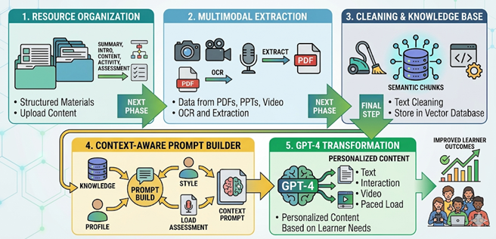
IT22166074 | Jayasinghe J. M. S. N.
Cognitive-Adaptive Content Personalization Engine (CACPE)
IT22166074 | Jayasinghe J.M.S.N. |R26-SE-004
6/11/2026

Slide 10
Cognitive-Adaptive Content Personalization Engine (CACPE)
Sub-Problem and Proposed Solution
Core Technical Contribution
Sub-Problem
Learners may experience high cognitive load when lesson materials are presented in a fixed format that does not match their cognitive style or current learning capacity
Proposed Solution
Develop an adaptive content conversion module that transforms educator-uploaded lesson materials into personalized learning content based on the learner’s cognitive load and cognitive style.
🔹Built a structured educator upload system for video, PPT, PDF, and images.
🔹Extracted lesson content automatically from uploaded files. 🔹Converted video/audio into text using speech-to-text.
🔹Extracted text from PPT and PDF materials.
🔹Stored extracted content as reusable knowledge chunks.
🔹Used one unified knowledge source for summaries, visuals, Q&A, and content conversion.
🔹Adapted lesson content based on learner profile, cognitive style, and cognitive load.
🔹Reduced hallucination by generating content only from uploaded lesson materials.
🔹Supported multiple outputs such as summaries, personalized explanations, visuals, and assistant responses.
IT22166074 | Jayasinghe J.M.S.N. |R26-SE-004
6/11/2026

Slide 11
Cognitive-Adaptive Content Personalization Engine (CACPE)
Implementation Checklist (PP1 Progress)
User Feedback on Prototype
Completed
✅Developed educator content upload.
✅Extracted content from PPT, PDF, video, and audio.
✅Converted extracted content into knowledge chunks.
✅Built content conversion based on cognitive style and load using
✅Used knowledge chunks to reduce hallucination.
✅Added cognitive style and load manually for testing.
In Progress
⬜Improving support for lengthy tutorials.
⬜Enhancing content conversion for larger structured lessons using Classifier.
⬜Improving adapted output quality and clarity.
Further Developments
🔄Connect with the cognitive load and style detector.
🔄 Replace manual input with automated component integration.
🔄 Improve output quality using multiple GPT responses.
🔄 Cross-check generated outputs and select the best one.
🔄 Add mid-video conversion suggestions when load is high.
🔄 Add end-video personalized conversion suggestions.
Avoid conversion prompts every 2 minutes.
Show prompts only at video middle and end.
Make the video screen larger.
Add full-screen option for personalized content.
Allow focus on video or personalized content separately.
Display images extracted from PDFs.
Show AI-generated visuals and mind maps.
Include both PDF images and generated visuals.
IT22166074 | Jayasinghe J.M.S.N. |R26-SE-004
6/11/2026

Slide 12

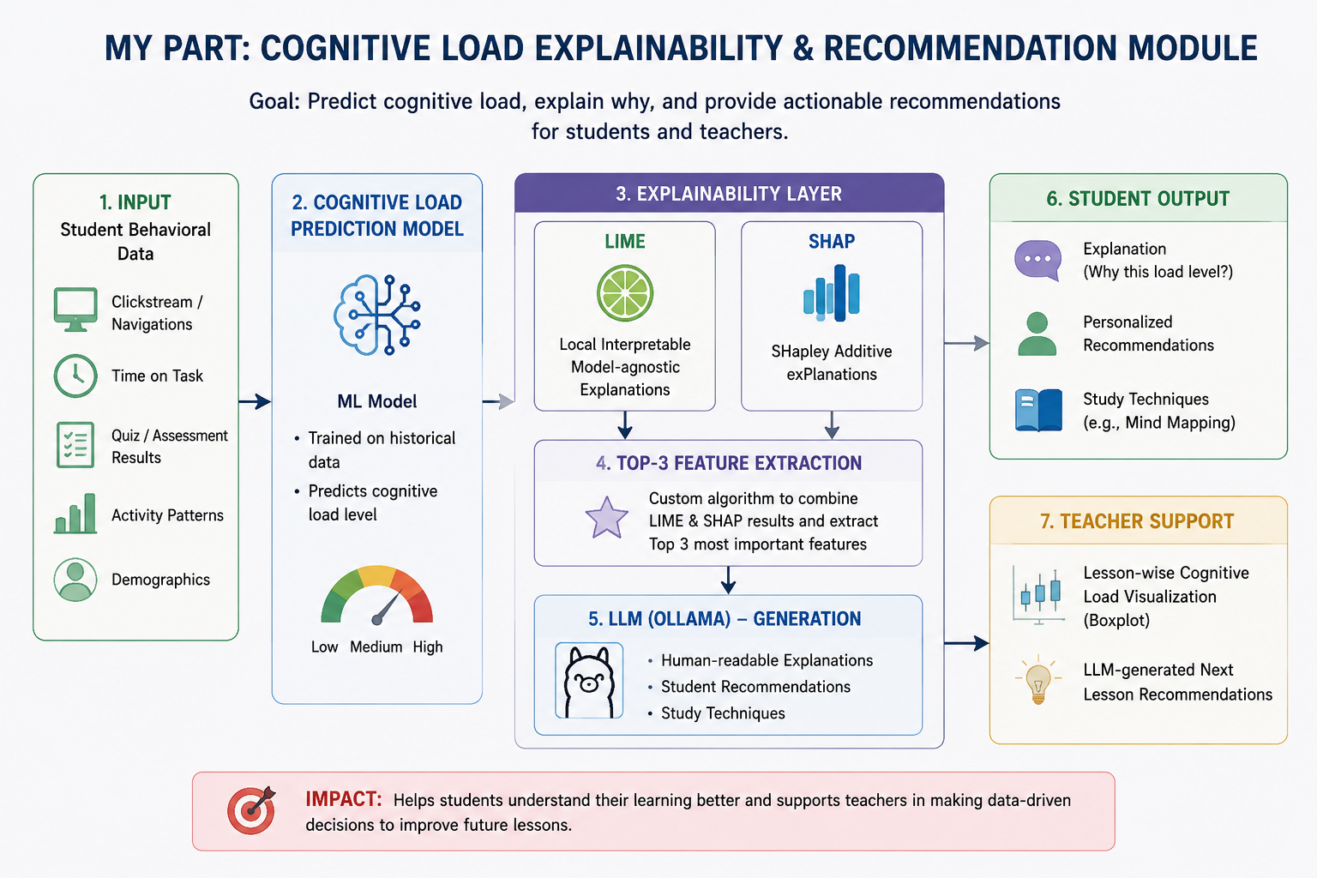
IT22055712 | Dilshan w.g.w
Student Must add a professional photo to this cage
Explainable Cognitive Insight Engine (ECIE)
It22055712 | Dilshan w.g.w|R26-SE-004

Slide 13
Explainable Cognitive Insight Engine (ECIE)
Sub-Problem and Proposed Solution
Sub-Problem
Lack of explainability in cognitive load prediction models
Students do not receive actionable guidance based on predictions
Teachers lack insights to understand why students struggle
No integration between prediction outputs and personalized learning support
Proposed Solution
Run LIME and SHAP in parallel to generate feature importance
Apply a custom algorithm to extract top 3 contributing factors
Use LLM (Ollama) to convert outputs into human-readable explanations
Generate personalized recommendations and study techniques
Provide teacher insights using lesson-level cognitive load visualization
Core Technical Contribution
Hybrid explainability approach combining LIME and SHAP
Custom top-3 feature selection algorithm for key factor identification
Integration of LLM (Ollama) for:
Human-readable explanations
Personalized recommendations
Study technique generation
MCQ generation
Student-level (guidance + practice)
Teacher-level (lesson insights +recommendations)
Visualization-driven insights using boxplot analysis
R26-SE-004

Slide 14
Explainable Cognitive Insight Engine (ECIE)
✅ Implementation Checklist (PP1 Progress)
🟢 Completed Tasks
✅ LIME & SHAP Integration for Explainability
✅ Top-3 Feature Extraction Algorithm Implemented
✅ Human-Readable Explanation Generation using LLM (Ollama)
✅ Personalized Student Recommendations Generated
✅ Study Technique Suggestions Provided (e.g., Mind Mapping)
✅ Lesson-wise Cognitive Load Visualization (Boxplot)
✅ Teacher Next Lesson Recommendations Generated
🟡 Remaining Tasks
⬜ Apply LIME & SHAP for Cognitive Style Analysis
⬜ MCQ Generation Module Development
⬜ Integration of Cognitive Style with Recommendation System
🔵 In Progress (Optional)
🔄 Performance Optimization (LIME processing time)
🔄 Prompt Engineering Improvements
User Feedback on Prototype
Users found explanations easy to understand
Students found recommendations helpful for learning improvement
Teachers valued lesson-level insights and decision support
Improvements Suggested
Improve performance (LIME execution time)
Enhance visualization clarity
Provide more detailed and diverse recommendations
R26-SE-004

Slide 15
Adaptive Cognitive Load & Cognitive Style Prediction System for Online Learning Using Behavioral Patterns
Market Size
Rapid growth of the global EdTech and online learning market
Increasing adoption of digital learning platforms post-pandemic
Rising demand for personalized and adaptive learning systems
Customer Persona
Universities and higher education institutions
Learning Management System (LMS) providers
Online training institutes and e-learning platforms
Educational technology (EdTech) solution providers
What is Unique
Real-time cognitive load prediction using student behavioral data
Non-intrusive approach (no sensors or physical devices required)
Integration of cognitive load and cognitive style for personalization
Explainable AI (LIME + SHAP) for transparent decision-making
Automated recommendations for both students and teachers using LLM
Business Sustainability
Commercialization / Sustainability
Can be deployed as a standalone system or as an API-based service
Supports cloud-based and on-premise deployment options
Cost Recovery Model
SaaS (Software-as-a-Service) subscription model (monthly / yearly plans)
Institutional licensing for universities and training centers
Enterprise-level deployment for large-scale organizations

