Slide 1

R26-SE-004
Adaptive Cognitive Load and Style Prediction System for Online Learning Using Behavioral Patterns
01
Adaptive Cognitive Load and Style Prediction System for Online Learning Using Behavioral Patterns
Progress Presentation 2
Group ID - R26-SE-004
2026-08-31
Notes:
Source: User-provided Lumora project description in this conversation.

Slide 2
R26-SE-004
Adaptive Cognitive Load and Style Prediction System for Online Learning Using Behavioral Patterns
02
Problem
Most e-learning platforms deliver the same lesson to every student, although learners differ in cognitive style and cognitive load.
Stakeholders
Students
Educators
Institutions / Platform
Cognitive mismatch creates overload, confusion, low motivation and weak retention.
Limited visibility into how students learn, where overload happens and what support is needed.
Generic learning paths make it hard to prove outcomes or provide scalable personalization.
High cognitive load
Cognitive Style mismatches
Low completion
Low content relevance
Longer time to understand
Measurable pain points
Lack of recommendations for Teacher
Weak quiz performance
No Personal Analysis
Lumora measures these signals and adapts the content instead of keeping the lesson static.
Notes:
Source: User-provided Lumora project description in this conversation.

Slide 3
R26-SE-004
Adaptive Cognitive Load and Style Prediction System for Online Learning Using Behavioral Patterns
03
Research Gap
Static E-Learning Lacks Real-Time Adaptation to Learners’ Cognitive Needs.
Gap identified
Research objectives
01
Infer cognitive style
Use AI models over learner interaction data.
Personalization is often static or profile-based based on Cognitive.
02
Track cognitive load
Monitor real-time load while learning via AI model.
Cognitive load is rarely monitored during learning.
03
Ground lesson resources
Extract, store and retrieve only relevant lesson knowledge.
Cognitive style is not used to transform content in real time.
04
Rank GPT outputs
Compare GPT-4 responses for faithfulness and readability from two separate GPTs.
LLM outputs can be ungrounded without faithfulness checks.
05
Support educators
Use analytics and LIME/SHAP explainability to understand learners.
Educators lack explainable analytics for student and teacher support.
06
Adapt assessment
Generate MCQs based on the learner cognitive-load state.
Notes:
Source: User-provided Lumora project description in this conversation.

Slide 4
R26-SE-004
Adaptive Cognitive Load and Style Prediction System for Online Learning Using Behavioral Patterns
04
Solution Overview
Lumora: a closed-loop adaptive e-learning platform
The platform observes the learner, understands cognitive state, grounds the lesson content, then personalizes learning support.
1. Observe
2. Understand
3. Extraction
4. Personalize
5. Assess & inform
Clicks, time, attempts, navigation and learning interaction signals, behavioral signals
AI models estimate cognitive style + track real-time cognitive load
Lesson extraction and retrieval remove irrelevant/noisy content
Two GPT-4 model generate alternatives; best response is selected via check
Load-aware MCQs + educator analytics with recommendations
Outcome: the same uploaded lesson becomes a personalized learning experience that matches cognitive style and reduces overload.
Notes:
Source: User-provided Lumora project description in this conversation.

Slide 5
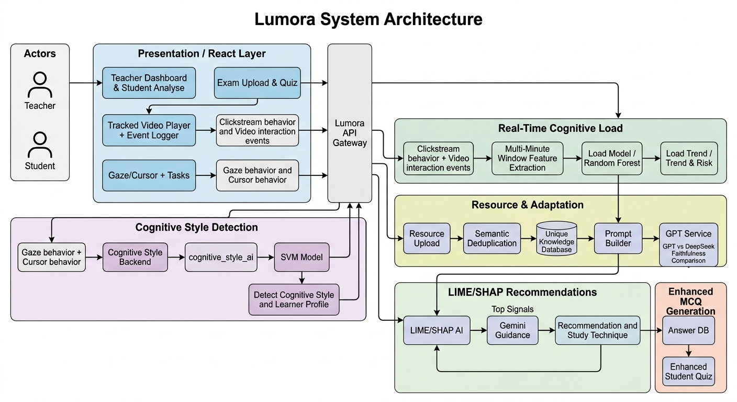
R26-SE-004
Adaptive Cognitive Load and Style Prediction System for Online Learning Using Behavioral Patterns
05
System Architecture
Separate services keep learning, AI inference, retrieval, LLM generation, evaluation, analytics and assessment independently scalable.
Notes:
Source: User-provided Lumora project description in this conversation.

Slide 6
Lumora
Adaptive Cognitive Load and Style Prediction System for Online Learning Using Behavioral Patterns
06
Integration & Completion Status
Completed Research Components
Cognitive style and cognitive load AI model services completed
100%
Learner app, educator upload flow and dashboard integrated
Fully Integrated System
System Development
Completed
Content extraction + retrieval + GPT personalization pipeline working
Faithfulness/readability ranking and best-output display completed
All planned research components and system integrations are implemented.
MCQ generation based on cognitive load implemented
Educator analytics with explainable AI insights prepared
Remaining: User Testing • Final QA • Deployment
Final stage roadmap: User Testing → Final QA → Deployment
PP2 Viva message: development is complete; focus is validation and deployment readiness.
Notes:
Source: User-provided Lumora project description in this conversation.

Slide 7
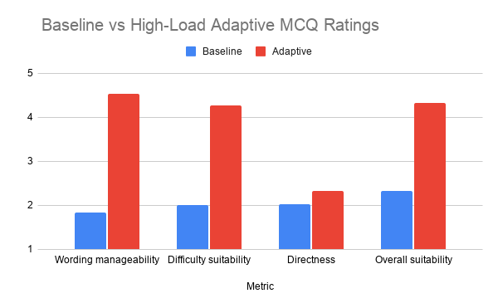
R26-SE-004
Adaptive Cognitive Load and Style Prediction System for Online Learning Using Behavioral Patterns
07
Evaluation Criteria
01.Visual Verbal Cognitive Style Prediction Model
02.Cognitive Load Prediction Model
Metric | Result
Accuracy | 77.50%
Precision | 79.17%
Recall | 76.13%
Macro F1-score | 76.45%
Based on the dataset collected, the Support Vector Machine Algorithm achieved the highest accuracy and was selected as the final model for Cognitive Style Detection.
Metric | Result
Accuracy | 79.52%
Precision | 79.87%
Recall | 79.48%
Macro F1-score | 79.55%
Random Forest Algorithm achieved the best overall performance and was selected as the final model for real-time cognitive load prediction.
03 Grounded Personalization
 | Hugging Face | Deepseek
input | Same Prompt + Knowledge chunk | Same Prompt + Knowledge chunk
Faithfulness | cosine(chunk, output) | cosine(chunk, output)
Readability | Flesch vs load target | Flesch vs load target
Composite | 0.65 × faith. + 0.35 × read | 0.65 × faith. + 0.35 × read
The same prompt is sent to Hugging Face and DeepSeek. We compare both answers and show the most accurate and suitable one to the student.
Accuracy is given more importance (65%) than readability (35%) to avoid showing incorrect information.
04 Analytics + MCQ Adaptation
Adaptive MCQs received higher ratings across all evaluated metrics, indicating better wording manageability, difficulty suitability, directness, and overall suitability compared to the baseline.
Notes:
Source: User-provided Lumora project description in this conversation.

Slide 8
R26-SE-004
Adaptive Cognitive Load and Style Prediction System for Online Learning Using Behavioral Patterns
08
From PP2 demo to pilot-ready adaptive learning product
Commercialization Path
Demo roadmap
1
Cognitive Style Picker
1
Free launch
2
Engagement
Identify the learner’s cognitive style from their interaction behavior.
2
Cognitive Load Tracker
Open access for early practice and system adoption.
Students and educators experience adaptive learning benefits.
Monitor the learner’s cognitive load in real time while they study.
3
Resource Upload & Content Conversion
3
Revenue scale
4
Paid courses
Educator uploads learning resources → content is extracted, retrieved and converted into a learner-matched format.
Educators publish premium courses after user trust grows.
Platform earns through course sales, sharing with educators.
4
AI Recommendation & MCQ Generation
Recommend the best-fit personalized content and generate MCQs based on the learner’s cognitive state.
Next milestone: pilot with real course content → usability testing → cloud deployment → institution feedback loop.
Notes:
Source: User-provided Lumora project description in this conversation.

Slide 9
R26-SE-004
Adaptive Cognitive Load and Style Prediction System for Online Learning Using Behavioral Patterns
09
Thank You!
Notes:
Source: User-provided Lumora project description in this conversation.

