Slide 1

CS390 - Fundamental Programming Practices (FPP) Professor Paul Corazza
MAHARISHI UNIVERSITY of MANAGEMENT
Engaging the Managing Intelligence of Nature
Computer Science Department

Slide 2
Lecture 1: Introduction to Java And the Eclipse Development Environment
Pulling the Arrow Back to Hit the Target

Slide 3
Wholeness of the Lesson
Java is an object-oriented highly portable programming language that arose as an easy alternative to the once dominant, but error-prone, C++ language. Eclipse is one of many open source, powerful but easy-to-use integrated development environments for use with Java and related technologies. Working from deeper levels of intelligence allows one to accomplish more with fewer mistakes and less effort.

Slide 4
About Java
Brief History. The Java language began as a language for programming electronic devices, though the original project was never completed. Its creator was James Gosling, of Sun Microsystems. The language was developed privately starting in 1991, and was made publicly available in 1994. In 2009, Oracle bought the rights to Java from Sun Microsystems.
Interpreted Language. When you "compile" Java code, the result is not executable binary code, targeted to a particular machine; instead, the result is bytecode, having a portable intermediate code format. The bytecode is then executed by running an interpreter, called the Java Virtual Machine (JVM). This approach makes Java code highly portable; Java will run on any platform for which a JVM has been created.

Slide 5
About Java
JIT. Interpreters run much more slowly than native binary executable code. Java performance is boosted considerably in modern-day JVMs because of the inclusion of a just-in-time compiler; this feature compiles frequently occurring bytecode sequences into native binary code and caches the results, re-using the cache as needed. The result is that Java runs almost as fast as C++ in typical cases.
No Pointers. Unlike C and C++, Java does not make use of pointers; developers are not required to manage the memory usage of their applications. Memory management is handled automatically in Java by means of a garbage collector. The garbage collector is run by the JVM at different times during program execution to return to memory all unusued object references.

Slide 6
About Java
Java Is an OOP Language. Java is an OO programming language, and succeeds in this better than C++, which (for the sake of backwards compatibility with C) supports a non-OO programming style (in C++, OO programming is "optional").
Convenient Libraries. Java provides convenient libraries for handling files and streams, networking, http, gui development, and database connection. Compared to languages like C and C++, the increased ease of use is significant.
Number 1 Language. For more than 15 years, Java has been the Number 1 programming language in the IT world.

Slide 7
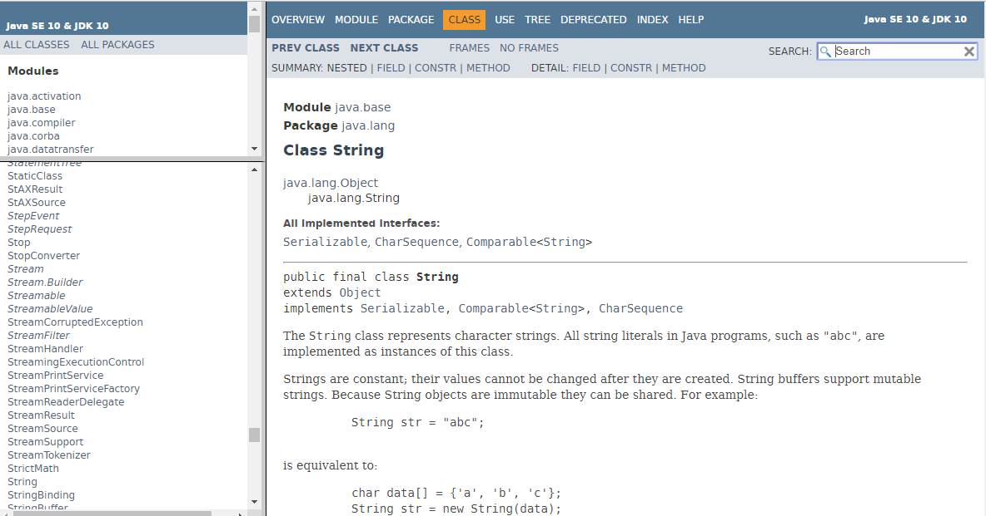
The Java 10 API Docs
Oracle provides online documentation of all the Java library classes. Full documentation of each class in the Java libraries is provided. For Java 10, the link is
https://docs.oracle.com/javase/10/docs/api/index.html?overview-summary.html

Slide 8
The JDK Commandline Tools
To compile and run Java from a command window, you will use the executables javac.exe and java.exe, located in the bin directory of the Java distribution. The bin directory contains many additional tools for commandline processing.
TIP: If, to your PATH environment variable, you add the path to javac.exe and java.exe, compiling and running Java programs from the console is much easier. Typical path to these executables is the following (modify the jdk version number as necessary)
C:\Program Files\Java\jdk-10.0.2\bin
Add this string to the front of the PATH string in your system environment variables.
To change the system environment variables, follow these steps: Type "advanced" in the search window on the far left of the task bar (at the bottom of the main Windows screen). Click the option "View advanced system settings". Click environment variables. Click the Path row and click Edit. Follow the path you are adding (to the beginning) with a ';'

Slide 9
Compiling and Running from a Command Window
Create a “hello world” example by typing the following lines of code in WordPad (or Notepad), and save in a convenient location as Hello.java.
class Hello {
public static void main(String[] args) {
System.out.println("Hello World");
}
}
Open a command window, change directory to the directory that contains Hello.java, and then compile by typing the following command in the console:
javac Hello.java
If a compiler error occurs, the compiler attempts to indicate clearly where the mistake occurred.
When compilation is successful, a new file Hello.class has been created. Execute the code with the command
java Hello
//output: Hello World!

Slide 10

Compiling and Running from a Command Window – Using Packages
Create a folder on your file system called "hello"
Enter this new folder and create the same “hello world” example as before, but add the line "package hello;" at the top and have the print statement call a function that returns the string "Hello World!".
package hello;
class Hello {
public static void main(String[] args) {
String hello = sayHello();
System.out.println(hello);
} public static String sayHello() {
return "Hello World!";
}
}
Open a command window, change directory to the directory that contains the new hello folder, and then compile by typing the following command in the console:
javac hello\Hello.java
When compilation is successful, a new file Hello.class has been created in hello. Execute the code with the command, run from the directory that contains the hello folder:
java hello.Hello
//output: Hello World!

Slide 11
Exercise 1.1
Download and install the Java JDK (follow the directions given in item 4 of the “Setting up for CS390-FPP course” Google Doc provided here.
Do Exercise 1 of the Lab1-Orientation Lab.pdf. You will create your own Java file named, Welcome using Notepad. Instructions are in the document.
Do not develop your code in Eclipse – for now, just use Notepad and follow the instructions in the Exercise 1, as given in the Lab1-Orientation Lab.pdf document.

Slide 12
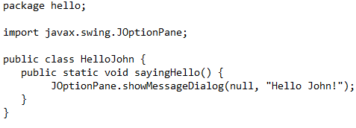
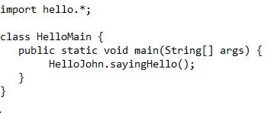
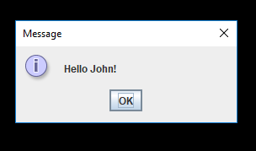
Communication Between Objects and Presenting a UI Message
Create a folder on your file system called "hello"
Enter this new folder and create a class HelloJohn which outputs “Hello World!” to a UI message box (called a JOptionPane).
Inside the parent folder of hello, create a class that will call sayingHello(), which we will call HelloMain.
Open a command window, change directory to the hello directory and type
javac HelloJohn.java
Then in the parent directory of hello, type javac HelloMain.java
Execute the code with the following command, run from the directory that contains the hello folder:
java HelloMain

Slide 13

Communication Between Objects and Presenting a UI Message – with a JAR
As in the previous slide, we have classes HelloJohn and HelloMain. Here, we will access HelloJohn in the form of a "java archive" – called a JAR file. (We will discuss in a later lesson how these are created.) The code is the same as before, but now HelloMain will access HelloJohn through the HelloJohn.jar file.
Open a command window, change directory to the directory containing these files. Tell the compiler where the jar file is by using the classpath option -cp
javac –cp HelloJohn.jar HelloMain.java
Run HelloMain; you will need to use the –cp option again here. Since we are specifying a classpath, we need to explicitly tell the java executable to look in the current directory : java –cp .;HelloJohn.jar HelloMain.java
Output is again the following message window:

Slide 14
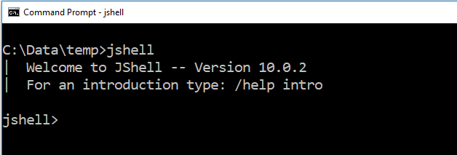
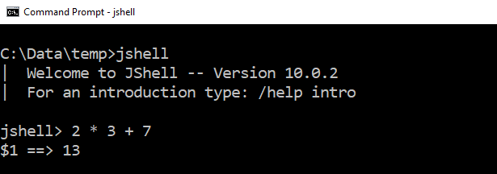
Trying Out Code with JShell
JShell is a Java 9 feature that lets you try out code interactively at the commandline.
To start JShell, type jshell at the commandline
You can use JShell to evaluate expressions

Slide 15
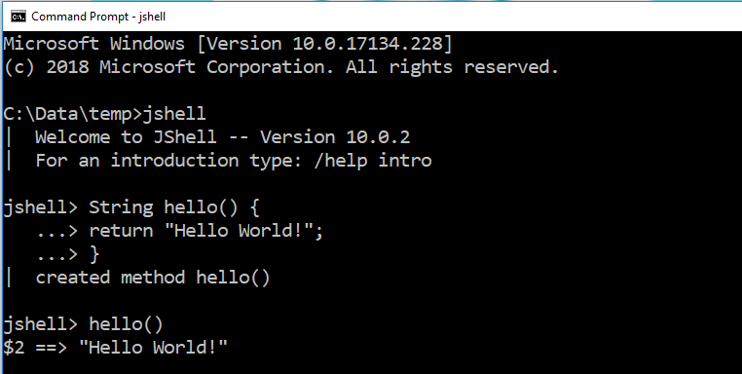
(continued)
You can define a Java method in JShell and then run it
Exit JShell by typing /exit at the jshell prompt

Slide 16
Main Point
Java is an object-oriented programming language that is easier to use, less error-prone, more portable, and more popular than C++. Java code is compiled to bytecode, which can then be converted to native code on a target platform by way of a JVM interpreter. The inefficiency of an interpreter has largely been eliminated through the use of the just-in-time compiler, which compiles frequently occurring bytecode sequences to native code and caches these for further use, at runtime. Any language has the power to reveal or obscure the truth – as Maharishi says in SCI, "it is the power of speech that it can bind the boundless."

Slide 17
Integrated Development Environments
A good IDE supports compiling, running, and debugging code with tools that are integrated and typically easy to use. For a large Java project, an IDE is indispensable.
Good choices of IDE are NetBeans, IBM Rational Application Developer (formerly WebSphere Application Developer), Borland's JBuilder, JetBrains’ IntelliJ
Another excellent choice, which has become an industry standard, is the open-source IDE Eclipse, written entirely in Java. Among IDEs for Java, in recent years, Eclipse is the most widely used. We will use Eclipse in this course.

Slide 18
The Eclipse IDE
Getting started. To use Java 11, you need Eclipse Oxygen (or later); earlier versions of Eclipse do not support Java 11.
Features of the IDE [demo]

Slide 19

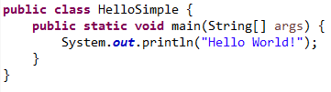
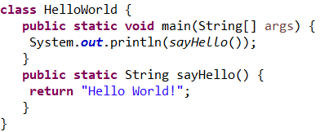
"Hello World" in Eclipse
When you create a class Hello in Eclipse, it creates a default package. In a moment we will see how to place a class in a different package.
We can directly print "Hello World!", or we can ask a function to return the String "Hello World!" and then print that returned String

Slide 20

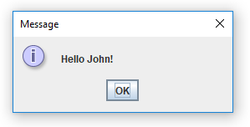
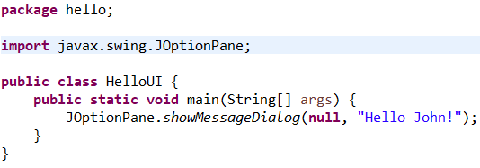
"Hello World" continued
This time we first create a package to contain a class HelloUI. We print "Hello John", this time using a Swing dialog box. Eclipse assists us in finding the correct import. We need to specify the package "hello".

Slide 21

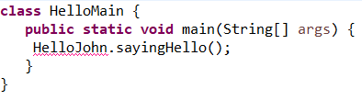
Adding JAR Files in Eclipse
As in the command line example, we have a class HelloMain and wish to access class hello.HelloJohn that has been packaged in a JAR file. First copy the HelloMain class code into a Java project in Eclipse. There is a compiler error because the HelloJohn class is not yet accessible. Need to put HelloJohn.jar on the classpath.

Slide 22
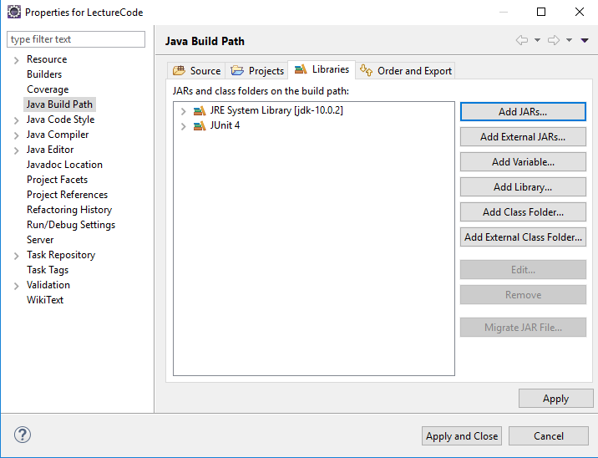
Adding JAR Files in Eclipse
To add HelloJohn.jar to the classpath, do these steps: Right click on the Project (here, it is LectureCode) and select Properties > Java Build Path and click Add External Jars…

Slide 23
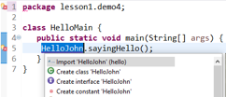
Adding JAR Files in Eclipse
Navigate to the HelloJohn.jar file. Click Apply and Close. Eclipse now tells you how to find HelloJohn (located in HelloJohn.jar) – right click on the yellow/red marker and select Import HelloJohn.

Slide 24
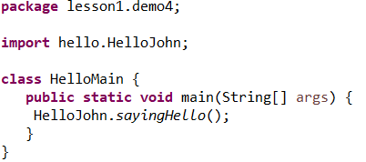
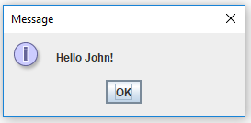
Adding JAR Files in Eclipse
HelloMain now compiles. When you run it, output is the same as when it was run on the commandline.

Slide 25
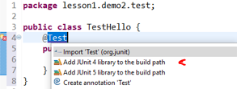
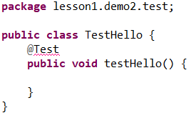
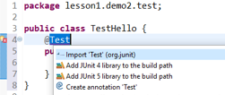
Perform Unit Testing With Eclipse
Create a package in demo2 called test and in that package create a class TestHello. We will test the sayHello() method from demo2.
Write the following code in TestHello:
The @Test annotation tells the compiler you wish to use the JUnit library. Click on the red/yellow marker to add the JUnit4 library to the classpath. After loading, let Eclipse import that Test class from JUnit for you.

Slide 26
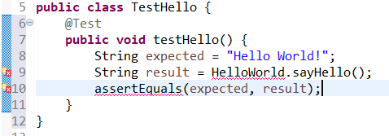
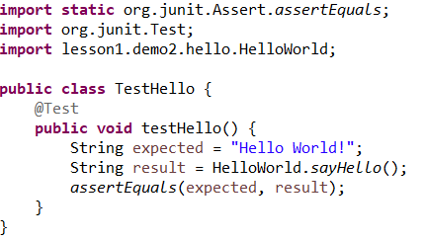
Perform Unit Testing With Eclipse
Write code that will test your sayHello() method
Tell Eclipse which HelloWorld class to use by clicking the red/yellow marker and allowing Eclipse to import demo2.HelloWorld.
Tell Eclipse about the assertEquals() method by clicking the other red/yellow marker and allowing it to import the necessary method.

Slide 27
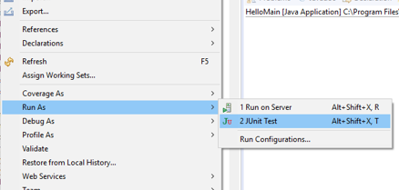
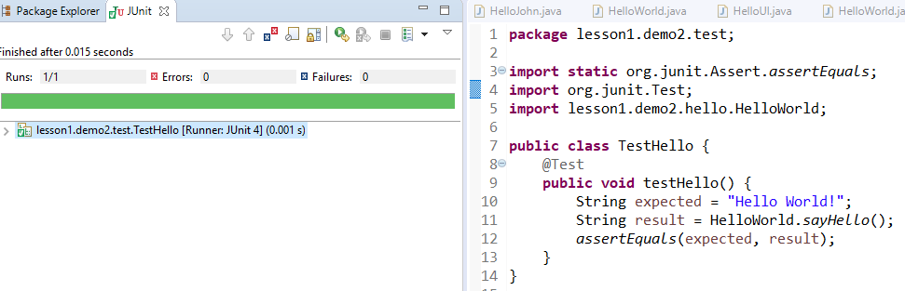
Perform Unit Testing With Eclipse
To run your test, right click on the file TestHello.java and select Run As JUnit Test.
If your code passes the test, you will see something like the following:

Slide 28
Exercise 1.2
Do Exercise 2 of the Orientation Lab (see the InClassExercises project in your workspace). In this lab you will create a Java class and test it using JUnit4.
Note: You do not need to deploy your completed application.
In Eclipse, your code is placed in a project. Inside a project you create packages and inside a package you place your Java classes. There is also a larger organiza-tional unit called modules, which contain packages.
project
ʟ module
ʟ package
ʟ class

Slide 29
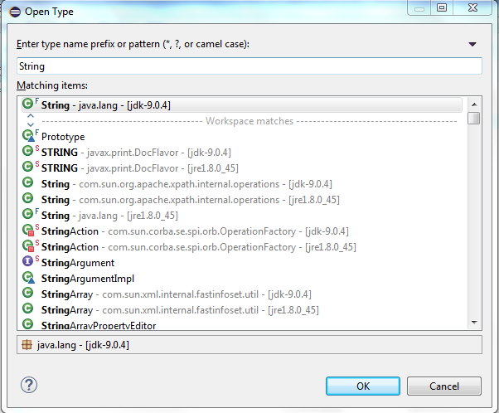
Viewing Source Code
Allows you to see how Java has implemented their library code. You must have src.zip in your Java distribution.
Steps:
Open any project in Eclipse and type Ctrl Shift T
Brings up this screen:
[Note: “String” was typed into search window]
(Caution: If you have multiple jre's installed, be sure to choose the Java 9 version of the desired class – in this case, String)

Slide 30
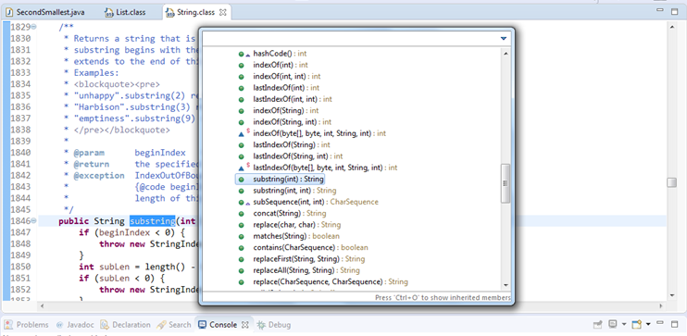
Viewing Source Code 2
To locate a method inside the class (say, “substring()” in String), type Ctrl-O and type in search string

Slide 31
Deploying a Java Application
There are several ways to deploy a Java application. For this course, we demonstrate two of the ways:
Create a batch file (Windows) to invoke the main method of the primary class of the application. (In Linux and Apple systems, a shell script can be used.)
Save the application as a runnable jar file. The application can then be launched by double-clicking the jar file. (This approach is not good for applications that need to send output to the console.)

Slide 32
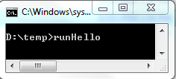
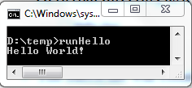

Creating a Batch File Launcher
If you used the default package, create a batch file in the same directory as the main .class file, like Hello.class. (Or, your batch file can cd to that directory as a first step.)
The batch file runHello.bat will consist of the commands used to launch the program from the commandline (as in earlier slides). You can launch the batch file by running it from the command window or by double-clicking the .bat file. runHello.bat

Slide 33
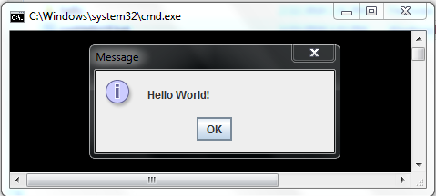

(continued)
If the main method is in a class that resides in a non-default package (as was done for HelloUI in package hello), place the batch file in the same directory as the top-level package.
runHelloUI.bat

Slide 34
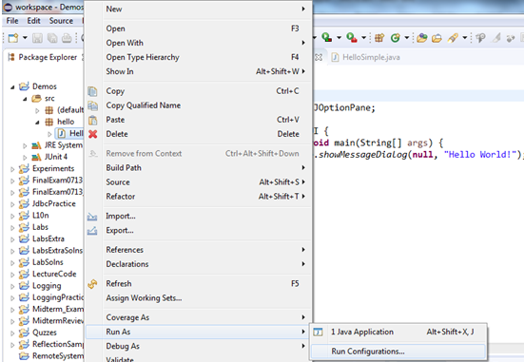
Creating a Runnable Jar
Create a Run Config. Right-click on the class with the main method and select: Run As > Run Configurations ...

Slide 35
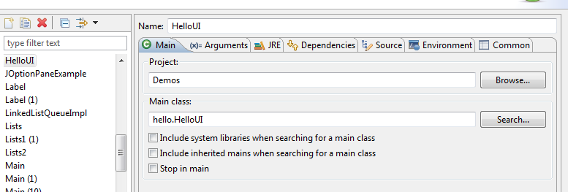
Creating a Runnable Jar (2)
Give the Run Config a name (here, it's HelloUI) and click the Close button

Slide 36
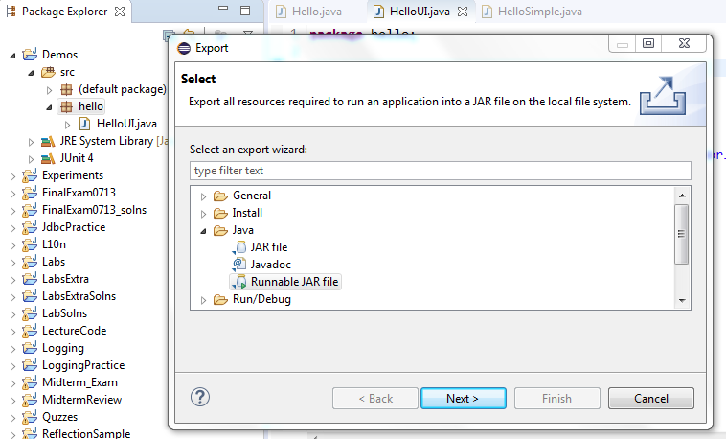
Creating a Runnable Jar (3)
Right-click on the top-level package and select Export > Java > Runnable JAR file

Slide 37
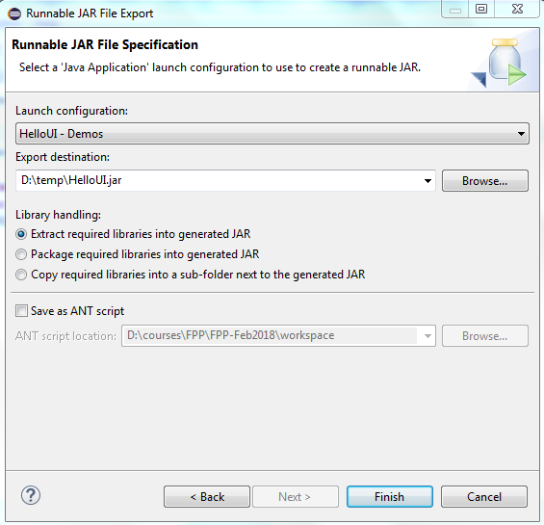
Creating a Runnable Jar (4)
Specify your Run Config and the destination directory

Slide 38
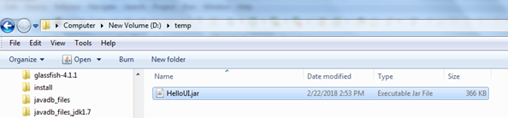
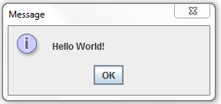
Creating a Runnable Jar (5)
Now you can run your Java application by double-clicking on the jar file that your just created

Slide 39
Main Point
Eclipse is a leading, open-source, 100% Java, integrated development environment, which provides excellent support for editing, compiling, running, and de-bugging Java applications. By analogy, to create a good life, we need to handle inner life and at the same time, structure a life-supporting environment – the goal is to live 200% of life.

Slide 40
Summary
After the JDK has been installed, it is possible to use javac.exe and java.exe, located in the bin directory of the JDK distribution, to compile and run Java code. It is also possible to try out code snippets using JShell at the commandline.
Developing code is much easier using an IDE – the most widely used IDE for Java is Eclipse.
Eclipse allows you to edit, compile, debug, and run Java code in an integrated environment. It also lets you view Java library code (ctrl-shift-T, and attach source).
JUnit is one of the most popular Java add-ons for unit-testing Java code, and is supported in the Eclipse environment.
Java applications may be deployed either by creating a batch file (Windows only) that calls the main method of the main class, or creating a runnable jar file using tools provided by Eclipse.

Slide 41
Connecting the Parts of Knowledge With the Wholeness of Knowledge
Using Java, highly functional applications can be built more quickly and with fewer mistakes than is typically possible using C or C++.
To optimize the use of Java's features, IDE's such as Eclipse ease the work of the developer by handling in the background many routine tasks.
Transcendental Consciousness: To be successful, action must be based on the field of pure intelligence, which is located at the source of thought.
Wholeness moving within itself: In Unity Consciousness, the pure intelligence located in TC is found pervading all of creation, from gross to subtle.

