Slide 1

CS390 Foundamental Programming Practices (FPP) Professor Paul Corazza
MAHARISHI UNIVERSITY of MANAGEMENT
Engaging the Managing Intelligence of Nature
Computer Science Department

Slide 2
Lecture 4: Inheritance, Interfaces, and Polymorphism

Slide 3
Wholeness of the Lesson
Java supports inheritance between classes in support of the OO concepts of inherited types and polymorphism. Interfaces support encapsulation, play a role similar to abstract classes, and provide a safe alternative to multiple inheritance. Likewise, relationships of any kind that are grounded on the deeper values at the source of the individuals involved result in fuller creativity of expression with fewer mistakes.

Slide 4
Outline of Topics
Introduction to Inheritance – Example of Subclassing a Class
The "IS-A" and LSP Criteria for Proper Use of Inheritance
Rules for Subclass Constructors
Inheritance and the Object Class
Inheritance for Generalization and Introduction to Polymorphism
Order of Execution with Inheritance
Introduction to Java Interfaces, Comparable, Functional Interfaces
New Java 8 Features for Interfaces
Introduction to the Reflection Library
The Class Class
The Constructor Class
The Object Class
The toString Method
The equals Method
The hashCode Method
The clone Method, the protected Keyword and Shallow and Deep Copies

Slide 5
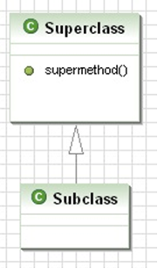
Introduction to Inheritance
Definition. A class Subclass inherits from another class Superclass if objects of type Subclass have automatic access to the "available" methods and variables that have been defined in class Superclass. By "automatic access" we mean that no explicit instantiation of (or reference to) the class Superclass is necessary in order for objects of type Subclass to be able to call methods defined in class Superclass. By "available" methods and variables, we mean methods and variables that have been declared either public or protected (or have package level access if in the same package).
class Superclass {
protected void supermethod() {
int x = 0;
}
}
class Subclass extends Superclass {
}
class Main {
public static void main(String[] args) {
Subclass sub = new Subclass();
sub.supermethod();
}
}
A class, method, or variable labeled protected is accessible to all subclasses.

Slide 6
The protected Keyword
Methods and variables in a class that are qualified with the protected access specifier are accessible to all subclasses of the class and all classes in the same package as the class. Therefore, the access specifiers in Java, listed from most to least restrictive, are:
private, <package level>, protected, public
Some people believe (like the author of the book) that a variable should never be given protected level access because it would violate encapsulation. No general agreement on this point.
Warning! The rules governing the use of the protected keyword are somewhat more involved than this – these will be discussed at the end of the lesson.

Slide 7
Motivation for Inheritance
In our programming projects, we may find that we define two classes that have many of the same fields and methods. It is natural to think of a single class that generalizes the two classes and that contains the code needed by both.
Secretary
properties:
name
address
telNum
vehicleType
numYears
behavior:
computeSalary()
Professor
properties:
name
address
telNum
vehicleType numPublications
behavior:
computeSalary()

Slide 8
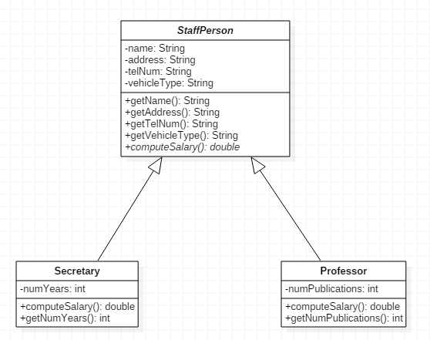
Strategy: Create a generalization of Secretary and Professor from which both of these classes inherit. A StaffPerson class can be defined having nearly all fields that were previously in Secretary and Professor. We then require Secretary and Professor to inherit from StaffPerson.

Slide 9
When the classes have this relationship, we may view the type of an instance of a subclass as being that of the superclass. For example, we can instantiate like this:
StaffPerson person1 = new Professor():
StaffPerson person2 = new Secretary();
This is similar in spirit to the automatic conversions that are done for primitive types:
byte b = 8;
int k = b;

Slide 10
Another Example of Inheritance: Manager as a subclass of Employee
//Employee class, as defined in previous lessons
class Employee {
Employee(String aName, double aSalary, int aYear, int aMonth, int aDay) {
name = aName;
salary = aSalary;
hireDay = LocalDate.of(aYear,aMonth,aDay);
}
// instance methods
public String getName() {
return name;
}
public double getSalary() {
return salary;
}
public LocalDate getHireDay() {
return hireDay;
}
public void raiseSalary(double byPercent) {
double raise = salary * byPercent / 100;
salary += raise;
}
//instance fields
private String name;
private double salary;
private LocalDate hireDay;
}

Slide 11
class Manager extends Employee {
public Manager(String name, double salary, int year,
int month, int day) {
super(name,salary,year,month,day);
bonus = 0;
}
@Override
public double getSalary() {
//no direct access to private variables of
//superclass
double baseSalary = super.getSalary();
return baseSalary + bonus;
}
public void setBonus(double b) {
bonus = b;
}
private double bonus;
}

Slide 12
class ManagerTest {
public static void main(String[] args) {
Manager boss = new Manager("Boss Guy", 80000,
1987, 12, 15);
boss.setBonus(5000);
Employee[] staff = new Employee[3];
staff[0] = boss;
staff[1] = new Employee("Jimbo", 50000, 1989, 10, 1);
staff[2] = new Employee("Tommy", 40000, 1990, 3,15);
//print names and salaries
for(Employee e : staff) {
System.out.println( "name: " + e.getName() +
"salary: " + e.getSalary());
}
}
}

Slide 13
Points to observe:
Manager provides all the "services" of Employee, with additional functionality (involving bonuses) – so it's a good candidate for extending Employee.
We use the extends keyword to indicate that Manager is a subclass of Employee
A Manager instance can freely use the getName and getHireDay methods of its superclass Employee – no need to re-code these methods. However, special methods that are unique to Manager (in particular, the setBonus method) cannot be called on an Employee instance.
Manager m = new Manager(. . .);
m.getName(); //ok
m.setBonus(5000); //ok
Employee e = new Employee(. . .);
e.getName(); //ok
e.setBonus(5000); //compiler error

Slide 14
We override the getSalary method in the Manager class.
This means that the method has the same signature as the original version in Employee , but is defined differently. A Manager object computes salary differently from Employee objects.
We still wish to use getSalary in Employee, but add the value of bonus to it. How can this be done?
In general, how to access the superclass version of a method from within a subclass?
Solution: Use super to indicate that you are accessing the
superclass version.
Best Practice. Use the @Override annotation on getSalary. Two reasons :
It is possible for another user of your code not to realize that your method overrides a method in a superclass.
Provides a compiler check that your method really is overriding a superclass method. Example: Overriding the equals method (see below)

Slide 15
In the Manager constructor, we wish to reuse the constructor that is found in Employee, but we also want to include more code. This is accomplished by using the super keyword again (but it has a different meaning here). Like this in constructor, the use of super to refer to a superclass constructor must occur on the first line of the constructor body.
Polymorphic types. The 0th element of the staff array was defined to be of type Manager, yet we placed it in an array of Employee objects.
Manager boss = new Manager(…);
Employee[] staff = new Employee[3];
staff[0] = boss;
The fact that an object variable can refer to an object of a given type
as well as objects that belong to subtypes of the given type is called
polymorphism.

Slide 16
Dynamic binding. When the getSalary method is called on staff[0], the version of getSalary that is used is the version that is found in the Manager class. This is possible because the JVM keeps track of the actual type of the object when it was created (that type is set with execution of the "new" operator). The correct method body (the version that is in Manager) is associated with the getSalary method at runtime – this "binding" of method body to method name is called late binding or dynamic binding.

Slide 17
Exercise 4.1
Which line of code below produces a compiler error?
public class Student { ... }
public class Undergraduate extends Student { ... }
public class Graduate extends Student { ... }
Student st1, st2, st3;
Graduate st4;
st1 = new Student();
st2 = new Undergraduate();
st3 = new Graduate();
st4 = new Student();

Slide 18

Solution
public class Student { ... }
public class Undergraduate extends Student { ... }
public class Graduate extends Student { ... }
Student st1, st2, st3;
Graduate st4;
st1 = new Student();
st2 = new Undergraduate();
st3 = new Graduate();
st4 = new Student(); //compiler error

Slide 19
Main Point
One class (the subclass) inherits from another class (the superclass) if all proteced and public data and methods in the superclass are automatically accessible to the subclass, even though the subclass may have additional methods and data not found in the superclass. Java supports this notion of inheritance. In Java syntax, a class is declared to be a subclass of another by using the extends keyword. Likewise, individual intelligence "inherits from" cosmic intelligence, though each "implementation" is unique.

Slide 20
Outline of Topics
Introduction to Inheritance – Example of Subclassing a Class
The "IS-A" and LSP Criteria for Proper Use of Inheritance
Rules for Subclass Constructors
Inheritance and the Object Class
Inheritance for Generalization and Introduction to Polymorphism
Order of Execution with Inheritance
Introduction to Java Interfaces, Comparable, Functional Interfaces
New Java 8 Features for Interfaces
Introduction to the Reflection Library
The Class Class
The Constructor Class
The Object Class
The toString Method
The equals Method
The hashCode Method
The clone Method, the protected Keyword and Shallow and Deep Copies

Slide 21
Correct Use of Inheritance
Here are two tests to check whether one class should inherit from another.
Manager IS-A Employee – it's not just that the two classes have some methods in common, but a manager really is an employee. This helps to verify that inheritance is the right relationship between these classes.
Liskov Substitution Principle (LSP). Another test is: Can a Manager instance be used whenever an Employee instance is expected? The answer is yes, since every manager really is an employee, and partakes of all the properties and behavior of an employee, though managers support extra behavior.

Slide 22
Common Mistake: Indiscriminate Generalization
The following strategy is a mistake: Place methods common to several classes into one superclass for all of them. Then all the classes have immediate access to methods that they all can use.
This is undesirable because, eventually, some methods and variables in the superclass will not be relevant for some of the subclasses – those subclasses will therefore offer "services" that they cannot possibly provide.

Slide 23
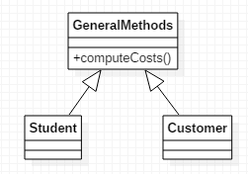
(continued)
At first, this may seem reasonable

Slide 24
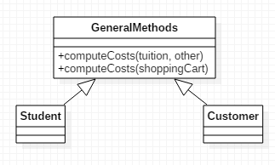
(continued)
At first, this may seem reasonable
As your project evolves, you may find that different versions of computeCosts are needed for Student and Customer
Now a Customer seems to be supporting computeCosts with input tuition and other. This undermines the purpose of the Customer class

Slide 25
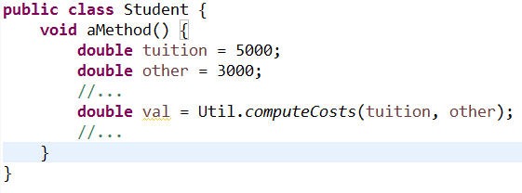
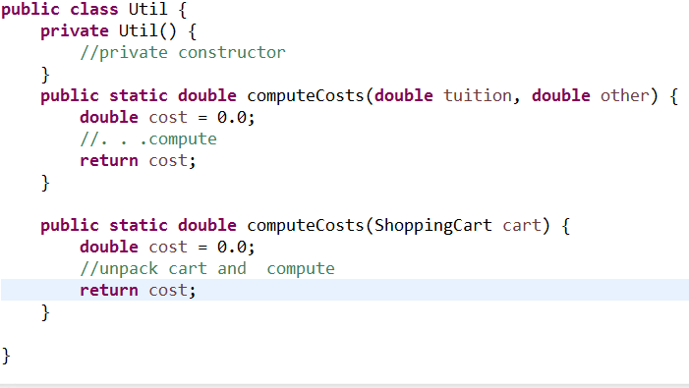
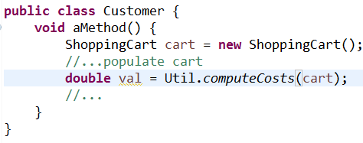
(continued)
A better approach is to place commonly used methods in a utility class.

Slide 26
Preventing/restricting inheritance
Declaring a class to be final prevents creation of any subclass (recall: this is one of the techniques used to ensure that a class is immutable)
Declaring a method to be final prevents any subclass from overriding it

Slide 27
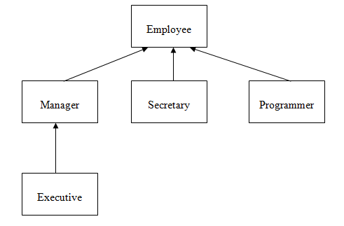
Inheritance hierarchies
Sometimes a subclass of a class is further extended by another subclass. Repeated subclassing results in an inheritance hierarchy.

Slide 28
Main Point
As a matter of good design, a class C should not be made a subclass of a class D unless C "IS-A" D. Likewise, individual intelligence "is" cosmic intelligence, though this relationship requires time to be recognized as true.

Slide 29
Outline of Topics
Introduction to Inheritance – Example of Subclassing a Class
The "IS-A" and LSP Criteria for Proper Use of Inheritance
Rules for Subclass Constructors
Inheritance and the Object Class
Inheritance for Generalization and Introduction to Polymorphism
Order of Execution with Inheritance
Introduction to Java Interfaces, Comparable, Functional Interfaces
New Java 8 Features for Interfaces
Introduction to the Reflection Library
The Class Class
The Constructor Class
The Object Class
The toString Method
The equals Method
The hashCode Method
The clone Method, the protected Keyword and Shallow and Deep Copies

Slide 30
Rules for Subclass Constructors
The Rule:
a subclass constructor must make use of
one of the constructors from its superclass
Reason for the rule The state of the superclass (values of its instance variables) should be set by the superclass (not by the subclass). So, during construction, the subclass must request the superclass to first set its state, and then the subclass may perform further initialization of its own state.
Example. Employee/Manager:
class Employee{
Employee(String name, double salary, int y, int m, int d){
//…//
}
}
class Manager extends Employee {
Manager(String name, double salary, int y, int m, int d) {
super(name,salary,y,m,d); //makes use of superclass constructor
}
}

Slide 31
Note: It is not necessary for any of the subclass constructors to have the same signature as any of the superclass constructors. However, each of the subclass constructors must access one of the superclass constructors in its implementation.
class Employee{
Employee(String name, double salary, int y,
int m, int d){
//…//
}
}
class Manager extends Employee {
Manager(String name, double salary,
double bonus,//different but ok
int y, int m, int d) {
super(name,salary,y,m,d);
this.bonus = bonus;
}
}

Slide 32
The subclass may make use of the implicit default constructor only if either
the no-argument constructor of the superclass has been explicitly defined, OR
no constructor in the superclass is explicitly defined
In either of these cases, the subclass may make use (possibly implicitly) of the superclass' s default constructor.
//Case A.
class Employee{
Employee(String name, double salary, int y, int m, int d){
//…//
}
//explicit coding of default constructor since another //constructor is present
Employee() {
//…//
}
}
class Manager extends Employee {
//no explicit constructor call here, so the superclass //default constructor is used implicitly
}

Slide 33
//Case B.
class Superclass{
//…//
}
class Subclass extends Superclass {
//…//
}
class Callingclass {
public static void main(String[] args) {
Superclass s = new Subclass(); //this is ok
}

Slide 34
Outline of Topics
Introduction to Inheritance – Example of Subclassing a Class
The "IS-A" and LSP Criteria for Proper Use of Inheritance
Rules for Subclass Constructors
Inheritance and the Object Class
Inheritance for Generalization and Introduction to Polymorphism
Order of Execution with Inheritance
Introduction to Java Interfaces, Comparable, Functional Interfaces
New Java 8 Features for Interfaces
Introduction to the Reflection Library
The Class Class
The Constructor Class
The Object Class
The toString Method
The equals Method
The hashCode Method
The clone Method, the protected Keyword and Shallow and Deep Copies

Slide 35
Inheritance and the Object Class
In Java, there is a class called Object. Every class created in Java (either in the Java libraries, or user-defined) belongs to the inheritance hierarchy of Object.
For example:
class MyClass {
}
This MyClass class automatically inherits from Object, even though we do not write syntax that declares this fact.
In later slides, we will discuss the (primarily public) methods that belong to Object, and that are therefore inherited by every class in Java.

Slide 36
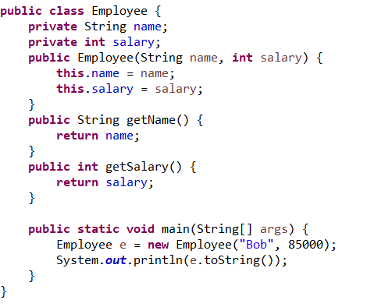
Exercise 4.2 – the Object class
One of the public methods in Object is toString(). This method returns a String representation of a given object.
The code to the right uses the fact that every class automatically inherits the toString() method from Object. What will be the output when the main method is run? Is this output a useful representation of the Employee class? What could be done to make it more useful?

Slide 37
Using the instanceof operator to check type.
The following code returns true:
"Hello" instanceof java.lang.String
In general, you can query Java about the type of any runtime object by using instanceof. The general synatx is
ob instanceof <classname>
where ob is an object. This expression will return true if the runtime type of ob really is of the specified type, or if the class of ob is a subclass of (or a subclass of a subclass of…etc) the specified type. Therefore, for example, if man is an instance of Manager and str is a String, all of the following are true
man instanceof Employee
man instanceof Object
str instanceof Object
Whenever the instanceof operator returns true, the object on the left side of the expression can be viewed as having type indicated on the right side (via polymorphic type assignment). So in this example, we could type man and str above as Objects:
Object ob_m = man;
Object ob_s = str;

Slide 38
Outline of Topics
Introduction to Inheritance – Example of Subclassing a Class
The "IS-A" and LSP Criteria for Proper Use of Inheritance
Rules for Subclass Constructors
Inheritance and the Object Class
Inheritance for Generalization and Introduction to Polymorphism
Order of Execution with Inheritance
Introduction to Java Interfaces, Comparable, Functional Interfaces
New Java 8 Features for Interfaces
Introduction to the Reflection Library
The Class Class
The Constructor Class
The Object Class
The toString Method
The equals Method
The hashCode Method
The clone Method, the protected Keyword and Shallow and Deep Copies

Slide 39
Two Ways Inheritance Arises
We saw Manager was a natural choice for a subclass of Employee because it extends Employee's behavior.
Another situation that gives rise to inheritance occurs when several classes are seen to naturally belong to the same general type – this is generalization. In the "figures" example (next slide), it seems natural to generalize the curves Triangle, Circle, Square

Slide 40
final class Triangle {
final double base;
final double height;
Triangle(double base, double height){
. . .
}
double computeArea() {
return (0.5 * base * height);
}
}

Slide 41
final class Square {
final double side;
Square(double side) {
this.side = side;
}
double computeArea() {
return(side*side);
}
}
final class Circle {
final double radius;
Circle(double radius) {
this.radius = radius;
}
double computeArea() {
return (Math.PI * radius * radius);
}
}

Slide 42
Demo: lesson4.closedcurve.bad
//Illustrates a non-OO (= bad) way of computing areas
class Test {
public static void main(String[] args) {
Object[] objects = {new Triangle(3,3),
new Square(3),
new Circle(3)};
//compute areas
for(Object o : objects) {
if(o instanceof Triangle) {
Triangle t = (Triangle)o;
System.out.println(t.computeArea());
}
if(o instanceof Square) {
Square s = (Square)o;
System.out.println(s.computeArea());
}
if(o instanceof Circle) {
Circle c = (Circle)o;
System.out.println(c.computeArea());
}
}
}
}

Slide 43
Points:
Notice we can arrange Triangle, Square, Circle into an array of type Object[] by polymorphism. But Object does not have a computeArea method, so we cannot polymorphically compute areas by using a single superclass method computeArea.
Instead, if we use an array Object[], we have to repeatedly test the type of the Object in the area in order to execute the correct computeArea method (using the instanceof operator).
This approach needs improvement! (You should never write code that looks like this!)

Slide 44
Towards an OO Solution
Can generalize the behavior of these geometric shape classes to support polymorphic access to a general computeArea method.
abstract class ClosedCurve {
abstract double computeArea();
}
The keyword abstract on a method means the method is unimplemented

Slide 45
final class Triangle extends ClosedCurve {
final double base;
final double height;
Triangle(double base, double height){
. . .
}
double computeArea() {
return (0.5 * base * height);
}
}

Slide 46
final class Square extends ClosedCurve {
final double side;
Square(double side) {
this.side = side;
}
double computeArea() {
return(side*side);
}
}
final class Circle extends ClosedCurve {
final double radius;
Circle(double radius) {
this.radius = radius;
}
double computeArea() {
return (Math.PI * radius * radius);
}
}

Slide 47
//This is the OO (= good) way of computing areas
class Test {
public static void main(String[] args) {
ClosedCurve[] objects = {new Triangle(3,3),
new Square(3),
new Circle(3)};
//compute areas
for(ClosedCurve cc : objects) {
System.out.println(cc.computeArea());
}
}
}

Slide 48
Points
No testing of types is required to access the computeArea method
New types of objects (such as Rectangle) can now be introduced by adding new subclasses to ClosedCurve. The only change to the code that is needed is inclusion of new instances in the ClosedCurve[] array, when it is initialized. This is an example of the Open-Closed Principle: a well-designed OO program is open to extension but closed to modification.

Slide 49
Points about the code: The abstract keyword.
If a class is declared abstract, it cannot be instantiated.
If a method is declared abstract, it cannot have a body -- it can only be declared.
If a class has at least one abstract method, the class must be declared abstract.
A subclass of an abstract class must implement (provide method bodies for) every abstract method in its superclass (or else declare unimplemented methods abstract).
An abstract class is used to declare "services" that it provides. Any subclass of an abstract class promises to make those services available, though different subclasses may accomplish this in different ways (the method computeArea is an example of this).
Abstract classes may include instance variables and other non-abstract (implemented) methods.

Slide 50
Outline of Topics
Introduction to Inheritance – Example of Subclassing a Class
The "IS-A" and LSP Criteria for Proper Use of Inheritance
Rules for Subclass Constructors
Inheritance and the Object Class
Inheritance for Generalization and Introduction to Polymorphism
Order of Execution with Inheritance
Introduction to Java Interfaces, Comparable, Functional Interfaces
New Java 8 Features for Interfaces
Introduction to the Reflection Library
The Class Class
The Constructor Class
The Object Class
The toString Method
The equals Method
The hashCode Method
The clone Method, the protected Keyword and Shallow and Deep Copies

Slide 51
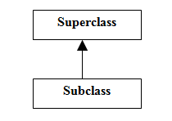
Order of Execution with Inheritance
Suppose, as in a typical case, we have Subclass as a subclass of Superclass. When we run
new Subclass()
the sections of the code are executed according to the following scheme:

Slide 52
In Superclass, all static variables are initialized and all static initialization blocks are run, in the order in which they appear in the file.
In Subclass, all static variables are initialized and static initialization blocks are run, in the order in which they appear in the file.
In Superclass, all instance variables are initialized and all object initialization blocks are run, in the order in which they appear in the file
In Superclass, the (relevant) constructor is run.
In Subclass, all instance variables are initialized and all object initialization blocks are run, in the order in which they appear in the file
In Subclass, the (relevant) constructor is run.
[See Demo – lesson4.orderofexec]

Slide 53
Outline of Topics
Introduction to Inheritance – Example of Subclassing a Class
The "IS-A" and LSP Criteria for Proper Use of Inheritance
Rules for Subclass Constructors
Inheritance and the Object Class
Inheritance for Generalization and Introduction to Polymorphism
Order of Execution with Inheritance
Introduction to Java Interfaces, Comparable, Functional Interfaces
New Java 8 Features for Interfaces
Introduction to the Reflection Library
The Class Class
The Constructor Class
The protected Keyword and Inheritance Hierarchies
The Object Class
The toString Method
The equals Method
The hashCode Method
The clone Method: Shallow and Deep Copies

Slide 54
Introduction to Java Interfaces
A Java interface is like an abstract class except:
No instance variables (other than variables declared final) or implemented methods can occur
An interface is declared using the interface keyword, not the class keyword
A class that implements an interface uses the implements keyword rather than the extends keyword
Can implement more than one interface. Syntax:
MyClass implements Intface1, Intface2, Intface3
Can also extend and implement. Syntax:
MyClass extends SuperClass implements Intface1, Intface2
However, no class can have more than one superclass. (Multiple inheritance not supported)
When a class implements an interface, it must implement (or declare as abstract) all methods in the interface.
In the earlier example, ClosedCurve could have been made to be an interface. The code would have looked like the following:

Slide 55
public interface ClosedCurve {
double computeArea();
}
class Triangle implements ClosedCurve {
double base;
double height;
Triangle(double side1,
double side2, double side3) {
double[] arr = sort(side1,side2,side3);
double x = arr[0];
double y = arr[1];
double z = arr[2];
if(x + y < z) {
System.out.println("Illegal sizes for a triangle:
"+side1+", "+side2+", "+side3);
System.out.println("Using default sizes.");
computeBaseAndHeight(DEFAULT_SIDE,
DEFAULT_SIDE,DEFAULT_SIDE);
}
else {
//method body not shown
computeBaseAndHeight(x,y,z);
}
}
double computeArea() {
return (0.5 * base * height);
}
}

Slide 56
class Square implements ClosedCurve {
double side;
Square(double side) {
this.side = side;
}
double computeArea() {
return(side*side);
}
}
class Circle implements ClosedCurve {
double radius;
Circle(double radius) {
this.radius = radius;
}
double computeArea() {
return (Math.PI * radius * radius);
}
}

Slide 57
class Test {
public static void main(String[] args) {
ClosedCurve[] objects = {new Triangle(5,5),
new Square(3),
new Circle(3)};
//compute areas
for(ClosedCurve cc : objects) {
System.out.println(cc.computeArea());
}
}
}
Note. This example illustrates the fact that a class that implements an interface may be cast as the type of that interface. A simple instance of this, like the example above, would be:
ClosedCurve cc = new Rectangle(2,4);

Slide 58
Interfaces in the Java Library: Comparable
The compareTo method in String, Integer, Double, etc, is in every case an implementation of Java's Comparable interface.
For Strings, the interface looks like this:
interface Comparable<String> {
public int compareTo(String s);
}
In the Java library, Comparable is defined generically, for any
possible type, like this:
interface Comparable<T> {
public int compareTo(T s);
}
Note: Generic types will be discussed more in Lesson 8

Slide 59
Functional Interfaces
Whenever an interface has just one abstract method, the interface is called a functional interface. The reason for the terminology is that, since there is just one abstract method, implementations of a functional interface behave like a function.
Comparable is an example of a functional interface
Functional interfaces have become an important aspect of Java since Java SE 8 because implementations can be represented using lambda expressions (see Lesson 6)

Slide 60
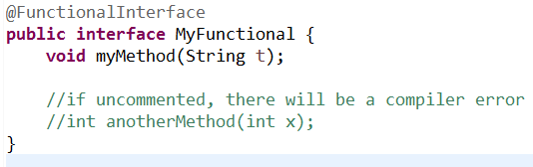
User-Defined Functional Interfaces
Defining your own functional interface is easy, but if you want to use it in the context of new Java 8 features, you have to prevent other developers from accidentally adding methods to your interface. This can be done by using the @FunctionalInterface annotation.

Slide 61
Outline of Topics
Introduction to Inheritance – Example of Subclassing a Class
The "IS-A" and LSP Criteria for Proper Use of Inheritance
Rules for Subclass Constructors
Inheritance and the Object Class
Inheritance for Generalization and Introduction to Polymorphism
Order of Execution with Inheritance
Introduction to Java Interfaces, Comparable, Functional Interfaces
New Java 8 Features for Interfaces
Introduction to the Reflection Library
The Class Class
The Constructor Class
The Object Class
The toString Method
The equals Method
The hashCode Method
The clone Method, the protected Keyword and Shallow and Deep Copies

Slide 62
New Interface Features in Java 8
Before Java 8, as we have seen, none of the methods in an interface had a method body; all were unimplemented.
In Java 8, two kinds of implemented methods are now allowed: default methods and static methods. Both can be added to legacy interfaces without breaking code.
A default method is a fully implemented method within an interface, whose declaration begins with the keyword default
A static method is a fully implemented method within an interface, having the same characteristics as any static method in a class.
Demo: package lesson4.java8interface

Slide 63
Interfaces in Java 7 and Java 8
Interview Question: What is the difference between an abstract class and an interface?
Answer from the perspective of Java 7 (and before)
Abstract classes may have fully implemented methods, but interfaces may not
Abstract classes may contain static methods while interfaces may not
Abstract classes may have instance variables of any kind, whereas interfaces can have only public final variables
All methods in an interface are public, but abstract classes may have implemented methods of any visibility and abstract methods that are either public or protected

Slide 64
Answer from the perspective of Java 8 (and after)
Abstract classes may have fully implemented instance methods; interfaces may also have implemented instance methods, but they must bear the keyword “default”
Abstract classes may have instance variables of any kind, whereas interfaces can have only public final variables
All methods in an interface are public, but abstract classes may have implemented methods of any visibility and may have abstract methods that are either public or protected

Slide 65
Main Point
Interfaces are used in Java to specify publicly available services in the form of method declarations. A class that implements such an interface must make each of the methods operational. Interfaces may be used polymorphically, in the same way as a superclass in an inheritance hierarchy. Because many interfaces can be implemented by the same class, interfaces provide a safe alternative to multiple inheritance. The concept of an interface is analogous to the creation itself – the creation may be viewed as an “interface” to the undifferentiated field of pure consciousness; each object and avenue of activity in the creation serves as a reminder and embodiment of the ultimate reality.

Slide 66
Outline of Topics
Introduction to Inheritance – Example of Subclassing a Class
The "IS-A" and LSP Criteria for Proper Use of Inheritance
Rules for Subclass Constructors
Inheritance and the Object Class
Inheritance for Generalization and Introduction to Polymorphism
Order of Execution with Inheritance
Introduction to Java Interfaces, Comparable, Functional Interfaces
New Java 8 Features for Interfaces
Introduction to the Reflection Library
The Class Class
The Constructor Class
The Object Class
The toString Method
The equals Method
The hashCode Method
The clone Method, the protected Keyword and Shallow and Deep Copies

Slide 67
Introduction to Java's Reflection Library
Reflection in Java allows an object to
determine information about other objects at runtime (such as attributes, methods, constructors)
instantiate another object given just the name of the class (and names or types of the parameters passed to the constructor, if any)
call a function based only on the name of the function, the class to which it belongs, and the names or types of the function arguments, if any
For this course, we will see how Reflection can work in conjunction with polymorphism. We will see how techniques of Reflection give us more flexibility in creating polymorphic code.

Slide 68
Challenge: Accessing Types without Violating the Open-Closed Principle
In the ClosedCurve example, how can we make it so that not only is each area printed out in the for each loop, but also the type of closed curve, as in the following:
The area of this Triangle is 12.5
The area of this Square is 9.0
The area of this Circle is 28.274
We do not want to test the type of each object in the array – this would violated the Open-Closed Principle. How can we output the type of each object in a generic way?
public class Test {
public static void main(String[] args) {
ClosedCurve[] objects = {new Triangle(5,5),
new Square(3), new Circle(3)};
//compute areas
for(ClosedCurve cc : objects) {
System.out.println(cc.computeArea());
}
}
}

Slide 69
Solution: Use the Class Class
The Java runtime keeps track of "runtime type information" about each object. This information includes the class to which it belongs, the name of that class, and many details about the structure of the class.
This information is accessible through an object's Class. The Class to which an object belongs is obtained like this:
String s = "Hello";
Class cl = s.getClass(); //cl represents the String class
This same class can be specified in two other ways:
Class cl2 = String.class;
System.out.println(cl == cl2); //true Class cl3 = Class.forName("java.lang.String"); System.out.println(cl == cl3); //true

Slide 70
From the name of the class, the Class can be discovered. Conversely, from the Class instance, the name of the class can be discovered:
// "java.lang.String"
String name = "Hello".getClass().getName();
// "String"
String name3 = "Hello".getClass().getSimpleName();

Slide 71
Application: These features of the Class class allow us to solve the Challenge:
public class TestSecond {
public static void main(String[] args) {
ClosedCurve[] objects = {new Triangle(10,9,6),
new Square(3),
new Circle(3)};
//compute areas
for(ClosedCurve cc : objects) {
String nameOfCurve = cc.getClass().getSimpleName()); System.out.println("The area of this " +
nameOfCurve + " is " + cc.computeArea());
}
}
}

Slide 72
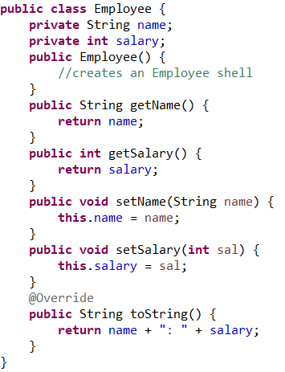
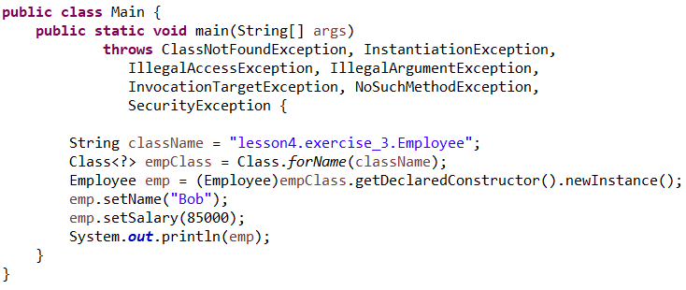
Exercise 4.3: Using Reflection
Reflection can be used to create an instance of a class just by supplying the name of class. This exercise gives an example of this kind of code. Try running the code shown here (it is in the InClassExercises project). Try to explain how the code works.

Slide 73
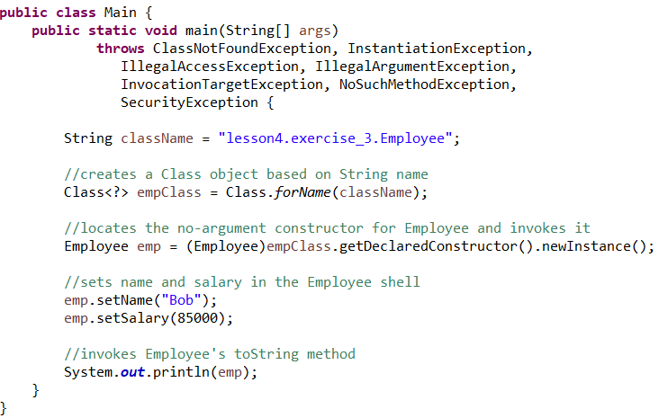
Solution

Slide 74
Main Point
The classes in the Java Reflection package can be used to construct an instance of a class (with parameters) from a String (which stores the name of the class) or Class object; similarly, it is possible to invoke a method on another class (with parameters) simply by knowing the String name of the method. In a parallel fashion, according to ancient wisdom, it is possible to experience the subtlest value of the name of an object – at a level where the impulses that structure the name are the same as those that structure the object. Working at that level, by invoking the name of the object, the object can be made to appear.

Slide 75
Outline of Topics
Introduction to Inheritance – Example of Subclassing a Class
The "IS-A" and LSP Criteria for Proper Use of Inheritance
Rules for Subclass Constructors
Inheritance and the Object Class
Inheritance for Generalization and Introduction to Polymorphism
Order of Execution with Inheritance
Introduction to Java Interfaces, Comparable, Functional Interfaces
New Java 8 Features for Interfaces
Introduction to the Reflection Library
The Class Class
The Constructor Class
The Object Class
The toString Method
The equals Method
The hashCode Method
The clone Method, the protected Keyword and Shallow and Deep Copies

Slide 76
The Object Class
Singly-rooted. Every Java class belongs to one large inheritance hierarchy in which Object is at the top. No explicit mention of "extending" Object needs to be made in your code – it is already understood by the compiler and JVM.
Every class has access to the following methods (and others that we will not cover here):
public String toString()
public boolean equals(Object o)
public int hashCode() [See Lesson 11]
protected Object clone() throws CloneNotSupportedException

Slide 77
The toString Method
If a class does not override the default implementation of toString given in the Object class, it produces output like the following:
public static void main(String[] args) {
System.out.println(new Object());
System.out.println(new StoreDirectory(null));
}
//output
java.lang.Object@18d107f
scope.more.StoreDirectory@ad3ba4
This is a concatenation of the fully qualified class name with the hexadecimal version of the "hash code" of the object (we will discuss hash codes in Lesson 11)

Slide 78
Most Java API classes override this default implementation of toString. The purpose of the method is to provide a (readable) String representation (which can be logged or printed to the console) of the state of an object.
Example from the Exercises:
// the Account object has this implementation of // toString
public String toString(){
String ret =
"Account type: " + acctType +
"\nCurrent bal: " + balance;
return ret;
}
Best Practice. For every significant class you create, override the toString method.

Slide 79
toString is automatically called when you pass an object to System.out.println or include it in the formation of a String
Examples:
Account acct = . . . //populate an AccountString output = "The account: " + acct;
_______________________________
Account acct = . . . // populate an Account System.out.println(acct);

Slide 80
toString for arrays – sample usage
Suppose we have the array
String[] people = {"Bob", "Harry", "Sally"};
Wrong way to form a string from an array
people.toString()
//output: [Ljava.lang.String;@19e0bfd
Right way to form a string from an array
Arrays.toString(people)
//output: [Bob, Harry, Sally]

Slide 81
The equals Method
Implementation in Object class:
ob1.equals(ob2) if and only if ob1 == ob2
if and only if references point to the same object
Using the '==' operator to compare objects is usually not what we intend (though for comparison of primitives, it is just what is needed). For comparing objects, the equals method should (usually) be overridden to compare the states of the objects. Example:
class Person {
private String name;
Person(String n) {
name = n;
}
}
Here, two Person instances should be "equal" if they have the same name. Next slide shows a good way to override equals

Slide 82
//an overriding equals method in the Person class
@Override
public boolean equals(Object aPerson) {
if(aPerson == null) return false;
if(!(aPerson instanceof Person)) return false;
Person p = (Person)aPerson;
boolean isEqual = this.name.equals(p.name);
return isEqual;
}
Things to notice:
The argument to equals must be of type Object (otherwise, compiler error)
If input aPerson is null, it can’t possibly be equal to the current instance of Person, so false is returned immediately
If runtime type of aPerson is not Person (or a subclass), there is no chance of equality, so false is returned immediately
After the preliminary special cases are handled, two Person objects are declared to be equal if and only if they have the same name.

Slide 83
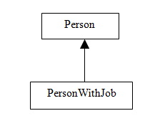
Handling equals() in Inherited Classes
Example: Add a subclass PersonWithJob to Person:

Slide 84
class Person {
private String name;
Person(String n) {
name = n;
}
public String getName() {
return name;
}
@Override
public boolean equals(Object aPerson) {
if(aPerson == null) return false;
if(!(aPerson instanceof Person)) return false;
Person p = (Person)aPerson;
boolean isEqual = this.name.equals(p.name);
return isEqual;
}
}
class PersonWithJob extends Person {
private double salary;
PersonWithJob(String n, double s) {
super(n);
salary = s;
}
}
The equals() method is inherited by PersonWithJob in this implementation. So objects of type PersonWithJob are compared only on the basis of the name field.

Slide 85
Example:
PersonWithJob joe1 = new PersonWithJob("Joe", 100000);
PersonWithJob joe2 = new PersonWithJob("Joe", 50000);
boolean areTheyEqual = joe1.equals(joe2); //areTheyEqual == true
Best Practices: If, in your code, this kind of situation does not present a problem – if it is OK to inherit equals() in this way – then the implementation given here is optimal. This is called the instanceof strategy for overriding equals
Best practice in the case where subclasses need to have their own form of equals is more complicated (discussed below)

Slide 86
What Happens When Subclasses Need Their Own Form of equals()
Example. Provide PersonWithJob its own equals method.
Demo: lesson4.equals.asymmetry
//an overriding equals method in the PersonWithJob class
@Override
public boolean equals(Object withJob) {
if(withJob == null) return false;
if(!(withJob instanceof PersonWithJob)) return false;
PersonWithJob p = (PersonWithJob)withJob;
boolean isEqual= getName().equals(p.getName()) && this.salary == p.salary;
return isEqual;
}

Slide 87
This creates a serious problem, called asymmetry (violates contract for equality)
Person p = new Person("Joe");
PersonWithJob withJob = new PersonWithJob("Joe", 100000);
//true – using Person’s equals()
theyreEqual1 = p.equals(withJob);
//false – using PersonWithJob’s equals()
theyreEqual2 = withJob.equals(p);

Slide 88
Example. Implement equals in a different way for both Person and PersonWithJob.
Demo: lesson4.equals.sameclass
//alternative equals method in the Person class
@Override
public boolean equals(Object aPerson) {
if(aPerson == null) return false;
if(aPerson.getClass() != this.getClass())
return false;
Person p = (Person)aPerson;
boolean isEqual = this.name.equals(p.name);
return isEqual;
}
//alternative equals method in the PersonWithJob class
@Override
public boolean equals(Object withJob) {
if(withJob == null) return false;
if(withJob.getClass() != this.getClass()) return false;
PersonWithJob p = (PersonWithJob)withJob;
boolean isEqual = getName().equals(p.getName()) &&
this.salary == p.salary;
return isEqual;
}

Slide 89
This solves the asymmetry problem – now, it is impossible for a PersonWithJob object to be equal to a Person object, using either of the equals() methods. This is called the same classes strategy for overriding equals.

Slide 90
Difficulty with the Same Classes Strategy
Example: Continuing the example from above, suppose we have a subclass PersonWithJobWithCounter of PersonWithJob.
Demo: lesson4.equals.sameclass.theproblem
//using same classes strategy as shown earlier
class PersonWithJob extends Person {
private double salary;
PersonWithJob(String n, double s) {
super(n);
salary = s;
}
@Override
public boolean equals(Object withJob) {
if(withJob == null) return false;
if(withJob.getClass() != this.getClass())
return false;
PersonWithJob p = (PersonWithJob)withJob;
boolean isEqual = getName().equals(p.getName()) &&
this.salary == p.salary;
return isEqual;
}
}

Slide 91
class PersonWithJobWithCounter
extends PersonWithJob {
static private int counter;
PersonWithJobWithCounter(String n, double s){
super(n, s);
counter++;
}
}
The intention here is that PersonWithJobWithCounter will use the equals method of its superclass. But this creates a problem:
PersonWithJob joe1 =
new PersonWithJob("Joe", 50000);
PersonWithJobWithCounter joe2 = new PersonWithJobWithCounter("Joe", 50000);
joe2.equals(joe1); //value is false since joe2 //is not of same type as joe1

Slide 92
Best Practice When Using Same Classes Strategy
The example shows that whenever the same classes strategy is used to provide separate equals methods for classes B and A, where B is a subclass of A, then we should prevent the possibility of creating a subclass of B to prevent the introduction of unexpected results of equals method.
Best Practice – Same Classes Strategy. If B is a subclass of A and each class has its own equals method, implemented using the same classes strategy, then the class B should be declared final to prevent unexpected result of applying equals in a subclass of B.
Question. What if we don’t wish to make B final?

Slide 93
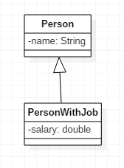
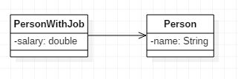
Using Composition Instead of Inheritance
Previous example shows that when a class B inherits from a class A and you want B and A to have different equals methods, you need to use the same classes strategy and you have to make B final. This procedure is somewhat error-prone (you may forget to make B final) and may not even be desirable (your design may require you to allow B to have subclasses).
An alternative to the same classes strategy, when you need classes A and B to have separate equals methods, is to use composition instead of inheritance. In that case, B does not inherit from A. This is always a good alternative unless you are needing to use polymorphism.
Example: Implementing Manager using Composition instead of Inheritance (See sample code in package lesson4.empmanager.usecomposition)

Slide 94
Summary of Best Practices for Overriding Equals In the Context of Inheritance
Suppose B is a subclass of A.
If it is acceptable for B to use the same equals method as used in A, then the best strategy is the instanceof strategy
If two different equals methods are required, two strategies are possible
Use the same classes strategy, but declare subclass B to be final
Use composition instead of inheritance – this will always work as long as the inheritance relationship between B and A is not needed (e.g. for polymorphism)

Slide 95
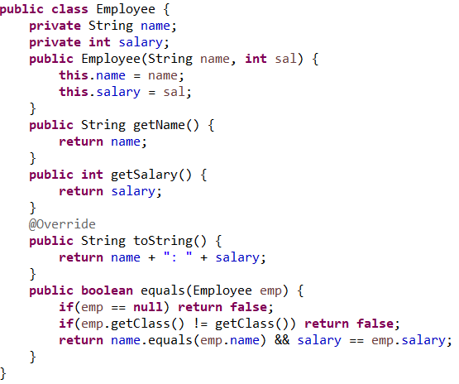
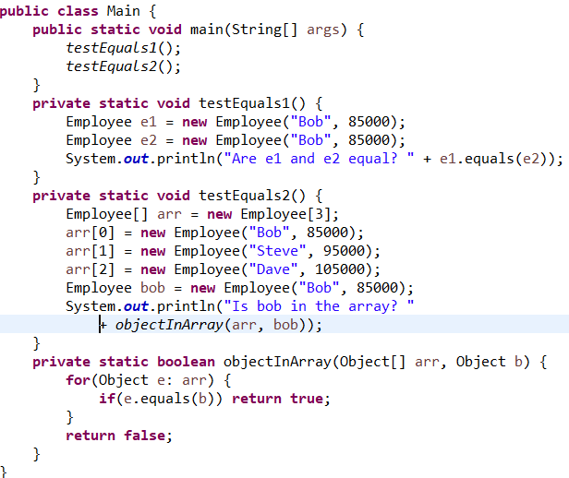
Exercise 4.4: Overriding Equals
In the Employee class, an equals method has been provided. Does equals perform as expected when it is tested in the Main class? What is wrong? How can the problem be fixed? The code is in the InClassExercises project.

Slide 96
The clone() Method
The following is a method of Object:
protected Object clone() throws CloneNotSupportedException
The CloneNotSupportedException is thrown when an attempt is made by an object of type A to perform a cloning operation but A does not implement the Cloneable interface.

Slide 97
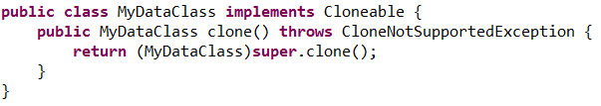
Access of protected Members from Within a Subclass
The rules governing protected allow a subclass to directly access protected members of its superclasses. Here is an example where the superclass is Object and MyClass is any other class (the subclass). This behavior matches the common understanding of the rules for protected members. See the demo lesson4.clonegood.

Slide 98
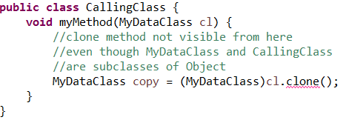
Attempting to Access protected Members from the Outside
Demo: lesson4.clonebad
The following produces a compiler error. The CallingClass is attempting to access the proteced member of Object by using the object reference cl of type MyClass. Compiler error states that “clone()is not visible.” Note that CallingClass and MyClass are both subclasses of Object.
public class MyDataClass implements Cloneable {
String name = "harry";
}

Slide 99
Usual Approach to Gain Access from Outside: Override Demo: See lesson4.clonegood again
public class CallingClass {
public MyClass tryToClone(MyClass cl) {
try {
//ok since clone() is now a public method in MyClass
return (MyClass) cl.clone();
} catch(CloneNotSupportedException e) {
return null;
}
}
public static void main(String[] args) {
CallingClass cc = new CallingClass();
MyClass cl = new MyClass();
MyClass result = cc.tryToClone(cl);
}
}
//Developer is now able to declare that class is available for cloning
public class MyClass implements Cloneable {
String name = "harry";
@Override
public Object clone() throws CloneNotSupportedException {
return super.clone();
}
}

Slide 100
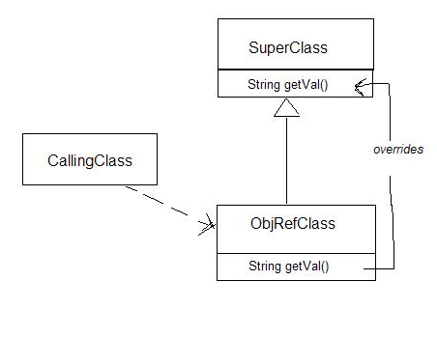
Use of protected in General
Use of the protected keyword follows same access rules as we see for the clone method:
In order to access a protected method of superclass
by accessing a subclass, the subclass must explicitly provide access by overriding the superclass method
Exception: If the calling class happens to be in the same package as the super class, it can access the superclass method through the subclass even if subclass does not override. See demo lesson4.protectedex.try3.objrefpkg

Slide 101

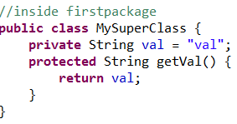
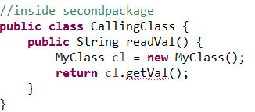
Exercise 4.5: Working with the protected Qualifier
The code below generates a compiler error. How can this be fixed?

Slide 102
Shallow Copies
The default version of the clone() method creates a shallow copy of an object. A shallow copy of an object will have an exact copy of all the fields of the original object. If the original object has any references to other objects as fields, then only references of those objects are copied into the clone object; copies of those objects are not created. That means any changes made to those objects through the clone object will be reflected in original object, and vice-versa.
Demo: lesson4.clone.shallowcopy
A shallow copy is good for copying primitives and immutable objects, but other object references still point to the original objects; this behavior is not usually desirable.

Slide 103
public class Job implements Cloneable {
int numhours;
String typeOfJob;
public Job(int n, String t) {
numhours = n;
typeOfJob = t;
}
@Override
public Object clone() throws CloneNotSupportedException {
//shallow copy is fine here – variables are primitive //or immutable
return (Job)super.clone();
}
public String toString() {
return typeOfJob + ": " + numhours;
}
}
public class Person implements Cloneable {
String name;
Job job;
public Person(String name, Job j) {
this.name = name;
job = j;
}
public String toString() {
return "name: " + name + ", job: [" + job + "]";
}
@Override
public Object clone() throws CloneNotSupportedException {
//shallow copy not fine here: Job in copy is same as //Job in original
return (Person) super.clone();
}
}

Slide 104
public class Main {
public static void main(String[] args) {
Job joesjob = new Job(40, "Carpenter");
Person joe = new Person("Joe", joesjob);
System.out.println(joe);
try {
Person joecopy = (Person)joe.clone();
System.out.println(joecopy);
joecopy.job.typeOfJob = "Painter";
//modifies original object!
System.out.println(joe);
} catch(CloneNotSupportedException e) { }
}
}

Slide 105
Producing Deep Copies
A deep copy of an object will have an exact copy of all the fields of the original object, just like a shallow copy. But in addition, if the original object has any references to other objects as fields, then a copy of each of those objects is also created when clone() is called. That means the clone object and the original object will be 100% disjoint and 100% independent of each other. None of the changes made to the clone object will be reflected in the original object; none of the changes made to original object will be reflected in the copy either.
Demo: lesson4.clone.deepcopy
A deep copy is produced by separately cloning all the object instance variables in the class to be cloned and inserting them into the clone.

Slide 106
public class Job implements Cloneable {
int numhours;
String typeOfJob;
public Job(int n, String t) {
numhours = n;
typeOfJob = t;
}
@Override
public Object clone() throws CloneNotSupportedException {
//shallow copy is fine here – variables are primitive //or immutable
return (Job)super.clone();
}
public String toString() {
return typeOfJob + ": " + numhours;
}
}
public class Person implements Cloneable {
String name;
Job job;
public Person(String name, Job j) {
this.name = name;
job = j;
}
public String toString() {
return "name: " + name + ", job: [" + job + "]";
}
@Override
public Object clone() throws CloneNotSupportedException {
//creates a deep copy
Person pcopy = (Person) super.clone();
pcopy.job = (Job) job.clone();
return pcopy;
}
}

Slide 107
public class Main {
public static void main(String[] args) {
Job joesjob = new Job(40, "Carpenter");
Person joe = new Person("Joe", joesjob);
System.out.println(joe);
try {
Person joecopy = (Person)joe.clone(); System.out.println(joecopy);
joecopy.job.typeOfJob = "Painter";
//does not modify orig object!
System.out.println(joe);
} catch(CloneNotSupportedException e) { }
}
}

Slide 108
Shallow Copy vs Deep Copy In Java
Shallow Copy | Deep Copy
Clone Object and original object are not 100% disjoint. | Clone Object and original object are 100% disjoint.
Any changes made to clone object will be reflected in original object and vice versa. | No changes made to clone object will be reflected in original object and vice versa.
Default version of clone method creates a shallow copy of an object. | To create a deep copy of an object, you have to override clone method.
Shallow copy is preferred if an object has only primitive and immutable fields. | Deep copy is preferred if an object has references to other mutable objects as fields.
Shallow copy is fast and also less expensive. | Deep copy is slower and more expensive.

Slide 109
Summary
Inheritance provides subclasses with access to data and methods that may be inaccessible to other classes.
Inheritance supports polymorphism, which makes it possible to perform operations on many different types by performing those operations on just one supertype.
Inheritance must be used wisely; the IS-A and LSP criteria provide guidelines for when subclassing can be used safely.
Java interfaces provide even more abstraction of classes, and also support polymorphism.
As of Java 8, static and default methods may be included in a Java interface.
Java's Reflection library makes it possible at runtime for objects to instantiate classes based only on their name and constructor argument types, and to examine the structure of objects at runtime. These tools can provide a powerful addition to OO programming techniques; they play a fundamental role in the design of modern frameworks, like Spring.
The Object class is the single root of the inheritance hierarchy that includes all Java classes. Consequently, every Java class, including user-defined classes, automatically inherits several methods defined in Object: equals, hashCode, toString, and clone. Whenever these methods are needed, their default implementation in Object typically needs to be overridden by in user-defined classes.

Slide 110
Connecting the Parts of Knowledge With the Wholeness of Knowledge
Using Reflection to create objects at the level of "name”
Ordinarily, an object of a certain type is created in Java by calling the constructor of the class that realizes this type. This is object construction on the level of form.
Java's Reflection API allows the developer to construct on object based on the knowledge of the name (and the number and types of arguments required by the constructor). This is object construction on the level of name.
Transcendental Consciousness: The fundamental impulses that structure both the name and form of an object have their basis in the silent field of pure consciousness.
Wholeness moving within itself: In Unity Consciousness, the finest structuring mechanics of creation are appreciated as modes of vibration of the Self.

