Slide 1
Lesson 8 - Supplement A: Introduction to Generics Weaving the Universal into the Fabric of the Particular

Slide 2
Wholeness Statement
Generics involve type variables that can stand for any possible type; in this sense they embody a universal quality. Yet, it is by virtue of this universal quality that we are able to specify particular types (instead of using a raw List, we can use List<T>, which allows us to specify a list of Strings – List<String> -- rather than a list of Objects, as we have to do with the raw List).
This shows how the lively presence of the universal sharpens and enhances the particulars of individual expressions. Likewise, contact with the universal level of intelligence sharpens and enhances individual traits.

Slide 3
Introducing Generic Parameters
Prior to Java version 5.0, a collection of any type consisted of a collection of Objects, and downcasting was required to retrieve elements of the correct type.
List words = new ArrayList(); words.add("Hello"); words.add(" world!"); String s = ((String)words.get(0)) + ((String)words.get(1)); System.out.print(s); //output: Hello world!
In Java 5.0 and above, generic parameters are added to the declaration of collection classes, so that the above code could be rewritten as follows:
List<String> words = new ArrayList<String>(); words.add("Hello"); words.add(" world!"); String s = words.get(0) + words.get(1); System.out.print(s); //output: Hello world!

Slide 4
Benefit of Generics
Stronger type checks at compile time. A Java compiler applies strong type checking to generic code and issues errors if the code violates type safety. Detecting errors at compile time is always preferable to discovering them at runtime (especially since, otherwise, the problem might not show up until the software has been released).
Example of poor type-checking
List myList = new myList(); myList.add("Tom"); myList.add("Bob"); . . . // no compiler check to prevent this
Employee tom = (Employee)myList.get(0);

Slide 5
Generics Terminology and Naming Conventions
In the following code:
List<String> words = new ArrayList<String>(); words.add("Hello"); words.add(" world!"); String s = words.get(0) + words.get(1); System.out.print(s); //output: Hello world!
the class (found in the Java libraries) with declaration
class ArrayList<T> { . . . }
is called a generic class, and T is called a type variable or type parameter.

Slide 6
The declaration
List<String> words; //read:"List of String"
is called a generic type invocation, String is (in this context) a type argument, and List<String> is called a parametrized type. Also, the class List, with the type argument removed, is called a raw type.
Note the difference between generic class and parameterized type, and between type variable and type argument
Note: When raw types are used where a parametrized type is expected, the compiler issues a warning because the compile-time checks that can usually be done with parametrized types cannot be done with a raw type.

Slide 7
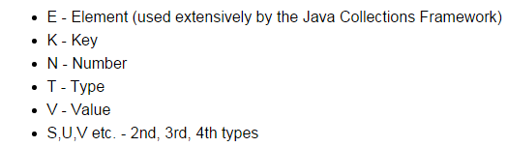
Commonly used type variables:

Slide 8
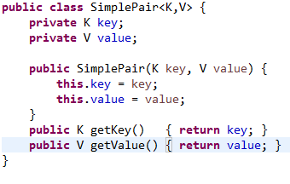
Creating Your Own Generic Class or Interface
Notes:
The class declaration introduces type variables K, V. These can then be used in the body of the class as types for variables and method arguments and return types. The same principle applies when defining a generic interface.
The type variables may be realized as any Java object type (even user-defined), but not as a primitive type.
Usage Example:
SimplePair<Integer,String> pair
= new SimplePair<>(10123, "Jim"); String employeeId = pair.getKey(); //returns Jim's ID

Slide 9

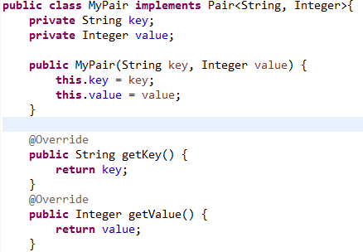
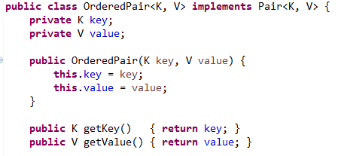
Implementing a Generic Interface
One way: Create a parametrized type implementation
Another way: Create a generic class implementation
See Demo: lesson1.generics.pairexamples
Notes:
The same points apply for extending a generic class:
Class MyList<T> extends List<T>{}
Or
Class MyList extends ArrayList<String>{}

Slide 10

Generic Methods
Generic methods are methods that introduce their own type parameters. This is similar to declaring a generic type, but the type parameter's scope is limited to the method where it is declared. Static and non-static generic methods are allowed, as well as generic class constructors.

Slide 11


Calling a Generic Method
Earlier versions of Java required that you specify the generic type arguments when calling a generic method (see below), but current versions are always able to infer types, so the type arguments can be left out.
The complete syntax for invoking this method would be:
The generic type(s) can always be inferred by the compiler, and can be left out.

Slide 12
Main Point
Generic methods make it possible to create general-purpose methods in Java by declaring and using one or more type variables in the method. This allows a user to make use of the method using any data type that is convenient, with full compiler support for type-checking.
Likewise, when individual awareness has integrated into its daily functioning the universal value of transcendental consciousness, the awareness is maximally flexible, able to flow in whatever direction is required at the moment, free of rigidity and dominance of boundaries.

