Slide 1
Introduction to computer programming

Slide 2
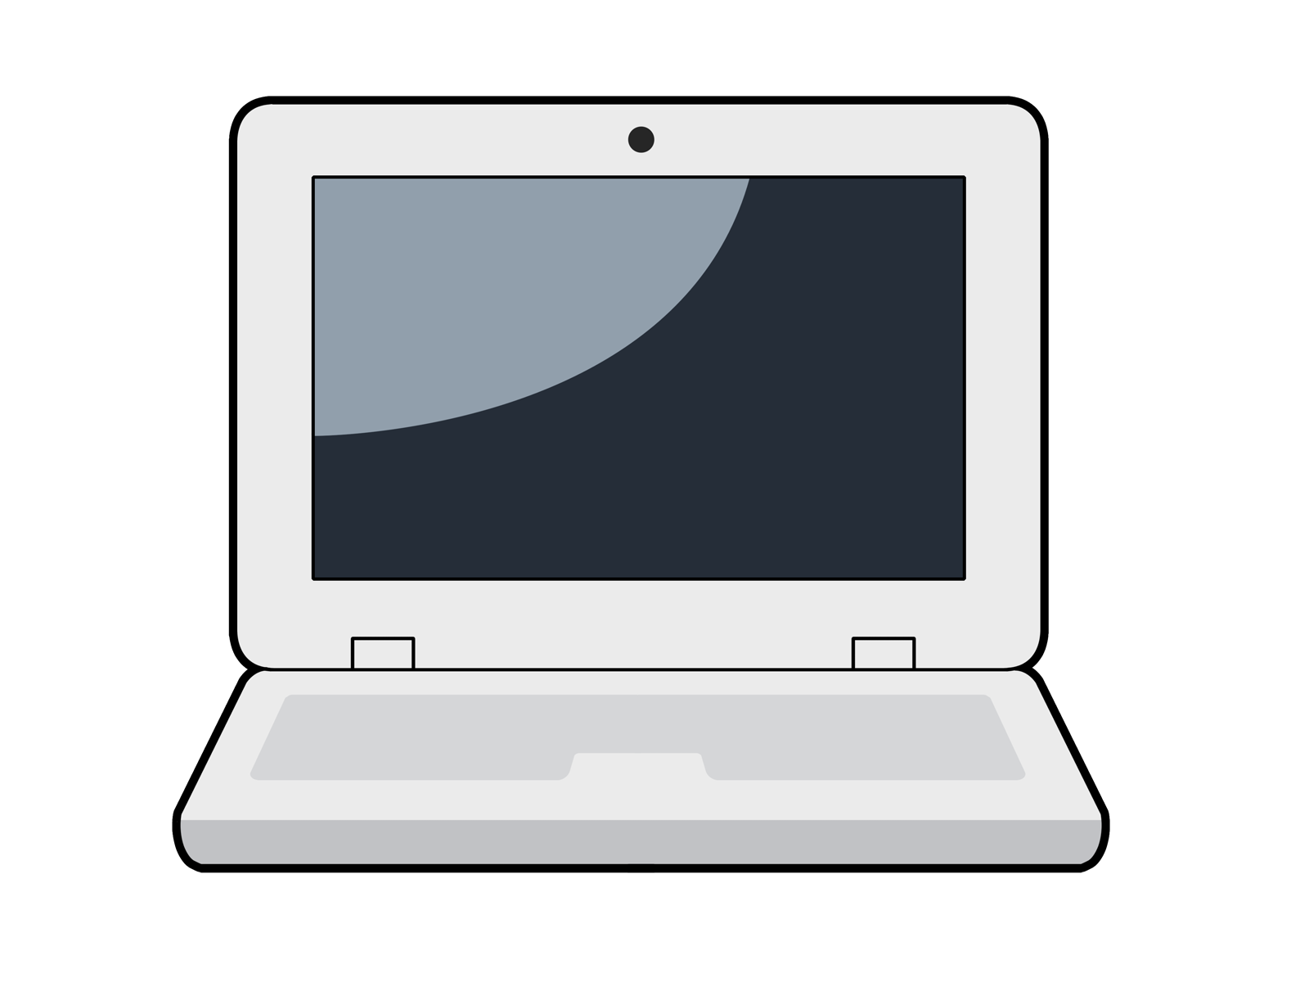
Computer
A computer can do many things with its
high computing power and
large memory
But, it needs to be programmed to perform a specific task or solve a certain problem.

Slide 3
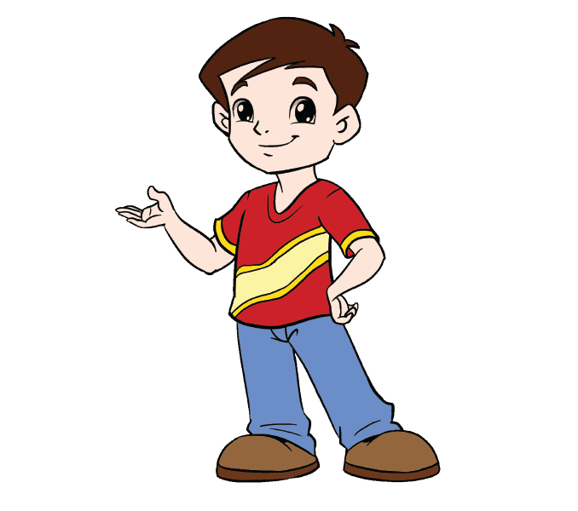
programming
Programming is telling a computer what to do.
0101011101101000011000010111010000111111
Hey computer, do something!

Slide 4

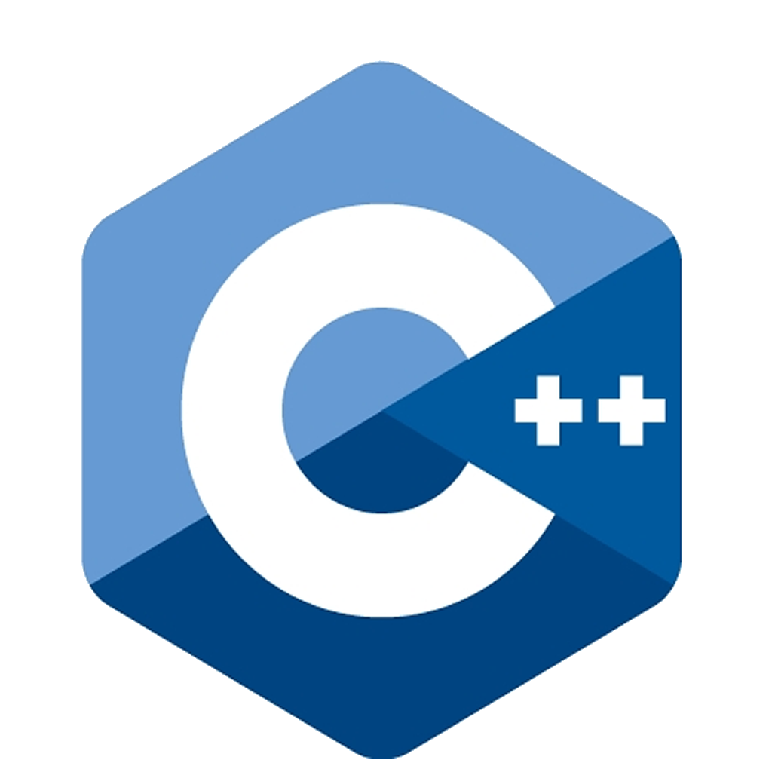

Programming languages
A programming language is a set of vocabulary and grammatical rules for instructing a computer or computing device.
Each has a unique set of keywords that it understands and a special syntax for organizing instructions.

Slide 5
Syntax semantic and pragmatic
Syntax : the structure or grammar of the language (How to construct a valid sentence?)
Semantic : the meaning of the sentence (What does a sentence mean?)
Pragmatic : the right usage of the language (How the language is used?)

Slide 6
Language Hierarchy
High Level Language
Assembly Language
Machine Language
Computer Hardware

Slide 7
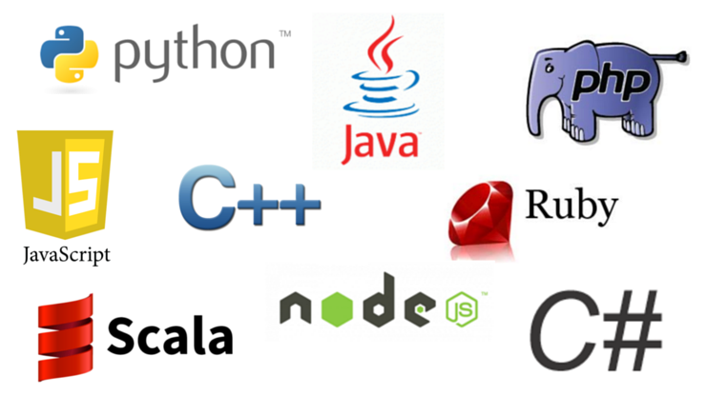
High level programming languages
Human readable
Used by developers to create software and applications across various platforms
Can’t be understood by the machine directly

Slide 8
Compiler and interpreter
Programs written in high level languages must be translated into a format the computer can understand (machine code) before they can be run.
There are two primary ways:
Compiling
Interpreting

Slide 9
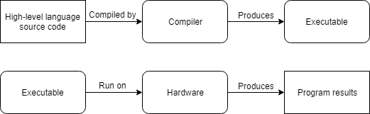
Compiler
A program that reads source code and produces a stand-alone executable program
Need to be run only once
Can do optimizations

Slide 10
Interpreter
A program that directly execute the source code
Need to interpret every time the program is run
More flexible than compilers but less efficient

Slide 11
Introduction
Created by Guido van Rossum
High level, interpreted language
Multiple programming paradigms (OOP, functional programming)
Two major versions (Python 2 and Python 3) not compatible with each other
Free, open-source, portable and platform independent
Simplicity, readability, fast development

Slide 12
Is used
Game development
Web development
Software development
Raspberry Pi
AI and machine learning

Slide 13
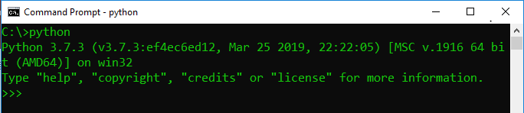
Getting started
Being an interpreted language, the python interpreter is necessary. Open the command prompt and try typing “python” and press “Enter”.
If it results as the following, python is already installed.
If not, you need to install python first!

Slide 14
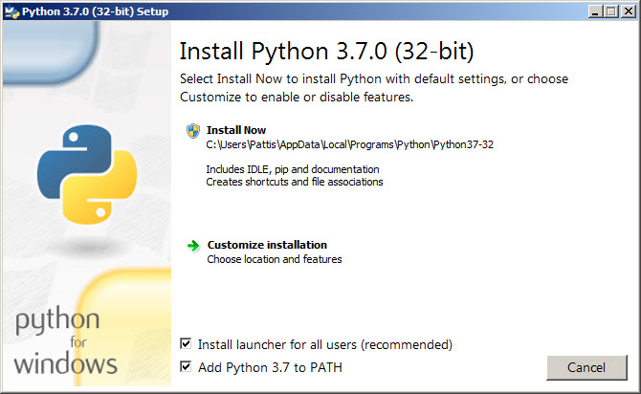
You can get the installer from https://www.python.org/downloads/, the python official website.
Run the installer! You will see the following window.

Slide 15
Interactive mode
Good for learning, testing and exploring new things.
Cannot save the statements written.
You can get into this mode with the command “python” and quit with “Ctrl+Z”
Three options:
python –c command
python –m module
python –i filename

Slide 16
ide
IDE (Integrated Development Environment) is a software application that provides comprehensive facilities to programmers.
An IDE normally consists of a source code editor and build automation tools
There are many IDEs to develop python. (Eclipse with PyDev, spyder, VScode, sublime text, pycharm, etc.)
You can also use IDLE already installed together with python.

Slide 17



Python syntax
A line is considered terminated with newline character.
Block of codes are written with indentation.
Comments are written with “#” prefix.

Slide 18
Writing a python file
Python files have extension “.py”.
Create a new file and type “print(‘Hello World’)” then save as “hello.py”.
A python file can be run from –
IDE
Command prompt

