Slide 1
Python basics
Part - I

Slide 2

Data types
A data type is categorization of data of different types.
A data type defines set of values along with operations that can be performed on those values.
Explicit values are known as literals. (10, 3.14, ‘python’, [1,2,3])
Each literal has a type. (int, float, string, list)

Slide 3
Python’s Core types
Numbers
Strings
Lists
Dictionaries
Tuples
Files
Sets
Booleans
Types
None
Functions, modules, classes
Compiled code

Slide 4
Everything is object
Everything in python is treated as Objects.
Every object has an identity, a type and a value.
id() function can get the identity.
type() function can get the type.
All the available functions supported by an object can be get with dir() function.

Slide 5
Numbers
Integers
No range limit
Sequence of digits without any prefix is interpreted as decimal numbers
Prefix ‘0b’ for binary numbers
Prefix ‘0o’ for octal numbers
Prefix ‘0x’ for hexadecimal numbers
Type ‘int’

Slide 6
Numbers
Floating-point numbers
Real numbers with decimal point
No range limit
Type ‘float’
Complex numbers
Represented with real part and imaginary part
Example (-5+3j)
Type ‘complex’

Slide 7

numbers
Fractional numbers
Numbers that are represented with a numerator and a denominator
Can be implemented with ‘fractions’ module
Example :
Type ‘fractions.Fraction’

Slide 8
strings
Strings are sequences of characters.
String literals may be delimited using either (‘ ’), (“ ”), (‘’’ ’’’) or (“”” “””).
All the characters between the opening delimiter and the matching closing delimiter are part of the string.
Example : ‘hello’, “python”
Type ‘str’

Slide 9
Lists
An ordered collection of one or more data items, not necessarily of the same type, put in squared brackets ‘[]’ and separated by comma
Each item is assigned with an integer that is the position of that item.
Example : [1, 2, 3], [‘python’, ‘java’, ‘c#’], [[0, 1], [1, 0]]
Type ‘list’

Slide 10
tuples
An ordered collection of one or more data items, not necessarily of the same type, put in parentheses ‘()’, separated by comma
Each item is assigned with an integer that is the position of that item.
One element tuple is (‘world’,).
Example : (1, 2, 3), (‘python’, ‘java’, ‘c#’), ((0, 1), (1, 0))
Type ‘tuple’

Slide 11
dictionaries
An unordered collection of data items in ‘key: value’ pair form and enclosed in curly brackets ‘{}’.
Key can be any data type but not list and dictionary and must be unique in a dictionary.
Value can be any data types with no exceptions.
Example : {‘name’: ‘John’, ‘age’: 30, ‘jobs’: [‘singer’, ‘doctor’, ‘actor’]}
Type ‘dict’

Slide 12
sets
A set is an unordered, unindexed collection of data items, not necessarily of the same type enclosed in curly brackets ‘{}’.
No duplicate items can be put into a set.
Example : {‘apple’, ‘banana’, ‘orange’}
Type ‘set’

Slide 13
Booleans
Data with one of two built-in values True or False.
True can be considered as integer 1.
False can be considered as integer 0.
Type ‘bool’

Slide 14
Mutable immutable
Data objects whose values can be modified during processing are said to be mutable.
Can’t be hashable.
Lists, dictionaries
Data objects whose values can’t be altered once they are created are said to be immutable.
Can be hashable.
Numbers, strings, tuples, sets

Slide 15
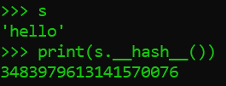
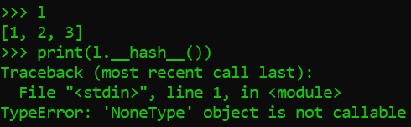
Hashable unhashable
If an object’s __hash__() method returns a value, that object is hashable.
If an object’s __hash__() method returns None, that object is unhashable.

Slide 16
variables
Something that can change
A way of referring to a memory location which may contain values like numbers, strings or other types
No pre declaration is required
Both the value and type may change during program execution

Slide 17
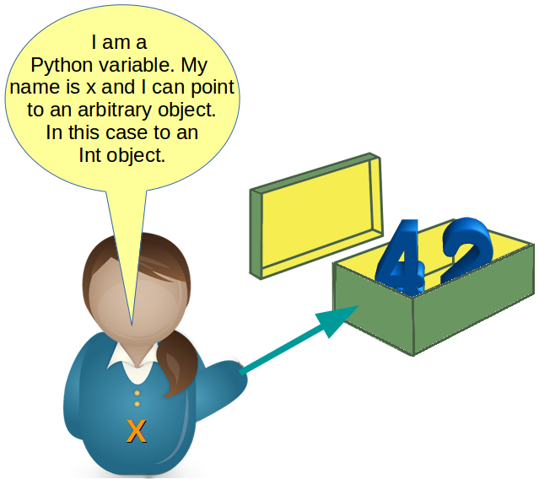
Object references
As variables are pointing to objects and objects can be of arbitrary data type, variables cannot have types associated with them.

Slide 18
Naming rules
To name a variable, the following rules must be followed.
can begin with underscore ‘_’ or letter (a-z, A-Z)
can contain alphanumeric characters and underscore ‘_’
can not use keywords or reserved words
case sensitive
can not contain any punctuation characters

Slide 19
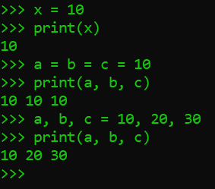
Assigning variables
Variables can be assigned in many ways.
Single variable assignment
Multiple variable assignment
Single value to multiple variable
Multiple values to multiple variables

Slide 20
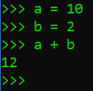
operators
Special symbols that carry out arithmetic or logical computation
Can manipulate the value of operands
An operand is the value that the operator operates on.
In the sample code, ‘a’ and ‘b’ are the operands and ‘+’ is the operator.

Slide 21
Types of operators
There are many types of operators in Python.
Arithmetic Operators
Comparison (Relational) Operators
Assignment Operators
Logical Operators
Bitwise Operators
Membership Operator
Identity Operator

Slide 22
Arithmetic operators
Operator | Meaning | Example | Precedence
+ | Addition | 4 + 7 => 11 | 3
- | Subtraction | 2 – 9 => -7 | 3
* | Multiplication | 3 * 4 => 12 | 2
/ | Division | 7 / 4 => 1.75 | 2
% | Modulus (Remainder) | 7 % 4 => 3 | 2
// | Floor division (Quotient) | 7 // 4 => 1 | 2
** | Exponent | 3 ** 5 => 243 | 1

Slide 23
Comparison operators
Return Boolean type value True or False
Operator | Meaning
== | Equal to
!= | Not equal to
> | Greater than
< | Less than
>= | Greater than or equal to
<= | Less than or equal to

Slide 24
Bitwise operators
Operator | Meaning | Example
& | Binary AND | 9 & 10 => 8
| | Binary OR | 9 | 10 => 11
^ | Binary XOR | 9 ^ 10 => 3
~ | One’s complement | ~10 => -11
<< | Left shift | 8 << 2 => 32
>> | Right shift | 8 >> 2 => 2

Slide 25
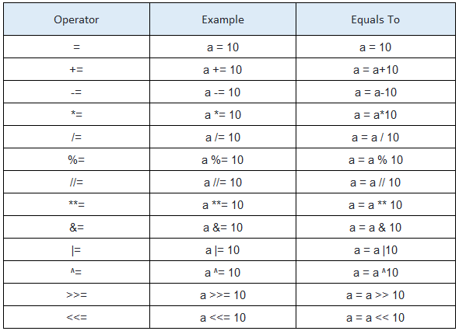
Assignment operators

Slide 26
Logical operators
Operator | Operation | Result
and | False and False | False
 | False and True | False
 | True and True | True
 | True and False | False
or | False or False | False
 | False or True | True
 | True or True | True
 | True or False | True
not | not False | True
 | not True | False

Slide 27
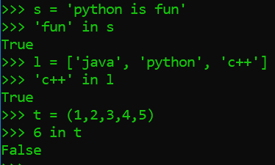
Membership operator
The operator is “in”.
It is used with the sequence type objects to check whether a certain value contains or not.
Return Boolean value True or False.

Slide 28
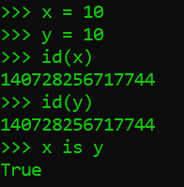
Identity operator
The operator is “is”.
It is used to check whether the two values are identical or not.
In other words, it is checking the memory location (id) of the values.
Return Boolean value True or False.

