Slide 1
Python basics
Part - II

Slide 2

Input and output
input(prompt = None)
Standard input
print(value,…, sep = ‘ ‘,
end = ‘\n’, file = sys.stdout,
flush = False)
Standard output
Both input() and print() are built-in functions.

Slide 3
Sequence type operations
Sequence type objects string, list and tuple have these common operations.
Sorting
Maximum
Minimum
Getting length
Indexing
Slicing
Concatenation
Repetition
Membership

Slide 4
Getting length
The length of a sequence type object can be get with the function “len()”.
The length means the number of items in that object.
len(‘Python is fun’) will result 13 which is the number of characters in the string
len([‘car’, ‘bike’, ‘plane’]) will result 3 which is the number of items in the list

Slide 5
Indexing
The items in a sequence type object can be accessed through indices.
Index is an integer number which is automatically assigned when the object is created.
Indices start from zero (0) which means the first item (leftmost one) is at the index 0.
Indexing syntax
var_name[index]
Python also supports negative indexing

Slide 6
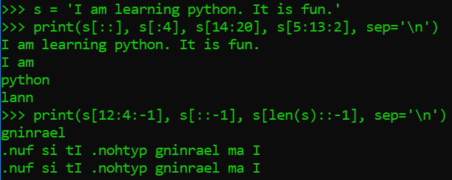
Slicing
Slicing can be used to access ranges of elements by providing indices and step(optional).
General syntax:
var_name[start:end:step]

Slide 7
Concatenation
Concatenation means joining things together.
Operator : +
Works on : strings, lists, tuples
Returns the new concatenated value without effecting the original values.

Slide 8

repetition
Repetition is joining itself with its own value several times.
Operator : *
Works on : strings, lists, tuples
Returns the new repeated value without effecting the original value.

Slide 9
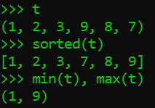
Sorted max and min
sorted() function is used to sort any sequence type objects (list, tuple, string). The result is a list sorted in ascending order.
max() function is used to get the maximum value in a sequence.
min() function is used to get the minimum value in a sequence.

Slide 10
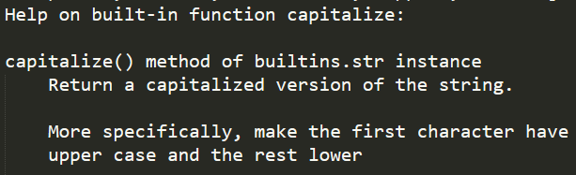
More on strings
The functions supported by the str object can be get with dir() function. And help() function can show the brief documentation of each function.
Example:
s = ‘a string’
dir(s)
help(s.cpitalize)

Slide 11
String formatting (one way)
Formatting strings is an important operation.
It formats the strings to be outputted at the console.
Example:
string = ‘I am %s. I was born in %s.’
values = (‘Bo Bo’, ‘Yangon’)
print(string % values)
conversion specifiers

Slide 12
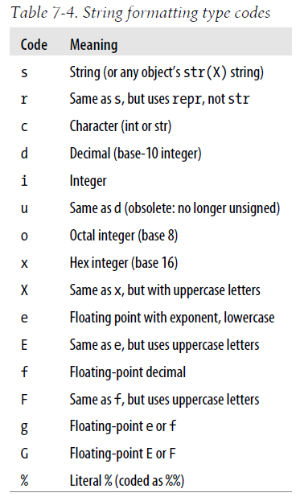

Slide 13
Another way
Using with format() function
Example:
‘{} {} and {}’.format(‘first’, ‘second’, ‘third’)
‘{2} {0} {1} {3} {2} {0}’.format(‘be’, ‘or’, ‘to’, ‘not’)
‘My name is {name}. I am a {job}’.format(name = ‘Bo Bo’, job = ‘doctor’)

Slide 14
Replacement fields can contain
Field name
Conversion flag
Format specifier
Examples:
"{foo} {} {bar} {}".format(1, 2, bar=4, foo=3)
print("{pi!s} {pi!r} {pi!a}".format(pi=chr(960)))
"The number is {num:f}".format(num=42)
"The number is {num:b}".format(num=42)

Slide 15
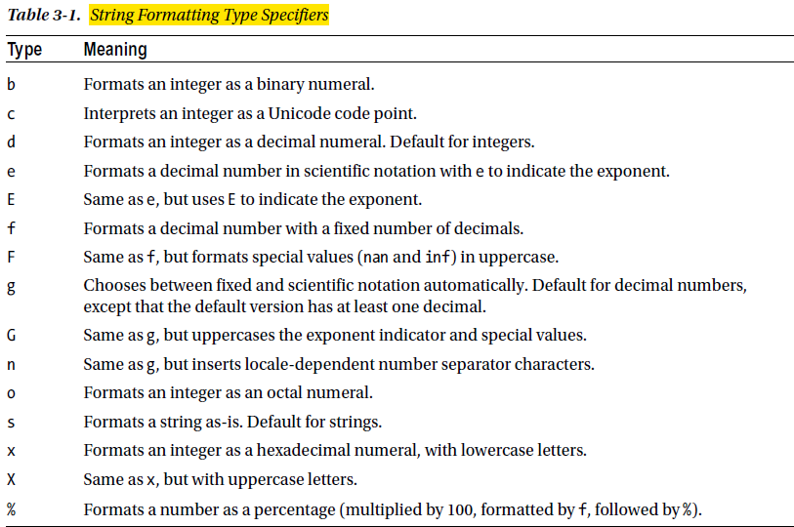

Slide 16
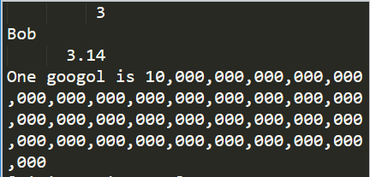
Width, precision, thousands separator
"{num:10}".format(num=3)
"{name:10}".format(name="Bob")
"{pi:10.2f}".format(pi=pi)
'One googol is {:,}'.format(10**100)

Slide 17
Signs alignment zero padding
print('{0:<10.2f}\n{0:^10.2f}\n{0:>10.2f}'.format(pi))
'{:010.2f}'.format(pi)
"{:$^15}".format(" WIN BIG ")
print('{0:10.2f}\n{1:10.2f}'.format(pi, -pi))
print(‘{0:=+10.2f}\n{1:=+10.2f}'.format(pi, -pi))

Slide 18
More on lists
list() function can be used to convert sequence type objects to list.
Example:
str to list => list(‘Hello World!’)
list to str => ‘’.join(a_list)
Lists can be changed as they are mutable.

Slide 19
Changing list
The elements in a list can be changed in place by assignment.
Example: x = [1, 2, 2]
x[2] = 3
Elements in a list can be deleted with del statement.
Example: x = list(‘pytthon’)
del x[2]

Slide 20
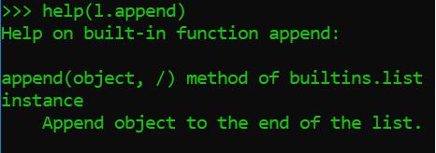
List methods
A list has the following methods.
append
clear
copy
count
extend
sort
Take a look what they do with help() function.
index
insert
pop
remove
reverse

Slide 21
More on tuples
Tuples can’t be changed in place like lists as they are immutable.
When creating a tuple, parentheses can be omitted.
tuple() function convert sequence type objects to tuple.
Tuples can be used as keys in dictionary and members of set
There are only two methods : count() and index()

Slide 22
More on dictionaries
a data structure in which you can refer to each value by name
the only built-in mapping type
the values don’t have any particular order, stored under a key
A dictionary can be created as the following…
key
value
an item

Slide 23
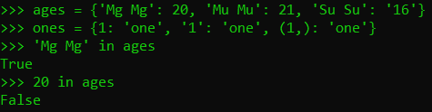

Constraints on keys
must be unique
can be of any immutable type
numbers
strings
Tuples
membership function always looks for key

Slide 24
Dictionary methods
clear
removes all items from the dictionary
in-place operation
returns None
copy
returns a new dictionary with the same key-value pairs (shallow copy)
to perform deep copy, use the module copy
from copy import deepcopy

Slide 25
fromkeys
create a new dictionary with the given keys, each with default corresponding value of None
default value None can be changed
dict.fromkeys([‘name’, ‘age’])
dict.fromkeys([‘name’, ‘age’], ‘val’)
get
a way of accessing dictionary items
no error with the keys that does not exit and returns None by default
default value None can be changed
d = {}
d[‘name’]
d.get(‘name’)
d.get(‘name’, ‘not found’)

Slide 26
items
returns all the items as a list in which each item in the form (key, value)
return type is called dictionary view and can be used for iteration.
keys
returns a dictionary view of the keys
pop
can be used to get the value of a given key and then remove that key-value pair
popitem
remove and return some (key, value) pair as a 2-tuple
raise KeyError if the dictionary is empty

Slide 27
setdefault
retrieves a value with a given key
if key doesn’t exist, set a value with that key
update
updates one dictionary with the items of another
values
returns a dictionary view of the values
the returned values may contain duplicates

Slide 28
String formatting with dictionaries
String formatting can be performed with dictionary by using the function “format_map”.
Example:
phonebook = {‘Beth’ : ‘9102’ , ‘Alice’ : ’2341’ , ’Ceil’ : ’3258’}
“Ceil’s phone number is {Ceil}.”.format_map(phonebook)

Slide 29
more on sets
unordered collection type, mutable, unique elements
{} or set() or frozenset() function can be used to create sets
to create empty set, use only set() as {} will create empty dictionary.
frozenset() is just like set() but immutable
supports all mathematic operations that can be performed on sets

Slide 30
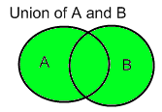
methods on set
add
adds a new item if it is not in the set
p = {‘John’, ‘Mary’, ‘Susan’}
p.add(‘Mike’)
union (|)
returns a union of two sets
p = {‘David’, ‘Luke’}
g = {‘Karan’, ‘Arjun’, ‘Jay’}
p.union(g)
p|g

Slide 31
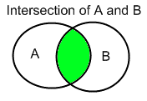
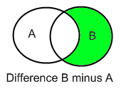
methods on set
intersection (&)
returns an intersection of two sets
s1 = {1,2,3,4}
s2 = {3,4,5,6}
s1.intersection(s2)
s1 & s2
difference (-)
returns a set with all the elements of invoking set which are not in the second set
s1.difference(s2)
s1 – s2

