Slide 1
Python basics
Part – III

Slide 2

statements
Programs are composed of modules.
Modules contain statements.
Statements contain expressions.
Expressions create and process objects.
Each statement has it’s own specific purpose and syntax. many statements share common syntax patterns, and some statements’ roles overlap. They can perform actions, repeat tasks, make choices, build larger program structures, and so on.

Slide 3


blocks
A block is a group of statements that can be executed.
A block is created by indenting.
Each line in a block must be indented by the same amount.
C++
Python

Slide 4
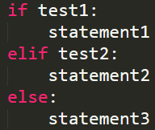
Conditional statements
Conditional statements (if statements) are used to make choices and decisions according to a condition.
The general format:
can contain one or more
optional

Slide 5
special “if” rule ternary operator
When there is only one expression to be executed that expression can be written in a single line.
Example:
a, b = 10, 20
min = a if a < b else b
print(‘a and b are equal’ if a == b else ‘a is greater’ if a > b else ‘b is greater’)

Slide 6
loop statements
Loop statements are used to repeat a statement or group of statements while a given condition is true or for a certain number of times.
Python provides the following types of loops
while loop
for loop
block of codes
Condition
True
False

Slide 7
while loop
In while loop, the target statement is repeatedly executed as long as the given condition is True.
syntax:
while expression:
statements
statements

Slide 8
for loop
for loops are used to execute a target statement for a certain number of times or to iterate the elements in a sequence type object (str, list, tuple, dictionary, range).
syntax:
for iterating_variable in sequence:
statements
statements

Slide 9
else clause in loops
An optional else clause can be added at the end of the loop statements. That else block is run when the loop is over normally.
while condition:
statements
statements
else:
statements
for var in sequence:
statements
statements
else:
statements

Slide 10
loop control statements
Loop statements are very useful for executing a certain task repeatedly. But, you may want to exit a loop completely or skip specific part of a loop on a specified condition.
Loop control statements can alter or control the flow of loop based on specified conditions.
break
&
continue

Slide 11
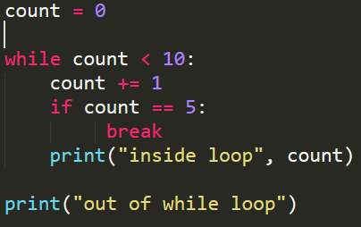
break statement
Inside any loops, when break statement encounters, it breaks or terminate that loop by skipping all the rest of iterations.

Slide 12
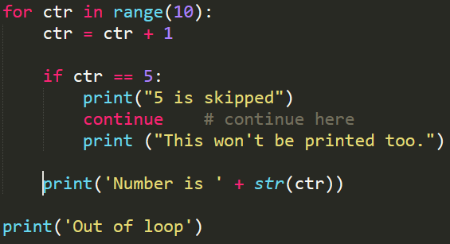
continue statement
Inside any loops, when a continue statement encounters, it skips the rest of statements inside that loop for only the current iteration.

Slide 13
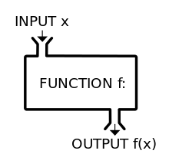
functions
A block of re-usable code to perform specific tasks under a name
Two main kinds : user-defined and built-in
Functions are also treated as objects
Functions make a program more organized, easy to maintain and can support modular design approach.

Slide 14
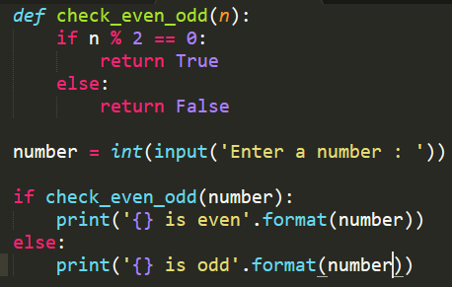
Defining functions
function name
parameters
keyword
function body
function call

Slide 15
arguments
Four different types of arguments can be passed when a function is invoked.
Default arguments
Required arguments
Keyword arguments
Variable number of arguments

Slide 16
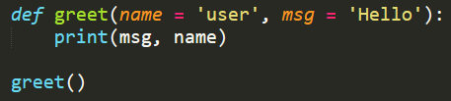
default arguments
Default arguments indicate that the function will take that value if no argument is passed during the function call.
Default value is assigned when the function is defined.

Slide 17
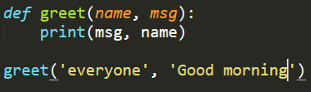
required arguments
Required arguments must be passed in correct number and order during function call.

Slide 18
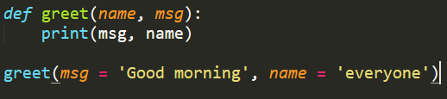
keyword arguments
The keywords or the parameter names are mentioned during function calls. They can be passed in any order.

Slide 19
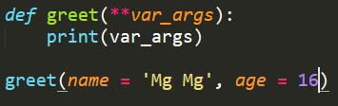
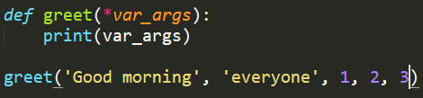
variable number of arguments
When the exact number of arguments to be passed is unknown, this is the way. Any number of arguments can be passed during function calls.

Slide 20

return statement
The return statement exits a function optionally passing back the values or expressions to the caller. A return statement with no argument is the same as return None.

Slide 21
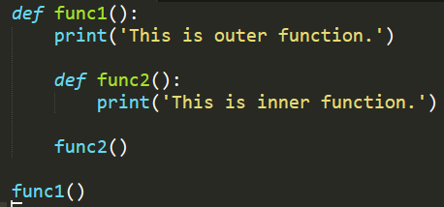
Functions inside functions
Functions can also be defined nested inside another function.
Inner functions cannot be called from outside (global scope)
So, if the outer function is not called, the inner functions will never run.
Inner functions are used to be protected from outside.

Slide 22
Namespaces
A name is just a way to access a variable and acts as a reference to get the objects.
A namespace controls the names in a program to be unique and won’t lead to any conflict. Namespaces are in the form of dictionaries.
Local namespace (local names inside a function)
Global namespace (names from imported modules)
Built-in namespace (names of built-in functions and exceptions)

Slide 23
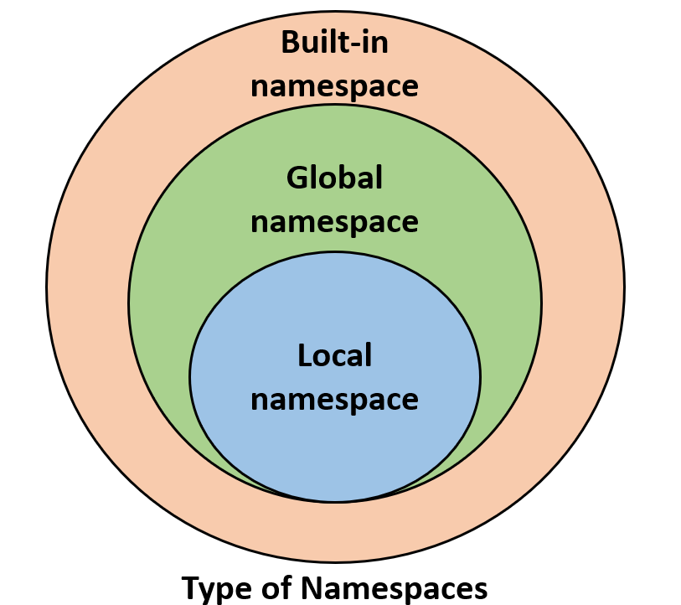

Slide 24
Scopes
A variable name can’t be used from anywhere we want. The scope determines the parts of the program where you could use a name.
Scope resolution for a given name begins from the inner-most function and then goes higher and higher until the program finds the related object.
If the search ends without any outcome, then the program throws a NameError exception.

Slide 25
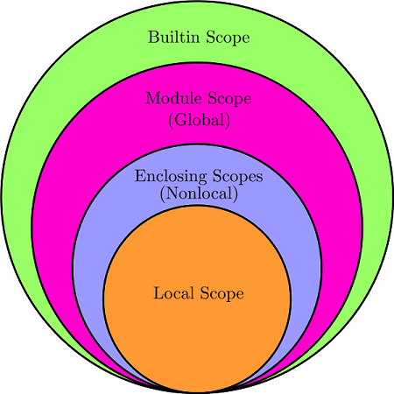
Types of Scopes

Slide 26
Anonymous functions (Lambda operator)
lambda operator is a way to create small anonymous functions.
They can have any number of arguments but only one expression.
lambda functions are mainly used in combination with the functions filter(), map() and reduce().
General syntax :
Returns a function object.
lambda arg_list: expression

Slide 27
map function
map() function is used to apply a function on all elements of specified iterable.
Returns iterable map object that can be converted to list or tuple.
General syntax :
If many iterables are passed, the map function stops when the shortest iterable is exhausted.
map(func, *iterables)

Slide 28
Filter Function
filter() function takes two arguments : function_object and iterable.
The function must return a Boolean value.
filter() function returns an iterable object with elements that make the function return True.
General syntax :
If None is passed as first argument, the items from iterable which evaluate to True will be returned.
filter(func, iterable)

Slide 29
reduce function
reduce() function is used to apply a particular function to all of the list elements and is defined in functools module.
It reduces to a single value and return that value.
It takes two arguments : function object and iterable.
General syntax :
functools.reduce(func, iterable)

Slide 30
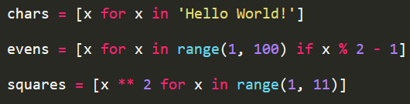
List comprehension
List comprehension is a very powerful and useful way to create and define lists from any iterable.
General syntax :
The additional for or if clauses can follow.
Example :
aList = [x for x in iterable]

Slide 31

Dictionary comprehension
Dictionary comprehension is also a way to create dictionary objects and is similar to list comprehension.
General syntax :
value can also be expressions and additional if clauses can follow.
Example :
aDict = {key: value for (key, value) in iterable}

Slide 32
iterable
An iterable is any object in Python which has an __iter__ or __getitem__ method defined which returns an iterator.
Example : str, list, tuple, range, dict, set
next()
x = [1, 2, 3]
iter()
iterator
1
2
the iterable
the iterator
3

Slide 33
Iterator
An iterator is an object representing a stream of data and can be created by applying the iter() built-in function to an iterable.
An iterator is any object in Python which has a __next__ function defined.
next()
x = [1, 2, 3]
iter()
iterator
1
2
the iterable
the iterator
3

Slide 34
iteration
Iteration means taking each item of something, one after another when looping through the objects or items in a collection.
next()
x = [1, 2, 3]
iter()
iterator
1
2
iterations
the iterable
the iterator
3
StopIteration

Slide 35
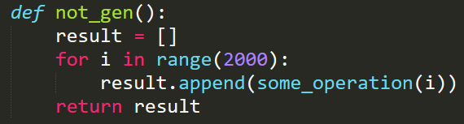
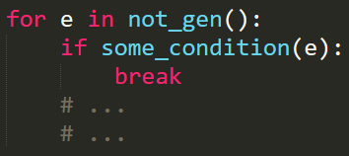
Generators
A generator can be used to let a function return a list of values without having to store them all at once in memory.
No need to wait until all the values are computed.

Slide 36
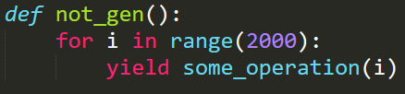
A normal function to a generator
A normal function can be turned into a generator by using “yield” statement.
“yield” statement pauses the function saving all its state and later continues.
When a generator function is called, an iterator object is returned.

Slide 37
Generator comprehension
A simple generator can be defined in a single line of code using generator comprehension.
The difference with list comprehension is that generator comprehension returns an iterator.
General syntax :
(<expression> for <var> in <iterable> if <condition>)

Slide 38
Find all of the numbers from 1-1000 that are divisible by 7
Find all of the numbers from 1-1000 that have a 3 in them
Remove all of the vowels in a string
Find all of the words in a string that are less than 4 letters

