Slide 1



Homework 01
Tell me about yourself, what and how do you like to study from MIP 330
Produce one your favorite AIGC content with prompts

Slide 2
Homework 01
我是来自计算机系的大四学生王谦益，我选这门课是想学习有关音频、图像处理以及动画相关的知识。我想学习这些方面的算法以及相关应用。

Slide 3
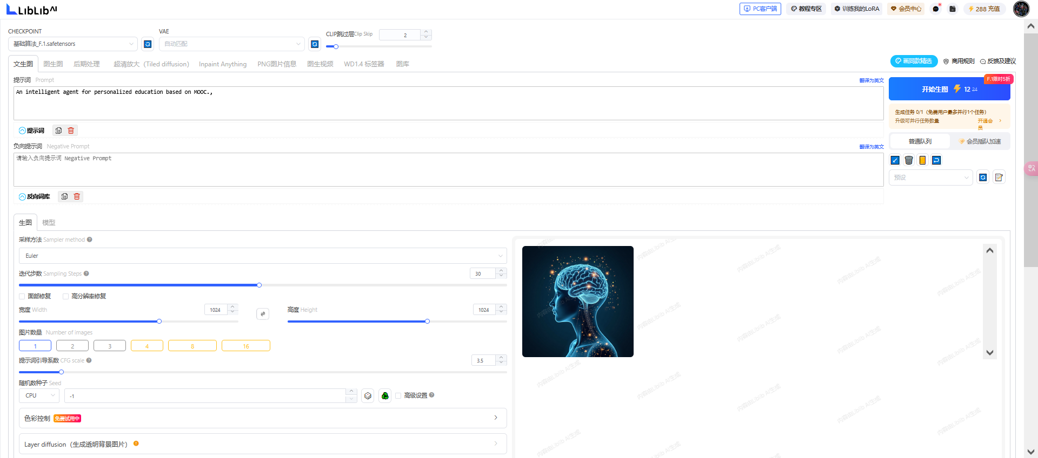

Slide 4
Homework 01 (Lab)
Think of a project topic to work on and submit
Start to form your group before end of Lecture 3, if you have formed your group, and nominate a group leader, and ask the group leader to add me as friend in Wechat

Slide 5
Homework 01 (Lab)
基于MOOC的个性化教育智能体

