Slide 1

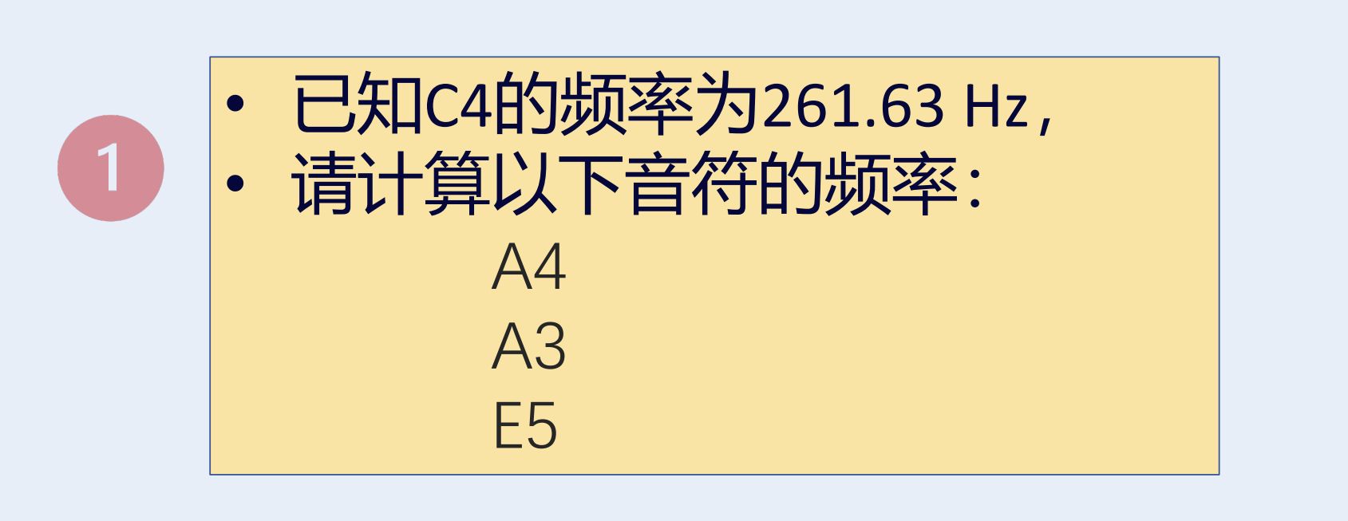
Homework 08-1

Slide 2
Homework 08-1
C4的频率是261.63Hz，f = f_{基准}​·2^{n/12}（n为半音数）
A4：比C4高9个半音，n = 9
f_{A4}​ = 261.63Hz·2^{9/12} ≈ 440.00Hz
A3：比C4低36个半音，n = -36
f_{A3} ​= 261.63Hz·2^{−36/12} ≈ 32.70Hz
E5：比C4高16个半音，n = 16
f_{E5} ​= 261.63Hz·2^{16/12} ≈ 659.26Hz
因此，A4是440.00Hz，A3是32.70Hz，E5是659.26Hz

Slide 3

Homework 08-2（问卷调查）
https://www.wjx.cn/vm/wi0PvkV.aspx#

