Slide 1
Customized Food Cooking Technology
customize your own favorite dishes
汇报人：王谦益

Slide 2
Contents
01.
02.
03.
04.
Future
Scenario
Technology
Speculation
Sci-fi work
Comparison
Visualization
Image

Slide 3
Future Scenario
Part One

Slide 4
Background Settings
Food supply is no longer a problem
people are looking for flavor and nutrition

Slide 5
Technology Speculation
Part Two

Slide 6
4 Sections
Get the requirements
need — associate cases / scan physical statement
want — brain wave detection / speech recognition
Custom recipes
AI learns different recipes & ingredients
suggest / select the production method
Cook the food
biological manufacturing — precision synthesis and production optimization
high-end technologies — achieve precise regulation at the molecular level
Extended function
VR & AR — show comprehensive information
Notes:
3.1 such as cell culture, fermentation engineering
3.2 such as bioengineering and nanotechnology

Slide 7
Sci-fi work Comparison
Part Three

Slide 8
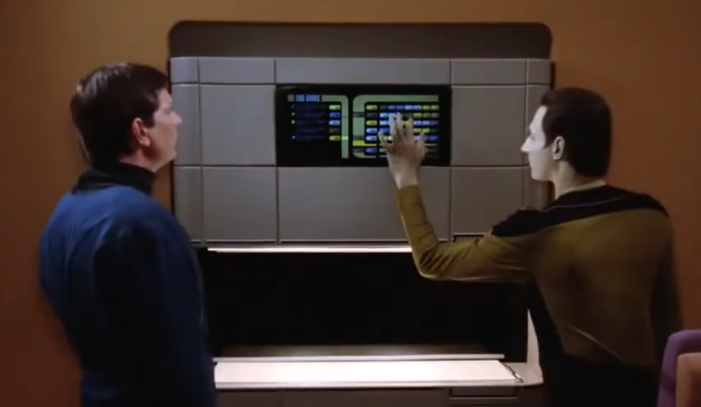
Star Trek
replica technology
the user describes the food they want and it is generated out of thin air in a short time
same
customized food production
differences
theory
direct molecular level construction
raw material processing
purpose
Making food itself (replication)
Pursuing taste and nutrition (customization)

Slide 9
Visualization Image
Part Four

Slide 10
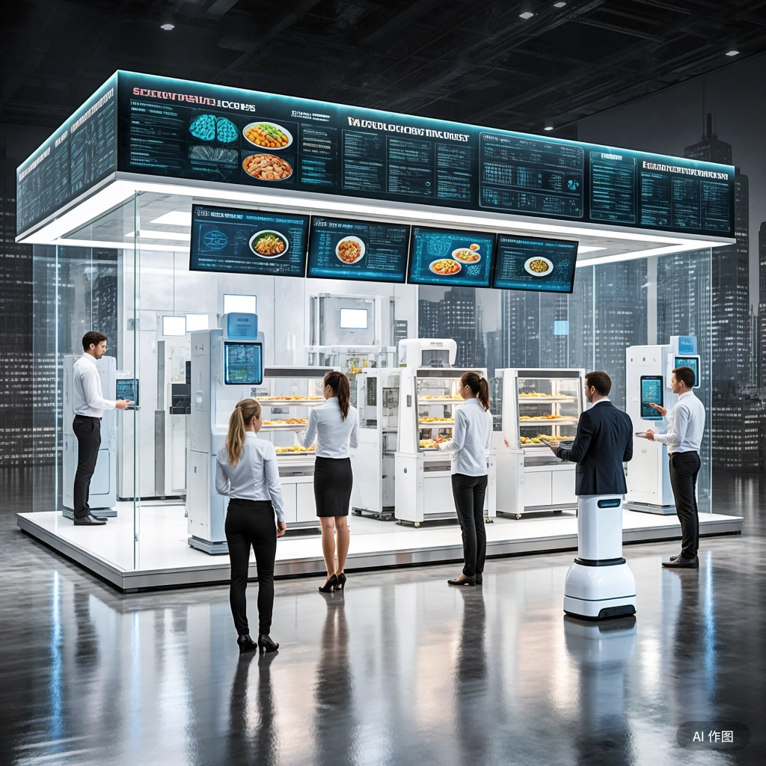
文心一言
# Customized Food Cooking Technology
## Part 1 —— Future Scenario
- background settings:
- 食物供应问题不再是难点
- 人们开始追求风味与营养
## Part 2 —— Technology Speculation
### 2.1 step 1 —— 获取需求
- 需要 vs 想要：
- 需要 —— 关联病例 / 实时扫描身体状态
- 想要 —— 脑波检测 / 语音识别
### 2.2 step 2 —— 定制菜谱
- 个性化服务：
- AI综合学习各种食谱与食材
- 推荐 / 辅助筛选制作方式
### 2.3 step 3 —— 烹饪食物
- 智能烹饪：
- AI总体把控
- 生物制造（如细胞培养、发酵工程） —— 精准合成与生产优化
- 生物工程、纳米技术等高端科技 —— 实现分子级别的精准调控
### 2.4 step 4 —— 扩展功能
- 信息展示 —— VR、AR：
- 食物来源 —— 区块链溯源与供应链管理
- 烹饪过程 —— 动漫化食品加工制作流程
根据上述内容，生成一张图片（Utilize AI tools to create an image
that visualizes the future city or urban life as you imagine it）

Slide 11
Reference
中国食品科学技术学会, 国际食品科技联盟. 聚焦生物制造 拥抱人工智能——全球食品产业未来发展热点[C]//2025年国际食品安全与健康大会. 北京, 2025.
佚名. 这11项创新技术将颠覆你对未来食品的想象[EB/OL]. (2025-05-28)[2025-05-28]. https://bbs.360.cn/forum.php?mod=viewthread&tid=15487663&extra=page%3D1&page=1&archive_src=bbs_smart.
佚名. 探索食品科技新潮流：味蕾与科技的完美碰撞![EB/OL]. (2025-05-28)[2025-05-28]. https://baijiahao.baidu.com/s?id=1822819003526694126&wfr=spider&for=pc.

Slide 12
Thank you for listening
汇报人：王谦益

