Slide 1




Intelligent Interactive Assessment System for Students' Writing Level based on Large Model 基于大模型的学生写作水平智能交互评估系统研发
Instructor: Jimmy Liu, Xiaoqing Zhang
Group member: Tianrui Wang, Qianyi Wang, Peng Sheng
2024.11.04

Slide 2
1
BackGround
2
Experiment Works
3
Future Works

Slide 3
BackGround
1

Slide 4
Experiment Works
2

Slide 5
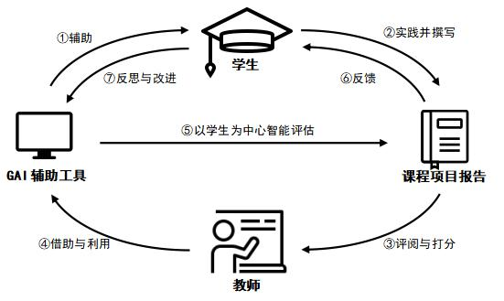
2.1 Design Pattern
图1 教育智能框架下计算机课程项目报告的智能评估方法（）
Notes:
首先，学生在课程学习过程中，借助GAI辅助工具例如大模型去辅助
课程项目实践及项目报告撰写，并在规定时间通过教学系统把项目报告提交给老师。其次，
教师收到学生的课程项目报告后，对课程项目报告进行初步地评阅与打分，同时借助自身经
验设计可量化的评分标准，并在相应的提示语帮助下利用GAI辅助工具对项目报告进行智能
评估，得到评分和评阅意见。第三，教师结合评分和评阅意见对课程项目报告进行最终打分
和撰写对应反馈。最后，学生收到老师对他们的课程项目报告的评分和有针对性的反馈，在
GAI辅助工具引导下反思和改进自身劣势与不足，从而进一步弥补知识短板，提升学术写作
能力和逻辑思维。

Slide 6
2.2 Backend Design
连接大语言模型接口
设计提示语对模型进行引导
导入学生报告，得到模型反馈结果
根据反馈进一步修改提示语
进一步改进，形成接口与前端对接

Slide 7
2.3 Prompt Design
评估方法确认
综合评分：最后的总评价
维度图：结构完整性、逻辑清晰度、语言连贯性、内容独特性和创新性、参考文献规范性课程知识掌握度
评语：打分原因以及修改意见
报告输入方式
纯文本
文本 + 图片
文件（.txt, .pdf, .doc, .md等）

Slide 8
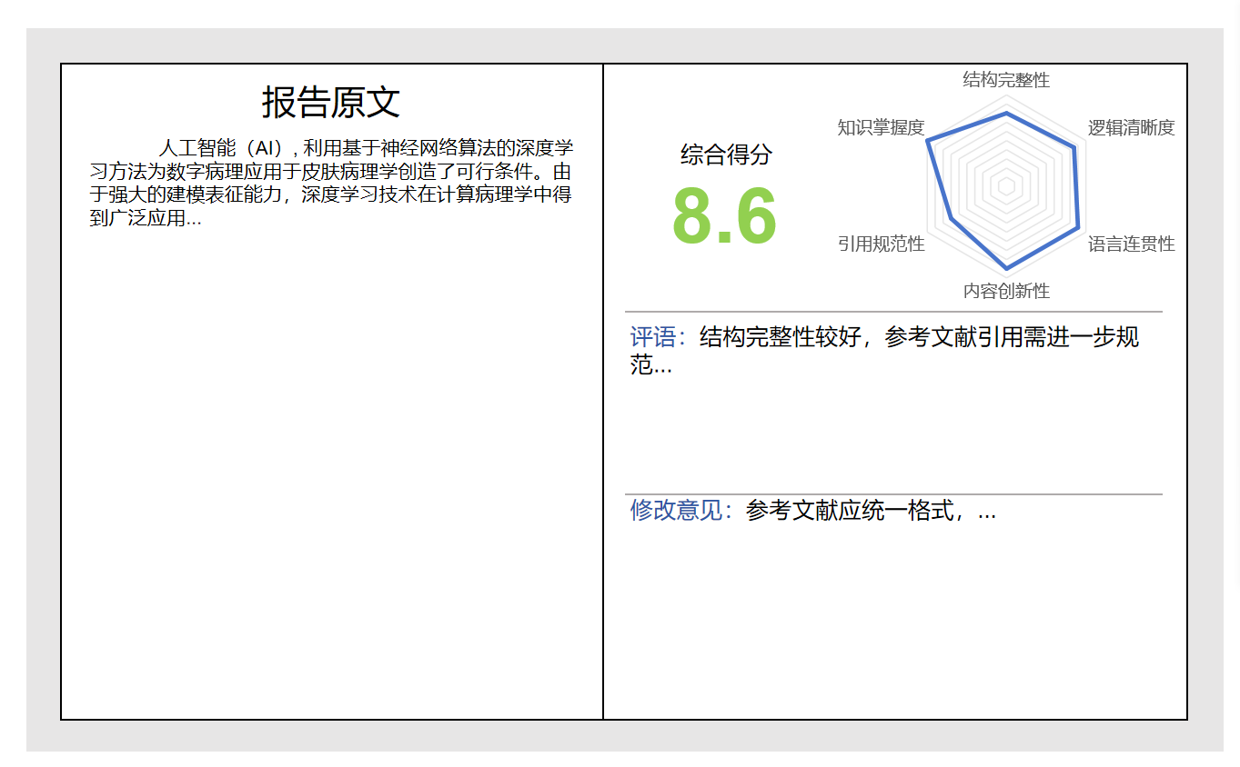
2.4 Frontend Design

Slide 9
3
Future Works

Slide 10
Summary
04

Slide 11
Time Schedule
Phase I (week1~ week 7)
Phase II ( week8~ week 12)
Phase III (week13~ week 17)
1.Data clean
2.Rebulid code and read some papers
1.Test the function and ensure the performance of the final model
2.get result and confirm the final model
1.Use Enhancement Data
2. change loss & model
3. Test other new models

Slide 12
Summary of Works
1. Data clean of two new dataset
2. Rebuild code of stage one
3. Change stage two loss
4. Confirm the final model into one model
5. Make comparation of related models
6. Web development and show
7. Enter a competition
8. Patent pending
9. Meet the “climbing plan” completion conditions

Slide 13
Reference Paper
Ying X, Guo H, Ma K, et al. X2CT-GAN: reconstructing CT from biplanar X-rays with generative adversarial networks[C]//Proceedings of the IEEE/CVF conference on computer vision and pattern recognition. 2019: 10619-10628.
Wang Y, Sun Z L, Zeng Z, et al. TRCT-GAN: CT reconstruction from biplane X-rays using transformer and generative adversarial networks[J]. Digital Signal Processing, 2023, 140: 104123.
Song W, Liang Y, Yang J, et al. Oral-3d: Reconstructing the 3d structure of oral cavity from panoramic x-ray[C]//Proceedings of the AAAI conference on artificial intelligence. 2021, 35(1): 566-573.
Chen, Z., Long, F., Qiu, Z., Yao, T., Zhou, W., Luo, J., & Mei, T. (2024, March 25). Learning spatial adaptation and temporal coherence in diffusion models for video Super-Resolution. arXiv.org. https://arxiv.org/abs/2403.17000
Li X, Yang Y, Li X, et al. GenView: Enhancing View Quality with Pretrained Generative Model for Self-Supervised Learning[J]. arXiv preprint arXiv:2403.12003, 2024.

Slide 14

THANKS
for LISTENING
2024.11

