Slide 1
Video Generation
PART I

Slide 2
Content
Endora: Video Generation Models as Endoscopy Simulators
Lumiere: A Space-Time Diffusion Model for Video Generation

Slide 3
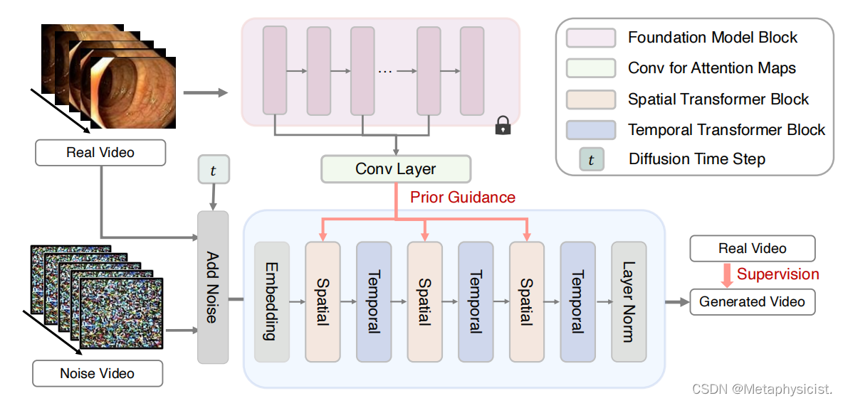
Endora

Slide 4
Diffusion Model for Video Generation
Generative diffusion models based on Denoising Diffusion Probability Models (DDPM) specializes in transforming disordered noise into desirable samples.

Slide 5
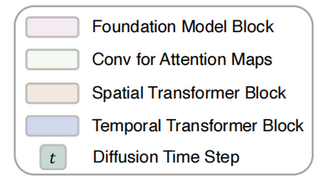
Spatial-temporal Transformer
A transformer that exclusively extracts spatial information from tokens that share the same temporal index is introduced as a Spatial Transformer.
A Temporal Transformer is further introduced to capture temporal information across video frames.

Slide 6
Prior-guided Feature Facilitation
With the guidance of the discriminative DINO prior, the semantic and spatial dependence can be thoroughly enhanced, boosting the photorealism of generated videos.

Slide 7
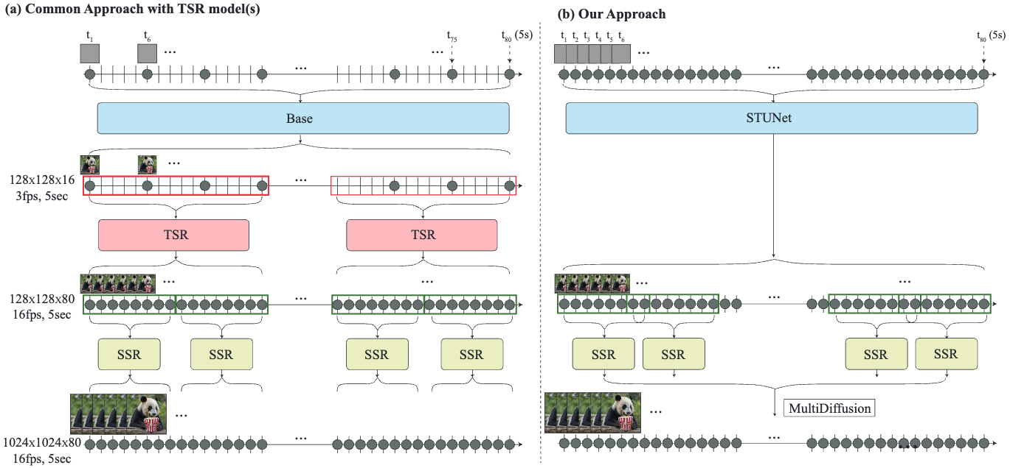
Lumiere

Slide 8
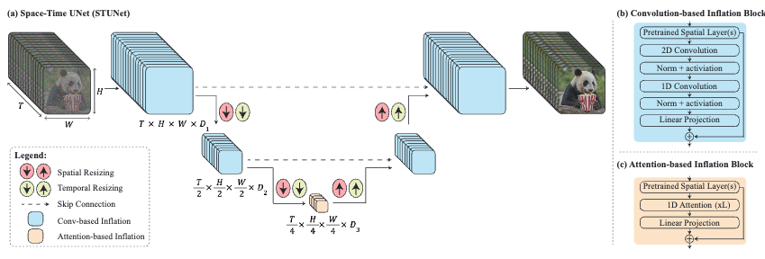
Space-Time U-Net (STUnet)
“Inflate” a pre-trained T2I U-Net architecture (Ho et al., 2022a) into a Space-Time UNet (STUNet) that down- and up-sample the video in both space and time.

Slide 9
Multidiffusion for Spatial-Super Resolution
Achieve smooth transitions between the temporal segments by employing Multidiffusion (Bar-Tal et al., 2023) along the temporal axis, to avoid temporal boundary artifacts.

