Slide 1
Video Generation
PART I

Slide 2
Content
Vidu: a Highly Consistent, Dynamic and Skilled Text-to-Video Generator with Diffusion Models
Lumina-T2X: Transforming Text into Any Modality, Resolution, and Duration via Flow-based Large Diffusion Transformers

Slide 3
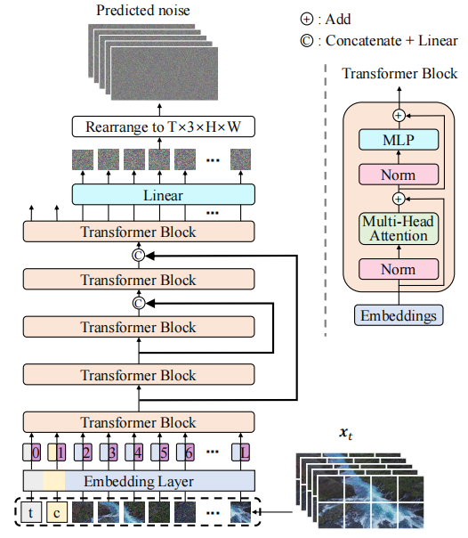
Vidu
Video autoencoder to reduce both the spatial and temporal dimensions.
Vidu employs a U-ViT as the noise prediction network to model these compressed representations.
Train a high-performance video captioner optimized for understanding dynamic information in videos, and then automatically annotate all the training videos using this captioner.

Slide 4
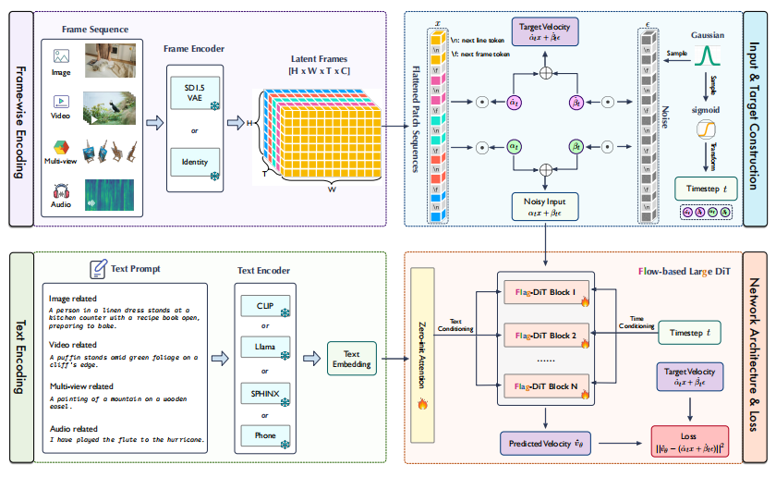
Lumina-T2X

Slide 5
Frame-wise Encoding of Different Modalities
The key ingredient for unifying different modalities within framework is treating images, videos, multi-view images, and speech spectrograms as frame sequences of length T.
Specifically, for images (T = 1), videos (T = numframes), and multiview images (T = numviews)
Use SD 1.5 VAE to independently encode each image frame into latent space and concatenate all latent frames together

Slide 6
Text Encoding with Diverse Text Encoders
For text-conditional generation, encode the text prompts using pre-trained language models.
Specifically, incorporate a variety of diverse text encoders with varying sizes, including CLIP, LLaMA, SPHINX, and Phone encoders, tailored for various needs and modalities, to optimize text conditioning.Input & Target Construction

Slide 7
Input & Target Construction
Latent frames are first flattened using 2×2 patches into a 1-D sequence, then added with [nextline] and [nextframe] tokens as identifiers.
Adopt the time resampling strategy to sample timestep from a log-norm distribution during training.
Specifically, first sample a timestep from a normal distribution N (0, 1) and map it to [0, 1] using the logistic function in order to emphasize the learning of intermediate timesteps.

Slide 8
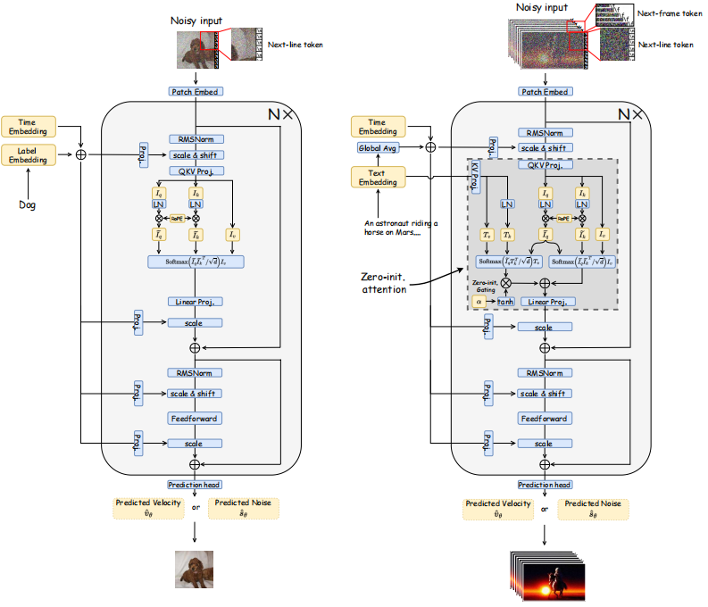
Network Architecture & Loss
Use Flag-DiT as denoising backbone.
Add RMSNorm at the start of each attention and MLP block to prevent the absolute values grow uncontrollably causing numerical instability

