Slide 1

Measurements and results
    FastTrack:
      38.97 copies per user
      8683 decoy users from 624 Ips
      Decoyers are 7% of all users but provide 77% of all copies and 73% of all versions
    Overnet:
      11 copies per user
      27 decoy users from 26 Ips
      Most of the versions and copies are provided by decoyers

Slide 2
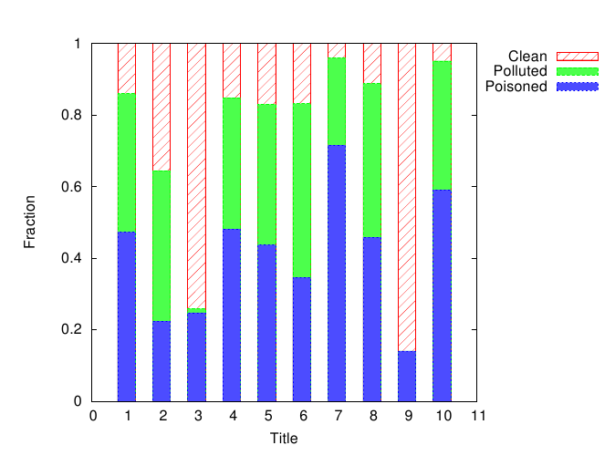

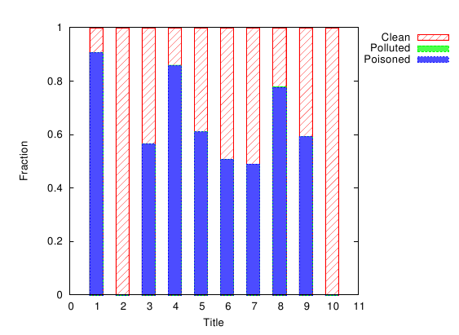
Mesurements and results - Copies
There are different companies and techniques
Total decoy percentage is from 50% to 95%
Little pollution in Overnet

Slide 3
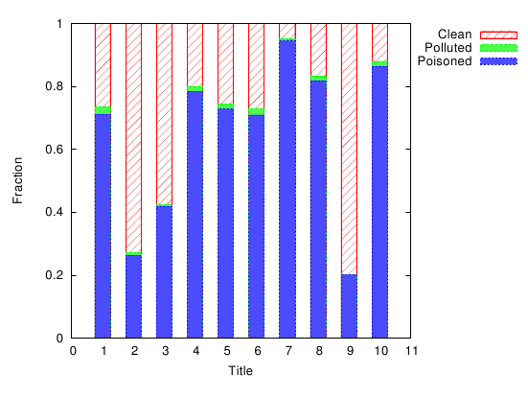
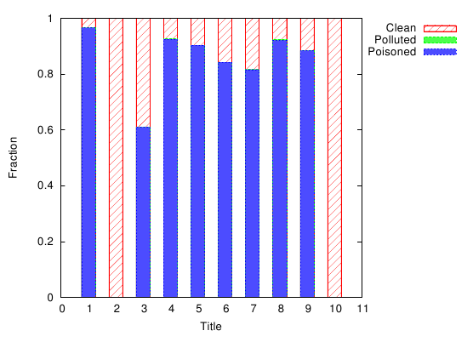
Mesurements and results - Versions
Majority of vrsions is poisoned
Versions poison level is higher than copies poison level: decoyers make copies of polluted version, copies of poisoned versions do not circulate

Slide 4
Defending against poisoning attack
Solutions:
Rating versions and advertisements (forums).
Rating sources (blacklists of IP ranges based on reputation)

Slide 5
DHT vulnerabilities to poisoning
Node insertion attack: observed in Overnet, can prevent users from finding clean versions
Attack on DHT requires less resources ehrn poisonong small number of titles. But with hidh number of titles it can require more resources than attack on unstructured overlay.
DHT can be the source of a powerful DDoS attack.

