Slide 1
Cougaar Overview
March 12nd, 2007
Todd Wright
twright@bbn.com

Slide 2
Outline
What is Cougaar?
Cougaar architecture overview
  Nodes, agents, plugins
  Core services (Blackboards, Servlets, etc)
  XML-based configuration
Demo applications
  Minimal "Hello, world!“
  Two-agent "ping" application with Servlet
Additional Cougaar features
  Built-in metrics services
  Message Transport Protocols (JMS, CORBA, ..)
  FrameSets
Q&A

Slide 3
What is Cougaar?

Slide 4
What Is Cougaar?
Cougaar is an open-source agent architecture.
Agents are autonomous software entities which communicate with other agents or external services to achieve domain-specific functionality.
Agent-based computing is a programming methodology which facilitates straightforward decomposition of complex tasks.
Cougaar includes the infrastructure and core services
Cougaar supports highly distributed, survivable applications

Slide 5
High-Level Architecture View
Cougaar Agents contain Plugins that define each agent’s behavior, integrate with infrastructure services, and perform inter-agent coordination.
Cougaar Nodes (JVMs) run one or more agents and advertise services for use by the local agents. These services are defined by Components and can wrap non-Cougaar libraries (e.g. to perform external I/O).
Behavior
Behavior
blackboard
blackboard
Agent Society
Agent
Agent
sensor
coordinator
coordinator
sensor
activator
activator
service
service
service
service
service
component
component
component
component
component
Runtime Environment
library
library
Environment

Slide 6
Why Cougaar?: Benefits
Cougaar benefits:
  Supports highly scalable, distributed systems
  Supports modular, parallel software development
  Easy to deploy and configure systems
  Can integrate with other technologies
  Proven survivability
Cougaar provides the infrastructure and core services to build highly distributed, survivable applications

Slide 7
Cougaar Scalability and Survivability
Multi-dimensional Scalability
  PDA ➔ Mainframe
  1 Mission ➔ 1000s of Missions
  1 Processor ➔ 1000s of Processors
Tunable Survivability
  Distributed control to eliminate single points of failure
  Dynamic role assignment enables virtual organization of tasking
  Unconstrained, dynamic peer-to-peer functionally oriented groupings
  Survivability roles complement domain processing roles

Slide 8
How is Cougaar Different?
Question:
  How is Cougaar different from:
    Containers such as WebLogic, J2EE, Spring, JADE, ... ?
    Protocols such as JINI, SOAP, JMS, JMX, IIOP, … ?
Answer:
  Cougaar can use or integrate with these technologies
  Cougaar provides a comprehensive solution
    It can embed some of these
    It can be embedded in some of these
    It can inter-operate with any of these

Slide 9
How is Cougaar Different? (2)
Question:
  Why use Cougaar? Can’t this all be done using existing frameworks (e.g. WebLogic, JMS, J2EE, etc)?
Answer:
  The Cougaar architecture is designed to support a certain type of application:
    Autonomous processing
    Peer-to-Peer coordination via messaging
    Highly configurable, robust, and scalable
  Claim:
    Although such applications could be built using other architectures, the solution would end up re-implementing many Cougaar architecture features.

Slide 10
Cougaar Architecture Overview

Slide 11
Scope of this Overview
This overview focuses on the Cougaar architecture and “core” services
There are additional tutorials on how to use Cougaar for planning/logistics applications
  E.g. Task/Allocation patterns, Asset prototypes
  See http://tutorials.cougaar.org
Here we focus on the architecture...

Slide 12
Creating a Cougaar Agent
Generic Agent
+
Domain Specific
Business Rules &
Processes
=
Domain Specific Agent
For example:
Generic Agent
+
Aircraft Scheduling
Behavior Plugins
=
Air Scheduling Agent
Flight
Scheduler
Plugin
Agent A
Agent A
=
Flight
Scheduler
Plugin
Airport
Inventory
Plugin
+
=
Airport
Inventory
Plugin
PlugIn
Blackboard
Blackboard
Airplane
Model
Plugin
Weather Status
Airplane
Model
Plugin

Slide 13
Nodes, Agents, Plugins
A Cougaar Agent runs on a Cougaar Node (Java Virtual Machine), which runs on a host.
An agent is comprised of one or more Plugins, which define that agent's behavior.
An agent with zero Plugins does nothing.
Host “localhost”
Java Virtual Machine (JVM)
JVM
Node 1
Node 2
Agent A
More agents
Blackboard
Plugin
X
Plugin
Y
Plugin
Z
Agent B
Plugin
Q
Blackboard

Slide 14
Core services
Cougaar includes many advanced, built-in services
  A publish/subscribe blackboard for plugin communication within an agent and between agents
  A Servlet engine for HTTP-based UIs
  Robust naming and message transport services
  Optional metrics, security, and UDDI-based discovery services
The infrastructure is componentized to allow these services to be replaced or augmented with new services with minimal code changes, if any.
More on the following slides...

Slide 15
Blackboard v.s. Messaging
Each agent has a private publish/subscribe “blackboard” shared memory for use by its local Plugins.
Plugins (should) only communicate with each other through their local blackboard.
Certain blackboard objects (e.g. Relays) are observed by the infrastructure and turned into inter-agent messages.
  The messaging is transparent to the Plugins.
  This is a Cougaar-specific “design pattern”.
Node 1
Agent A
Node 2
Plugin
X
Local Data
Agent B
Plugin
Y
Plugin
Q
Relay Data
Relay Data
Blackboard
Blackboard
Message Transport
Message Transport
Message

Slide 16
Blackboard service (continued)
In contrast to other, entirely message-based architectures, Cougaar’s blackboard-based plugins are primarily data-driven
  Plugins react to blackboard data add/change/remove notifications in a transactional “execute()” method
  All inter-plugin coordination is performed through these asynchronous data subscriptions
  As previously noted, the infrastructure translates certain blackboard data operations into inter-agent messages, but this is hidden from the plugin developer
Blackboard add/change/remove notifications are batched by the infrastructure, which improves system performance, robustness, and scalability.
Note that all state is saved on the blackboard, which is used to support persistence and crash recovery.
Local
Data
Structures
Relay
Data
Structures
Agent
Blackboard
Plugin
Plugin
Plugin
Plugin

Slide 17
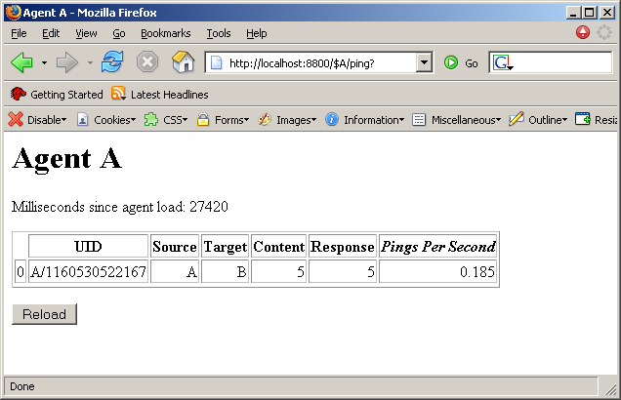
Servlet service
Plugins can also act as “Servlets”, which listen for remote URL connections
The “ServletService” is another built-in Cougaar service, analogous to the “BlackboardService”
In the example below, agent A has a Servlet/Plugin that will listen for browser requests to:
  http://localhost:8800/$A/ping
This Servlet queries the blackboard and prints the data as HTML, for display in the browser.
As another example, it could return XML or Java Objects to a Swing UI. This is Cougaar’s preferred “UI” design pattern.
Browser View of
http://localhost:8800/$A/ping
(Servlet returns HTML)
Node 1
Agent A
Servlet
“/ping”
Data
Blackboard
Blackboard
Tomcat Servlet Engine
HTTP

Slide 18
Servlet service (continued)
A Cougaar node runs an HTTP Servlet engine (Tomcat) that is shared by all agents on that node.
Plugins within each agent can bind to URL paths within the local HTTP listener.
  For example, agent "x" can bind path "/y", and all browser requests for "http://somehost:8800/$x/y" will be forwarded to that plugin.
  A plugin can register for multiple paths or all subpaths with a certain prefix, such as "/y/*".
Servlets can reply with arbitrary data:
  HTML, XML, or any other text content
  Serialized Java Objects
  Binary data
Web-based Servlet UIs are more scalable and distributed UIs than standard "popup" Swing UIs.

Slide 19
XML-based configuration
Cougaar configuration is discussed in detail in the “demo” section of these slides. Here’s a high-level overview:
Cougaar agents are configured in XML society files, e.g.:
Java System Properties are defined in XML runtime files, e.g.:
The Cougaar node is typically started on the command line, e.g.:
  cougaar MySociety.xml MyRuntime.xml
<society>
<node name=“Node1”>
<agent name=“A”>
<component class=“org.cougaar.demo.hello.HelloPlugin”/>
</agent>
</node>
</society>
<runtime>
<vm_parameter name=“-Dfoo” value=“bar”/>
<vm_parameter value=“-Xmx500m”/>
</runtime>

Slide 20
XML-based configuration (continued)
In addition to the node/agent/plugin XML files, Cougaar uses separate XSL “template” files to define the infrastructure components
  All Cougaar infrastructure components are pluggable, such as:
    The “StandardBlackboard” component, which advertises the per-agent BlackboardService
    The “RootServletServiceComponent”, which advertises the ServletService
    The Cougaar message transport, naming service, etc
  Template variables can be used to turn on/off components that are listed in the XSL template file
  These XSL files can be modified to add custom services or replace the standard Cougaar services implementations
  For details, see the template documentation.
This componentization of the Cougaar infrastructure is a key strength – it makes it easy to tailor the Cougaar Node/Agent definitions to fit new environments!

Slide 21
Demos

Slide 22
Demos Overview
The following slides discuss two demos:
  A minimal “hello world” application
  A two-agent “ping” application

Slide 23
Demo Download
The following demo code and XML config files are available on the Cougaar Website:
  http://tutorials.cougaar.org/demo
In particular, the zip file link is:
  http://tutorials.cougaar.org/demo/cougaar_demo.zip
The README file provides detailed installation and usage notes.

Slide 24
Demo Installation
  Install Cougaar:
    Verify that Java 1.5+ is installed
    Download the “cougaar.zip” and “cougaar-support.zip”
      Either download the 12.2 release:
        http://cougaar.org/frs/?group_id=17&release_id=132
      Or download the latest nightly build:
        http://build.cougaar.org/auto/HEAD/latest_success
      Note that the full Cougaar release is large (~40mb) but, for the subset we’ll use in these demos, this can be trimmed way down (<5mb).
    Create an install directory and set the COUGAAR_INSTALL_PATH. This directory can be shared and read-only, e.g.:
      mkdir /usr/local/cougaar
      export COUGAAR_INSTALL_PATH=/usr/local/cougaar
    Unzip the zips in the COUGAAR_INSTALL_PATH
    Add the “bin/cougaar” script to your path, e.g.:
      export PATH=$COUGAAR_INSTALL_PATH/bin:$PATH
  Install the Demo:
    Create a society directory and set the COUGAAR_SOCIETY_PATH. This directory can be private and read-write, e.g.:
      mkdir ~/demo
      export COUGAAR_SOCIETY_PATH=~/demo
    Unzip the “cougaar_demo.zip” into the above directory.
    If the COUGAAR_INSTALL_PATH is read-only, then copy the “webtomcat” directory to the COUGAAR_SOCIETY_PATH. More info can be found here. Do:
      cp –r $COUGAAR_INSTALL_PATH/webtomcat $COUGAAR_SOCIETY_PATH

Slide 25
“Hello, world” Demo Overview
The “hello world” application is a bare-minimum Cougaar application
  Single agent on a single node
  Single plugin on that agent
  The plugin simply prints “Hello, world!”
This example illustrates the standard plugin base class, logging service, and society XML configuration file

Slide 26
“Hello, world” Configuration
The “cougaar_demo.zip” includes the following XML files:
  The society XML file, which defines which agents to load and each agent’s list of plugins. This is “configs/hello/HelloSociety.xml”:
  The runtime XML file, which defines the “-D” Java System Properties. This is “configs/hello/HelloRuntime.xml”:
<society>
<node name=“Node1”>
<agent name=“A”>
<component class=“org.cougaar.demo.hello.HelloPlugin”/>
</agent>
</node>
</society>
<runtime>
<!-- Set the infrastructure to single-JVM -->
<vm_parameter
name=“-Dorg.cougaar.society.xsl.param.template”
value=“single_node”/>
<!-- Optional log4j config file -->
<vm_parameter
name=“-Dorg.cougaar.core.logging.config.filename”
value=“logging.props”/>
</runtime>

Slide 27
“Hello, world” Usage and Output
To run the Node:
  cd $COUGAAR_SOCIETY_PATH/configs/hello
  cougaar HelloSociety.xml HelloRuntime.xml
Note:
  On some version of Cygwin on Windows, you many need to specify “cougaar.bat” instead of “cougaar”, otherwise the Java classpath will be unable to find the “Bootstrapper” class.
  To run in Eclipse, first run `cougaar –v HelloSociety.xml HelloRuntime.xml`, to see the full list of default “-D” system properties set by the “cougaar” script. This “-D” list is also documented in the javadocs.
Sample Output:
Press “CTRL-C” to stop the node.
COUGAAR 12.2 built on Tue Feb 27 13:30:21 EST 2007
Repository: HEAD on Tue Feb 27 01:00:13 EST 2007
VM: JDK 1.5.0_07-b03 (mixed mode)
OS: Linux (2.6.11-1.1369_FC4smp)
…
2007-02-27 21:03:36,942 SHOUT [HelloPlugin] - A: Hello, world!
2007-02-27 09:03:41,929 SHOUT [DOTS] - ......
Log says agent name

Slide 28
“Hello, world” Plugin Code
The following code is included in the “cougaar_demo.zip”, as “src/org/cougaar/hello/HelloPlugin.java”
To optionally recompile and create a new “lib/hello.jar”, run the zip’s “build.xml” Ant script
package org.cougaar.demo.hello;
import org.cougaar.core.plugin.ComponentPlugin;
import org.cougaar.core.service.LoggingService;
/** A minimal plugin that prints "Hello, world!". */
public class HelloPlugin extends ComponentPlugin {
private LoggingService log;
/** This method is called when the agent is created. */
public void load() {
super.load();
// Get our required Cougaar services
log = (LoggingService)
getServiceBroker().getService(this, LoggingService.class, null);
}
/** This method is called when the agent starts. */
protected void setupSubscriptions() {
log.shout("Hello, world!");
}
/** This method is called whenever a subscription changes. */
protected void execute() {
// we don't have any subscriptions, so we never "execute()"
}
}
Extends a standard Plugin base class
Obtains the logging service
Logs “Hello, world!

Slide 29
“Ping” application
The “ping” application is comprised of two agents:
  Agent “A" contains the “PingSender“ plugin, which sends a blackboard relay to agent “B"
  Agent “B" contains the “PingReceiver” plugin, which replies to agent “A"'s relay
There is a 5 second delay between "ping" iterations, which is specified as a plugin parameter.
Also, Agent “A" contains a servlet to allow the user to view the blackboard relay as an HTML page.
Ping
Message
Relay
Relay
copy
Agent A
Reply
Message
Agent B
Blackboard
Blackboard
Ping
Sender
Ping
Servlet
Ping
Receiver

Slide 30
“Ping” code
Code is in the “cougaar-src.zip”, in:
  core/src/org/cougaar/core/relay/Ping*java
  Also available online at:
    http://cougaar.org/cgi-bin/viewcvs.cgi/core/src/org/cougaar/core/relay/?cvsroot=core
As noted on the prior slide, there are three plugins:
  PingSender (144 lines of code)
  PingReceiver (52 lines of code)
  PingServlet (118 lines of code)
The following slides illustrate various configurations of the minimal “ping” application

Slide 31
Basic “Ping” configuration
The following society xml file is included in the “cougaar_demo.zip”, as “configs/ping/PingBasicSociety.xml”
<society>
<node name=“Node1”>
<agent name=“A”>
<!-- This plugin sends the ping to agent “B” -->
<component class=“org.cougaar.core.relay.PingSender”>
<argument name=“target” value=“B”/>
<argument name=“delayMillis” value=“5000”/>
<argument name=“verbose” value=“true”/>
</component>
<!-- Our servlet to view the blackboard -->
<component class=“org.cougaar.core.relay.PingServlet”>
<argument name=“path” value=“/ping”/>
</component>
</agent>
<agent name=“B”>
<!-- This plugin replies to pings from any sender -->
<component class=“org.cougaar.core.relay.PingReceiver”>
<argument name=“verbose” value=“true”/>
</component>
</agent>
</node>
</society>

Slide 32
Basic “Ping” configuration (2)
The following runtime xml file is included in the “cougaar_demo.zip”, as “configs/ping/PingBasicRuntime.xml”
<runtime>
<!-- Set infrastructure to single-JVM -->
<vm_parameter
name=“-Dorg.cougaar.society.xsl.param.template”
value=“single_node”/>
<!-- Optional log4j config file -->
<vm_parameter
name=“-Dorg.cougaar.core.logging.config.filename”
value=“logging.props”/>
</runtime>

Slide 33
Basic “Ping” Usage and Output
Run the Node:
  cd $COUGAAR_SOCIETY_PATH/configs/ping
  cougaar PingBasicSociety.xml PingBasicRuntime.xml
Sample Output:
COUGAAR 12.2 built on Tue Feb 27 13:30:21 EST 2007
…
2007-02-27 21:29:49,243 SHOUT [PingSender] - A: Sending ping 0 to B
2007-02-27 09:29:49,273 SHOUT [DOTS] - +-
2007-02-27 21:29:49,343 SHOUT [PingReceiver] - B: Responding to ping 0 from A
2007-02-27 09:29:49,353 SHOUT [DOTS] - +-
2007-02-27 21:29:49,363 SHOUT [PingSender] - A: Received response 0 from B
2007-02-27 21:29:49,363 SHOUT [PingSender] - A: Will send ping 1 to B in 5 seconds
2007-02-27 09:29:54,210 SHOUT [DOTS] - .
2007-02-27 21:29:54,370 SHOUT [PingSender] - A: Sending ping 1 to B
2007-02-27 09:29:54,370 SHOUT [DOTS] - +-
2007-02-27 21:29:54,380 SHOUT [PingReceiver] - B: Responding to ping 1 from A
2007-02-27 09:29:54,380 SHOUT [DOTS] - +-
2007-02-27 21:29:54,380 SHOUT [PingSender] - A: Received response 1 from B
2007-02-27 21:29:54,380 SHOUT [PingSender] - A: Will send ping 2 to B in 5 seconds
2007-02-27 09:29:59,217 SHOUT [DOTS] - .
..
First
iteration
Second
iteration
...

Slide 34
Basic “Ping” Servlet view
Point a browser at http://localhost:8800/$A/ping
About 5 seconds each, which matches
our “delayMillis=5000” setting

Slide 35
Two-Node “Ping” Configuration
Goal: Modify configuration to run across two nodes
The following society xml file is included in the “cougaar_demo.zip”, as “configs/ping/PingTwoNodesSociety.xml”:
<society>
<node name=“Node1”>
<agent name=“NameServer”>
<!-- Act as a naming service agent for the society -->
<component class=“org.cougaar.core.wp.server.Server”/>
</agent>
<agent name=“A”>
<component class=“org.cougaar.core.relay.PingSender”>
<argument name=“target” value=“B”/>
<argument name=“delayMillis” value=“5000”/>
<argument name=“verbose” value=“true”/>
</component>
<component class=“org.cougaar.core.relay.PingServlet”>
<argument name=“path” value=“/ping”/>
</component>
</agent>
</node>
<node name=“Node2”>
<agent name=“B”>
<component class=“org.cougaar.core.relay.PingReceiver”>
<argument name=“verbose” value=“true”/>
</component>
</agent>
</node>
</society>
Naming Service Agent
Same “A” as in the prior single-node config
Same “B” as in the prior single-node config

Slide 36
Two-Node “Ping” Configuration (2)
The following runtime xml file is included in the “cougaar_demo.zip”, as “configs/ping/PingTwoNodesRuntime.xml”:
<runtime>
<!-- Set infrastructure to multi-node -->
<vm_parameter name=“-Dorg.cougaar.society.xsl.param.template” value=“lan”/>
<!--
Make agent "NameServer" on Node1 be our shared naming service server.
If running multi-host, change "localhost" to the host that will run "Node1".
-->
<vm_parameter name=“-Dorg.cougaar.name.server” value=“NameServer@localhost:8888”/>
<!-- Optional tuning to reduce naming service startup time -->
<vm_parameter name”-Dorg.cougaar.core.wp.server.successTTD” value=“30000”/>
<vm_parameter name=“-Dorg.cougaar.core.wp.server.failTTD” value=“1000”/>
<vm_parameter name=“-Dorg.cougaar.core.wp.resolver.rmi.minLookup” value=“500”/>
<vm_parameter name=“-Dorg.cougaar.core.wp.resolver.rmi.maxLookup” value=“2000”/>
<vm_parameter name=“-Dorg.cougaar.core.mts.destq.retry.initialTimeout” value=“250”/>
<vm_parameter name=“-Dorg.cougaar.core.mts.destq.retry.maxTimeout” value=“500”/>
<!-- Optional log4j config file -->
<vm_parameter name=“-Dorg.cougaar.core.logging.config.filename” value=“logging.props”/>
</runtime>

Slide 37
Two-Node “Ping” Usage and Output
To run single-host:
  In the first console do:
    cougaar PingTwoNodesSociety.xml PingTwoNodesRuntime.xml Node1
  In a second console, do:
    cougaar PingTwoNodesSociety.xml PingTwoNodesRuntime.xml Node2
  The output should be the same as in the single-node “ping”.
To run multi-host:
  Modify the “name.server” system property to specify the host that will run “Node1”, instead of “localhost”
  For example, if Node1 will run on host “foo.com” and Node2 on a different host, then change the system property to:
    <vm_parameter name=“-Dorg.cougaar.name.server” value=“Node1@foo.com:8888”/>

Slide 38
Benchmark “Ping” Configuration
Goal: Modify the configuration to run as fast as possible, plus enable optional metrics data collection and servlets
Note: We’ll configure this as a single-node test.
The following society xml file is included in the “cougaar_demo.zip”, as “configs/ping/PingBenchmarkSociety.xml”:
<society>
<node name=“Node1”>
<agent name=“A”>
<component class=“org.cougaar.core.relay.PingSender”>
<argument name=“target” value=“B”/>
<argument name=“delayMillis” value=“0”/>
<argument name=“verbose” value=“false”/>
</component>
<component class=“org.cougaar.core.relay.PingServlet”>
<argument name=“path” value=“/ping”/>
</component>
</agent>
<agent name=“B”>
<component class=“org.cougaar.core.relay.PingReceiver”>
<argument name=“verbose” value=“false”/>
</component>
</agent>
</node>
</society>
Set delay to zero, to run as fast as possible.
Turn off verbose logging.
We could also set this by modifying our log4j “logging.props” file.

Slide 39
Benchmark “Ping” Configuration (2)
The following runtime xml file is included in the “cougaar_demo.zip”, as “configs/ping/PingBenchmarkRuntime.xml”:
<runtime>
<!-- Enable metrics and single-JVM -->
<vm_parameter
name=“-Dorg.cougaar.society.xsl.param.template”
value=“single_debug”/>
<!-- Optional log4j config file -->
<vm_parameter
name=“-Dorg.cougaar.core.logging.config.filename”
value=“logging.props”/>
<!-- Turn off "+/-" logging on every message send/receive -->
<vm_parameter name=“-Dorg.cougaar.core.agent.quiet” value=“true”/>
</runtime>
Set infrastructure to the single-node template with metrics enabled
Turn off verbose logging.

Slide 40
Benchmark “Ping” Usage and Output
Run the Node:
  cougaar PingBenchmarkSociety.xml PingBenchmarkRuntime.xml
Sample Output:
We’ve turned off all logging output, so we’ll need to look at the servlet to see what’s going on..
COUGAAR 12.2 built on Tue Feb 27 13:30:21 EST 2007
…
2007-02-27 09:29:54,210 SHOUT [DOTS] - …………..
Just “dots”

Slide 41
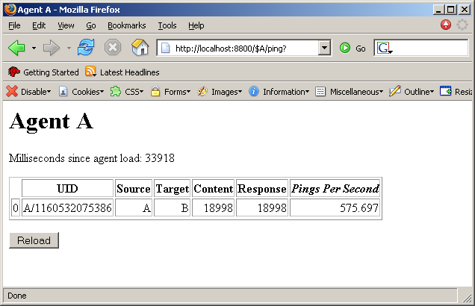
Benchmark “Ping” Servlet View
Point a browser at http://localhost:8800/$A/ping
Pretty fast!

Slide 42
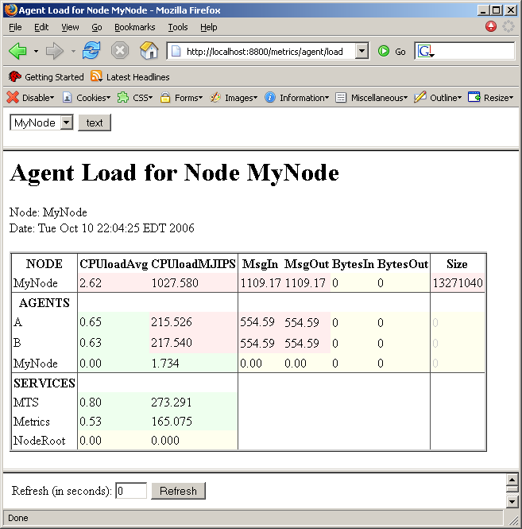
Benchmark “Ping” Metrics View
Point a browser at http://localhost:8800/metrics/agent/load
Since we’re running with the “single_debug” infrastructure template, the Cougaar metrics servlets are loaded.
This servlet shows the CPU load and message throughput. For more info on this and the other metrics servlets, see the docs.
Matches our custom “/ping” servlet measurements. Note the additional ping “reply” messaging from B to A.

Slide 43
Additional Cougar Features

Slide 44
Metrics Services
The prior “Ping” benchmark demo showed one of the metrics servlets
The Cougaar release includes additional documentation on the metrics service:
doc/OnlineManual/MetricsService/index.html
In particular, see the list of metrics servlets:
doc/OnlineManual/MetricsService/operation.html

Slide 45
Message Transport Protocols
The Cougaar Message Transport supports pluggable message transport protocols
  By default, Cougaar uses Java RMI
  Cougaar includes support for JMS, HTTP, and IIOP
The message transport also supports pluggable “aspects” to alter its behavior, e.g. to add security, compression, etc.

Slide 46
FrameSet Knowledge Representation
Traditionally, “Frames” are simple “name=value” data structures, i.e. “HashMaps”
Cougaar includes basic Frame support plus extends upon this idea
  Supports complex data types and relationships:
    Developers can define standard types in XML, which are code-generated into equivalent, optimized Java classes
    Optimizes slot access by supporting primitive fields, constant values, default values, etc
    Adds parent-child data inheritence
    Adds containment, composition, etc
  Supports dynamic data:
    If a slot value is derived from other slots/relationships, update all the corresponding data frames
  Optimizes memory and bandwidth
    When synchronizing Frames between agents, only send the required deltas
    Policies make them Quality-of-Service and Network aware, which is smarter than simple RPC change notifications.
In addition to the data representation facet, FrameSets tie into the idea that Cougaar blackboards are data-driven, and that not every add/change/remove translates into a message
  E.g. we may have a policy to batch deltas
  This is an overlay network
Host
Equip
Process
Appl
Thing
Object
Class
Frame
name value
name value
name value
Relationship
parent-name value
child-name value

Slide 47
More Cougaar Features
Too much to cover:
  Agent mobility between nodes (including across hosts)
  Agent state persistence and crash recovery
  Distributed, replicated naming service
  Directory services (UDDI)
  Agent communities and “ABA” group messaging
  Embedding a Cougaar node in an Applet, Bean Container, etc.
  JMX
  OWL
  The planning and logistics domains
  ..

Slide 48
Additional References

Slide 49
Additional tutorials and documentation
See http://docs.cougaar.org for additional documentation:
  The Cougaar FAQ
  The Cougaar Developers' Guide
  The Cougaar Architecture Document
  Conference Papers
See http://tutorials.cougaar.org for additional tutorials:
  The Planning Domain “Training Course”
  The “Pizza Party” application, which features Task/Allocation planning and dynamic service provider discovery.

Slide 50
Contact Us!
To contact us:
  Subscribe to our mailing list by visiting http://cougaar.org/mailman/listinfo/cougaar-developers
  Then send an email to cougaar-developers@cougaar.org

