Slide 1
Tryllian Agent Technology
AgentLink
21 January 2002
Christine Karman

Slide 2
Agenda
Introduction
Tryllian, the company
Agent technology
Example applications

Slide 3
Tryllian
Software agent company
Founded in 1998
Main investors GIMV, FLV, NIF, NPM.
Focus on business integration and wireless apps

Slide 4
Tryllian Facts and Figures
CEO Han Witvoet
Founder Christine Karman
40 employees
Head Office Amsterdam
Sales Office San Francisco
Initial revenues achieved

Slide 5
Tryllian: what do we do?
Software Manufacturer
Application Development Kit
Focus: Business Integration

Slide 6
Business Integration
Integrating businesses, processes, apps:
  Distributed organizations
  Across companies
  Heterogeneous business environments
  Multi platform
Key features:
  Code mobility
  Runtime component behavior

Slide 7



Container scanning
Customs
95%
Port of Rotterdam
5%
Final destination
Scan
Demo
Container
Selection
Scan
Appointment
Transporters
Transportation
Appointment
Forwarder

Slide 8
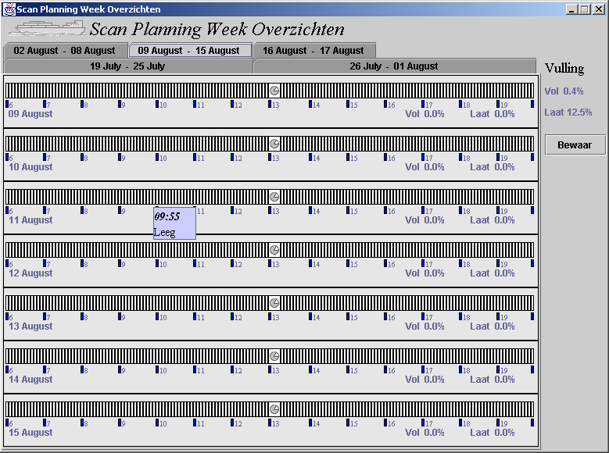
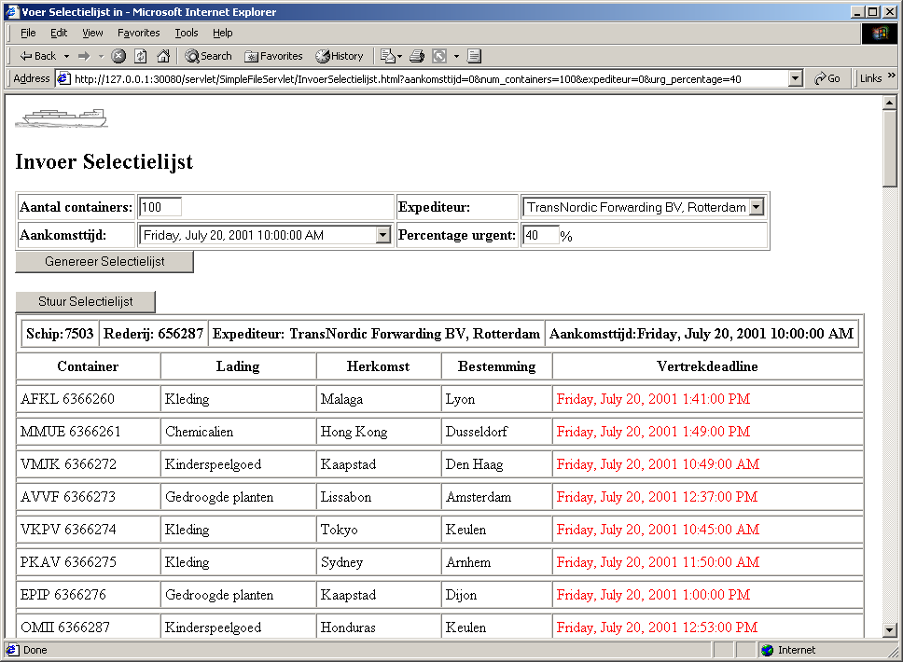

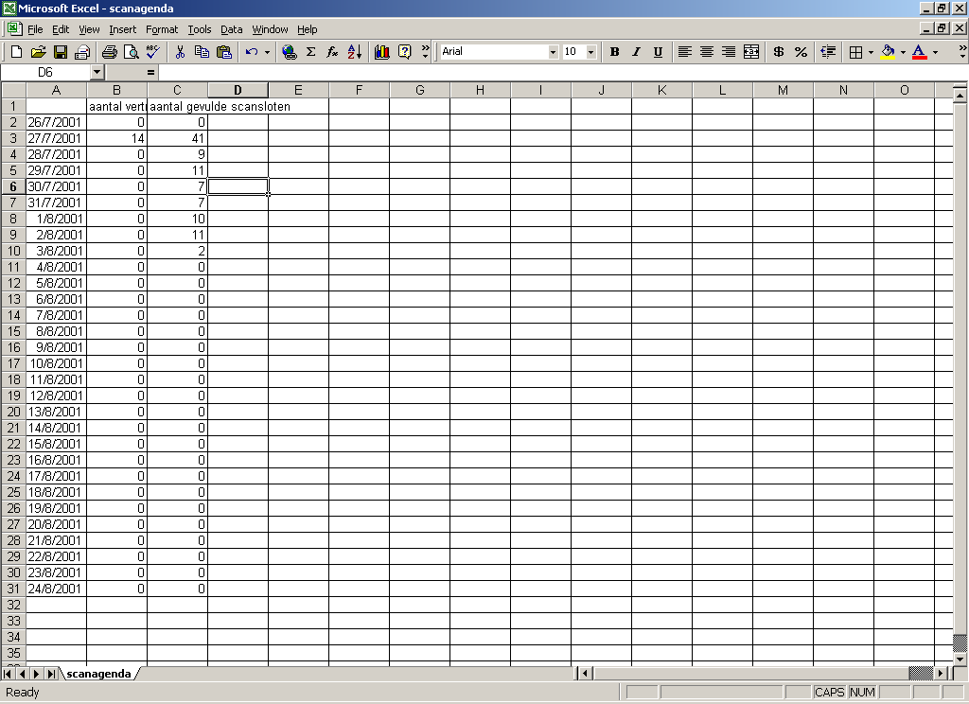
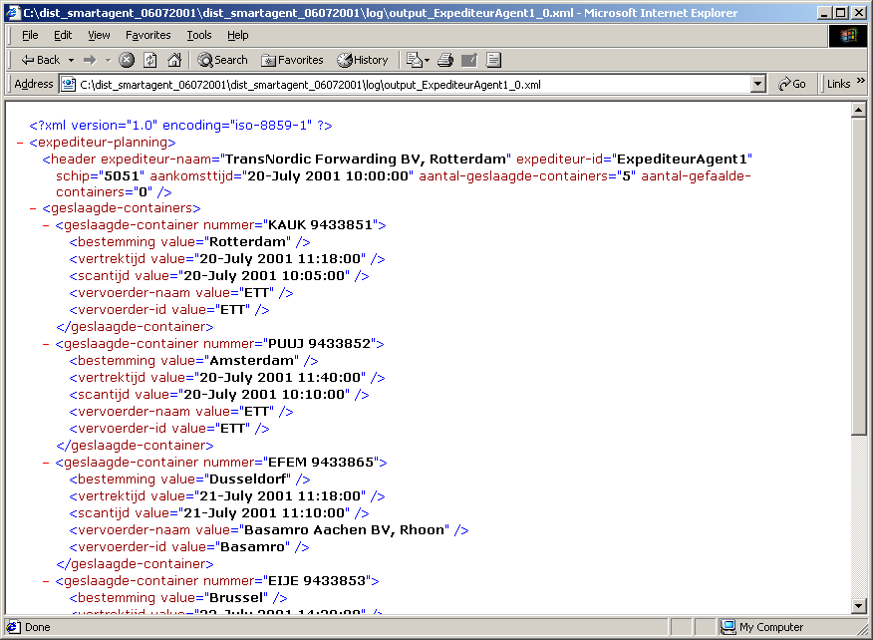
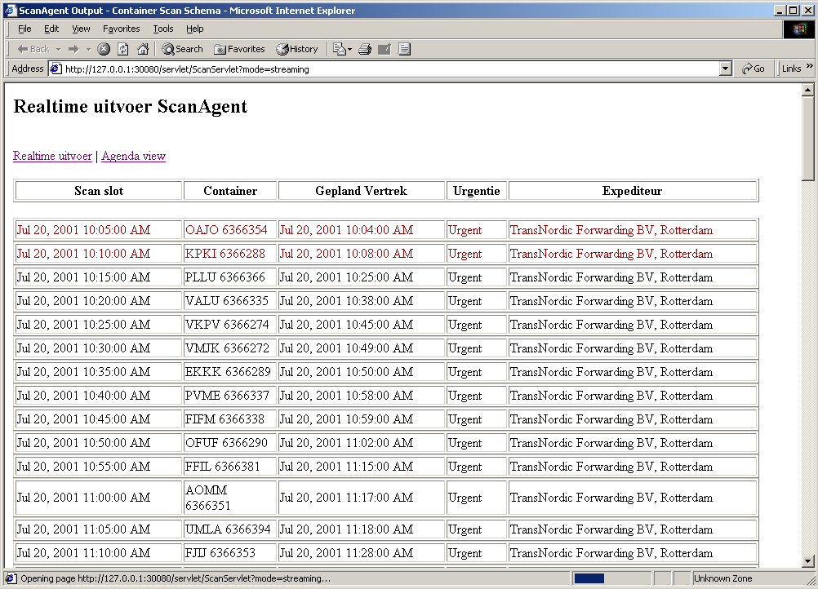
System overview
Scan servlet
Customs
Agent system
Scan Agent
Forwarder
Agents
6
Excel-file
1
2
4
3
9
XML-file
Internal
transporter
Agent
5
Transport
list Agent
SMS-
message
7
Transporter
Output Agent
External
transporter
Agents
Transporter servlet
8
8

Slide 9
Agent Development Kit
The Agent Foundation Classes (AFC)
providing tools, libraries, building blocks and examples for building Agent Based Applications
The Agent Runtime Environment (ARE)
a “habitat” for hosting agents developed using the AFC
Agent Management Tools for managing agents on a server

Slide 10
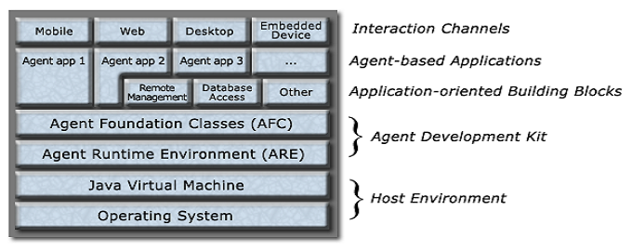
ADK System Architecture

Slide 11
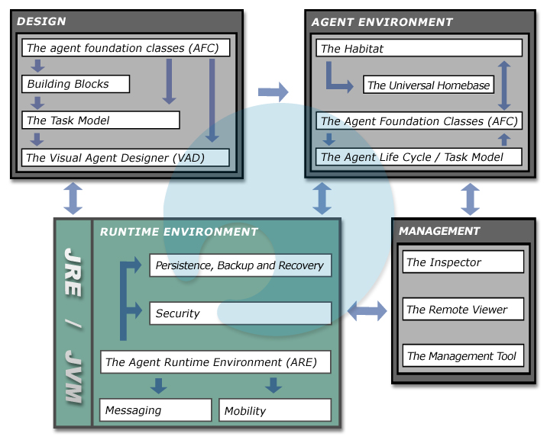

Slide 12
Examples

Slide 13
Mobile Dating
SMS UI
Many responses to one query
Responses have to be answered or discouraged
High user cost for unwanted interactions
Hi, what's
Sofia, and
your name?
yours?

Slide 14


Agent Based Dating: FROG
Hi, what's
Sofia, and
your name?
yours?

Slide 15
Why Agents?
Initial interaction via Web: rich User Interface
Agent handles unwanted interactions
User cost only for wanted interactions
Cost control for both User and Telco
Appealing growth path

Slide 16
FROG dating app
Agent server at central (Telco) location
Users own their agent(s)
Users specify preferences
Agents use preferences for controlling traffic
Agents can integrate with other apps

Slide 17
FROG Advantages
Appealing to user
Limits unwanted traffic
Expandable
Provides control over traffic
Flexible UI: SMS, email, etc.
Agent ties User to Telco

Slide 18
Future directions
Agent is “on the watch” for new info
Agent monitors traffic, etc. info and sends you custom notifications
In Sync with future wireless technology
Filtering of incoming messages, and calls

Slide 19

Another example

Slide 20
Overview
Network discovery
Remote software installation
Database discovery
Data retrieval
Upgrade Agent functionality dynamically

Slide 21
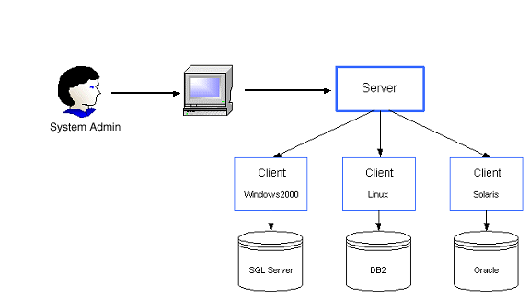
Architecture

Slide 22
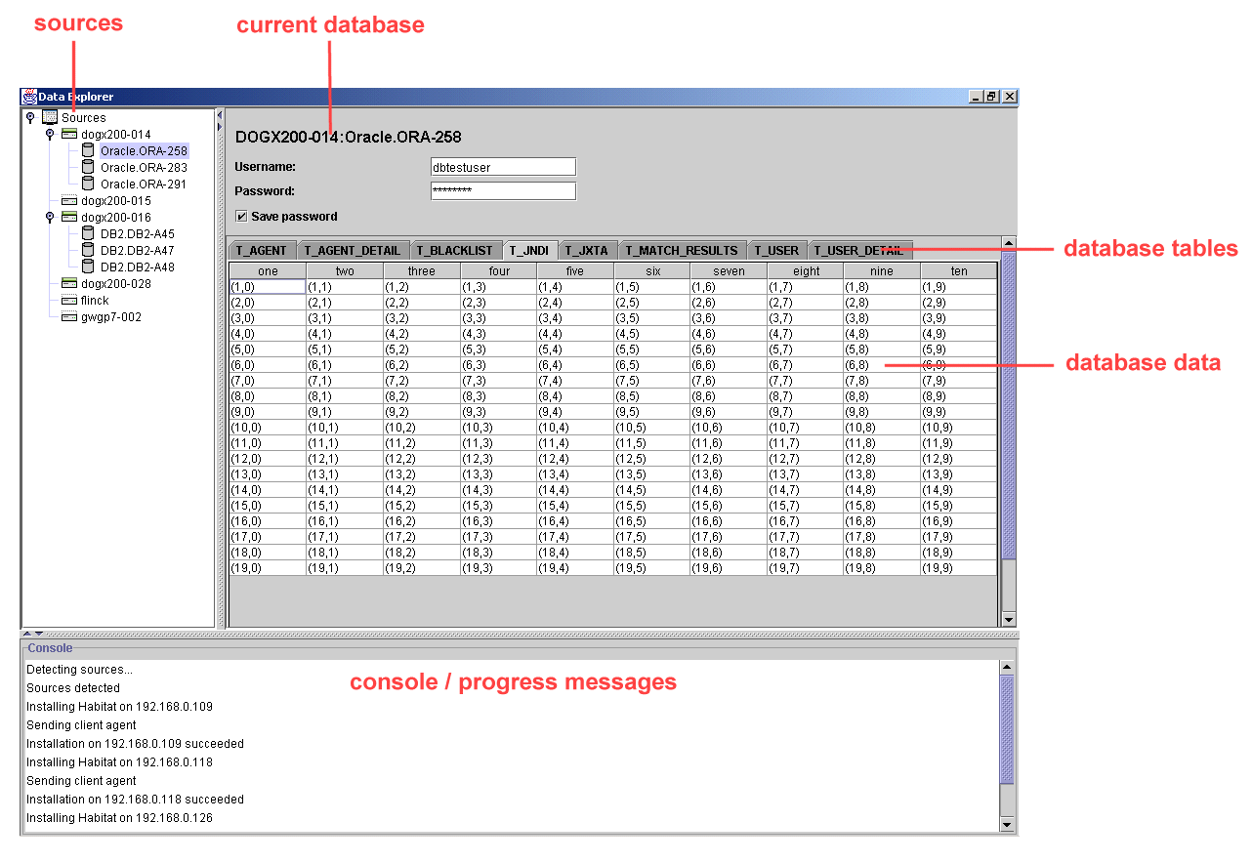
User Interface

Slide 23
Web Services
Agents talk to “outside world”, talking webservices
Agents implement webservices
Common ground:
Using the internet as a computing platform, integrating businesses

Slide 24
Why Agents in Webservices?
Code mobility
Agent autonomy and dynamism
Ease of understanding
Distributed Transaction Management

Slide 25
Conclusion
Agent mobility provides easy and adaptable global integration of business processes
Agent autonomy and dynamism provide easy and fast adaptation to changing markets and circumstances

