Slide 1
Welcome to C Programming!
While Loop
반복 문

Slide 2
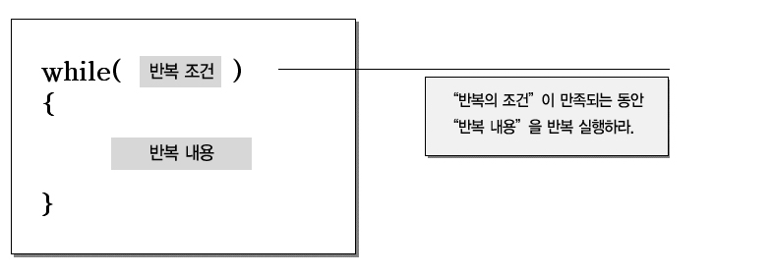
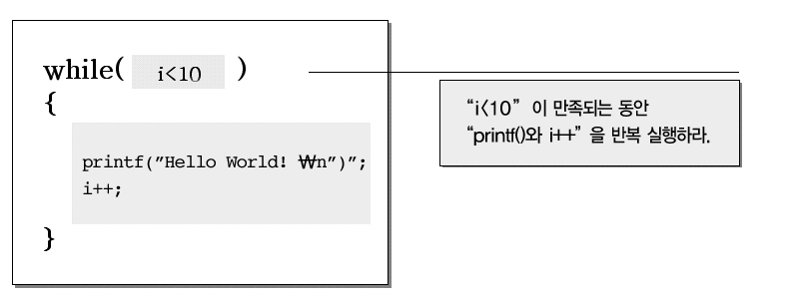
-While 반복 문 : 특정 영역을 특정 조건이 만족하는 동안에 반복

Slide 3
#include <stdio.h>
int main (void)
{
int iFahrenheit, iCelsius = 0;
int iLower, iUpper, iStep;
iLower = 0;
iUpper = 300;
iStep = 20;
iFahrenheit = iLower;
while (iFahrenheit <= iUpper)
{
iCelsius = 5 * (iFahrenheit - 32) / 9;
printf_s("화씨 : %d\t섭씨 : %d\n", iFahrenheit, iCelsius);
iFahrenheit += iStep;
}
printf_s("\n");
return 0;
}

Slide 4
- 무한 루프
#include <stdio.h>
#include <stdlib.h>
int main (void)
{
int iNumber = 0;
while (true) // 반복 조건이 true 이면 계속하여 실행
{
system(“cls”);
printf_s(“Loop Count! : %d\n\n”, iNumber);
iNumber++;
}
return 0;
}

Slide 5

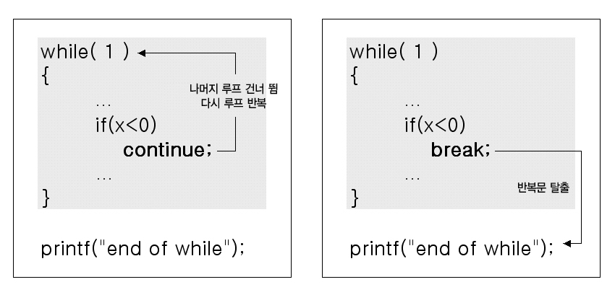
-탈출 (break;) 과 반복 (continue;)

Slide 6
#include <stdio.h>
#include <stdlib.h>
int main (void)
{
int iNumber1 = 0;
int iNumber2 = 0;
int iNumber3 = 0;
int iNumber4 = 0;
int iNumber5 = 0;
int iCount = 0;
while (true)
{
iCount++;
printf_s("%d\n", iCount);
system("cls");
if (iNumber1 == 0 || iNumber2 == 0 || iNumber3 == 0 || iNumber4 == 0 || iNumber5 == 0)
{
if (iCount == 80 && iNumber1 == 0)
{
iNumber1 = iCount;
iCount = 0;
continue;
}
else if (iCount == 90 && iNumber2 == 0)
{
iNumber2 = iCount;
iCount = 0;
continue;
}
↓↓↓↓↓↓↓↓↓↓↓↓↓↓↓↓↓↓↓↓↓↓↓↓↓↓↓↓↓↓↓↓↓↓↓↓↓↓↓↓↓↓↓↓↓↓↓↓↓↓↓↓↓↓↓↓↓↓↓↓↓↓

Slide 7
↑↑↑↑↑↑↑↑↑↑↑↑↑↑↑↑↑↑↑↑↑↑↑↑↑↑↑↑↑↑↑↑↑↑↑↑↑↑↑↑↑↑↑↑↑↑↑↑↑↑↑↑↑↑↑↑↑↑↑↑↑↑
else if (iCount == 97 && iNumber3 == 0)
{
iNumber3 = iCount;
iCount = 0;
continue;
}
else if (iCount == 99 && iNumber4 == 0)
{
iNumber4 = iCount;
iCount = 0;
continue;
}
else if (iCount == 101 && iNumber5 == 0)
{
iNumber5 = iCount;
iCount = 0;
continue;
}
}
else
{
printf_s("%c %c %c %c %c\n", iNumber1,iNumber2, iNumber3, iNumber4, iNumber5);
break;
}
}
return 0;
}

Slide 8

To be continued

