Slide 1



LAWSAGE
Team Members
1.Soham Rao
2.V S Manoj Kumar
3. Vineeth Udupa
4.Tanmay Anand
Presented By,
Team Id : #H7026
Team Name : Hack-Athletes

Slide 2
INTRODUCTION
The AI-Based Legal Chatbot project is an innovative approach to providing immediate legal information and support to individuals navigating the complexities of the Indian legal system. By leveraging advanced artificial intelligence and a user-friendly web interface, this chatbot serves as a readily accessible tool for understanding and asserting one's legal rights under the Indian Constitution.

Slide 3
PROBLEM STATEMENT
Accessing legal assistance to understand one's rights and defend oneself in court is often a challenging, expensive, and time-consuming process, especially for the average middle-class person in India. Currently, there is no specific law in the Indian Constitution mandating the provision of a lawyer to every accused person.

Slide 4
PROPOSED SOLUTION
There is a need for an AI-based legal chatbot that can provide immediate, relevant legal information based on an individual's specific situation. This tool should help individuals understand their rights under the Indian Constitution and defend themselves until they can secure professional legal representation.

Slide 5
SYSTEM ARCHITECTURE & TECH STACK
Frontend :
HTML
CSS
JavaScript
Backend :
Python for AI model using NLTK
Flask for web framework
Data storage in a JSON file
Git for version control

Slide 6
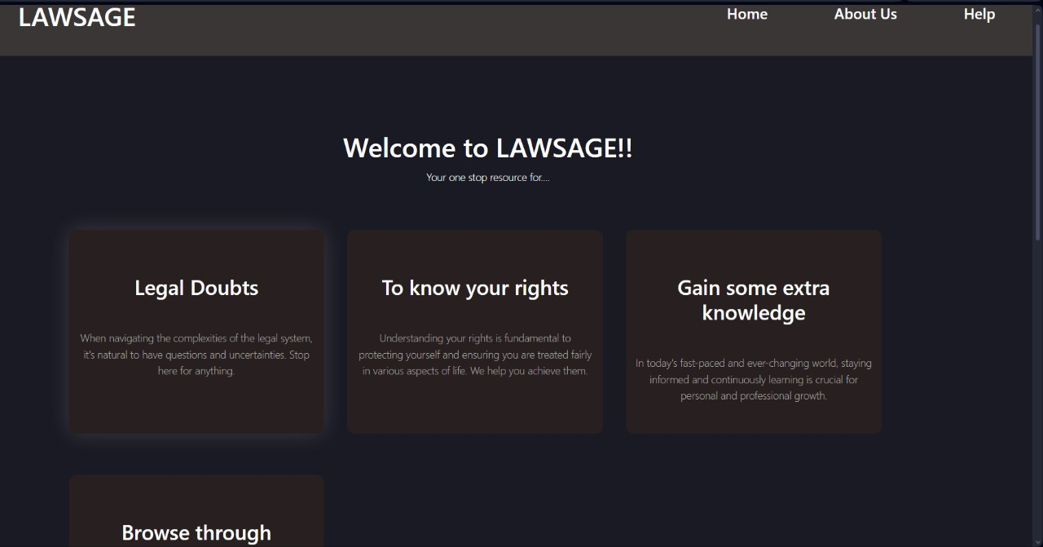
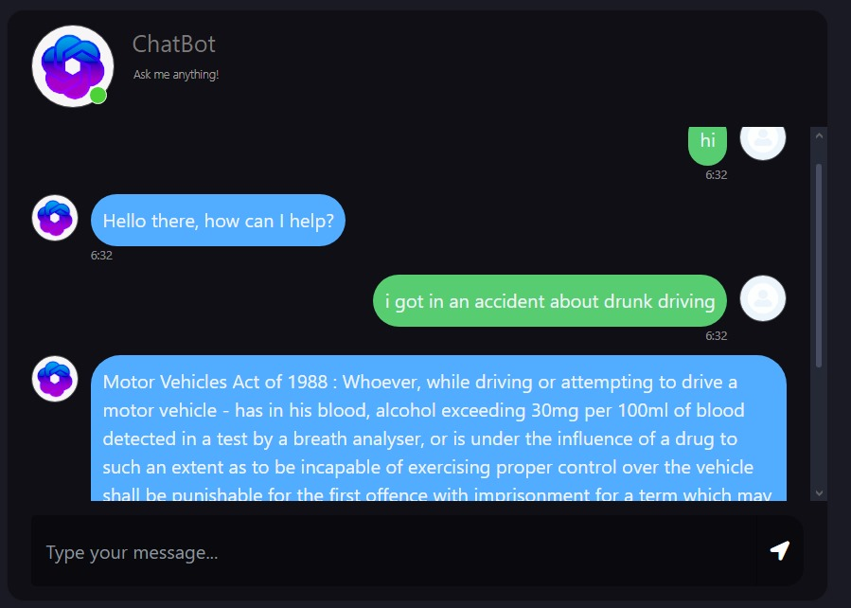
PROTOTYPE AND DEMO
https://github.com/Soham-Rao/Hackman

Slide 7
BUSINESS MODEL
The primary objective of this chatbot is to provide easily accessible and free legal advice to users. To sustain this service while managing server-side costs, we propose a multifaceted business model that includes advertising. Implementing targeted advertising which will be relevant to the user-base, such as ads for legal services, law firms, legal insurance and related products, we can create a sustainable business model.

Slide 8
FUTURE SCOPE
Implementing larger neural networks such as BERT for better and deeper natural language processing.
Expansion to other domains of the Indian Constitution.
Developing mobile and PC applications.
Improving the database system by incorporating SQL or NoSQL databases for better efficiency.
Quality of life changes such as improved UI/UX, response time and personalised outputs.

Slide 9
CONCLUSION
The AI-Based Legal Chatbot is a groundbreaking initiative designed to democratize access to legal information and support for individuals navigating the complexities of the Indian legal system. By combining advanced AI technology with a user-friendly web interface, this chatbot provides immediate, relevant, and accurate legal guidance tailored to users' specific situations.

Slide 10
THANKYOU

