Slide 1
6-dars: Shartli operatorlar. Taqqoslash operatorlari. if...else operatori
Reja
Shartli operatorlar.
Taqqoslash operatorlari.
if...else operatori

Slide 2
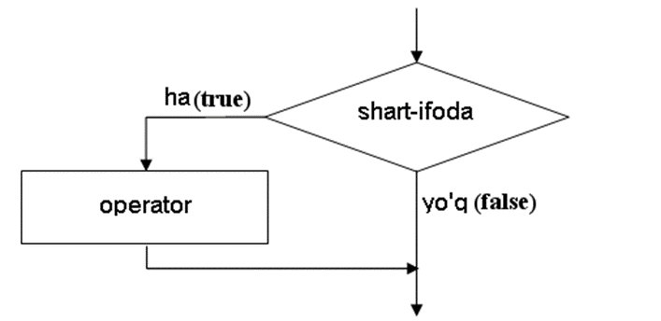
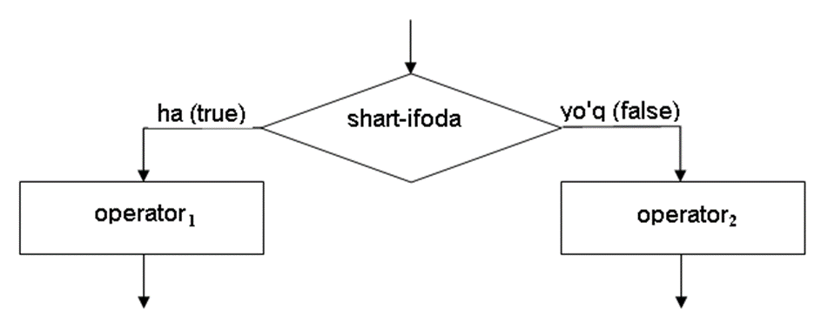

Slide 3
Shartli operatorlar
Shartli opearatorlar tegishli mantiqiy ifodaning qiymatiga ko’ra dasturning alohida bir qismini bajarilish yoki bajarilmasligini ta’minlaydi.
Mantiqiy ifoda faqat ikkita qiymat qabul qiladi: true (rost) yoki false (yolg’on), hisoblashda 1 yoki 0 sifatida qabul qilinadi.
>>> True + 2 # 1 + 2 ga teng kuchli
3
>>> False + 2 # 0 + 2 ga teng kuchli
2

Slide 4
Quyidagi obyektlar True qiymatni qaytaradi:
Nolga teng bo’lmagan ixtiyoriy son:
>>> bool (1), bоо1 (20) , bool (- 20)
(True , True , True )
>>> bool (l.0), bool(0.1), bool (-20.0)
(True, True, True)
Bo’sh bo’lmagan obyekt:
>>> bool ("0") , bооl ([0, None]), bool( (None, ) ), bool ({"х": 5})
(True, True, True, True)

Slide 5
Quyidagi obyektlar False kabi interpretasiyalanadi:
Nolga teng son:
>>> bool (0) , bool (0.0)
(False, False)
Bo’sh obyekt:
>>> bool (" "), bооl ([ ]), bool (( ))
(False, False , False )
None qiymati:
>>> bool (None )
False

Slide 6
Taqqoslash operatorlari
= = – teng:
>>> 1 = = 1, 1 = = 5
(True , False)
! = - teng emas:
>>> 1 ! = 5, 1 ! = 1
(True , False )
< – kichik :
>>> 1 < 5, 1 < 0
(True , False)

Slide 7
> – katta :
>>> 1 > 0, 1 > 5
(True , False )
<= - kichik yoki teng:
>>> 1 <= 5, 1 <= 0, 1 <= 1
(True , False, True )
>= - katta yoki teng:
>>> 1 >= 0, 1 >= 5, 1 >= 1
(True , False, True )

Slide 8
in – sonli ketma-ketlikka tegishlilikni tekshirish:
>>> "satr" in "qidirish uchun satr" # Satr
True
>>> 2 in [1 , 2, 3) , 4 in [1, 2, 3] # Ro’yxat
(True , False)
>>> 2 in (1, 2, 3) ' 4 in (1, 2, 3) # Kortejlar
(True , False )
in operatoridan shuningdek, lug’at kalitiga tegishlilikni tekshirishda ham foydalaniladi:
>>> "х" in {" х" : 1, "у" : 2}, "z" in {" х" : 1, "у" : 2}
(True , False )

Slide 9
not in – sonli ketma-ketlikka tegishli emaslikni tekshirish:
>>> "satr" not in "qidirish uchun satr" # Satr
False
>>> 2 not in [1, 2, 3] , 4 not in [1, 2, 3] # Ro’yxat
(False, True)
>>> 2 not in (1 , 2, 3) , 4 not in (1 , 2 , 3) # Kortej
(False , True )
is – ikkita o’zgaruchi bir obyektga havola qilinganini tekshiradi. Agar o’zgaruvchilar bior obyektga havola qilingan bo’lsa, is operatori True qiymat qaytaradi:
>>> х = у = [1, 2)
>>> х is у
True
>>> х = [1, 2] ; у= [1, 2)
>>> х is у
False

Slide 10
if...else tarmoqlanish operatori
if <mantiqiy ifoda>:
<agar mantiqiy ifoda rost qiymat qabul qilsa bajariladigan operatorlar to’plami>
[elif <mantiqiy ifoda>:
<agar mantiqiy ifoda rost qiymat qabul qilsa bajariladigan operatorlar to’plami>
]
[else:
<agar mantiqiy ifoda yolg’on qiymat qabul qilsa bajariladigan operatorlar to’plami> ]

Slide 11
Misol. Sonni juftlikka tekshirish
х = int(input("Sonni kiriting:"))
if х % 2 == 0:
print (x, " – juft son")
else:
print (x, " - toq son")

Slide 12
# -*-coding:utf-8-* -
х = int(input("Sonni kiriting: ") )
if х%2 == 0: print (x , " – Juft son" )
else: print (x, " – Toq son ")
input ( )

Slide 13
- * - coding: utf-8 - * -
х = int(input ("Sonni kiriting:"))
if х%2 == 0: print(x , end=" " ) ; print (" – juft son" )
else: print (x, end=" " ) ; print ( " – toq son" )
input( )

Slide 14
Misol. Bir nechta shartlarni tekshirish
# -*- coding : utf-8 - * -
print ("""Qaysi operatson tizimdan foyadalanasiz?
1 - Windows 8
2 - Windows 7
3 -Windows Vista
4 - Windows ХР
5 - boshqa""")
os = inрut ("Javobingizga mos sonni kiriting:")
if os == "1":
print ("Siz Windows 8 ni tanladingiz")
elif os == "2":
print (" Siz Windows 7 ni tanladingiz")
elif os == "3":
print ("Siz Windows Vistani tanladingiz" )
elif os == "4":
print ("Siz Windows XP ni tanladingiz")
elif os = = "5":
print ("Siz boshqa ni tanladingiz")
elif not os :
print ("Son kiritmadingiz")
else:
print ("Siz tanlagan OT ni aniqlay olmadik")
input( )

Slide 15
if ... else operatori yana bir boshqa formatda ham qo’llaniladi:
<O’zgaruvchi> = <rost> if <shart> else <yolg’on>
Misol:
>>>print ("Ha" if 10%2 == 0 else "Yo’q" )
Ha
>>> s = "Ha" if 10 % 2 == 0 else "Yo’q"
>>> s
'Ha'
>>> s = "Ha" if 11% 2 ==0 else "Yo’q"
>>> s
'Yo`q'

