Slide 1
Cluster Yangzhou Centers' Resturants Candiate Coffee Shop Location
Applied DS
Siwei Xiao

Slide 2
Business Environemnt in Yangzhou
More college students come to YANG ZHOU, where exists growing business potentials.
Coffee is more prevalent among the younger generation and coffee shops develop well
in Yangzhou city.
A phenomenon is that some coffee shops close down due to a bad location.
Analyze the restaurants clusters in Yangzhou's commercial circles and find appropriate places
Tasks include:
1. summarize existing restaurant types in major commercial circles;
2. clarify better locations for coffee shop operations.
Applied DS

Slide 3
Data description
Get Yangzhou geometry information from CYBPO.
(https://postal-codes.cybo.com/china/yangzhou/)
get the detailed information in each circle by applying Foursquare API
calculate geometry information, under specific conditions (e.g., about 3 km from city center, and each has 600 meters each circle apart)(here mostly for screening appropriate geographic postion, including city center, commercial clusters, and finally, opportunities)
Applied DS

Slide 4
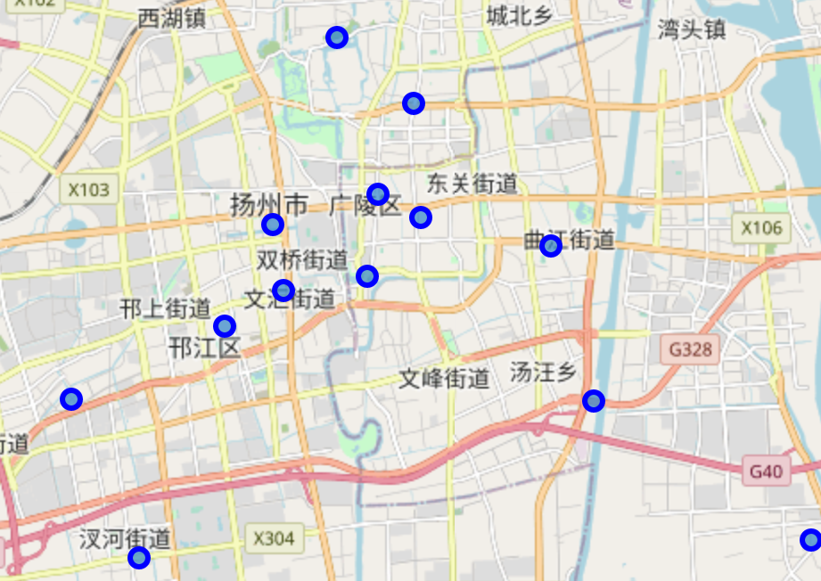
Methodology
We create the dataframe and load data from Yangzhou geometry platform, and then, we plot local map to identify the city center and determine where we could make further explorations by Foursquare.
Applied DS

Slide 5
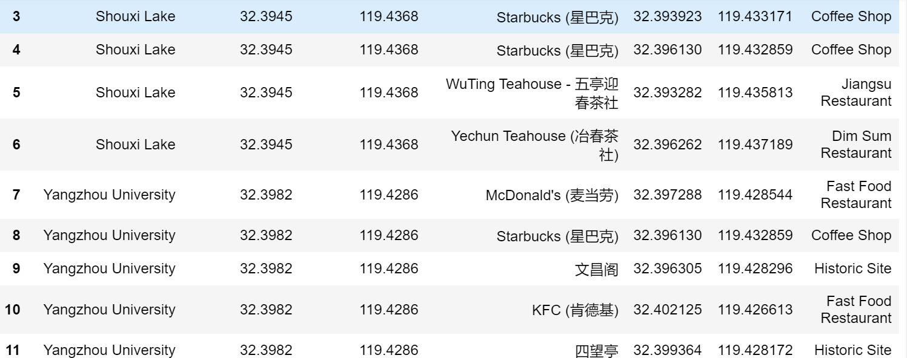
Methodology
we explore the venues of boroughs. There are five distinct districts in Yangzhou city and by creating venues groups, the surrounding conditions also become cleared. So, the target groups could be clustered through features like surrounding entertainment types for further determination.
Applied DS

Slide 6
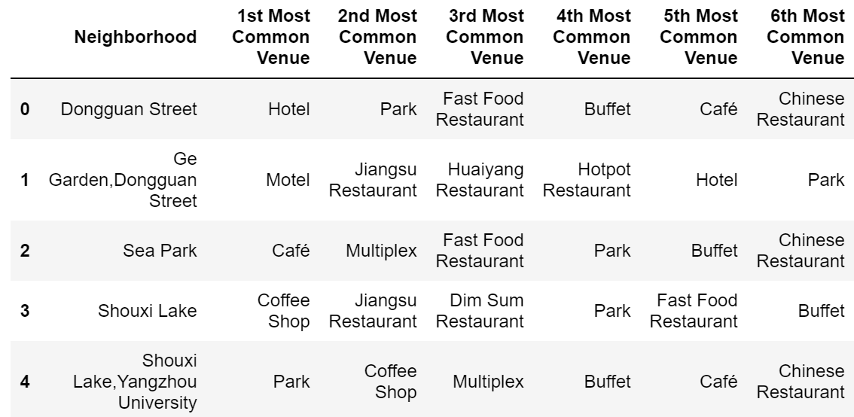
Methodology
For frequency analysis, we could determine the potential attractiveness of these locations to target customers and figure out what on earth are they interested in, based on ‘neighborhood’ and venue categories.
Applied DS

Slide 7
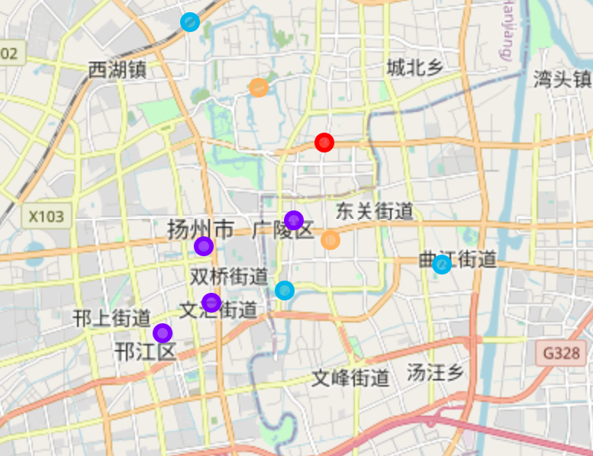
Methodology
Finally, we do the clustering to group these commercial circles to determine the appropriate place for opening coffee shop. Essentially, five groups are obtained here and directly, we can find Dongguang Street and Shouxi Lake could be most attractive to customers because of ecological environment.
Applied DS

Slide 8
Discussion and results
Applied DS
1.
From above analysis, it could be found that although Dongguan Street located at the city center and closed to commercial circles, but there are two main reasons for us to reject our business site there.
Tea is a popular drink type and more prevalent around Dongguan Street, and it is better to choose places where coffee is more acceptable to consunmers
the competition environment is fierce and surrounding attractions or entertainpment places are crowded and may be too noisy. There, it is not a good idea to open coffee shops around Dongguan Street, responding to the existing situation that only few coffee shops survive in Dongguang Street, for example, Starbucks

Slide 9
Discussion and results
Applied DS
1.
From above analysis, it could be found that although Dongguan Street located at the city center and closed to commercial circles, but there are two main reasons for us to reject our business site there.
Tea is a popular drink type and more prevalent around Dongguan Street, and it is better to choose places where coffee is more acceptable to consunmers
the competition environment is fierce and surrounding attractions or entertainpment places are crowded and may be too noisy. There, it is not a good idea to open coffee shops around Dongguan Street, responding to the existing situation that only few coffee shops survive in Dongguang Street, for example, Starbucks

Slide 10
Discussion and results
Applied DS
1.
From above analysis, it could be found that although Dongguan Street located at the city center and closed to commercial circles, but there are two main reasons for us to reject our business site there.
Guangling is very close to the largest commercial circle in Yangzhou
The frustructure of Guangling encourages coffee consumption and longer stay for customer, implying higher possibility of consumptions
The customers in Guangling is more accustomed to drinking coffee based on higher frequency, compared with other places. Therefore, if we want to choose a appropriate location to open a new restaurant, we choose from the target.

Slide 11
Applied DS
Yadava, N. R., & Sinha B. (2016). Scoring sustainability reports using GRI 2011
guidelines for assessing environmental, economic and social dimensions of
leading public and private Indian companies. Journal of Business Ethics, 138,
549-558. https://link-springer-com.ezproxy.csu.edu.au/article/10.1007/s10551-015-2597-1#Sec11
1.

