Slide 1
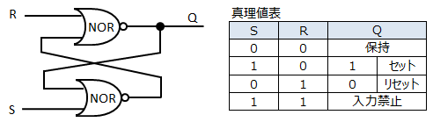
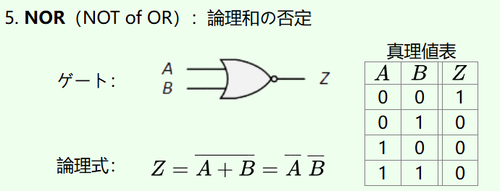
0
1
0
1
1

Slide 2
1
0
0
0
0

Slide 3
0
1
0
1
0

Slide 4
0
0
1
0
0

