Slide 1

Oct. 4th 2023
DS-RT
TILDE: Topic-tracking Infrastructure for Dynamic Message Latency and Deadline Evaluator for ROS 2 Application
Xuankeng He Hiromi Sato Yoshikazu Okumura Azumi Takuya
Saitama Univ. Saitama Univ. Research Institute of Saitama Univ.
Japan Japan Systems Planning, Inc Japan
Japan
Notes:
Hello, everyone. My name is Xuankeng He, a graduate school student from Saitama University in Japan.
It is my pleasure to have this opportunity to talk with you today.
Today I want to talk about my research: TILDE: Topic-tracking Infrastructure for Dynamic Message Latency and Deadline Evaluator for ROS 2 Application.

Slide 2
Outline
Background
Proposed Dynamic Message Tracking System
Evaluation
Conclusion
Notes:
My presentation is divided into four parts.
First I will state the background knowledge about this research.
Secondly, I will explain in depth about the design, mechanisms, use cases, etc. of this research.
Finally for this research, I have performed some overhead and performance testing, which will also be explained in detail in this presentation.

Slide 3
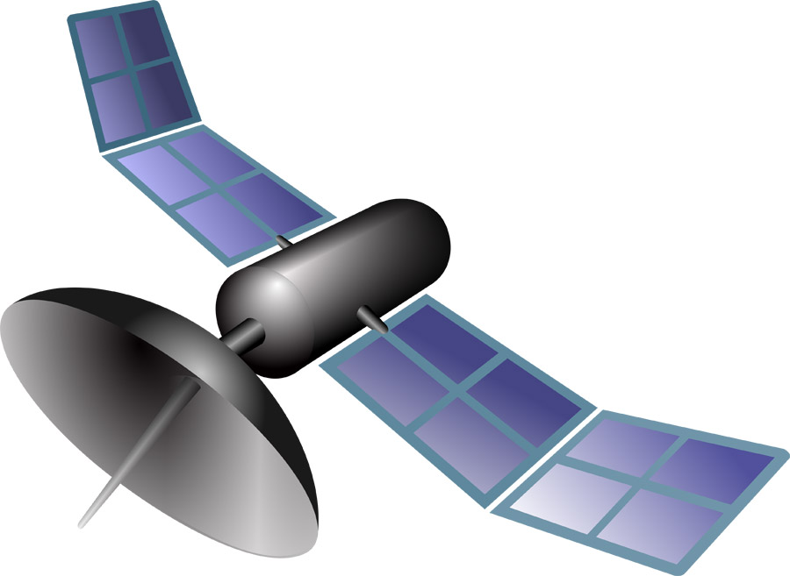

Autonomous-driving System
[Background]
Autonomous-driving technology is developing prolifically, increasing system complexity
Perception
Satellite
Camera
Sensor
High computational complexity
Increased task complexity
Real-time performance
Processing
Autonomous-driving
Control
Accelerator
Brake
Handle
Notes:
First, I begin with background knowledge about this research.
Now, with the development of autonomous driving technology, the complexity of autonomous driving systems is increasing. For example, vehicles use LiDAR to obtain environmental information from the outside, and then transmit this information to the autonomous driving system for processing. In order to allow cars to respond in a timely manner to sudden external environments, the real-time performance of the system is particularly important.
自動運転の概要の紹介

Slide 4
ROS 2
[Background]
The second generation of ROS（Robot Operating
System）
Embedded platform support
Real-time improvement
ROS
ROS 2
Notes:
Nowadays, the mainstream of autonomous driving system use ROS2. This is a robot operating system. ROS2 is the second generation of ROS, which was born in 2017. Compared to ROS, ROS2 has better real-time performance, which is why it is now used by many autonomous driving systems.
ROS2の紹介、特徴

Slide 5
ROS 2 (publish and subscribe model)
[Background]
Node: each module that accomplishes specific functionalities
Topic: a communication channel that allows nodes to
exchange messages
Publish: transmit a message of a specific data type to a
topic
Subscribe: receive and process messages of a specific data
type from a topic
Topic
Images
Publish
Subscribe
Camera
Driver
Subscribe
Pedestrian
Detection
Traffic Light
Recognition
Node
Node
Node
Notes:
The basic unit of ROS2 is the node. Each node implements specific functionalities.
In ROS2, communication between nodes uses the publish-subscribe model, as shown below.
Camera driver publishes a message that passes through the topic “Image” and is subsequently received by Traffic Light Recognition and Pedestrian Detection.
In this model, topic is a communication channel that allows nodes to exchange messages.
ROS2の通信モデルの概念の説明

Slide 6
ROS 1 & ROS 2
[Background]
This research was conducted in the Application Layer
ROS 1
Application
Application
Application
Layer
Master
Node
Node
Node
Node
Node
ROS 2
Client Library
Client Library
Middleware
Layer
Abstract DDS Layer
TCPROS/UDPROS
Nodelet
API
DDS
Intra-process
API
OS
Layer
Linux
Linux/Windows/Mac/RTOS
Notes:
The differences between the ROS and ROS2 architectures are shown here.
The architecture of ROS2 is divided into an application layer, a middleware layer and an OS layer. Our research is implemented in the application layer.
ROSとROS2の比較

Slide 7
Autoware
[Background]
Autonomous-driving software based on ROS 2
Sensing, Localization, Perception, Planning, and
Control, which are the components that control a
vehicle
Perception
Planning
Control
Localization
Sensing
Map data
Vehicle interface
Sensor
Notes:
Next, I introduce Autoware. This is the autonomous driving system to be validated.
Autoware is an open-source software stack for autonomous driving based on ROS2. It includes all the functionalities required for autonomous vehicles, from object detection to route planning and control, including self-positioning estimation.
検証対象となるAutowareの紹介

Slide 8
DAG (Directed Acyclic Graph)
[Background]
ROS 2 topic communication typically constitutes a DAG like the following
Sensor
NodeA
Sensor
NodeB
PlanningNode
/sensor/topic/A
/sensor/topic/B
/planning/base
/planning/fback
ObstacleChecker
FeedbackNode
LocalizationNode
Sensor
NodeC
/planning/refine
/localization/topic
ControlNode
/sensor/topic/C
/control/cmd
Notes:
An autonomous driving system based on ROS2 can be abstracted into a Directed Acyclic (/eɪˈsʌɪklɪk/) Graph (DAG) as shown below. In this Directed Acyclic Graph , we can understand the transfer of information within the system.
ROS2アプリケーションはDAGとしてモデル化できるので

Slide 9
End-to-End Latency
[Background]
The latency from the sensor node to the control node
Sensor
NodeA
Sensor
NodeB
PlanningNode
/sensor/topic/A
/sensor/topic/B
/planning/base
/planning/fback
ObstacleChecker
FeedbackNode
LocalizationNode
Sensor
NodeC
/planning/refine
/localization/topic
ControlNode
/sensor/topic/C
/control/cmd
Notes:
Next, I will introduce two concepts that are relevant for this research.
First, let’s see a critical concept, "end-to-end latency." As illustrated in the diagram, the system consists of three sensor nodes and a control node. Within such a system structure, "end-to-end latency" refers to the total time required to send a message from the sensor node, passing through the other nodes, until it's successfully processed by the control node.
To ensure the efficiency and real-time response of the system, managing and optimizing this latency is important. Especially in applications like autonomous driving that demand high real-time performance, any unnecessary delay might impact the system's normal operation and safety.
End-to-End Latencyの説明
レイテンシはエントリノードがpub する時点からexit nodeが処理終了までと計算

Slide 10
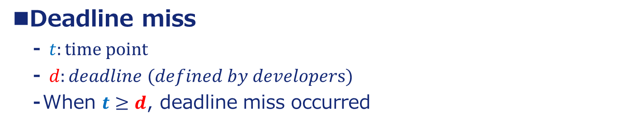
Data flow deadline miss
[Background]
Deadline miss
$t:time point$
$d:deadline (defined by developers)$
When $t≥d$, deadline miss occurred
SYSTEM
deadline: 17
Sensing
Planning
Control
publish
t = 5
publish
t = 15
Camera Node
NodeA
subscribe
t = 24
Deadline miss
subscribe
t = 8
publish
t = 2
Controller Node
publish
t = 25
LiDAR Node
NodeB
NodeC
Vehicle
Notes:
And the second concept, deadline miss will be introduced next.
A "deadline" is a value set by the developer, indicating that within a specified time, a task in the system must be completed. If not, it is considered to have missed the deadline, known as a "deadline miss.“
In the diagram, we can see that the LiDAR node sent a message to Camera node at time t=2. This message was finally processed and completed in the controller node at time t=25. The end-to-end latency for this path is 25−2=23. With a deadline set to 17, it's evident that the deadline was missed.
Deadline missの紹介
Deadline：17
LiDAR nodeは時刻2でpubする、controller nodeは時刻25で処理終了。レイテンシは25-2＝23。Deadline miss発生しています。

Slide 11
Contributions
[Proposed Dynamic Message Tracking System]
An online evaluation tool for ROS 2 application
Real-time monitoring of running programs
Latency viewing and deadline miss detection
Latency: the execution time between one node and another node
Deadline miss: the latency exceeds the time set by the developer
Real-time display of detecting results
Embedding in ROS 2 Application easily
Small overhead in the system
Notes:
To explore system latency and deadline miss, we created TILDE.
TILDE is an online evaluation tool for ROS2 application. It means that it can real-time monitoring the latency of running programs.
TILDE is running at application layer, but it is not running alone. It is embedded into ROS2 application that you want to evaluate.
Lastly, we also find that the overhead of TILDE-embedded ROS2 application is small.
TILDEの貢献

Slide 12
Goals of TILDE
[Proposed Dynamic Message Tracking System]
Since the DAG is not necessarily a straight path, the times of the referenced sensors may be different for each route
The case involving loops must also be considered
Some things cannot be known from the DAG
Some nodes may buffer messages and selectively use input data
Notes:
Using the DAG just described as an example, there are multiple points to note.
TILDE supports such cases in the DAG.
DAG in ROS2 applications are not always a straight path. One node can subscribe more than one message, so the times of the referenced sensors may be different for each route.
Corresponding loops in the DAG
Buffered and selective input data handling
TILDEは、DAGにこのようなケースを対応しています。
参照しているセンサの時間が異なる可能性
DAGにあるループの対応
バッファリングし選択的に入力データの対応

Slide 13
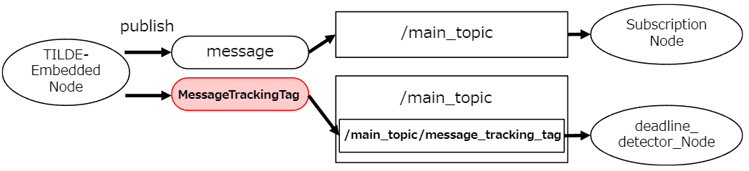
MessageTrackingTag
[Proposed Dynamic Message Tracking System]
A topic created by TILDE
TILDE publishes the main message and the tracking message at the same time
The main topic must have a std_msgs/msg/Header field with the appropriate value in the stamp field for message identification
publish
/main_topic
Subscription
Node
TILDE-Embedded Node
message
/main_topic
MessageTrackingTag
Deadline_Detector_Node
/main_topic/message_tracking_tag
Notes:
Next, I’d like to introduce MessageTrackingTag. This is a concept in TILDE.
When TILDE-embedded Node published a message, the MessageTrackingTag will be sent too.
And the TILDE-embedded Node creates a new topic for delivering messages that need to be collected.
Delivered messages are subscribed by latency viewer node or deadline detector node.
MessageTrackingTagの紹介

Slide 14


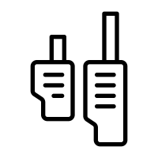
Design
[Proposed Dynamic Message Tracking System]
System model
TILDE Process
TILDE
Deadline Detector
Latency Viewer
embedded
notice
display
detect
ROS 2
Deadline Miss
Latency
Autoware
calculate
send MessageTrackingTag
Internal
Processing
…
…
send MessageTrackingTag
Notes:
The system model of TILDE looks like this.
First, we embed TILDE into ROS2 application, in this case, Autoware.
When each Autoware node’s message is sent to the appropriate topic, the corresponding MessageTrackingTag is also sent.
After collecting these MessageTrackingTags, TILDE performs the calculation process internally.
Finally, the measurement results are displayed.
システムモデル

Slide 15
Principle
[Proposed Dynamic Message Tracking System]
Example
stamp is the main topic Header stamp
stamp is time point of publishing
stamp=4
/sensor/topic/A
receive at 5
Fusion
Node
stamp=8
/sensor/fusion
stamp=6
/sensor/topic/B
receive at 7
stamp=8
stamp=3
Planning
Node
stamp=10
/planning/base
After going through topic,
the publish time of the predecessor node is known
Notes:
Next, I will give an example of TILDE to introduce the principle.
After going through topic, the publish time of the predecessor node is known.
So, we took advantage of this by recording the time point of publication for each node through MessageTrackingTag.
ユースケースを挙げて、TILDE内部でどう処理しているかを説明します。
あるノードがトピック経由でpubした後、publish時刻が分かります。

Slide 16
Principle
[Proposed Dynamic Message Tracking System]
Example
/sensor/fusion with stamp=8 referred to the following topic
stamp=4
/sensor/topic/A
receive at 5
Fusion
Node
stamp=8
/sensor/fusion
stamp=6
/sensor/topic/B
receive at 7
stamp=8
stamp=3
Planning
Node
stamp=10
/planning/base
MessageTrackingTag (FusionNode):
/sensor/topic/A with stamp=4 received at t=5
/sensor/topic/B with stamp=6 received at t=7
Notes:
In the case of FusionNode, we can know that
/sensor/fusion with stamp=8 referred to the following topic
/sensor/topic/A with stamp=4 received at t=5
/sensor/topic/B with stamp=6 received at t=7
Fusionノードが参照している情報を説明する

Slide 17
Principle
[Proposed Dynamic Message Tracking System]
Example
/planning/base with stamp=10 referred to the following topic
stamp=4
/sensor/topic/A
receive at 5
Fusion
Node
stamp=8
/sensor/fusion
stamp=6
/sensor/topic/B
receive at 7
stamp=8
receive at 9
stamp=3
Planning
Node
stamp=10
/planning/base
receive at 4
MessageTrackingTag (PlanningNode):
/sensor/fusion with stamp=8 received at t=9
/sensor/topic/B with stamp=3 received at t=4
Notes:
In the case of PlanningNode, we can know that
/planning/base with stamp=10 referred to the following topic
/sensor/fusion of stamp=8 received at t=9
/sensor/topic/B with stamp=3 received at t=4
Planningノードが参照している情報を説明する

Slide 18
Principle
[Proposed Dynamic Message Tracking System]
Example
Inference: /planning/base with stamp=10 is calculated based on the following sensor information
stamp=4
/sensor/topic/A
receive at 5
Fusion
Node
stamp=8
/sensor/fusion
stamp=6
/sensor/topic/B
receive at 7
stamp=8
receive at 9
stamp=3
Planning
Node
stamp=10
/planning/base
receive at 4
/sensor/topic/A: with stamp=4 (via /sensor/fusion)
/sensor/topic/B: with stamp=6 (via /sensor/fusion) and
with stamp=3 (received directly)
Notes:
By going backwards through the DAG and calculate the execution time in the reverse direction, we can know that the PlanningNode references three sensor time points.
/sensor/topic/A: with stamp=4 (via /sensor/fusion)
/sensor/topic/B: with stamp=6 (via /sensor/fusion) and
with stamp=3 (received directly)
最後TILDEがルートを遡って、参照している最初のpub時刻を探します。このケースは三つあります。

Slide 19
Principle
[Proposed Dynamic Message Tracking System]
Example
TILDE uses the MessageTrackingTag as a basis for tracing data backward through the DAG
/control/command/control_cmd (the last topic in Autoware) referring to which sensor information will be known
/topic/A
stamp=4
Node
stamp=8
/topic/C
/topic/B
stamp=6
stamp=8
stamp=3
Vehicle_cmd_gate
stamp=10
/control/command/control_cmd
Notes:
Similarly, when changing the measurement target to autoware, TILDE goes back from the last node and find the publish time of the sensor to be used as a reference.
計測対象をオートウェアに変更する場合も同様に、最後のノードから遡って、参照となるセンサーのpub timeを見つける。

Slide 20
Functionalities
[Proposed Dynamic Message Tracking System]
Latency Viewer
Deadline Detector
Notes:
Next, based on the principle. I’d like to introduce two functionalities in TILDE.
Latency Viewer and Deadline Detector.
TILDE二つの機能を紹介する

Slide 21
Latency Viewer
[Proposed Dynamic Message Tracking System]
Offline measurement
Evaluate performance after the system is running
Online measurement
MessageTrackingTag can be analyzed while the system is running
Notes:
First, I want to explain two measurement methods.
Offline measurement and Online measurement.
Offline measurement evaluates performance after the system is running.
But online measurement, as TILDE does, it uses MessageTrackingTag can be analyzed while the system is running.
オフライン計測とオンライン計測の違いを説明

Slide 22
Latency Viewer
[Proposed Dynamic Message Tracking System]
Example
/planning/base with stamp=10 refers to the following as the oldest value for each sensor
/sensor/topic/A: with stamp=4 (via /sensor/fusion)
/sensor/topic/B: with stamp=3 (directly received)
/sensor/topic/A
stamp=4
Fusion
Node
stamp=8
/sensor/fusion
/sensor/topic/B
stamp=6
stamp=8
stamp=3
Planning
Node
stamp=10
/planning/base
=>Took 6 seconds from sensor A, 7 seconds from sensor B
Notes:
Using the example described earlier, here is how Latency Viewer calculates latency.
With the method of going backward described earlier, the latency from Sensor A to the Planning node is 6, and the latency from Sensor B to the Planning node is 7.
If there are multiple routes from the sensor to the output node, only the route with the highest latency is displayed.
先ほどのユースケースを用いて、Latency Viewerはどう処理しているかを紹介

Slide 23
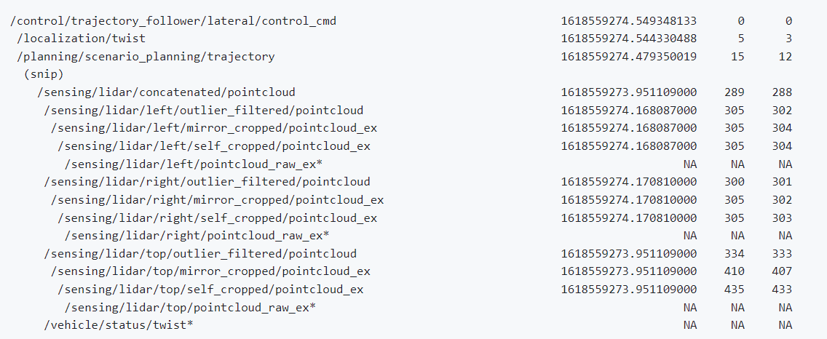
Latency Viewer
[Proposed Dynamic Message Tracking System]
time stamp
ROS time
steady time
control node
sensor node
Notes:
This is the image of latency viewer in action.
Latency Viewerが動作している画像を示す

Slide 24
Deadline Detector
[Proposed Dynamic Message Tracking System]
Indirect input topic latency (Case 1)
NodeA is stopped or /topicA is delayed
Case 1
10hz
10hz
NodeA
/topicA
NodeB
/topicB
TargetNode
(timer)
(timer)
<= 100 ms
Notes:
Next, I’d like to introduce another functionality, deadline detector. The deadline detector is use for detecting deadline misses.
In deadline detector, Latency types are divided into two cases.
Case 1 is indirect input topic latency. In this case, the latency is caused by NodeA being down or a delay in the message via /topicA.
In this case, The information referenced by NodeB may be out of date.
Deadline detector間接的な入力トピックの遅延を説明する

Slide 25
Deadline Detector
[Proposed Dynamic Message Tracking System]
Direct input topic latency (Case 2)
TargetNode may not be able to receive /topicB in the expected cycle due to NodeB or network latency
Case 2
10hz
10hz
NodeA
/topicA
NodeB
/topicB
TargetNode
(timer)
(timer)
<= 100 ms
Notes:
Another case is direct input topic latency. TargetNode may not be able to receive the message via /topicB in the expected cycle due to NodeB or network latency.
So, it directly affects the targetNode's message reception
Deadline detector直接的な入力トピックの遅延を説明する

Slide 26
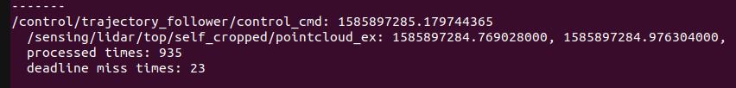
Deadline Detector
TIDE
[Proposed Dynamic Message Tracking System]
Notes:
This is the image of deadline detector in action. When a deadline miss occurred, deadline detector will push an information to announce user.
Deadline Detectorが動作している画像を示す

Slide 27
Environment
[Evaluation]
Processor | Intel® Core™ i7-10875H CPU@2.30 GHz
Number of Cores | 16
Memory | 17.1799 GB (16.0 GiB)
Graphics | NVIDIA Corporation TU106M [GeForce RTX 2060 Mobile] / Mesa Intel® UHD Graphics (CML GT2)
OS | Ubuntu 22.04.1 LTS
ROS 2 | Humble Hawksbill
DDS | Cyclone DDS
Notes:
At the end, I want to talk about the evaluation.
This is the environment to evaluate the performance of TILDE.
For software, I am using Ubuntu 22.04, Humble version of ROS2 and Cyclone DDS.
We use i7 intel processor with GeForce RTX 2060 Graphic， 16 cores CPU and 16GB memory.
評価環境

Slide 28
Overhead Measurement
[Evaluation]
Overhead calculation
Publisher
(original ROS 2 node)
String type
message
Subscriber
(original ROS 2 node)
Execution time
Overhead
Publisher
(TILDE node)
String type
message
Subscriber
(TILDE node)
Execution time
Notes:
The calculation of overhead is shown in Figure.
First, we measured the execution time of original ROS2 nodes, that are nodes without embedded TILDE.
Then, we measured the execution time of TILDE-embedded nodes.
The publisher for both measurements sends the same string type data that is finally received by the subscriber.
The difference between the execution time of the TILDE-embedded node and the original ROS2 node is defined as overhead.
オーバヘッドの測り方を説明する

Slide 29
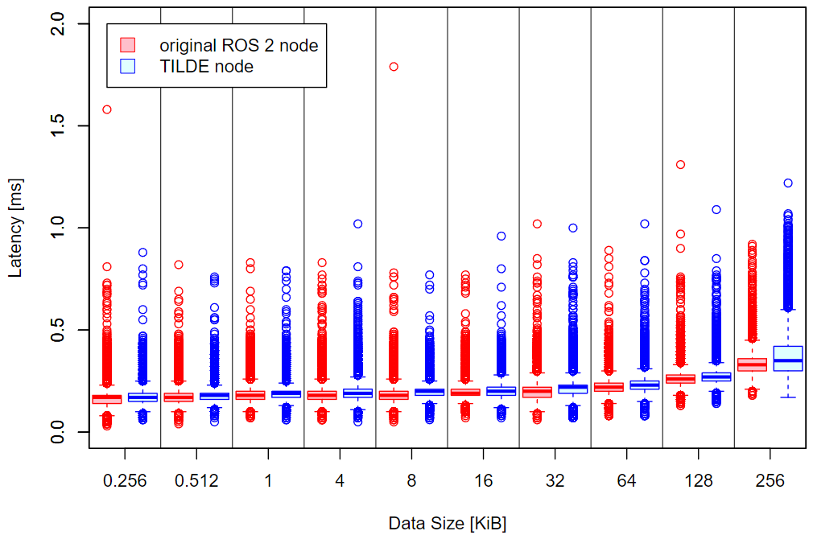
Overhead Measurement
[Evaluation]
Execution time of publishing and subscribing from 0.256 to 256 KiB string-type message per unit time (16 cores)
10,000 executions
Notes:
The measurement results after 10,000 executions with 16 cores are displayed here.
The vertical axis describes the latency per measurement, and the horizontal axis denotes the size of the delivered message.
As we can see that the average execution time using TILDE nodes increased. There are two factors considered to contribute to the overhead. In TILDE, we created a publish_info function publishes the MessageTrackingTag that is larger than the original message and the subscriber-received message registration requires additional time.
オーバヘッドの計測結果を説明する

Slide 30
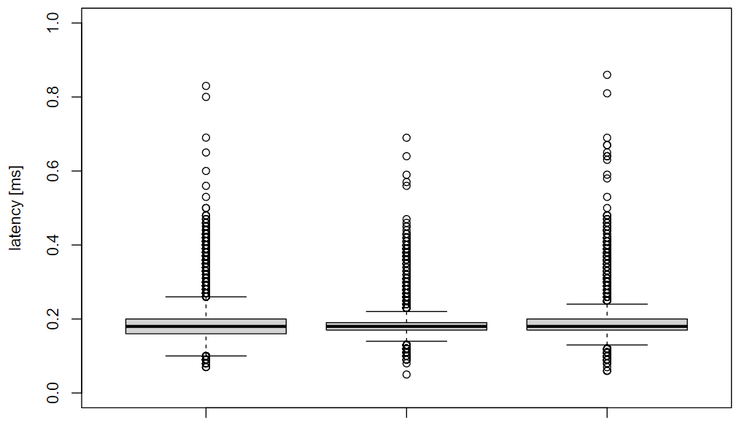
Overhead Measurement
[Evaluation]
Execution time of publishing and subscribing from 1 KiB string-type message per unit time between various nodes (16 cores)
① ② ③
Original ROS 2
node set
TILDE publisher
Original ROS 2 subscriber
Original ROS 2 publisher
TILDE subscriber
Notes:
The execution time of publishing and subscribing from 1 KiB string-type message per unit time between various nodes is shown here.
This measurement to determine overhead was carried out in three different models. Each model involved delivering a 1 KiB String type message.
The measurement models consisted of: (i) the original ROS2 publisher and subscriber set; (ii)and model 2, a TILDE publisher and the original ROS2 subscriber; and model 3, the original ROS2 publisher and TILDE subscriber.
the execution time for model3 was only marginally longer than model2, This difference was insignificant compared to the execution time of the original ROS2 node. Therefore, this finding confirms that there is minimal overhead present in the system.
オーバヘッドの計測結果を説明する

Slide 31

Deadline Miss Detection Rate Measurement
[Evaluation]
Chain-Aware ROS Evaluation Tool (CARET)
Offline measurement
Measuring all end-to-end latency accurately
T. Kuboichi et al., "CARET: Chain-Aware ROS 2 Evaluation Tool,“ IEEE International Conference on Embedded and Ubiquitous Computing (EUC), 2022
Notes:
Next, I would like to introduce deadline detection accuracy.
To illustrate the accuracy of the measurement results, the CARET measurement results are used as the standard.
計測結果の精度を説明するため、CARETの計測結果を標準とします

Slide 32
Deadline Miss Detection Rate Measurement
[Evaluation]
Results of deadline miss detection rate measurement
Detection rate acceptable percentage: 100%
testing the same ROS 2 application
Number of executing the path | 966
Number of deadline misses (deadline detector) | 3
Number of deadline misses (CARET) | 3
Notes:
We reviewed the Deadline Miss Detection Rate with TILDE.
We set the detection rate acceptable percentage to 100%.
And we used CARET and TILDE to test the same ROS2 application.
As we can see that the detection rate was 100%. All deadline misses were detected.
CARETの計測結果と比較して、検出精度はCARETと同じと証明します。

Slide 33
Conclusions
Background
ROS 2
Autoware
End-to-End latency and deadline miss
Proposed Dynamic Message Tracking System
Latency Viewer and Deadline Detector
Contributions
a new dynamic message tracking system for ROS 2 applications
a new tool for detecting the deadline miss for ROS 2 applications
explore the overhead of TILDE that is embedded in ROS 2 nodes
Future work
Improving the deadline detector’s integration with visualization functionality
Notes:
I’d like to conclude by making the following points.
In this research, we presented TILDE, a dynamic message tracking system for ROS2 applications. MessageTrackingTags are published alongside the original ROS2 messages to record which topics nodes published or subscribed to. These tags are collected by TILDE, which calculates the end-to-end latency of the dataflow and notifies the deadline miss.

Slide 34
Timing Challenges in the Measurement of Distributed Systems
Evaluation
ROS_TIME
Based on system time
STEADY_TIME
Application internal time
More accurate than system time because it is not affected by external protocols, such as Network Time Protocol (NTP)
In TILDE
We keep both type of time for measurement’s accuracy
Notes:
分散システムで異なる時間の可能性があります。TILDEはどう対応しているかを説明します。
ROS_TIMEとSTEADY_TIMEを使っています。

Slide 35
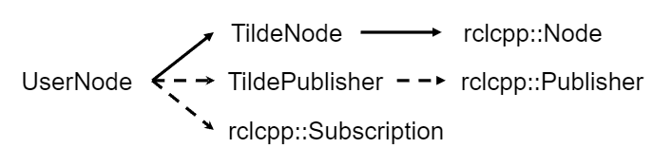
Design
TILDE
Class relation of TILDE
The TILDE node implementation inherits from rclcpp

Slide 36
Design
TILDE
Embed into ROS 2 application (manually)
Before | After
rclcpp::Node | tilde::TildeNode
rclcpp::Subscription | tilde::TildeSubscription
create_subscription | create_tilde_subscription
create_publisher | create_tilde_publisher

Slide 37
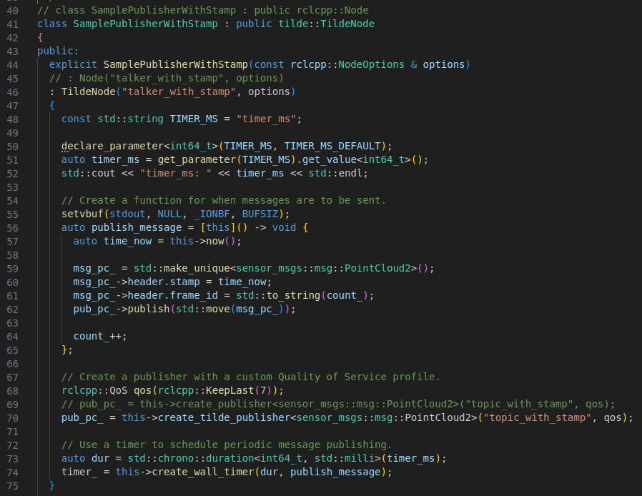
Design
TILDE
Sample for embed into ROS 2 application (manually)
Publisher for publishing PointCloud2-type data

Slide 38
End-to-End Latency
[Background]
End-to-End latency
The latency from entry node to exit node
End-to-End path
Entry
node
publish
Node
publish
Node
publish
Exit
node
subscribe
subscribe
subscribe
End-to-End latency
Notes:
Next, I will introduce two concepts that are relevant for this research.
First, let's introduce a critical concept, "end-to-end latency." As illustrated in the diagram, the system consists of an entry node and an exit node, with two intermediate standard nodes. Within such a system structure, "end-to-end latency" refers to the total time required to send a message from the entry node, passing through the intermediate nodes, until it's successfully processed by the exit node.
To ensure the efficiency and real-time response of the system, managing and optimizing this latency is of paramount importance. Especially in applications like autonomous driving that demand high real-time performance, any unnecessary delay might impact the system's normal operation and safety.
End-to-End Latencyの説明
レイテンシはエントリノードがpub する時点からexit nodeが処理終了までと計算

