Slide 1

May. 13th 2024
RAGE
Energy Consumption Prediction Framework in Model-based Development for Edge Devices
Yue Hou Azumi Takuya
Saitama Univ. Saitama Univ.
Japan Japan
Notes:
Hello, everyone. My name is Yue Hou, a graduate school student from Saitama University in Japan.
Today, I’ll give a presentation on my research which names [Energy Consumption Prediction Framework in Model-based Development for Edge Devices}

Slide 2
Outline
Background
Proposed Prediction Framework
Evaluation
Conclusion
Notes:
My presentation is divided into four parts.
First I will state the background knowledge about this research.
Secondly, I will explain in depth about the proposed framework, use cases and other things of this research.
Finally，for this research, I have performed some testing, which will also be explained in detail in this presentation.

Slide 3
Edge Device
[Background]
Development of Edge Device
The count of devices is increasing
Systems is becoming complex
Development of Systems on Edge Devices
The cost is becoming significant.
The reusability of the code developed with traditional method is limited.
Notes:
So, First, I‘ll begin with background knowledge about this research.
As the development of edge devices, those systems embedded in devices is becoming more complex
The cost of time and money spent on developing these systems is also becoming more and more significant.
Moreover, the reusability of the code of the system developed by the traditional development method is limited..

Slide 4

MATLAB/Simulink
[research background]
What is MATLAB/Simulink
MATLAB
A programming and numeric computing platform developed by MathWorks.
Simulink
A block diagram environment for Model-based Development integrated with MATLAB.
Why Use MATLAB/Simulink
Efficiency
Simplifies complex numerical calculations and visualization.
Integration
Provides an easy-to-use environment.
Versatility
Used in various industries, such as engineering and finance.
Notes:
To deal with these problems, Model based development was proposed
For better understand of mbd, let me first briefly introduce matlab which is often used in mbd
What is MATLAB/Simulink
MATLAB
A programming and numeric computing platform by MathWorks.
used for algorithm development, data analysis, visualization, and numerical computation.
Simulink
A block diagram environment for Model-based Development , integrated with MATLAB.
It supports simulation, automatic code generation, and continuous test and verification of embedded systems.
Why Use MATLAB/Simulink?
Efficiency: Accelerates the pace of engineering and science by providing a high-level programming environment that simplifies complex numerical calculations and visualization.
Integration: Seamlessly integrates computing, visualizing, and programming in an easy-to-use environment where problems and solutions are expressed in familiar mathematical notation.
Versatility: Used in various industries, including engineering, finance, and biotechnology, for tasks ranging from developing control systems to financial modeling and analysis.

Slide 5
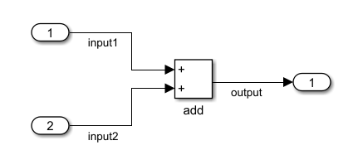
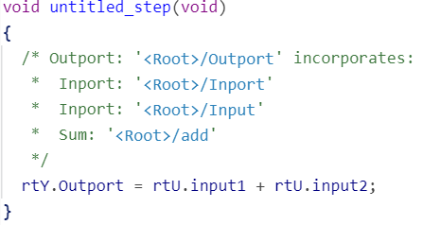
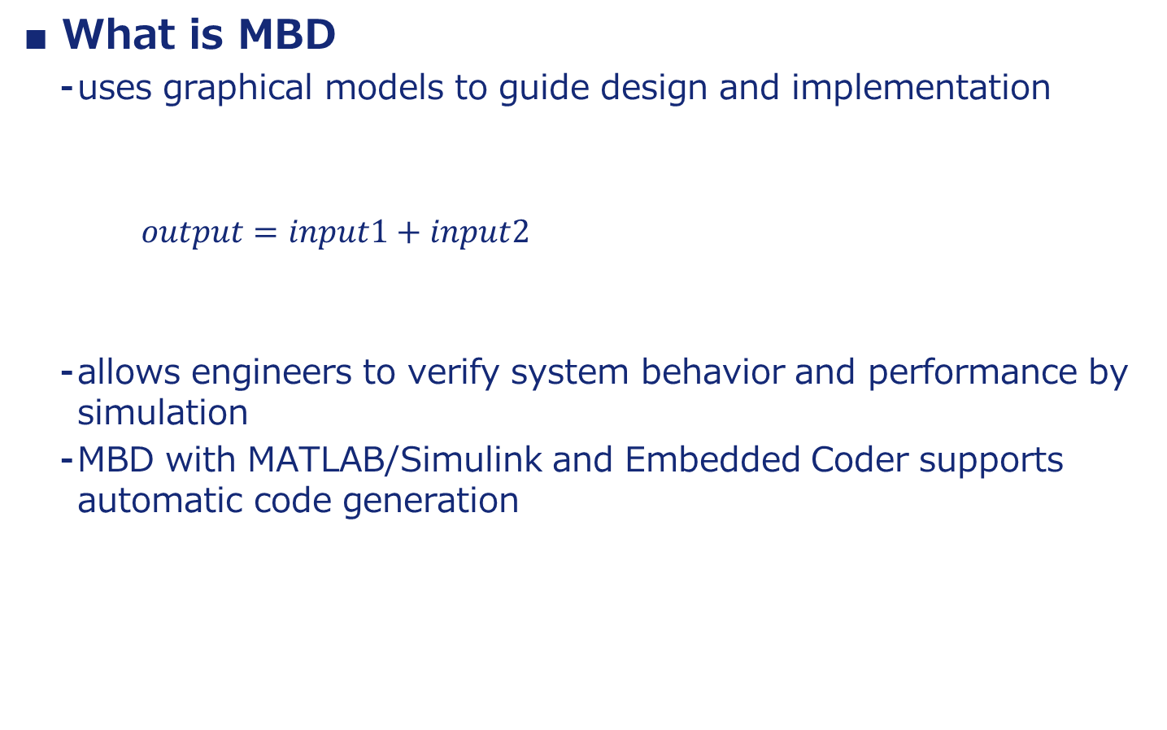
Model-based Development (MBD)
[research background]
What is MBD
uses graphical models to guide design and implementation
$output=input1+input2$
allows engineers to verify system behavior and performance by simulation
MBD with MATLAB/Simulink and Embedded Coder supports automatic code generation
Notes:
So what is model based development
Here I give a simple example of an equation and its corresponding model.
You can see the left equation was translated into the model on right side by using 3 kinds of blocks.
As this example shows, mbd uses graphical models to guide design and implementation
simplifying system design and verification. It also allows engineers to verify system behavior and performance before writing code. In particular, MBD with MATLAB Simulink and Embedded Coder supports automatic code generation, reducing development time and coding errors.
The code I gaved here is generated by embedded coder for the above model

Slide 6
Low Level Virtual Machine Intermediate Representation （LLVM-IR）
[research background]
What is LLVM-IR
A low-level programming language used as the primary IR within the LLVM compiler framework.
Serves as a bridge between high-level languages and the machine code, enabling code analysis and transformation.
Why Use LLVM-IR
Portability
Easy to support multiple target platforms.
Optimization
Facilitates various optimizations both at the compile time and at run time.
Flexibility
Allows developers to create compilers for new programming languages more easily, or extend the capabilities of existing languages.
Notes:
What is LLVM-IR?
LLVM-IR (Low Level Virtual Machine Intermediate Representation) is a low-level programming language used as the primary IR (intermediate representation) within the LLVM compiler framework.
It serves as a bridge between high-level languages and the machine code, enabling code analysis and transformation.
Why Use LLVM-IR?
Portability: LLVM-IR is designed to be independent of specific hardware architectures, which makes it easier to support multiple target platforms.
Optimization: It facilitates various optimizations both at the compile time and at run time. This modular IR can be optimized in multiple passes, improving performance and efficiency.
Flexibility: Being a central part of LLVM, it allows developers to create compilers for new programming languages more easily, or extend the capabilities of existing languages.

Slide 7
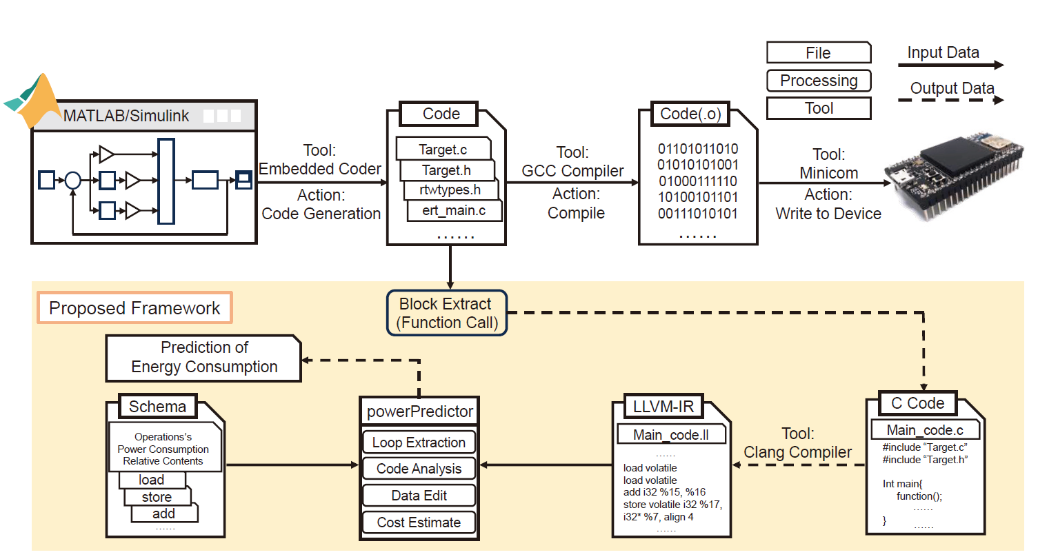
System Model
[Proposed Prediction Framework]
MBD Sequence
Modeling
Simulation
Code Generation
Compile
Write in
Notes:
Modeling
Definition: Create a mathematical and visual representation of the physical system. This involves defining the system’s dynamics, controls, and interactions using graphical blocks or scripting.
Purpose: Allows for abstracting real-world processes into manageable, simulatable models.
Simulation
Definition: Execute the model using simulation tools to predict the behavior of the system under various conditions.
Purpose: Validates the design by testing how the system will perform, helping to identify and correct issues early in the development cycle.
Code Generation
Definition: Automatically convert the validated model into executable code that can be deployed on hardware. This step uses tools that translate the high-level model into lower-level code (e.g., C, C++).
Purpose: Facilitates rapid prototyping and reduces the potential for human error compared to manual coding.
Compile
Definition: Compile the generated code into a binary format that can be executed by the target hardware.
Purpose: Ensures the code is optimized and compatible with the hardware, ready for real-world testing and deployment.
Write in
Definition: Upload and install the compiled code onto the physical hardware system.
Purpose: Allows the physical system to operate according to the design specified in the model, enabling actual system testing and deployment.

Slide 8
Proposed Method
[Proposed Prediction Framework]
Energy Consumption Description Schema
Objective
Provide a universal framework to describe energy consumption for any given instruction.
Notes:
Modeling
Definition: Create a mathematical and visual representation of the physical system. This involves defining the system’s dynamics, controls, and interactions using graphical blocks or scripting.
Purpose: Allows for abstracting real-world processes into manageable, simulatable models.
Simulation
Definition: Execute the model using simulation tools to predict the behavior of the system under various conditions.
Purpose: Validates the design by testing how the system will perform, helping to identify and correct issues early in the development cycle.
Code Generation
Definition: Automatically convert the validated model into executable code that can be deployed on hardware. This step uses tools that translate the high-level model into lower-level code (e.g., C, C++).
Purpose: Facilitates rapid prototyping and reduces the potential for human error compared to manual coding.
Compile
Definition: Compile the generated code into a binary format that can be executed by the target hardware.
Purpose: Ensures the code is optimized and compatible with the hardware, ready for real-world testing and deployment.
Write in
Definition: Upload and install the compiled code onto the physical hardware system.
Purpose: Allows the physical system to operate according to the design specified in the model, enabling actual system testing and deployment.

Slide 9
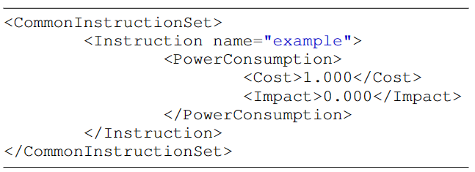
Proposed Method
[Proposed Prediction Framework]
Energy Consumption Description Schema
Three-Tier Structure
Top Layer
CommonInstructionSet
Middle Layer
Instruction
Bottom Layer
PowerConsumption
Notes:
Three-Tier Structure
Top Layer - CommonInstructionSet
Root element containing energy information for sets of instructions.
Middle Layer - Instruction
Each element describes energy consumption for a single instruction.
Attributes such as 'name' allow for individual representation and consideration.
Bottom Layer – PowerConsumption
Direct energy usage metrics for instructions.
Cost: Quantifies energy expenditure.
Impact: Evaluates the potential effects of resource competition in multicore systems, providing insights for future energy prediction models.

Slide 10
Proposed Method
[Proposed Prediction Framework]
Time and Energy Consumption of Instructions
Correlation of Time and Energy
Premise: Execution time of code is directly linked to energy consumption.
Validation: Accurate time predictions validate energy consumption estimates.
Importance of Measurement
Accuracy: Precise measurement of individual instructions is critical—errors directly affect overall prediction reliability.
Technique: A cyclic execution approach is commonly used for better precision in predicting individual instructions' time and energy use.
Notes:
Slide Title: Measuring Execution Time & Energy Consumption
Slide Content:
Correlation of Time and Energy
Premise: Execution time of code is directly linked to energy consumption.
Validation: Accurate time predictions validate energy consumption estimates.
Importance of Measurement
Accuracy: Precise measurement of individual instructions is critical—errors directly affect overall prediction reliability.
Technique: A cyclic execution approach is commonly used for better precision in predicting individual instructions' time and energy use.
Execution Time Measurement
Challenge: Selecting an accurate timing method is crucial for exact execution time capture.
Tools: While standard libraries offer timing functions, their precision may be insufficient.
Advanced Method: The experiment utilizes the DWT (Data Watchpoint and Trace Unit) on the SONY Spresense board, enhancing accuracy by directly accessing specific registers.
Consideration: Using DWT presents risks such as clock overruns, which must be managed.
Visual Aids:
A diagram illustrating the relationship between code execution time and energy consumption.
A flowchart depicting the steps for measuring instruction time and energy, highlighting the cyclic execution method and the use of DWT.
A side note or a callout on the slide about the need for careful handling of the DWT to avoid clock overruns.

Slide 11
Proposed Method
[Proposed Prediction Framework]
Time and Energy Consumption of Instructions
Execution Time Measurement
Challenge: Selecting an accurate timing method is crucial for exact execution time capture.
Tools: While standard libraries offer timing functions, their precision may be insufficient.
Advanced Method: The experiment utilizes the DWT (Data Watchpoint and Trace Unit) on the SONY Spresense board, enhancing accuracy by directly accessing specific registers.
Consideration: Using DWT presents risks such as clock overruns, which must be managed.
Notes:
Slide Title: Measuring Execution Time & Energy Consumption
Slide Content:
Correlation of Time and Energy
Premise: Execution time of code is directly linked to energy consumption.
Validation: Accurate time predictions validate energy consumption estimates.
Importance of Measurement
Accuracy: Precise measurement of individual instructions is critical—errors directly affect overall prediction reliability.
Technique: A cyclic execution approach is commonly used for better precision in predicting individual instructions' time and energy use.
Execution Time Measurement
Challenge: Selecting an accurate timing method is crucial for exact execution time capture.
Tools: While standard libraries offer timing functions, their precision may be insufficient.
Advanced Method: The experiment utilizes the DWT (Data Watchpoint and Trace Unit) on the SONY Spresense board, enhancing accuracy by directly accessing specific registers.
Consideration: Using DWT presents risks such as clock overruns, which must be managed.
Visual Aids:
A diagram illustrating the relationship between code execution time and energy consumption.
A flowchart depicting the steps for measuring instruction time and energy, highlighting the cyclic execution method and the use of DWT.
A side note or a callout on the slide about the need for careful handling of the DWT to avoid clock overruns.

Slide 12
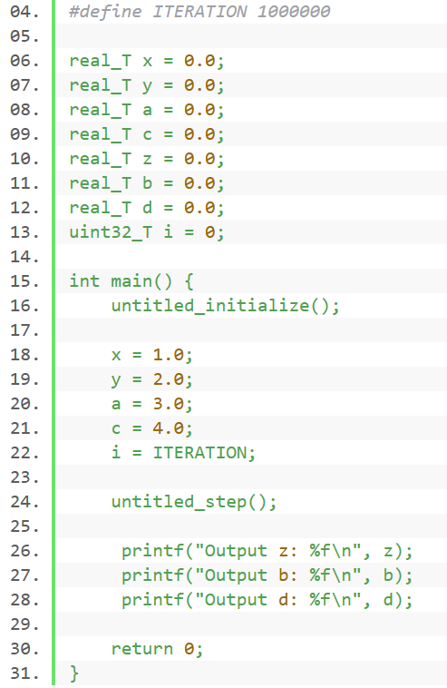
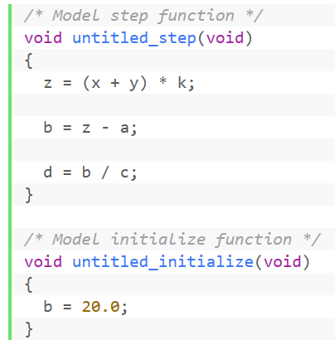
Proposed Method
[Proposed Prediction Framework]
Extract the Operation Part from Generated Code
Notes:
Slide Title: Measuring Execution Time & Energy Consumption
Slide Content:
Correlation of Time and Energy
Premise: Execution time of code is directly linked to energy consumption.
Validation: Accurate time predictions validate energy consumption estimates.
Importance of Measurement
Accuracy: Precise measurement of individual instructions is critical—errors directly affect overall prediction reliability.
Technique: A cyclic execution approach is commonly used for better precision in predicting individual instructions' time and energy use.
Execution Time Measurement
Challenge: Selecting an accurate timing method is crucial for exact execution time capture.
Tools: While standard libraries offer timing functions, their precision may be insufficient.
Advanced Method: The experiment utilizes the DWT (Data Watchpoint and Trace Unit) on the SONY Spresense board, enhancing accuracy by directly accessing specific registers.
Consideration: Using DWT presents risks such as clock overruns, which must be managed.
Visual Aids:
A diagram illustrating the relationship between code execution time and energy consumption.
A flowchart depicting the steps for measuring instruction time and energy, highlighting the cyclic execution method and the use of DWT.
A side note or a callout on the slide about the need for careful handling of the DWT to avoid clock overruns.

Slide 13
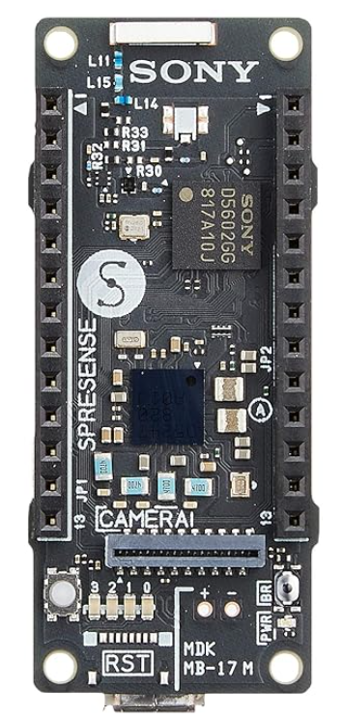
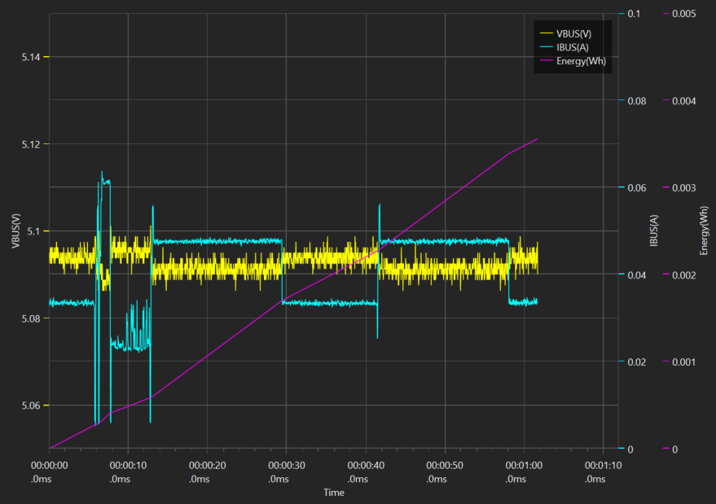
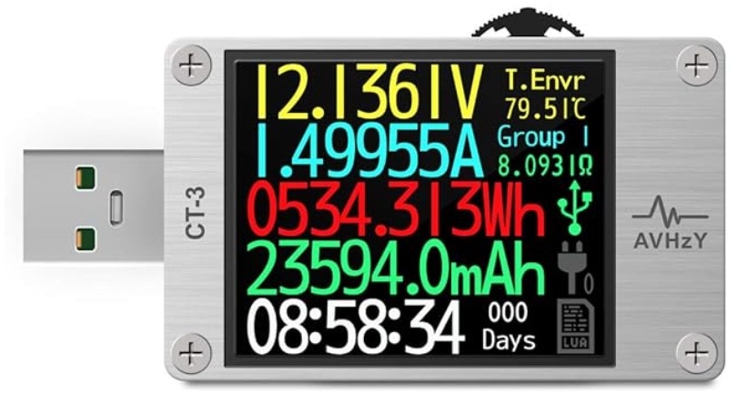
Experimental Environment
[Evaluation]
Target device
SONY Spresense (ARM Cortex M4F)
Measurement device
AVHzY CT-3 USB tester
Notes:
For each step, an experiment was set up
The target device is a SONY Spresense development board.
This board has 6 ARM Cortex M4F.
The measurement device is an ordinary usb tester.
The tester has the ability to record data, as well as the ability to visualize the data.

Slide 14
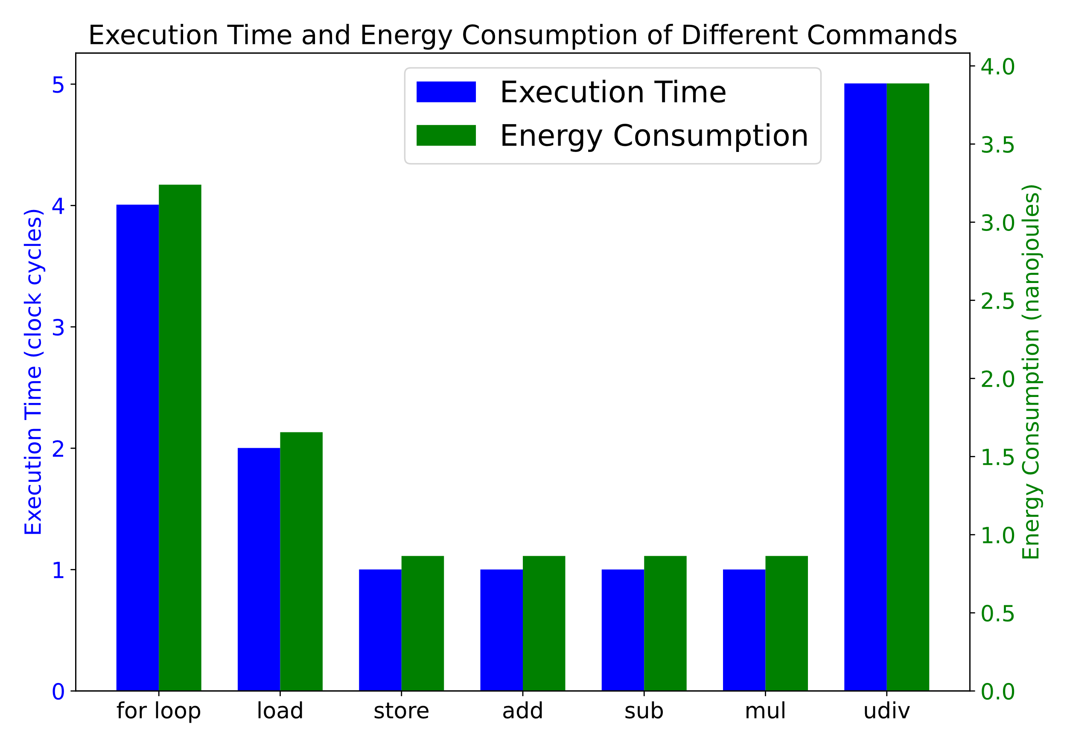
Experimental
[Evaluation]
Basic Evaluation
Measure the power consumption and execution time of basic instructions on the target device
Create test scripts to obtain actual execution time and power consumption in a single core environment
Notes:
Code execution time is closely related to energy consumption, and to predict energy consumption, code time estimation can be synchronized and used as a validation.
To this end, we have listed the following basic evaluations
To guarantee cross-platform and cross-architecture properties, the Low Level Virtual Machine Intermediate Representation (LLVM-IR) code is used in the experiment.
LLVM-IR provides a unified, hardware-independent basic instruction set.
First, it measures the power consumption and execution time of the basic instructions on the target device.
We also create a test script to obtain the actual execution time and power consumption in a single-core environment.
Finally, based on the measured single instruction data, predictions are made at the LLVM-IR instruction level and compared to the measured values to analyze the prediction accuracy.
The figure shows the measured power consumption and execution time of a number of basic instructions. The unit of execution time is cycles, and the unit of energy is nanojoules

Slide 15
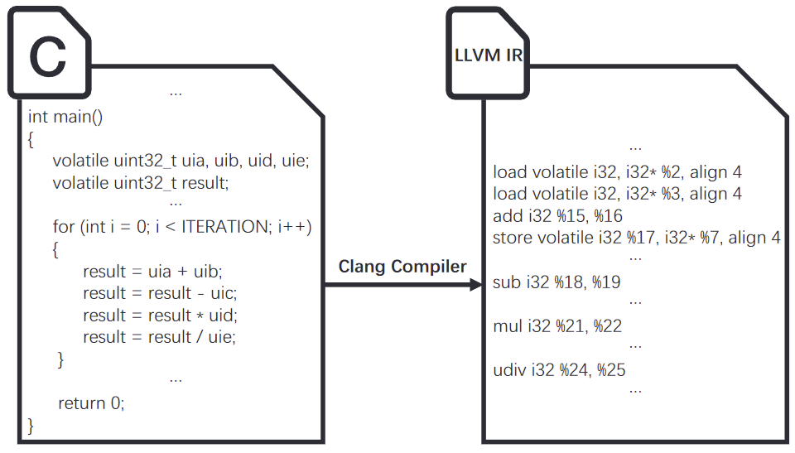
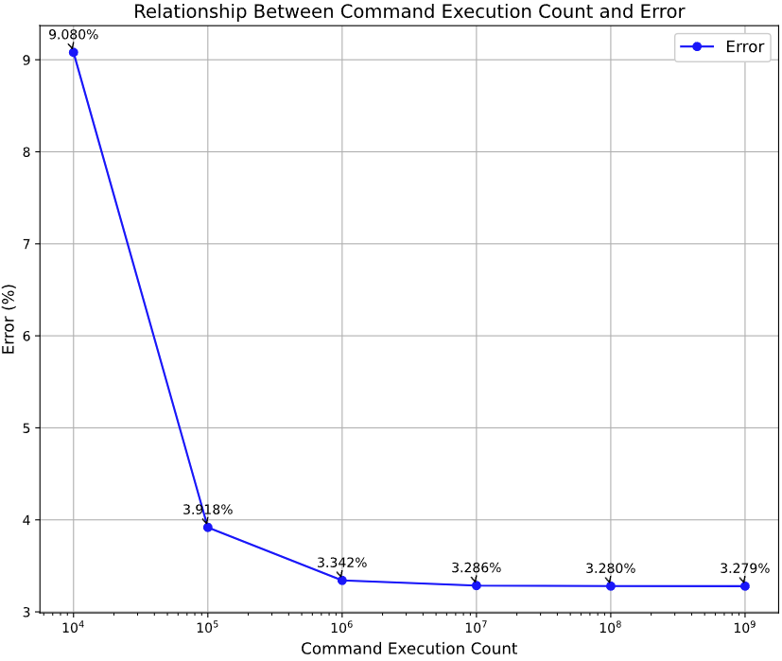
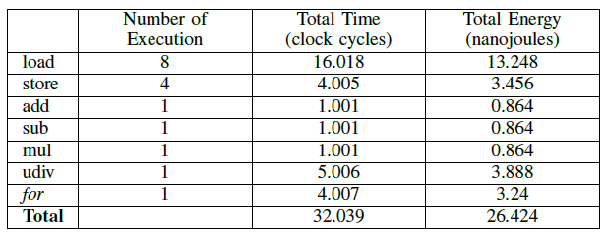
Experimental
[Evaluation]
Basic Evaluation
Test Scripts
Four arithmetic operations（add,sub,mul,div）
Predicting power consumption
Focus on the “for” statement part
Test Scripts
Time and Energy Consumption of Instructions
Power Consumption Prediction Focus on “for”
Notes:
In order to verify the feasibility of our proposed approach
The test script performs a simple four arithmetic operations.
in this case, we focus only on the for statement, so when the number of loops is small, the error is large.As the number of loops is increased, the error gradually decreases.

Slide 16
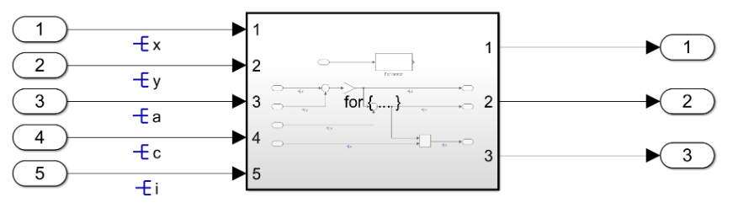
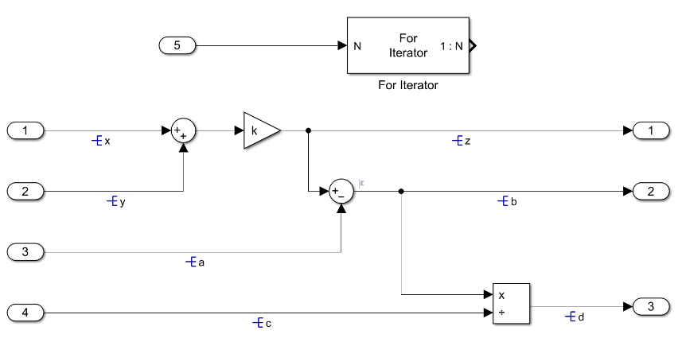
Experimental
[Evaluation]
Evaluation with Models
Overall Model Construction
For Iterator Subsystem Construction
Notes:
In addition, an evaluation using a model was conducted to determine if the proposed schema and estimation method are applicable in model-based development.
The model we prepared is shown in the figure below, using the for subsystem to perform the four arithmetic operations.
In the actual case, the model works by receiving information from the outside and passing it to the model after the process is complete, and the test model is also used in the function call.

Slide 17
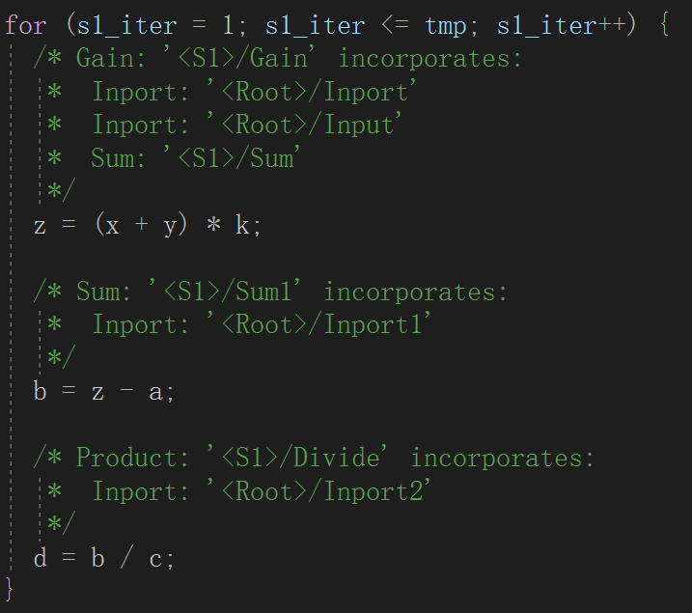
Experimental Environment
[Evaluation]
Evaluation with Models
Code generated by Embedded Coder
Execute in user code with function calls
Convert to LLVM-IR instructions
Make predictions with a prediction tool
Notes:
Once the model has been created, Embedded Coder generates the code.
The for statement part of the generated code is shown in the figure on the left
.Next, it writes in the user's code with a function call
Finally, the actual power consumption is calculated by writing to the target device.

Slide 18
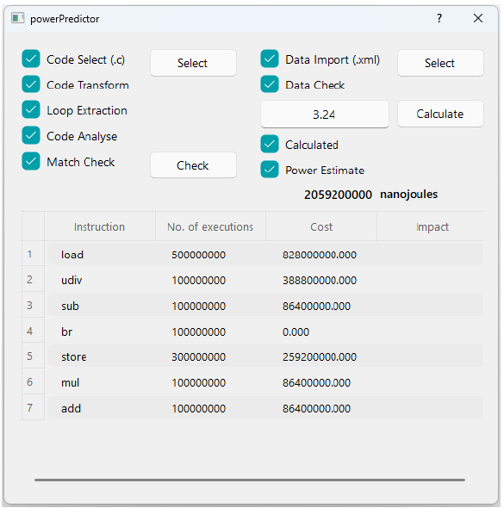
Experimental Environment
[Evaluation]
Evaluation with Models
Result
Prediction
2,059,200,000 nJ
Measurement
1,980,000,000 nJ
Error: 4%
Error Analysis
Precision of the equipment
1,000 times per second
Notes:
The prediction part converts the user code into LLVM-IR instructions, and the prediction is performed by the designed prediction tool.
The resulting error between actual and predicted power consumption is found to be 4%.

Slide 19
解決したい課題
モデルベース開発で、組込みソフトウェアの消費電力を見積もる研究がない
SHIM2.0では、定式化する機能がない
「組込みソフトウェア向け消費電力見積もりSHIMスキーマの提案」というテーマを提案する
Notes:
以上の問題を踏まえて、本研究で解決したい課題が挙げられました。
まず、モデルベース開発で、組込みソフトウェアの消費電力を見積もる研究がないことが判明されました
また、SHIMに対して、消費電力を定式化する機能がないこともわかりました
こちらの課題を解決するために、「組込みソフトウェア向け消費電力見積もりSHIMスキーマの提案」というテーマを挙げました。

Slide 20
アプローチ
問題を解決するための主なステップは以下の通り：
実機を使用した消費電力の測定
見積もりの基準となるデータを取得する
干渉要素と規則性の調査
定式化のために、両者の関連性を理解する
消費電力を表すスキーマの作成
スキーマを作成することで他のハードウェアにも適用する
スキーマを使用した各計算処理に対する消費電力の見積もり
実態にあった消費電力の見積もりを行う
ソフトウェアの消費電力の見積もり
ハードウェア要件に違反していないかを確認する
Notes:
具体的なアプローチは
まず、実機を使用して、消費電力の測定を行います
その上、干渉要素と規則性の調査を行います
続いて、消費電力を表すスキーマを作成した上、各計算処理に対する消費電力の見積もりを行います
最後、ソフトウェアの消費電力の見積もりを行います。

Slide 21
実験結果
実験
実験環境
ターゲットデバイス：SONY Spresense (ARM Cortex M4F)
測定デバイス：AVHzY CT-3 USB テスター
Notes:
各ステップに対して、実験が設けられました
ターゲットデバイスはSONY Spresense開発ボードです。このボードはARM社の Cortex M4F 6個を持っています。
測定デバイスは普通のusbテスターです。
このテスターはテータの記録機能を持っています、さらに、データの可視化機能も揃っています。

Slide 22
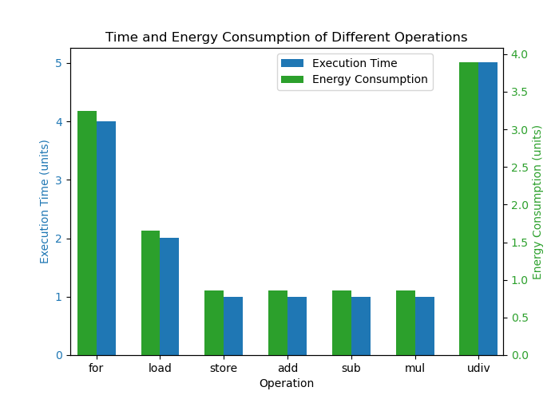
実験結果
実験
基礎評価
ターゲットデバイスの基本命令の消費電力量と実行時間を測定する
シングルコア環境における実際の実行時間と消費電力を取得するためのテストスクリプトを作成する
計測された単一命令データに基づき、LLVM-IR命令レベルでの予測を行い、計測値と比較することで予測精度分析を行う
Notes:
コードの実行時間はエネルギー消費量と緊密な関係があり、エネルギー消費量を予測するためには、コード時間の予測を同期させ、検証として使用することができます。
そのために、以下の基礎評価を挙げました。
cross-platformとcross-archtecture性を保証するために、実験で使っているのはLow Level Virtual Machine Intermediate Representation (LLVM-IR)のコードです。
LLVM-IRは統一された、ハードウェアに依存しない基本命令セットを提供しています。
まず、ターゲットデバイスの基本命令の消費電力量と実行時間を測定します
また、シングルコア環境における実際の実行時間と消費電力を取得するためのテストスクリプトを作成します
最後、計測された単一命令データに基づき、LLVM-IR命令レベルでの予測を行い、計測値と比較することで予測精度を分析します
この図に示しているのはいくつの基本命令の消費電力量と実行時間の実測値です。実行時間の単位はサイクル、エネルギーの単位はnanojoules

Slide 23
実験結果
実験
基本評価
テストスクリプト
四則演算
消費電力の予測
for文の部分に注目する
Notes:
テストスクリプトは簡単な四則演算を行います。
最後の予測結果として、右下の図のようになります。
今回はfor文の部分だけに注目しているので、loop数が小さい時、エラーは大きいです。
loop数が増やすと、エラーはだんだん減ってきます。最後は３％くらいに収束（しゅうそく）しました。
SHIMの20%の誤差範囲内にあるので、今回の命令レベルの消費電力の見積もり手法は実現できると考えています。

Slide 24
実験結果
実験
入力データの構造（3層構造）
CommonInstructionSet
記述スキーマ全体のルート要素として機能し、1つまたは複数の命令のエネルギー消費情報を含む
Instruction
name属性を通して特定の命令名を識別し、各命令のエネルギー消費情報を表現する
PowerConsumption
最も具体的な情報レイヤで、各命令に関連するエネルギー消費のコストを直接記述する。
Impactは、マルチコアシステムで行われる将来のエネルギー予測のための展望として考えられている
例：
<CommonInstructionSet>
<Instruction name="load">
<PowerConsumption>
<Cost>1.656</Cost>
<Impact>0.000</Impact>
</PowerConsumption>
</Instruction>
<CommonInstructionSet>
Notes:
そのために、SHIM 2.0の命令実行時間の記述部分を踏まえて、消費電力に関するスキーマを提案します。
提案するスキーマは三層の構造です。
まず、CommonInstructionSet層は記述スキーマ全体のルート要素として機能し、1つまたは複数の命令のエネルギー消費情報を含んています
Instruction層はname属性を通して特定の命令名を識別し、各命令のエネルギー消費情報を表現する
最後のPowerConsumption層は最も具体的な情報レイヤで、各命令に関連するエネルギー消費のコストを直接記述する。
その中、Impactという記述は、マルチコアシステムで行われる将来のエネルギー予測のための展望として考えられています
例として、load命令の記述を挙げました。

Slide 25
実験結果
実験
モデルを用いる評価
Notes:
また、今回提案するスキーマと見積もり手法はモデルベース開発で適用するかどうかを判明するために、モデルを用いる評価を行いました。
用意したモデルは図のようになります。for subsystemで四則演算を行います。
実際の場合だと、モデルは外部から、情報をもらって、処理が終わったから、情報を渡すという仕組みで動作すると考えると、テストモデルも関数呼出しで使われています。

Slide 26
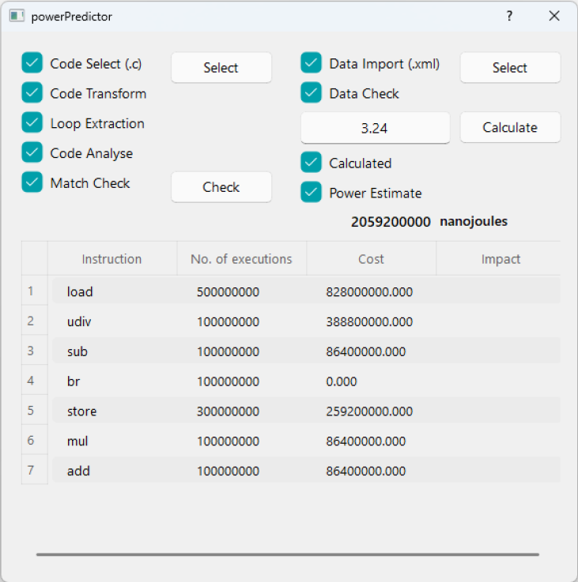
実験結果
実験
モデルを用いる評価
Embedded Coderで生成されたコード
関数呼出しでユーザーのコードで実行する
LLVM-IR命令に転換する
予測ツールで予測を行う
結果エラー：４％
Notes:
モデルが作成されたうえ、Embedded Coderでコードを生成します。
生成されたことのfor文の部分は左の図のようになります。
続いて、関数呼び出しでユーザーのコードで書き込みます
最後、targetデバイスに書き込んで、実際の消費電力を図ります。
予測の部分はユーザーのコードをLLVM-IR命令に転換し、設計された予測ツールで予測を行います
結果として、実際の電力消費量と予測電力消費量のエラーは４%になることがわかりました。

Slide 27
まとめ
研究背景
組込みシステムは通常最大電力が与えられるため、消費電力の見積もりが必要
提案手法
モデルベース開発でLLVM-IR命令レベルの電力消費量を導入して、組込ソフトウェアの消費電力を予測する
結論
LLVM-IR命令レベルの消費電力見積もり手法は利用可能
将来的な問題
マルチコアへの対応
外部デバイスの電力消費量の導入手法
本研究の方針
組込みソフトウェアに向ける静的な消費電力見積もりに適用するスキーマと見積もり手法を提案する
Notes:
発表は以上です．
ご清聴ありがとうございました．

Slide 28
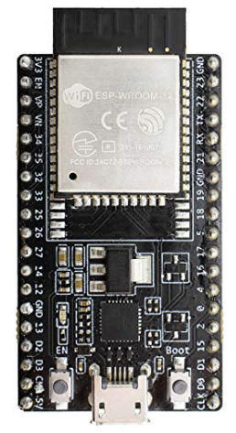
補足資料
他の実験
実験環境
ターゲットデバイス：ESP32 (Xtensa LX6)
一部のデータ
add | 利用中のコア数 | 各コアの実行回数 | 総実行回数
80 | 1 | 200000000 | 200000000
160 | 1 | 200000000 | 200000000
240 | 1 | 200000000 | 200000000
80 | 2 | 100000000 | 200000000
160 | 2 | 100000000 | 200000000
240 | 2 | 100000000 | 200000000
コストパワー(J)
8.928
6.084
5.4
5.4
3.924
3.816
Notes:
コードの実行時間はエネルギー消費量と緊密な関係があり、エネルギー消費量を予測するためには、コード時間の予測を同期させ、検証として使用することができます。
そのために、以下の基礎評価を挙げました。
cross-platformとcross-archtecture性を保証するために、実験で使っているのはLow Level Virtual Machine Intermediate Representation (LLVM-IR)のコードです。
LLVM-IRは統一された、ハードウェアに依存しない基本命令セットを提供しています。
まず、ターゲットデバイスの基本命令の消費電力量と実行時間を測定します
また、シングルコア環境における実際の実行時間と消費電力を取得するためのテストスクリプトを作成します
最後、計測された単一命令データに基づき、LLVM-IR命令レベルでの予測を行い、計測値と比較することで予測精度を分析します
この図に示しているのはいくつの基本命令の消費電力量と実行時間の実測値です。実行時間の単位はサイクル、エネルギーの単位はnanojoules

Slide 29
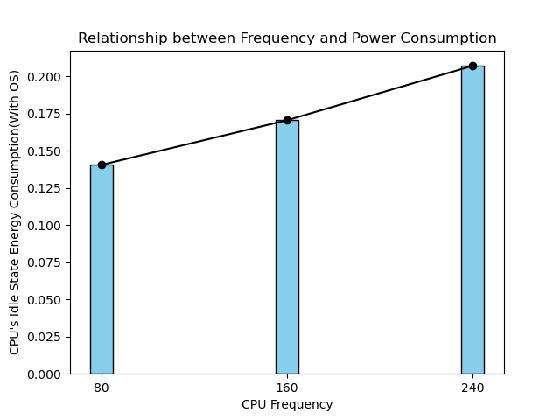
補足資料
他の実験
コストエネルギーの分割
ソフトウェア消費量（アプリケーション）
基礎消費量（OS、コンポーネントの静的消費）
基礎消費電力とCPU周波数の関係（２コアがIdle状態）
Notes:
コードの実行時間はエネルギー消費量と緊密な関係があり、エネルギー消費量を予測するためには、コード時間の予測を同期させ、検証として使用することができます。
そのために、以下の基礎評価を挙げました。
cross-platformとcross-archtecture性を保証するために、実験で使っているのはLow Level Virtual Machine Intermediate Representation (LLVM-IR)のコードです。
LLVM-IRは統一された、ハードウェアに依存しない基本命令セットを提供しています。
まず、ターゲットデバイスの基本命令の消費電力量と実行時間を測定します
また、シングルコア環境における実際の実行時間と消費電力を取得するためのテストスクリプトを作成します
最後、計測された単一命令データに基づき、LLVM-IR命令レベルでの予測を行い、計測値と比較することで予測精度を分析します
この図に示しているのはいくつの基本命令の消費電力量と実行時間の実測値です。実行時間の単位はサイクル、エネルギーの単位はnanojoules

Slide 30
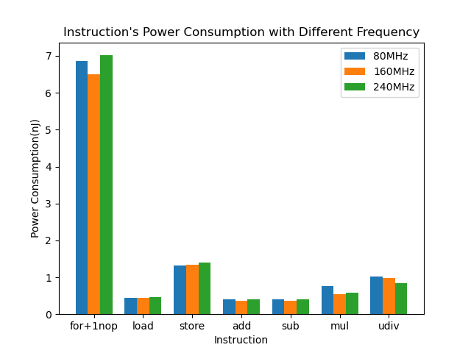
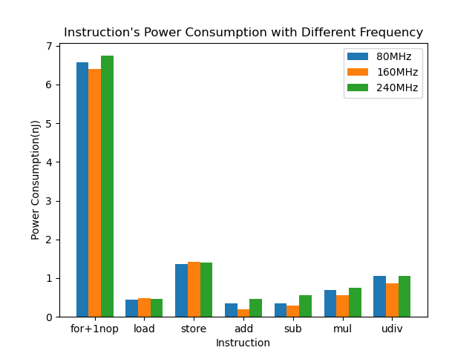
補足資料
他の実験
分割した後のデータ
各処理のコスト
add | 利用中のコア数 | 各コアの実行回数 | 総実行回数
80 | 1 | 200000000 | 200000000
160 | 1 | 200000000 | 200000000
240 | 1 | 200000000 | 200000000
80 | 2 | 100000000 | 200000000
160 | 2 | 100000000 | 200000000
240 | 2 | 100000000 | 200000000
基礎消費量 | ソフトウェア消費量
7.037 | 1.890
4.262 | 1.822
3.448 | 1.951
3.561 | 1.839
2.131 | 1.792
1.907 | 1.909
シングルコア
デュアルコア
Notes:
コードの実行時間はエネルギー消費量と緊密な関係があり、エネルギー消費量を予測するためには、コード時間の予測を同期させ、検証として使用することができます。
そのために、以下の基礎評価を挙げました。
cross-platformとcross-archtecture性を保証するために、実験で使っているのはLow Level Virtual Machine Intermediate Representation (LLVM-IR)のコードです。
LLVM-IRは統一された、ハードウェアに依存しない基本命令セットを提供しています。
まず、ターゲットデバイスの基本命令の消費電力量と実行時間を測定します
また、シングルコア環境における実際の実行時間と消費電力を取得するためのテストスクリプトを作成します
最後、計測された単一命令データに基づき、LLVM-IR命令レベルでの予測を行い、計測値と比較することで予測精度を分析します
この図に示しているのはいくつの基本命令の消費電力量と実行時間の実測値です。実行時間の単位はサイクル、エネルギーの単位はnanojoules

