Slide 1
















Slide 2

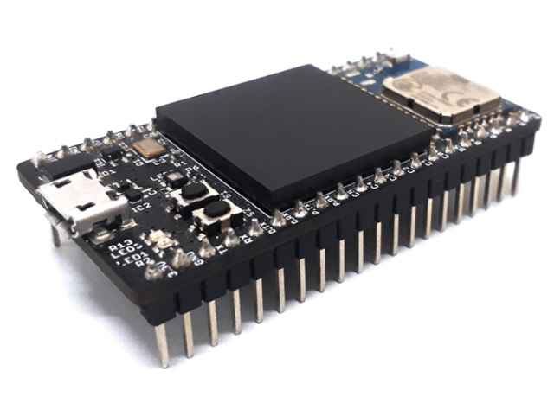
File
Input Data
Processing
Output Data
MATLAB/Simulink
Code
Code(.o)
Tool
Tool:
Embedded Coder
Target.c
Tool:
GCC Compiler
0110101101001010101001010001111101010010110100111010101
Tool:
Minicom
Target.h
Action:
Code Generation
rtwtypes.h
Action:
Compile
Action:
Write to Device
ert_main.c
……
……
Proposed Framework
Block Extract
(Function Call)
Prediction of
Energy Consumption
Schema
powerPreditor
LLVM-IR
C Code
Operations’s
Power Consumption
Relative Contents
Loop Extraction
Main_code.ll
Tool:
Clang Compiler
Main_code.c
……
#include “Target.c”
#include “Target.h”
Int main{
function();
}
Code Analysis
load volatile
load volatile
add i32 %15, %16
store volatile i32 %17, i32* %7, align 4
load
store
Data Edit
……
add
Cost Estimate
……
……
……

Slide 3
File
Input Data
Processing
Output Data
Code
Tool
Tool:
Embedded Coder
Target.c
Target.h
Action:
Code Generation
rtwtypes.h
Action:
Write to Device
ert_main.c
……
Proposed Framework
Prediction of Energy Consumption
Block Extract
(Function Call)
Schema
powerPreditor
LLVM-IR
C Code
Operations’s
Power Consumption
Relative Contents
Loop Extraction
Main_code.ll
Tool:
Clang Compiler
Main_code.c
……
……
Code Analysis
load volatile
load volatile
add i32 %15, %16
store volatile i32 %17, i32* %7, align 4
#include “Target.c”
#include “Target.h”
Int main{
function();
}
load
store
Data Edit
add
Power Estimate
……
……
……

Slide 4
Code
Code
Tool:
Embedded Coder
Target.c
Target.c
Target.h
Target.h
Action:
Code Generation
rtwtypes.h
Action:
Code Modification
rtwtypes.h
ert_main.c
ert_main.c
……
……
Schema
Operations’s
Power Consumption
Relative Contents
load
store
add
……

Slide 5




Slide 6
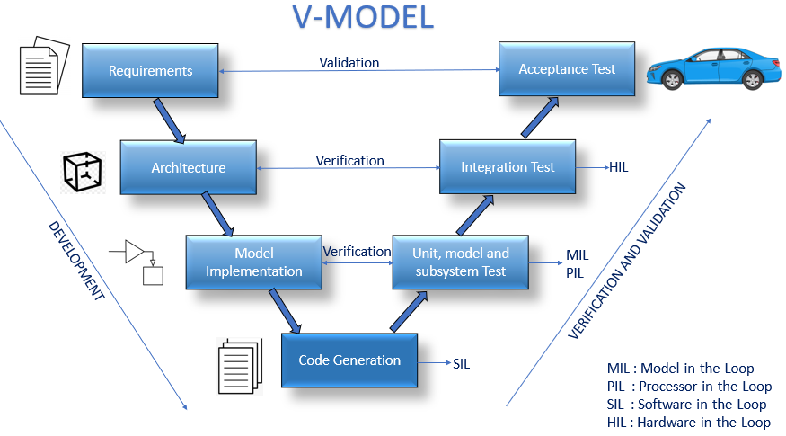
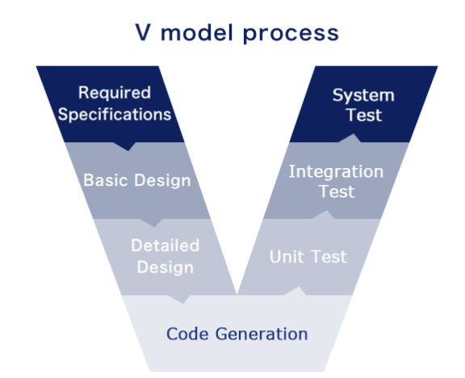
Required Specifications
System Test
Basic Design
Integration Test
Detailed Design
Unit Test
Code Generation

Slide 7
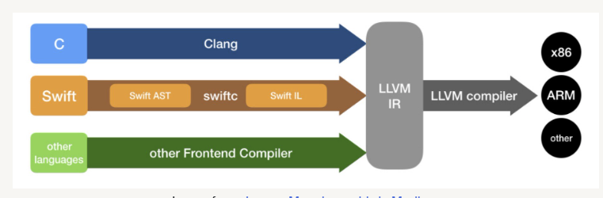
Required Specifications
System Test
C
Clang
LLVM IR
x86
Basic Design
Integration Test
Rust
rustc（librustc_parse）
LLVM compiler
ARM
other languages
other
Detailed Design
Other Frontend Compilers
Unit Test
Code Generation

Slide 8
Generated C Code
File
Input Data
Processing
Output Data
Tool
Block Extract
(Function Call)
Prediction of
Energy Consumption
Schema
powerPreditor
LLVM-IR
C Code
Operations’s
Power Consumption
Relative Contents
Loop Extraction
Main_code.ll
Tool:
Clang Compiler
Main_code.c
……
#include “Target.c”
#include “Target.h”
Int main{
function();
}
Code Analysis
load volatile
load volatile
add i32 %15, %16
store volatile i32 %17, i32* %7, align 4
load
store
Data Edit
……
add
Cost Estimate
……
……
……

Slide 9
Generated C Code
File
Input Data
Processing
Output Data
Tool
Block Extract
(Function Call)
Prediction of
Energy Consumption
Schema
powerPreditor
LLVM-IR
C Code
Operations’s
Power Consumption
Relative Contents
Loop Extraction
Main_code.ll
Tool:
Clang Compiler
Main_code.c
……
#include “Target.c”
#include “Target.h”
Int main{
function();
}
Code Analysis
load volatile
load volatile
add i32 %15, %16
store volatile i32 %17, i32* %7, align 4
load
store
Data Edit
……
add
Cost Estimate
……
……
……

Slide 10
Generated C Code
File
Input Data
Processing
Output Data
Tool
Block Extract
(Function Call)
Prediction of
Energy Consumption
Schema
powerPreditor
LLVM-IR
C Code
Operations’s
Power Consumption
Relative Contents
Loop Extraction
Main_code.ll
Tool:
Clang Compiler
Main_code.c
……
#include “Target.c”
#include “Target.h”
Int main{
function();
}
Code Analysis
load volatile
load volatile
add i32 %15, %16
store volatile i32 %17, i32* %7, align 4
load
store
Data Edit
……
add
Cost Estimate
……
……
……

