Slide 1


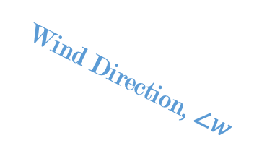





$$y$$
Wind Direction, $∠w$
$$w^{v}$$
$$w^{h}$$
$$x$$
Nacelle Direction, $∠n$
$$n^{c}$$
$$n^{s}$$

