Slide 1
Theoretical Foundations CSCI-3236 Project
Made by Austin Farmer

Slide 2
HTML Interface
Project GUI coded in HTML and CSS
Uploaded publicly to my personal GitHub with documentation
https://github.com/WindFreaker/theoretical-foundations-project
Tested only on Chromium browsers (WebKit limitation)

Slide 3

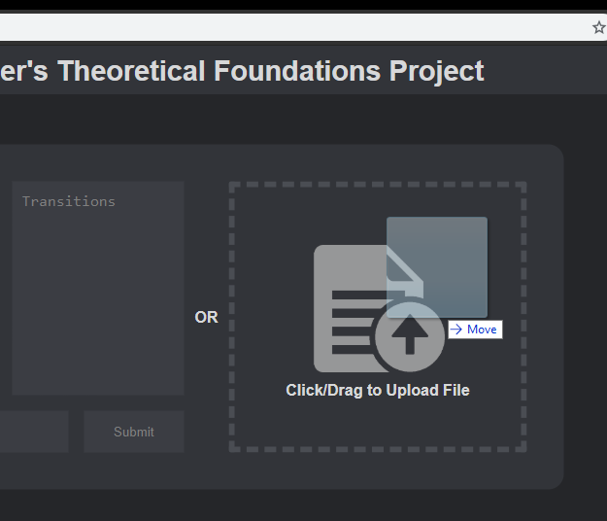
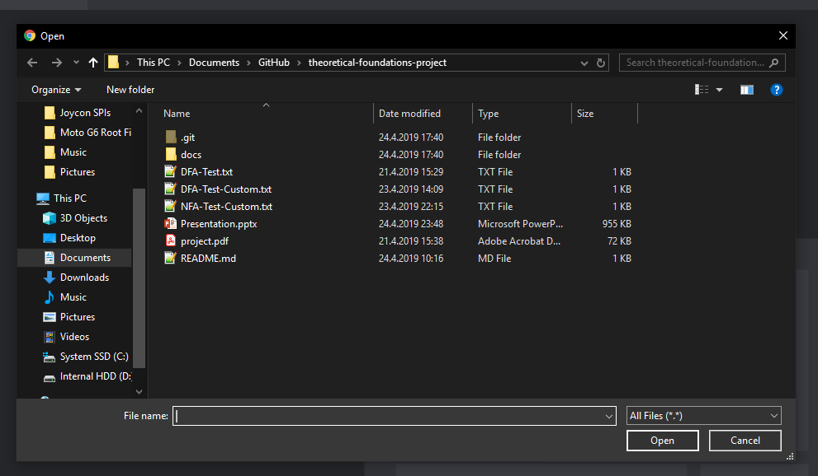
Files can be uploaded from the file explorer or by dragging them on to the GUI

Slide 4
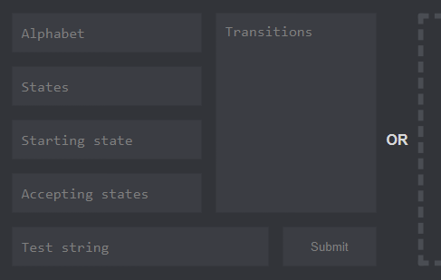
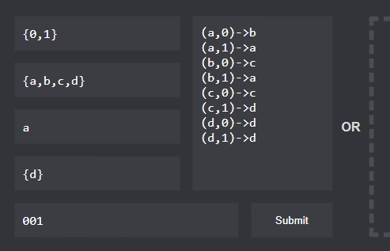
Uploaded file’s text is imported directly to the form’s fields Form fields can be manually changed

Slide 5
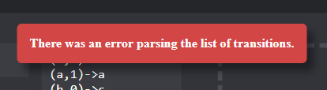
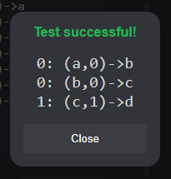
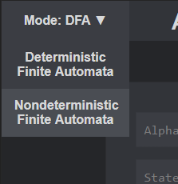
Tester script can be changed via selector Popups provide detailed read-out of identified problems Completed tests provide details about the steps taken

Slide 6
DFA Implementation
Code written entirely in JavaScript
All expected errors have proper outputs and are completely handled

Slide 7
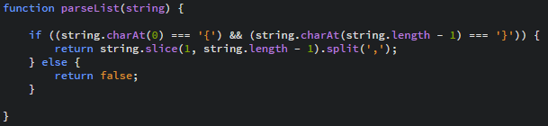
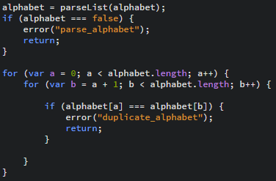
Parses string inputs for the alphabet, all possible states, and the accepting states Also checks to make sure there are no duplicate values either

Slide 8
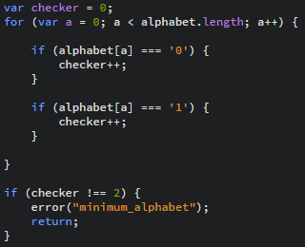
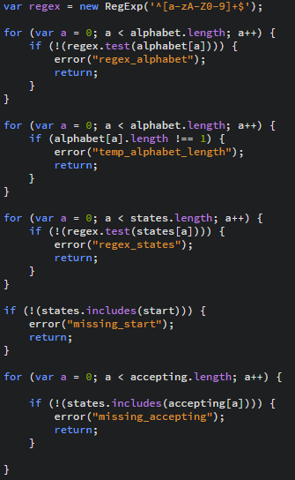
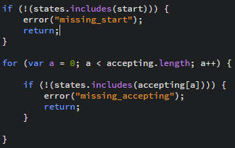
Verifies both 0 and 1 are in the alphabet Makes sure the alphabet and states are only made up of letters and numbers Other needed verifications, etc.

Slide 9
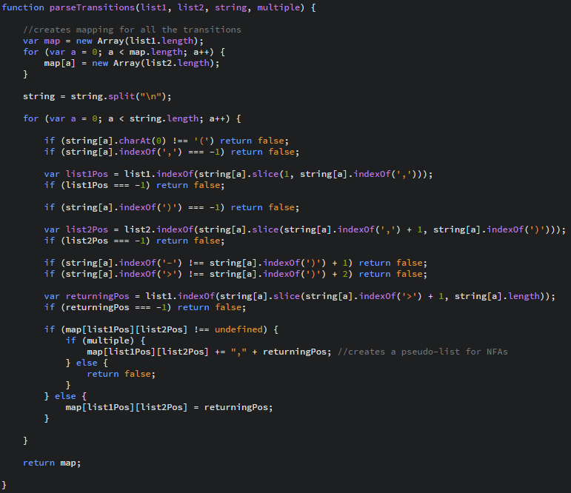
Parses list of transitions into a matrix

Slide 10
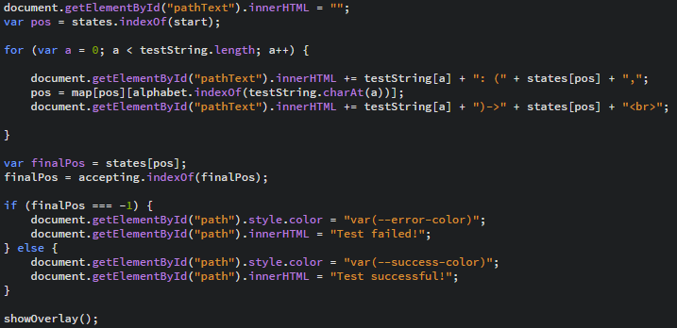
Iterates through every character in the test string

Slide 11
NFA Implementation
Carbon copy of DFA with some minor and major outlined changes
Avoided NFA ⮕ DFA solution
Any number of paths creates need for recursion

Slide 12
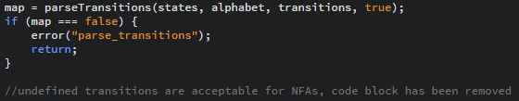
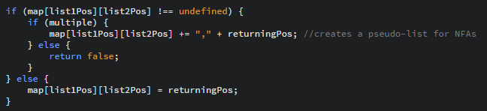
Major change allows for multiple paths for one test string Also possible for no paths to exist

Slide 13
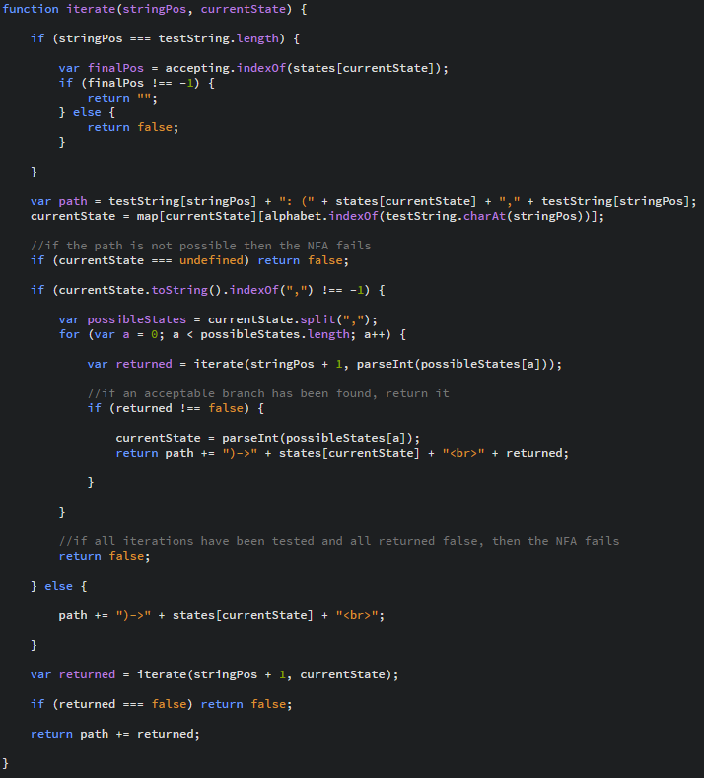
Iterate function created to recursively branch through all the possible paths

Slide 14
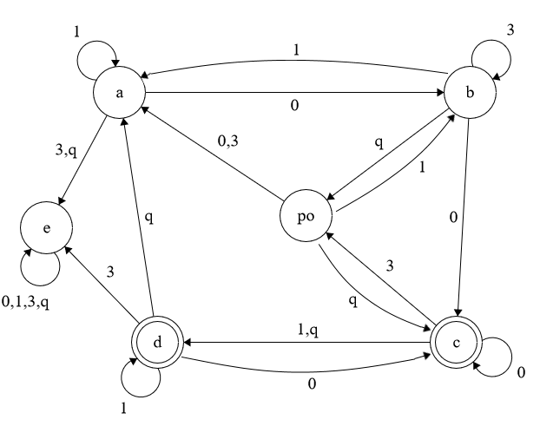
Custom DFA Test File
Alphabet: {0,1,3,q}
States: {a,b,c,d,e,po}
Start: a
Accepting: {c,d}
(c,q)->d
(d,0)->c
(d,1)->d
(d,3)->e
(d,q)->a
(e,0)->e
(e,1)->e
(e,3)->e
(e,q)->e
(po,0)->a
(po,1)->b
(po,3)->a
(po,q)->c
Transitions:
(a,0)->b
(a,1)->a
(a,3)->e
(a,q)->e
(b,0)->c
(b,1)->a
(b,3)->b
(b,q)->po
(c,0)->c
(c,1)->d
(c,3)->po

Slide 15
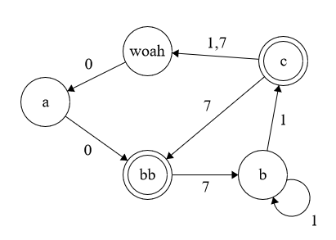
NFA File
Alphabet: {0,1,7}
States: {a,b,c,woah,bb}
Start: a
Accepting: {c,bb}
Transitions:
(a,0)->bb
(bb,7)->b
(b,1)->b
(b,1)->c
(c,1)->woah
(c,7)->woah
(c,7)->bb
(woah,0)->a

