Slide 1
Course Introduction
Module 1
VMware vSphere:
Troubleshooting Workshop

Slide 2
Importance
This hands-on workshop prepares experienced VMware vSphere® administrators for troubleshooting a variety of vSphere problems caused by misconfigurations and system failures.

Slide 3
Learner Objectives
By the end of this course, you should be able to meet the following objectives
• Use the VMware vSphere® Web Client, the command line, and log files to configure or diagnose and correct problems in vSphere
• Troubleshoot networking problems
• Troubleshoot storage problems
• Troubleshoot VMware vSphere® High Availability problems
• Troubleshoot VMware vSphere® Distributed Resource Scheduler problems
• Troubleshoot VMware vSphere® vMotion® problems
• Troubleshoot VMware vCenter Server problems
• Troubleshoot VMware vCenter Single Sign-On and certificate problems
• Troubleshoot VMware ESXi host problems
• Troubleshoot virtual machine problems

Slide 4
You Are Here
Course Introduction
Introduction to Troubleshooting
Troubleshooting Tools
Troubleshooting Virtual Networking
Troubleshooting Storage
Troubleshooting vSphere Clusters
Troubleshooting vCenter Server and ESXi
Troubleshooting Virtual Machines

Slide 5
Typographical Conventions
The following typographical conventions are used in this course.
Monospace | Filenames, folder names, path names, and command names: Navigate to the VMS folder.
Monospace bold | What the user types: Enter ipconfig /release.
Boldface | User interface controls: Click the Configuration tab.
Italic | Book titles and placeholder variables: vSphere Virtual Machine Administration ESXi_host_name

Slide 6
References
Title | Location
vSphere Troubleshooting | https://www.vmware.com/support/pubs/vsphere -esxi-vcenter-server-6-pubs.html
vCenter Server and Host Management | https://www.vmware.com/support/pubs/vsphere -esxi-vcenter-server-6-pubs.html
vSphere Virtual Machine Administration | https://www.vmware.com/support/pubs/vsphere -esxi-vcenter-server-6-pubs.html
vSphere Networking | https://www.vmware.com/support/pubs/vsphere -esxi-vcenter-server-6-pubs.html
vSphere Security | https://www.vmware.com/support/pubs/vsphere -esxi-vcenter-server-6-pubs.html
vSphere Resource Management | https://www.vmware.com/support/pubs/vsphere -esxi-vcenter-server-6-pubs.html

Slide 7
VMware Online Resources
VMware vSphere Blog: http://blogs.vmware.com/vsphere
VMware Communities: http://communities.vmware.com
VMware Support: http://www.vmware.com/support
VMware Education: http://www.vmware.com/education
VMware Certifications: http://mylearn.vmware.com/portals/certification
VMware Education and Certification Blog: http://blogs.vmware.com/education

Slide 8
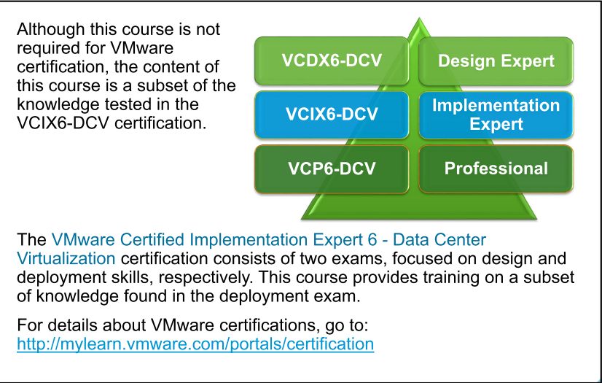
Vmware certificates

