Slide 1
Login
Login
Advanced Research
User
Guillaume
Collection
Password
***********
Extensions
Decks
Sign up
Login
About
Notes:
index:_view.php
Url:

Slide 2
Login
Sign up
Advanced Research
User
Guillaume
Collection
Password
***********
Extensions
Confirm Password
***********
Decks
Sign up
About
Back to login
Notes:
sign_up_view.php
Url: sign_up

Slide 3
Login
Advanced research
Card Name
Advanced Research
Chandra
Collection
Card Type
Extensions
Legendary Creature
Decks
Extension
Magics Origins
Color
White
Blue
Black
Red
Green
Format
Standard
About
Search
Notes:
Advanced_research.view.php
Url:advanced_research

Slide 4
Login
Advanced research
Advanced Research
Name
Extension
Chandra, Fire of Kaladesh
Magic Origins
Collection
Chandra, Acolyte of Flame
M20
Extensions
Chandra, Fire Artisan
War of the Spark
Decks
About
Notes:
Show_cards_view.php
Url: cards

Slide 5
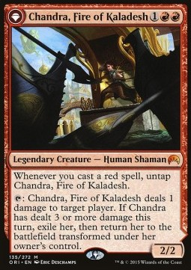
Login
Advanced research
Chandra, Fire of Kaladesh
Advanced Research
Collection
Extensions
Decks
Extension:
Magic Origines
About
Add to Collection
Notes:
Show_card.view.php
Url: card

Slide 6
Login
Collection
Sort
Color
Advanced Research
Chandra, Fire of Kaladesh
Name
Red
Collection
Name
Extension
Quantity
Extensions
Chandra, Fire of Kaladesh
Magic Origins
+
0
-
Decks
About
Notes:
Show_collection.view.php
Url: collection

Slide 7
Login
Extension
Advanced Research
Kamigawa: Neon Dynasty
Innistrad : Midnight Hun
Collection
Extensions
Adventure in the Forgotten Realms
Kaldheim
Decks
About
Notes:
Show_extensions.view.php
Url: extensions

Slide 8
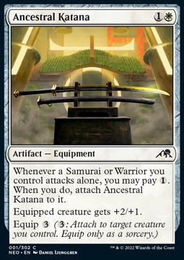
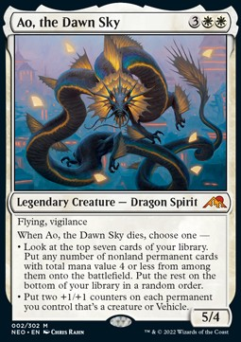
Login
Kamigawa : Neon Dynasty
Sort
Color
Advanced Research
Name
White
Collection
Extensions
Decks
+
1
-
+
0
-
About
Notes:
Show_extension.view.php
Url: extension

Slide 9
Login
Decks
Advanced Research
Elemental
Angel
Collection
Extensions
Deck name
Decks
About
Add deck
Notes:
Show_decks.view.php
Url: decks

Slide 10
Login
New deck
Advanced Research
Deck’s name
Warrior
Collection
Format
Standard
Extensions
Decks
Submit
About
Notes:
add_deck.view.php
Url: add_deck

Slide 11
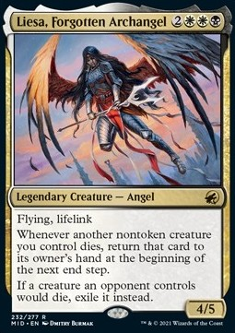
Login
Deck : Angel
Sort
Color
Advanced Research
Name
All Color
Collection
Extensions
Decks
Ouvre une page ressemblant à Advanced research sauf que ça ajoute directement au deck au lieu d’ajouter à la collection
+
2
-
+
4
-
About
Add Card
Notes:
Show_deck.view.php
Url: deck

