Slide 1
BUSINESS PROCESS MODELLING · ENTERPRISE ARCHITECTURE
Hospital Patient Referral & Treatment Management
BPMN v4 Process Model · i* Strategic Dependency & Rationale Diagrams
Week 6 Submission

Slide 2
Division of labor
Name | No | Job
Charlie Ye | 23084386 | BPMN、 Coding
Steven Ma | 23084388 | SR、SD 、Coding
Shaoyang Li | 22083638 | Testing
Zongyao Jin | 23084390 | Form、Dependency relationship
Subo Liu |  | SR、SD

Slide 3
AGENDA
What This Portfolio Covers
01
Response to the Five Improvement Requirements
How each lecturer feedback point was addressed in BPMN v4
02
Strategic Dependency (SD) Diagram
The cross-actor dependency model and its 9 strategic links
03
Strategic Rationale (SR) Diagram
The internal goals, tasks and resources of each actor
04
How SD, SR &amp; BPMN Connect
Mapping the strategic models onto the operational BPMN model
Hospital Referral & Treatment Management
02 / 18

Slide 4
01
Part 1 — Response to the Five Improvement Requirements
• The assignment was built as a BPMN v4 process model of the referral pathway.
• The lecturer returned 5 improvement requirements (RBAC, form validation, service workers, merging gateways, data persistence).
• Each following slide shows what we changed and the BPMN / i* evidence.
03 / 18

Slide 5
PART 1 · CONTEXT
The Assignment & The Five Requirements
Context
1
Implement role-based access control
We modelled the hospital patient referral & treatment process as BPMN v4 (4 pools, 7 lanes, 5 service tasks, 13 gateways, a data store), supported by i* SD / SR strategic models. The lecturer then asked us to strengthen five areas.
2
Strengthen form validation to prevent missing or invalid inputs
3
Implement the required business logic in service workers
4
Use merging gateways where appropriate to bring process paths together
5
Implement data persistence to store and retrieve application data
Hospital Referral & Treatment Management
04 / 18

Slide 6
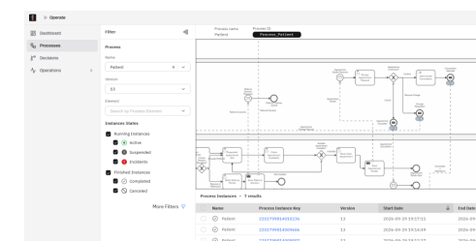
PART 1 · REQUIREMENT 1
1 · Implement Role-Based Access Control
The Requirement (verbatim)
What We Did
"Implement role-based access control"
Added role-based login and permission checks: after login, each party (Referring Organisation, Hospital, Patient, External Payment & Funding Providers) can view and operate only the functions and data within its own scope.
i* Strategic Link
Each i* actor boundary is a role boundary. The Consent Decision dependency Hospital →(Goal)→ Patient marks the patient role. The 4 BPMN pools = 4 role types.
BPMN v4 Evidence
4 pools and 4 internal Hospital lanes enforce separation. In Camunda Operate each party has independent Process Definitions and Instances — see screenshots
Hospital Referral & Treatment Management
05 / 18

Slide 7
PART 1 · REQUIREMENT 2
What We Did
Added required-field and format validation to the referral, payment and appointment forms (Enter Referral Details, Provide Payment or Funding Information, Book Initial Appointment, …).
BPMN v4 Evidence
Tasks Enter Referral Details / Check Referral Documents / Recheck Referral Documents with an "incomplete information" loop that blocks continuation until complete.
R2
Strengthen Form Validation
Test Result
No validation failures occurred; all required-field and format rules worked as expected.
Prevent missing or invalid inputs on referral, payment and appointment forms.
Hospital Referral & Treatment Management
06 / 18

Slide 8
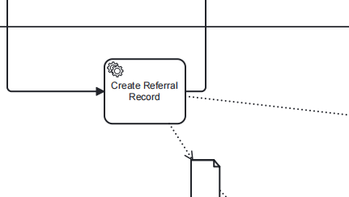
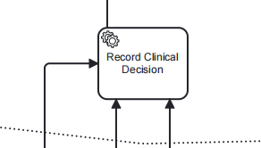
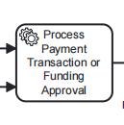
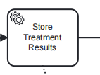
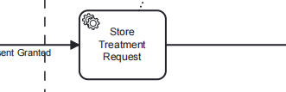
PART 1 · REQUIREMENT 3
3 · Business Logic in Service Workers
What We Did
Pushed business logic down into 5 workflow service tasks, all marked isExecutable = true:
Create Referral Record
Store Treatment Results
Record Clinical Decision
Store Treatment Request
Process Payment / Funding
5
service tasks
execute the core business logic in the process engine
Hospital Referral & Treatment Management
07 / 18

Slide 9
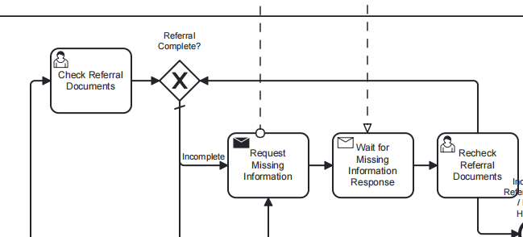
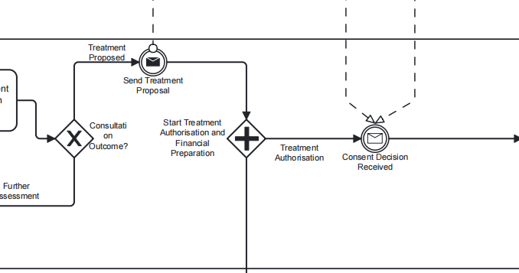
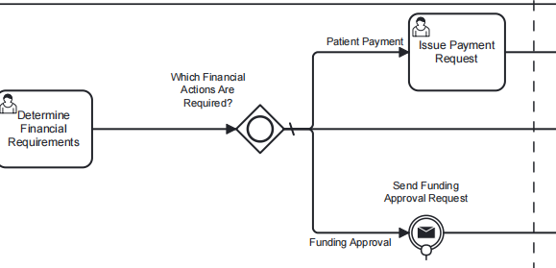
PART 1 · REQUIREMENT 4
4 · Merging Gateways
The Requirement (verbatim)
What We Did
"Use merging gateways where appropriate to bring process paths together"
Used parallel / inclusive / exclusive gateways for branching and merging. Example: treatment authorisation and financial preparation start in parallel and merge before treatment is delivered.
i* Strategic Link
Reflects the AND / OR decomposition in i* at the process layer: parallel = AND, branch = OR.
BPMN v3 Evidence
13 gateways in total: 11 exclusive, 1 inclusive (Which Financial Actions Are Required?), 1 parallel (Start Treatment Authorisation and Financial Preparation).
Hospital Referral & Treatment Management
08 / 18

Slide 10
PART 1 · REQUIREMENT 5
What We Did
Introduced a data store and persistence logic covering referral records, treatment results, financial settlements and clinic letters, supporting both writes and later reads.
BPMN v4 Evidence
Data store Patient Pathway Data Store + 4 data objects (Treatment Results, Clinic Letter, Referral & Clinical Information, Financial Clearance); writes via service tasks Store Treatment Results / Create Referral Record.
R5
Data Persistence
Store and retrieve application data across the referral pathway.
Status: Design level — runtime persistence is guaranteed by the Camunda engine; runtime screenshots still to be provided.
Hospital Referral & Treatment Management
09 / 18

Slide 11
02
Part 2 — Strategic Dependency (SD) Diagram
• The SD model answers who depends on whom for goals and resources.
• Our model has 4 actors and 9 strategic dependencies.
• It is the strategic "why" layer that the operational BPMN later realises.
10 / 18

Slide 12
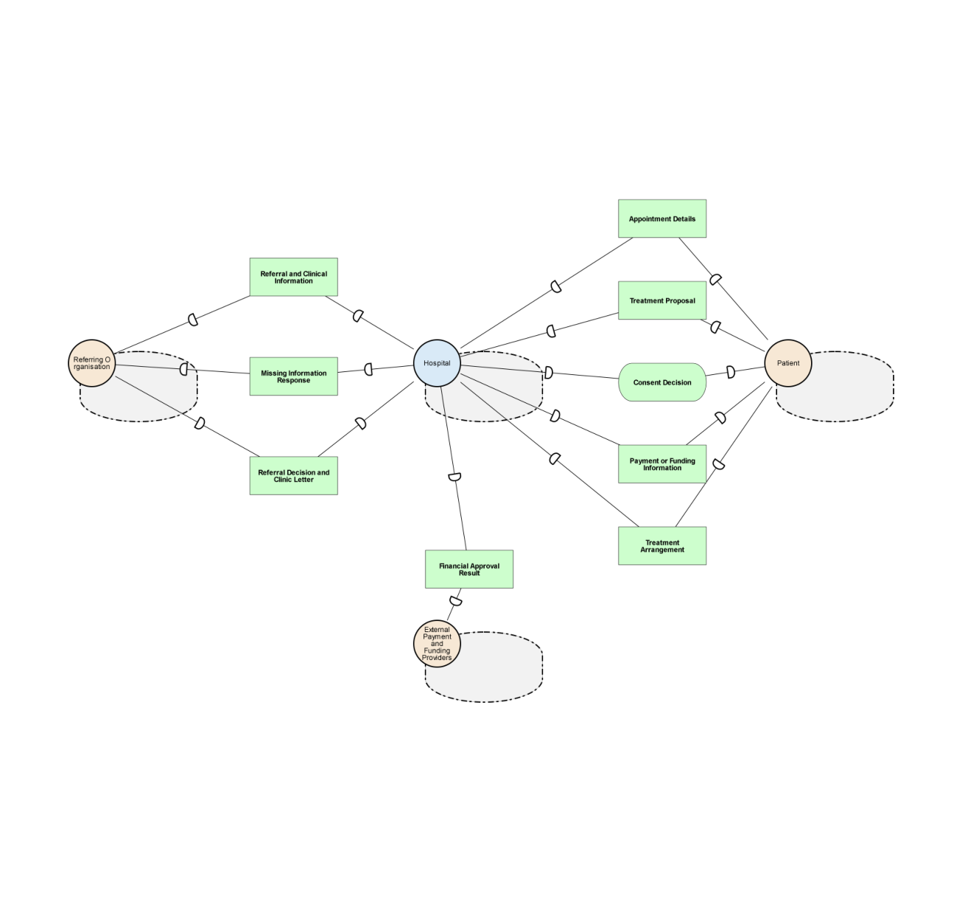
PART 2 · SD DIAGRAM
Strategic Dependency Model — Explained
What is the SD diagram?
It shows the relationships between actors: each dependency means actor A depends on actor B to achieve a goal or provide a resource.
Our 4 actors
Referring Organisation · Hospital · Patient · External Payment & Funding Providers.
Key dependencies (9 in total)
Hospital depends on Patient for Informed Consent; Patient depends on Hospital for Diagnosis & Treatment; Hospital & Patient both depend on External for Payment / Funding.
Hospital Referral & Treatment Management
11 / 18

Slide 13
PART 2 · SD DETAIL
The 9 Strategic Dependencies
Dependency | From → To | Type
Referral Handled & Managed | Referring Organisation → Hospital | Goal
Complete Referral Information | Referring Organisation → Hospital | Resource
Receive Diagnosis & Treatment | Patient → Hospital | Goal
Informed Consent Obtained | Hospital → Patient | Goal
Payment / Funding Information | Patient → Hospital | Resource
Funding Approval | Hospital → External Payment & Funding | Resource
Payment Settlement | Hospital → External Payment & Funding | Resource
Payment Processed | Patient → External Payment & Funding | Resource
Treatment Outcome & Clinic Letter | Referring Organisation → Hospital | Resource
Hospital Referral & Treatment Management
12 / 18

Slide 14
03
Part 3 — Strategic Rationale (SR) Diagram
• The SR model explains why each actor wants what it wants: goals, tasks, resources, softgoals.
• Our model has 4 actors holding 57 internal elements (RO 6, Patient 11, Hospital 31, External 9).
• It is the design rationale behind every BPMN task and service task.
13 / 18

Slide 15
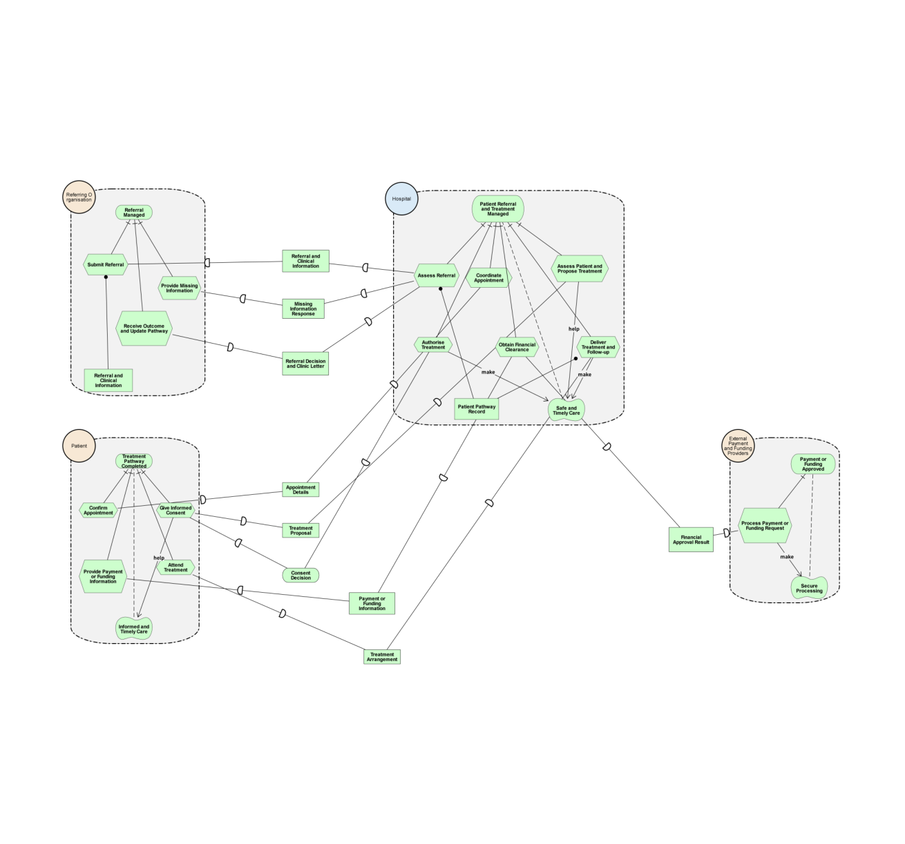
PART 3 · SR DIAGRAM
Strategic Rationale Model — Explained
What is the SR diagram?
Inside each actor it shows goals (rounded), tasks (hexagons), resources (rectangles) and softgoals (clouds), with AND/OR decomposition links.
Examples per actor
Hospital: Assess & admit referral, Diagnose patient, Obtain informed consent. Patient: Get diagnosed & treated, Give informed consent, Arrange & make payment.
Why it matters
The SR rationale is what the BPMN later turns into lanes, tasks and the 5 service tasks.
Hospital Referral & Treatment Management
14 / 18

Slide 16
PART 3 · SR DETAIL
Each Actor's Internal Rationale
Actor | Goals | Key Tasks & Resources
Referring Organisation | Refer patient for specialist care | Compile clinical history & findings; Submit referral request; Monitor referral progress (softgoals: Accurate & complete info, Continuity of care)
Patient | Get diagnosed & treated; Give informed consent | Attend appointment; Provide medical history; Follow treatment plan; Review & sign consent; Arrange & make payment (Resource: Payment Processed; softgoals: Affordable care, Convenient access)
Hospital | Deliver safe effective care; Assess & admit referral; Diagnose patient; Obtain informed consent | Triage; Verify completeness; Register patient; Schedule appointment; Clinical consultation; Order & review tests; Collect signed consent (Resource: Complete Referral Information)
External Payment & Funding | Fulfil funding & payment obligations | Process payment or funding requests (Resources: Payment Processed, Funding Approval, Payment Settlement)
Hospital Referral & Treatment Management
15 / 18

Slide 17
04
Part 4 — How SD, SR & BPMN Connect
• The three models are one layered story: strategy → rationale → operations.
• SD sets the actors and dependencies; SR explains each actor's goals; BPMN executes them.
• Next: the explicit mapping between the two i* models and the BPMN.
16 / 18

Slide 18
PART 4 · MAPPING
From i* Strategy to BPMN Operations
SD → BPMN pools
Each SD actor boundary becomes a BPMN pool — the 4 BPMN pools = the 4 role types.
SR → BPMN lanes & tasks
Each actor's tasks become lanes + tasks; the 5 service tasks realise the core business logic; softgoals become quality expectations.
BPMN = the operational realisation
The Requirements Traceability Matrix ties every requirement → i* element → BPMN element, closing the loop.
Hospital Referral & Treatment Management
17 / 18

Slide 19
SUMMARY & DELIVERABLES
What We Delivered
• BPMN v4 — 4 pools, 7 lanes, 5 service tasks, 13 gateways, 1 data store.
• i* SD & SR — 4 actors; SD 9 dependencies, SR 57 internal elements.
• All 5 lecturer requirements addressed with BPMN / i* evidence.
• Requirements Traceability Matrix + Response to Feedback documents.
Thank you — Hospital Patient Referral & Treatment Management

