Slide 1
CAMUNDA 8 · BPMN COLLABORATION PROCESS
Hospital Patient Referral
and Treatment Management
Operational Diagram & Measurable Acceptance Criteria
Charlie Ye · BPMN
Zongyao Jin · Forms
Steven Ma · Code
Shaoyang Li · Testing
Subo Liu · Integration
Advanced Information Systems · Year 4
Group Project Presentation

Slide 2
Team & Project Overview
5 Members · 1 Process
THE PROJECT
Referral
CY
Charlie Ye · BPMN Lead
in 4 Parties
ZJ
Zongyao Jin · Forms
SM
Steven Ma · Code Java
SL
Shaoyang Li · Testing
SLiu
Subo Liu · Integration
Hospital Referral Process · Group Project
02 / 10

Slide 3
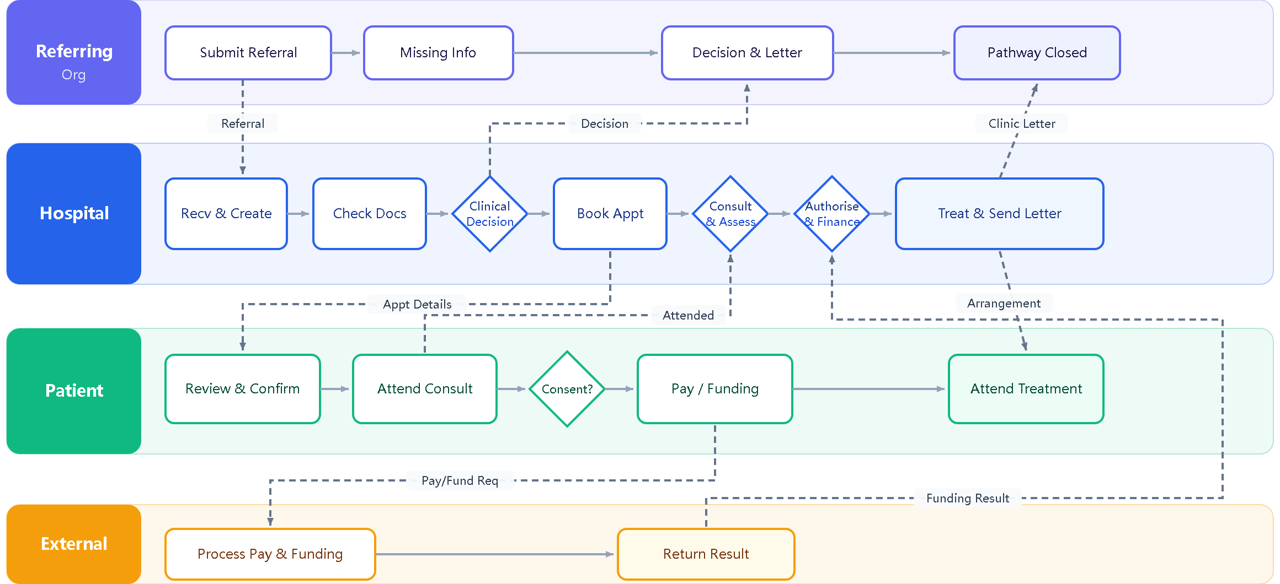
Operational Diagram
Charlie Ye ·BPMN Lead
03 / 10

