Slide 1




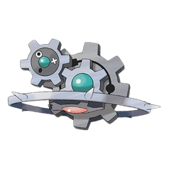
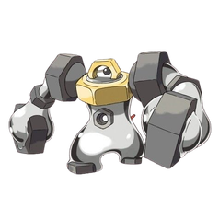
ORGANIC CHEMISTRY
ASYNCHRONOUS ACTIVITY 3
NAME IT, DRAW IT
Windel M. Narito
BSChE 2A

Slide 2
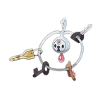
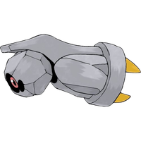
PART A -
STRUCTURE → NAME

Slide 3


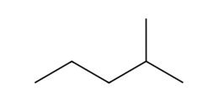
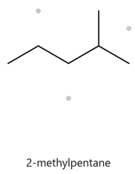


PART A - STRUCTURE → NAME
.
CARD A01 - FOUNDATION
MOLECULAR FORMULA: C6H14
  NUMBERED PARENT
  NAMING TRAIL
  Parent: longest chain = 5 C → pentane.
  Numbering: left → right gives 4; right → left gives 2. 2 < 4, so number from the right.
  Substituents: methyl on C2 → 2-methyl.
5
4
3
2
1
Parent (5 C) highlighted; carbons numbered from the right-hand end.
  MY NAME
  THE ALKANE CHECK
  Returned Name:
2-methylpentane
2-methylpentane
✅ Match
The rebuilt structure is a 5-C chain with one CH3 on the second carbon. The tool applies the same rules as the naming trail: longest chain first, then lowest locant (2 beats 4). Both therefore give the same name.
longest chain confirmed
lowest locants
alphabetical order
punctuation
formula counted

Slide 4
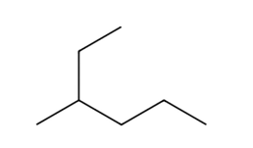
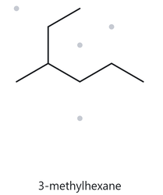
PART A - STRUCTURE → NAME
.
CARD A02 - FOUNDATION
MOLECULAR FORMULA: C7H16
  NUMBERED PARENT
  NAMING TRAIL
1
  Parent: longest chain = 6 C → hexane. The horizontal path is only 5 C.
  Numbering: top → bottom gives 3; the other direction gives 4. 3 < 4, so number from the top.
  Substituents: the short left stub is a methyl on C3 → 3-methyl
2
3
5
4
6
Parent (6 C) highlighted; the longest chain runs through the branch,
not along the horizontal.
  MY NAME
  THE ALKANE CHECK
  Returned Name:
3-methylhexane
3-methylhexane
✅ Match
The structure has a 6-C path through the branch point, with one methyl on the third carbon. The tool traces the longest chain through branch points, so hexane is chosen over the 5-C horizontal path, and 3 is the lowest locant.
longest chain confirmed
lowest locants
alphabetical order
punctuation
formula counted

Slide 5
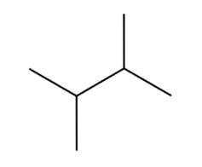
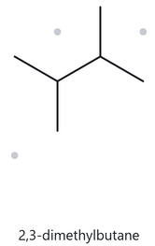
PART A - STRUCTURE → NAME
.
CARD A03 - FOUNDATION
MOLECULAR FORMULA: C6H14
  NUMBERED PARENT
  NAMING TRAIL
  Parent: longest chain = 4 C → butane.
  Numbering: both directions give 2,3, so the sets tie and either direction is fine.
  Substituents: methyl on C2 and methyl on C3 → 2,3-dimethyl
1
2
3
4
Parent (4 C) highlighted; the two vertical stubs are substituents.
  MY NAME
  THE ALKANE CHECK
  Returned Name:
2,3-dimethylbutane
2,3-dimethylbutane
✅ Match
The structure is a 4-C chain with one methyl on each middle carbon. The locant set is {2,3} from both ends, and the tool writes identical groups with the prefix di- and a comma between locants.
longest chain confirmed
lowest locants
alphabetical order
punctuation
formula counted

Slide 6
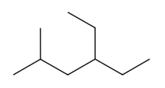
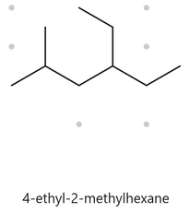
PART A - STRUCTURE → NAME
.
CARD A04 - DEVELOPING
MOLECULAR FORMULA: C9H20
  NUMBERED PARENT
  NAMING TRAIL
  Parent: 6 C → hexane. Another 6-C path runs through the ethyl, but it carries the same two substituents (a methyl and an ethyl), so it leads to the same name.
  Numbering: left → right gives 2,4; right → left gives 3,5. First point of difference: 2 < 3, so number from the left.
  Substituents: ethyl on C4, then methyl on C2 → 4-ethyl-2-methyl. Alphabetical order sets the citation order, not the locants.
1
2
3
4
5
6
Parent (6 C) highlighted; carbons numbered from the left-hand end.
  MY NAME
  THE ALKANE CHECK
  Returned Name:
4-ethyl-2-methylhexane
4-ethyl-2-methylhexane
✅ Match
The tool numbers from the end that gives {2,4}, not {3,5}. It cites ethyl before methyl because e comes before m alphabetically, even though ethyl has the higher locant.
longest chain confirmed
lowest locants
alphabetical order
punctuation
formula counted

Slide 7
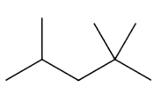
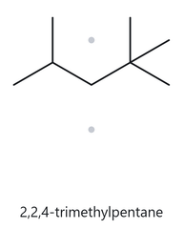
PART A - STRUCTURE → NAME
.
CARD A05 - DEVELOPING
MOLECULAR FORMULA: C8H18
  NUMBERED PARENT
  NAMING TRAIL
1
  Parent: longest chain = 5 C → pentane.
  Numbering: left → right gives 2,4,4; right → left gives 2,2,4. The first terms tie at 2. At the second term 2 < 4, so number from the right.
  Substituents:methyl on C2, C2 and C4 → 2,2,4-trimethyl.
5
4
3
2
Parent (5 C) highlighted; carbons numbered from the right-hand end.
  MY NAME
  THE ALKANE CHECK
  Returned Name:
2,2,4-trimethylpentane
2,2,4-trimethylpentane
✅ Match
The tool compares locant sets term by term, not by sum. {2,2,4} beats {2,4,4} at the second term, and the locant 2 is repeated once for each methyl on that carbon.
longest chain confirmed
lowest locants
alphabetical order
punctuation
formula counted

Slide 8
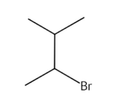
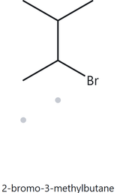
PART A - STRUCTURE → NAME
.
CARD A06 - DEVELOPING
MOLECULAR FORMULA: C5H11Br
  NUMBERED PARENT
  NAMING TRAIL
3
4
  Parent: longest chain = 4 C → butane.
  Numbering: both directions give {2,3}, so the locant sets tie.
  Tie-break: bromo (b) precedes methyl (m) alphabetically, so bromo gets C2.
  Substituents: bromo on C2, methyl on C3 → 2-bromo-3-methyl.
1
2
Parent (4 C) highlighted; Br and the other top methyl are substituents.
  MY NAME
  THE ALKANE CHECK
  Returned Name:
2-bromo-3-methylbutane
2-bromo-
3-methylbutane
✅ Match
The locants tie at {2,3}, so the tool applies the alphabetical tie-break and gives the lower number to bromo. The halogen is written as a prefix (bromo) and is not part of the parent name.
longest chain confirmed
lowest locants
alphabetical order
punctuation
formula counted

Slide 9
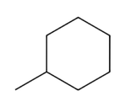
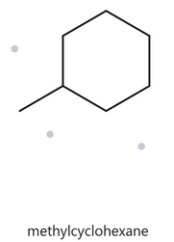
PART A - STRUCTURE → NAME
.
CARD A07 - DEVELOPING
MOLECULAR FORMULA: C7H14
  NUMBERED PARENT
  NAMING TRAIL
5
  Parent: the ring is the parent, 6 C → cyclohexane.
  Numbering: there is only one substituent, so there are no locants to compare. The substituent carbon is C1, and no locant is written.
  Substituents: methyl.
6
4
1
2
3
Parent (6-C ring) highlighted; the methyl is a substituent, not part of
the parent.
  MY NAME
  THE ALKANE CHECK
  Returned Name:
methylcyclohexane
✅ Match
methylcyclohexane
The structure is a 6-C ring with one CH3. The tool takes the ring as the parent and, because there is only one substituent, writes no locant (the name is not 1-methylcyclohexane).
longest chain confirmed
lowest locants
alphabetical order
punctuation
formula counted

Slide 10
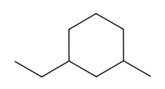
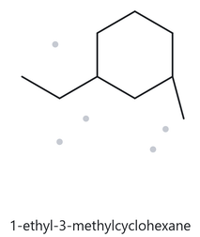
PART A - STRUCTURE → NAME
.
CARD A08 - CHALLENGE
MOLECULAR FORMULA: C9H18
  NUMBERED PARENT
  NAMING TRAIL
5
  Parent: the ring is the parent → cyclohexane.
  Numbering: going the short way round gives {1,3} whichever substituent is C1. The long way round gives {1,5}. {1,3} wins, and the two short-way sets tie.
  Tie-break: ethyl (e) precedes methyl (m), so ethyl gets C1.
  Substituents: ethyl on C1, methyl on C3 → 1-ethyl-3-methyl.
6
4
1
2
3
Parent (6-C ring) highlighted; numbered the short way round from
the ethyl carbon.
  MY NAME
  THE ALKANE CHECK
  Returned Name:
1-ethyl-3-
methylcyclohexane
1-ethyl-
3-methylcyclohexane
✅ Match
The two substituents are separated by one ring carbon, so the lowest locant set is {1,3}. The sets tie in both directions, so the alphabetical rule places ethyl on C1.
longest chain confirmed
lowest locants
alphabetical order
punctuation
formula counted

Slide 11
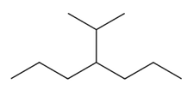
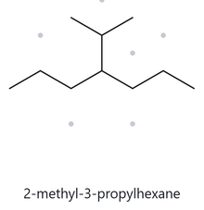
PART A - STRUCTURE → NAME
.
CARD A09 - CHALLENGE
MOLECULAR FORMULA: C10H22
  NUMBERED PARENT
  NAMING TRAIL
  Parent: Parent (7 C) highlighted; the 3-C branch is a substituent.
  Numbering: both directions give 4, so the sets tie.
  Substituents: a 3-carbon branch attached through its middle carbon is isopropyl, also written (1-methylethyl) or propan-2-yl, on C4.
1
2
3
4
5
6
7
Parent (6-C ring) highlighted; numbered the short way round from
the ethyl carbon.
  MY NAME
  THE ALKANE CHECK
  Returned Name:
2-methyl-3-propylhexane
4-isopropylheptane
❌Did Not Match
The tool chose a 6-C parent, but a 7-C chain exists through the two propyl arms. The longest-chain rule requires heptane, so the tool’s name breaks the rule and the trail’s name is kept.
longest chain confirmed
lowest locants
alphabetical order
punctuation
formula counted

Slide 12
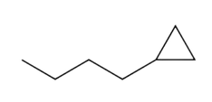
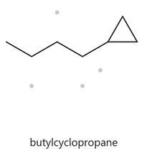
PART A - STRUCTURE → NAME
.
CARD A10 - CHALLENGE
MOLECULAR FORMULA: C7H14
  NUMBERED PARENT
  NAMING TRAIL
2
  Parent: the ring is the parent under this activity’s rule, even though the chain (4 C) is longer than the ring (3 C) → cyclopropane.
  Numbering: one substituent, so no locant is needed.
  Substituents: unbranched 4-carbon chain → butyl.
1
3
Parent (3-C ring) highlighted; the 4-C chain is a substituent.
  MY NAME
  THE ALKANE CHECK
  Returned Name:
butylcyclopropane
butylcyclopropane
✅ Match
The tool follows the same ring-as-parent rule as this activity. It names the 3-C ring as the parent and the chain as butyl, with no locant for a single substituent.
longest chain confirmed
lowest locants
alphabetical order
punctuation
formula counted

Slide 13
PART B -
NAME → STRUCTURE

Slide 14


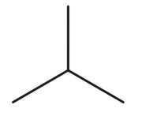
PART B - NAME → STRUCTURE
.
CARD B01 - FOUNDATION
Given Name: 2-methylpropane
  NAME DECODED
  BOND LINE STRUCTURE
  Parent: propane → a 3-carbon chain.
  Substituents: methyl on C2.
  Expected formula: 3 + 1 = 4 C; open chain → CₙH₂ₙ₊₂ = C₄H₁₀
  FORMULA
  BACK-CHECK
  Returned by The Alkane: 2-methylpropane
  ✓ Same as the given name
  The longest chain is 3 C (propane) with one methyl on the middle carbon, so the locant is 2 from either end.
  Counted from the drawing: C₄H₁₀
  Open chain: CₙH₂ₙ₊₂ = C₄H₁₀ ✓
parent length matches
substituent positions match
formula agrees
back-check recorded

Slide 15
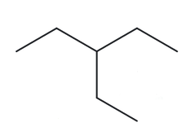
PART B - NAME → STRUCTURE
.
CARD B02 - FOUNDATION
Given Name: 3-ethylpentane
  NAME DECODED
  BOND LINE STRUCTURE
  Parent: pentane (5-carbon chain)
  Substituents: ethyl on C3.
  Expected formula: 5 + 2 = 7 C; open chain → C₇H₁₆.
  FORMULA
  BACK-CHECK
  Returned by The Alkane: 2-3-ethylpentane
  ✓ Same as the given name
  The longest chain is 5 C (pentane) with an ethyl on the middle carbon, so the locant is 3 from either end.
  Counted from the drawing: C₇H₁₆
  Open chain: CₙH₂ₙ₊₂ = C₇H₁₆ ✓
parent length matches
substituent positions match
formula agrees
back-check recorded

Slide 16
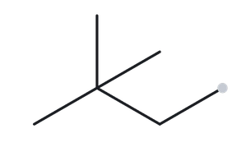
PART B - NAME → STRUCTURE
.
CARD B03 - FOUNDATION
Given Name: 2,2-dimethylbutane
  NAME DECODED
  BOND LINE STRUCTURE
  Parent: butane (4-carbon chain)
  Substituents: two methyls, both on C2.
  Expected formula: 4 + 2 = 6 C; open chain → C₆H₁₄.
  FORMULA
  BACK-CHECK
  Returned by The Alkane: 2,2-dimethylbutane
  ✓ Same as the given name
  The longest chain is 4 C (butane). Numbering gives 2,2 from one end and 3,3 from the other, so 2,2 wins.
  Counted from the drawing: C₆H₁₄.
  Open chain: CₙH₂ₙ₊₂ = C₆H₁₄ ✓
parent length matches
substituent positions match
formula agrees
back-check recorded

Slide 17
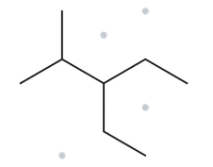
PART B - NAME → STRUCTURE
.
CARD B04 - DEVELOPING
Given Name: 3-ethyl-2-methylpentane
  NAME DECODED
  BOND LINE STRUCTURE
  Parent: pentane (5-carbon chain)
  Substituents: methyl on C2; ethyl on C3. Ethyl is cited first because e comes before m, even though its locant is higher.
  Expected formula: 5 + 1 + 2 = 8 C; open chain → C₈H₁₈.
  FORMULA
  BACK-CHECK
  Returned by The Alkane: 3-ethyl-2-methylpentane
  ✓ Same as the given name
  Numbering gives {2,3} from one end and {3,4} from the other, so {2,3} wins. Ethyl is cited before methyl alphabetically.
  Counted from the drawing: C₈H₁₈.
  Open chain: CₙH₂ₙ₊₂ = C₈H₁₈ ✓
parent length matches
substituent positions match
formula agrees
back-check recorded

Slide 18
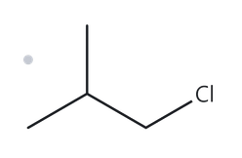
PART B - NAME → STRUCTURE
.
CARD B05 - DEVELOPING
Given Name: 1-chloro-2-methylpropane
  NAME DECODED
  BOND LINE STRUCTURE
  Parent: propane (3-carbon chain)
  Substituents: chloro on C1; methyl on C2.
  Expected formula: 3 + 1 = 4 C; open chain → C₄H₁₀; Cl replaces one H → C₄H₉Cl.
  FORMULA
  BACK-CHECK
  Returned by The Alkane: 1-chloro-2-methylpropane
  ✓ Same as the given name
  Numbering gives {1,2} from the Cl end and {2,3} from the other, so {1,2} wins. Chloro is cited before methyl alphabetically.
  Counted from the drawing: C₄H₉Cl.
  Open chain: CₙH₂ₙ₊₂ = C₄H₁₀; minus one H for Cl = C₄H₉Cl ✓
parent length matches
substituent positions match
formula agrees
back-check recorded

Slide 19
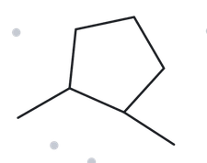
PART B - NAME → STRUCTURE
.
CARD B06 - DEVELOPING
Given Name: 1,2-dimethylcyclopentane
  NAME DECODED
  BOND LINE STRUCTURE
  Parent: cyclopentane (5-carbon ring)
  Substituents: methyl on C1; methyl on C2.
  Expected formula: 5 + 2 = 7 C; one ring → C₇H₁₄.
  FORMULA
  BACK-CHECK
  Returned by The Alkane: 1,2-dimethylcyclopentane
  ✓ Same as the given name
  The ring is the parent. Numbering the short way round gives {1,2}, and the long way gives {1,5}, so {1,2} wins.
  Counted from the drawing: C₇H₁₄.
  One ring: CₙH₂ₙ = C₇H₁₄ ✓
parent length matches
substituent positions match
formula agrees
back-check recorded

Slide 20
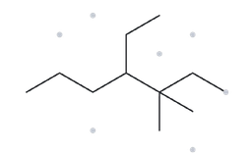
PART B - NAME → STRUCTURE
.
CARD B07 - DEVELOPING
Given Name: 4-ethyl-3,3-dimethylheptane
  NAME DECODED
  BOND LINE STRUCTURE
  Parent: heptane (7-carbon chain)
  Substituents: two methyls on C3 (3,3-dimethyl); ethyl on C4. Ethyl is cited first because e comes before m.
  Expected formula: 7 + 2 + 2 = 11 C; open chain → C₁₁H₂₄
  FORMULA
  BACK-CHECK
  Returned by The Alkane: 4-ethyl-3,3-dimethylheptane
  ✓ Same as the given name
  The longest chain is 7 C. Numbering gives {3,3,4} from one end and {4,5,5} from the other, so {3,3,4} wins. Ethyl is cited before dimethyl.
  Counted from the drawing: C₁₁H₂₄.
  Open chain: CₙH₂ₙ₊₂ = C₁₁H₂₄ ✓
parent length matches
substituent positions match
formula agrees
back-check recorded

Slide 21
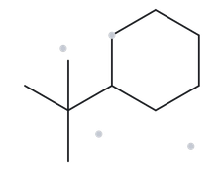
PART B - NAME → STRUCTURE
.
CARD B08 - CHALLENGE
Given Name: tert-butylcyclohexane
  NAME DECODED
  BOND LINE STRUCTURE
  Parent: cyclohexane (6-carbon ring)
  Substituents: tert-butyl, (CH₃)₃C–, a 4-carbon group, on C1. A single substituent on a ring needs no locant.
  Expected formula: 6 + 4 = 10 C; one ring → C₁₀H₂₀.
  FORMULA
  BACK-CHECK
  Returned by The Alkane: (1,1-dimethylethyl)cyclohexane
  ✓ Same as the given name
  tert-Butyl and (1,1-dimethylethyl) are equivalent names for the same group (Appendix B.3).
  Counted from the drawing: C₁₀H₂₀.
  One ring: CₙH₂ₙ = C₁₀H₂₀ ✓
parent length matches
substituent positions match
formula agrees
back-check recorded

Slide 22
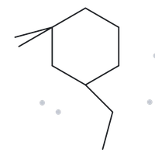
PART B - NAME → STRUCTURE
.
CARD B09 - CHALLENGE
Given Name: 3-ethyl-1,1-dimethylcyclohexane
  NAME DECODED
  BOND LINE STRUCTURE
  Parent: cyclohexane (6-carbon ring)
  Substituents: two methyls on C1 (1,1-dimethyl); ethyl on C3.
  Expected formula: 6 + 2 + 2 = 10 C; one ring → C₁₀H₂₀.
  FORMULA
  BACK-CHECK
  Returned by The Alkane: 3-ethyl-1,1-dimethylcyclohexane
  ✓ Same as the given name
  Numbering gives {1,1,3} one way round the ring and {1,1,5} the other, so {1,1,3} wins. Ethyl is cited before dimethyl.
  Counted from the drawing: C₁₀H₂₀.
  One ring: CₙH₂ₙ = C₁₀H₂₀ ✓
parent length matches
substituent positions match
formula agrees
back-check recorded

Slide 23
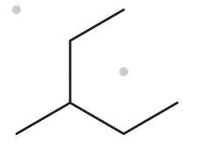
PART B - NAME → STRUCTURE
.
CARD B09 - CHALLENGE
Given Name: 2-ethylbutane
  NAME DECODED
  BOND LINE STRUCTURE
  Parent: butane (4-carbon chain)
  Substituents: ethyl on C2.
  Expected formula: 4 + 2 = 6 C; open chain → C₆H₁₄.
  FORMULA
  BACK-CHECK
  Returned by The Alkane: 3-methylpentane
  ✘ Different from the given name
  Rule broken: the longest-chain rule (Appendix B.1, step 1). The path ethyl → C2 → C3 → C4 has 5 carbons, which is longer than the 4-carbon “butane” chain. The parent is therefore pentane, and the leftover CH₃ is a methyl on C3 (position 3 from either end).
  Counted from the drawing: C₆H₁₄.
  Open chain: CₙH₂ₙ₊₂ = C₆H₁₄ ✓
parent length matches
substituent positions match
formula agrees
back-check recorded

