Slide 1
.Net & Clean Architecture
Template

Slide 2
Sommaire
Clean Architecture
.Net
Annexe

Slide 3
Clean Architecture
01

Slide 4
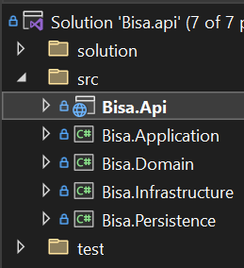
Clean Architecture
Pattern
Projects
Presentation
User Interface (Si App)
Layout. (Si App)
Pages / Components. (Si App)
Assets. (Css / Js / Icon / Svg…)
Middlewares.
Application
Business Logic
Mappers.
Dtos.
Services. Middleware
Validators.
Ui
Application
Infrastructure
Domain
Domain
Coeur de l’application
Attributes.
Configuration. Conf model
Enums. (avec Extensions)
Entities. (Si Api)
Exceptions.
Infrastructure
External components in interaction
HttpClients. Apis
HttpHandlers. Middleware
Consumer. Message Broker (Kafka)
Code Organisation
1 dossier / feature
1 fichier / classe
Le contenu de la solution VisualStudio est sync avec les dossiers & fichiers réels

Slide 5
.Net
02

Slide 6
C# | .Net
Annexe
C#
.Net
Syntax
Class | Property | Method
Record
Comment
C#10 -> 'state with { change }' (equiv JS {...spread, x:change})
Extension Methods (Ex)
?? Operator
« @ » Multi-line string
« $"{var}" » Param string
Async / Await / Task
Enumerable.Aggregate
Linq
Throw new XxxException
Class
Nommage
Contenu Ordonné
Classe
Propriété
Constructeur
Method Public
Method Privée
Api
Middleware
Controllers | Filters
Controller Resp
Services
Dtos
StartUp / Program
ConfigureService
Service options
Configuration
Pattern
Dependancy Injection
Date
DateTime
Comment
Summary
Api Call
HttpClient | Exemple
HttpClientFactory. Lib | Learn1 | Learn2
Http Message Handler | Http StatusCode
Json Serialize/Deserialize

Slide 7
.Net Blazor | Choose Version
Technology
 | Web Assembly | Server
Page Loading | Heavy 1st load (Retrieve DLL) | Only get page (Html / Css / Js)
Data Access | Access Db through Api (to create) | Can access db directly
Code Execution | In client browser | On server (
Server Load | Only on 1st app loading | Client have a SignalR connexion with the server

