Slide 1
Technology
Reference

Slide 2
Summary
.NET
Angular
Web
Database
Annexe

Slide 3
.NET
01

Slide 4
Versions
.NET
.NET
.NET Framework
10
TODO
4.8
Bonjour
9
TODO
4.5
Implémente .NET Standard
8
TODO

Slide 5
Overview
.NET
.NET 5+ (Prev. .NET Core)
.NET Framework
Overview
Multi-Platform
Ref Implem
Vers°. 5 to 10
Component
CLR, GC
CoreCLR
.NET Class Lib
HttpClient
LINQ
Framework
Windows Forms
ASP.NET Core
WPF
Overview
Best for Win° Desktop
Since 2002
Legacy
Vers° 1.0 to 4.8.1
Component
CLR
.NET Class Library
LINQ
Language
C# / F# / VB
Framework
Windows Forms
ASP.NET (4.x)
WPF
WCF
Mono
Lightweight ! => Mobile
Xamarin (Deprecated)
Unity engine games
ASP.NET
Overview
Framework dedicated to Web
Framework
Blazor
MVC
Web Forms
Web API
ASP.NET Core
Razor Pages
CLR. Common Language Runtime
WPF. Windows Presentation Foundation
WCF. Windows Communication Foundation
GC. Garbage Collector
.NET MVC
Model
Views / Partial Views
Controllers
XML

Slide 6
Managed execution in CLR
.NET
« PE » is a file format for executable code
(It’s what is in .exe & .DLL)
It extends the old COFF format
IL CIL MSIL. Common Intermediate Language
CLR. Common Language Runtime
GC. Garbage Collector
Managed Code. Code exe in CLR not in OS
Portable Exe (PE) File
Native Code
Target Machine Archi
CIL
(Managed code)
Source Code
C# / F# / VB
CLR
Compile CIL to Native
JIT .NET compiler
Or AOT :
Ngen.exe (.NET Fram)
Crossgen2 (.NET6+)
Services
Run Code
Garbage Collector
Type safety
X-lang Exc° Handling
X-lang Integration
Debugging capab
Custom attr / inheritance, interfaces…
Metadata
(types, members, ref…)
Language Compiler
Compilation AOT
Reference
CLR
Managed Execution Process
Verificat° Process
For TypeSafety

Slide 7
Concepts – By Stack
.NET
.NET API
.NET Blazor
Concept
Middlewares
Controllers | Filters
Controller Resp
Services
Api
Dtos
StartUp / Program
ConfigureService
Service options
Configuration
Component
Overview
Syntax. Razor (@{})
Lifecycle
Type Genericity
Data Binding
Event Handling
Templated Component (=Content Projection)
Style Isolation (Ex)
Routing
Blazor (Tutorial. Codemaze)
Blazor @page '<route>’
Pattern
Service Injection
@using & _Import.
JsInterop
Real Time Server To Client (SignalR)
Api Call
HttpClient | Exemple
HttpClientFactory. Lib | Learn1 | Learn2
Http Message Handler | Http StatusCode
Json Serialize/Deserialize
Date
DateTime
 | Web Assembly | Server
Page Loading | Heavy1st load (Retrieve Dll) | Only get page (Html / Css / Js)
Data Access | Through Api (to_create) | Direct Access
Code Exe° | In client browser | On server
Server Load | Only on 1st app loading | Client have a SignalR connexion with the server
Mapping
Lib. AutoMapper | DI
Learn | Conf ac Profile
Accessible par DI
Gérer les Collections
Reactivity
Make Blazor Reactive : Lien 1 - Lien 2

Slide 8
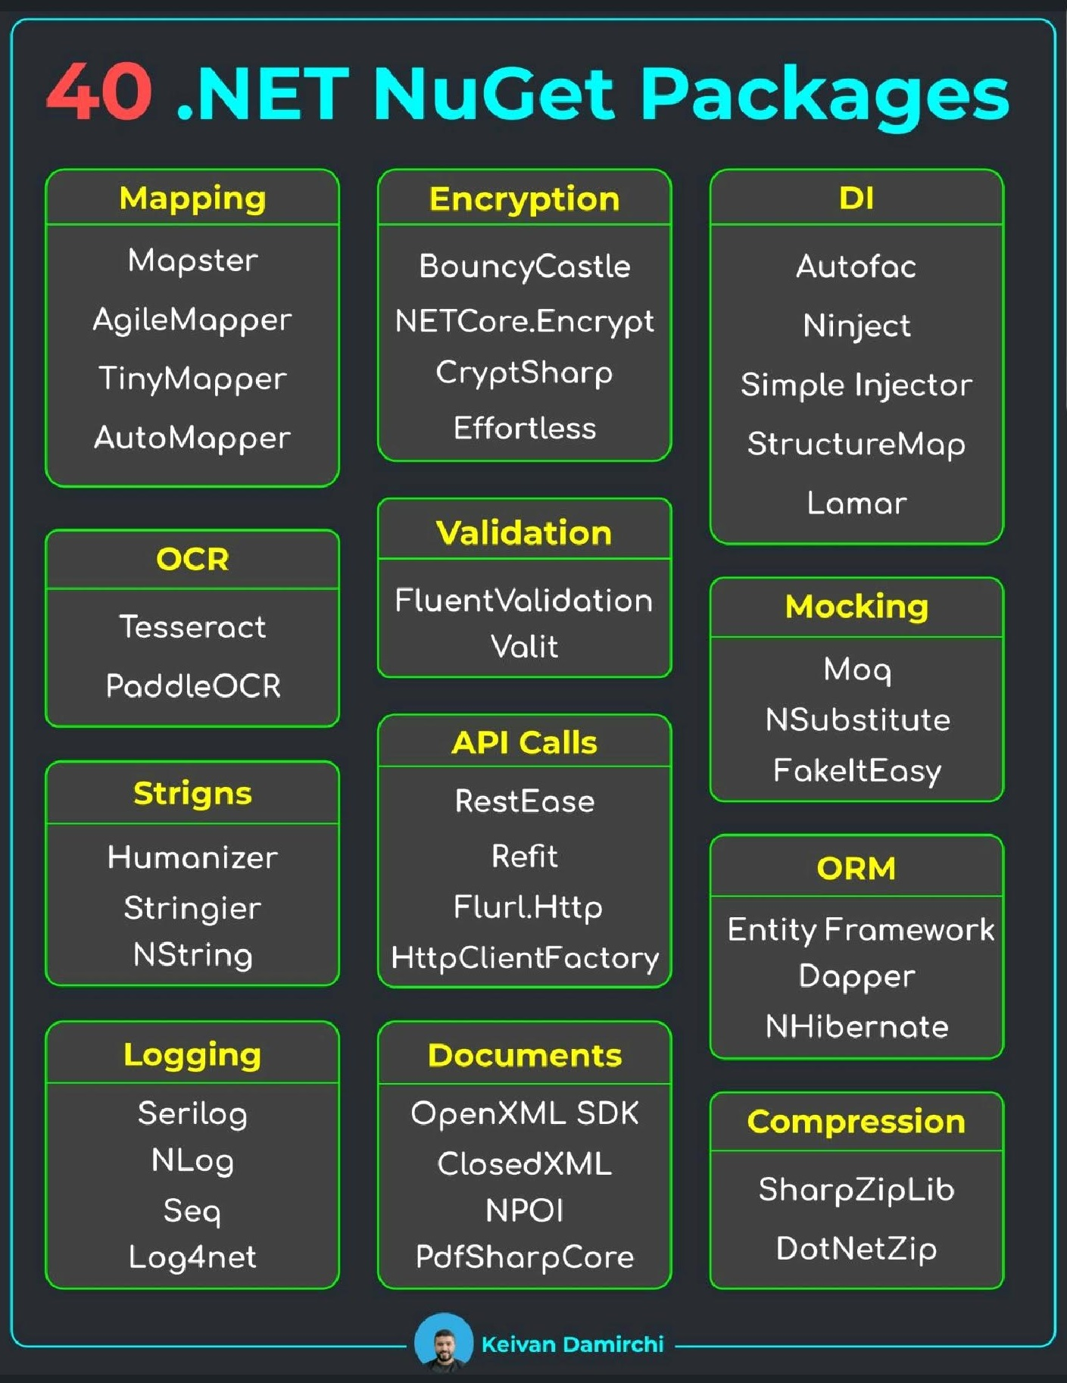
C# Language
.NET
Features
Variable, methods
Decorator (= Annotation)
Inheritance, Reflexion, Introspection
Multi-Threading
C#10. 'state with { change }’
?? Operator
Async / Await / Task
Throw new XxxException

Slide 9
C# Language – Types (Data Structure)
.NET
Built-In Types
Value. bool / int / double / float / string
Ref. object / string / delegate / dynamic
Others Custom Types
Struct. Value copy !
Class. Ref copy
Record.
Enum.
LINQ
Only executed when « ToList() »
2 Syntax
Method. collection.Ope (x => x.Attr)
Query. from item in collection ope
(Ex. from num in numbers select num)
String
Nb of char string.Length
Concat. str.Join/Concat / + operator
Concat. More efficient StringBuilder
Multi-line string (« @ »)
« $"{var}" » Param string
Collections
Use generic as return type
Array. statically sized
List. dynamically sized
Hashset. unordered unique elt
Dictionary. couple (Key, Value)
Queue.
Stack.
Enumerable.Aggregate
Operation
Select. Projection
Where. Filter on conditions
OrderBy. Sort (desc),
ThenBy().
ForEach. Do for each elt
ToList(), ToArray()
Interface
Concrete method since C# 8.0
Can inherit only interface
No properties, no constructors
All methods are public

Slide 10
C# Language
.NET
Modifiers
Class
Visibility
private, public, protected
Default to private in class/struct
Internal. Visible in assembly
Structure
Naming
Ordered Content
Class
Property
Constructor
Public Methods
Private Methods
Abstract Class
Use to define a base class in class hierarchy
Can’t be instantiated
Can have methods, fields, props (abstract & non abs)
Can have constructs (non abstract !)
Abstract element must be impl by subclass
Non abstract element provide def° imp
Syntax. public abstract class AbstractClass
virtual
Used in base class
Has default impl in base class
Specify that “method” & “property” can be overriden
Static Class
Use to contain utility methods or cstes (Ex. System.Math)
Contains only static elts (methods, properties)
Can be used to contain ExtensionMethod
Can’t be instantiated
Can’t be inherited (= Is “sealed”)
Syntax. public static class StaticClass
Methods
Extension Methods (Ex)
sealed
Apply on “virtual/override” method in parent class
Make the method not overridable in derived class
Compare
2 objs = mm hashcode
Comment
/// Summary
// Todo <=> Code à re-travailler
Exception
Others
static, abstract…

Slide 11
Angular
02

Slide 12
Versions
Angular
Référence
19
Angular Signals. Reactive StateMngt ASYNC
String interpolation in Ang Templates
16
Angular Signals. Reactive StateMngt SYNC
Self-closing tags <elt attr=« val » />
Route param mapping
18 (TS 5.4)
Content Projection (<ng-content> default)
Router & Redirects as Observable
SSR & Debug. Improvements
Zoneless change detection (Expé)
HttpClientModule => client HTTP Api (interceptors)
15
Evo 1
Evo 2
14
Stand-alone Component
17
Deferrable Views (@defer)
SSR. move package (universal deprecated)
Builder. Vite & esbuild become default
Debug. Inspect injectorTree of compo° in devtools
View Transition (Expé)
9
AOT compilation become default (JIT deprecate)

Slide 13
Overview
Angular
Presentation
Based on ‘HTML, CSS & TS’
Single Page Application (SPA) Framework
A collection of JS modules (So use : node, npm)
Adapted for “Web mobile & desktop, native mobile & desktop”
Implement “Inversion of Control” via “DI”
Versionné ! (Last. 19)
Features
Service Worker (Pour PWA !)
Web Worker
SSR (Angular Universal Old.)
Resolvers.
Signals (State Mngt)
Internationalization (i18n)
Router
Directive
Guard
Pipe
Http Client / Interceptor
Modularity
Module
Component (.html, .css, .ts)
Service. Injectable (DI)

Slide 14
Concepts
Angular
Module
Lazy loading (Warn : != JS module = every js file)
Ex. root module, Router, FormsModule
Metadata. imports (module), providers, declaration, exports, bootstrap
Directive
Type. Component, Attribute, Structural
Ex. ngModel, ngSwitch, ngStyle, ngClass
ngFor, ngIf,
Service
For data/logic not associated with a specific view
Make any entity (class, compo…) a Service : @Injectable()
Provide the service
Component
Extend “Directive” :O
Metadata. CSS Selector, HTML tmplt, Providers
Lifecycle (init, destroy, changes…)
Pass data btw Component : @input, @output, EventEmitter
Web Worker
Code that allow to run heavy task in background

Slide 15
Web Component
Angular
Material
mat-form-field
mat-icon
mat-button
…
Bootstrap
Use Bootstrap with angular => angular bootstrap
Fournit classe “{property}{sides}-{breakpoint}{size}”
{property} : m, p
{sides} : top, bottom, left, x,y

Slide 16
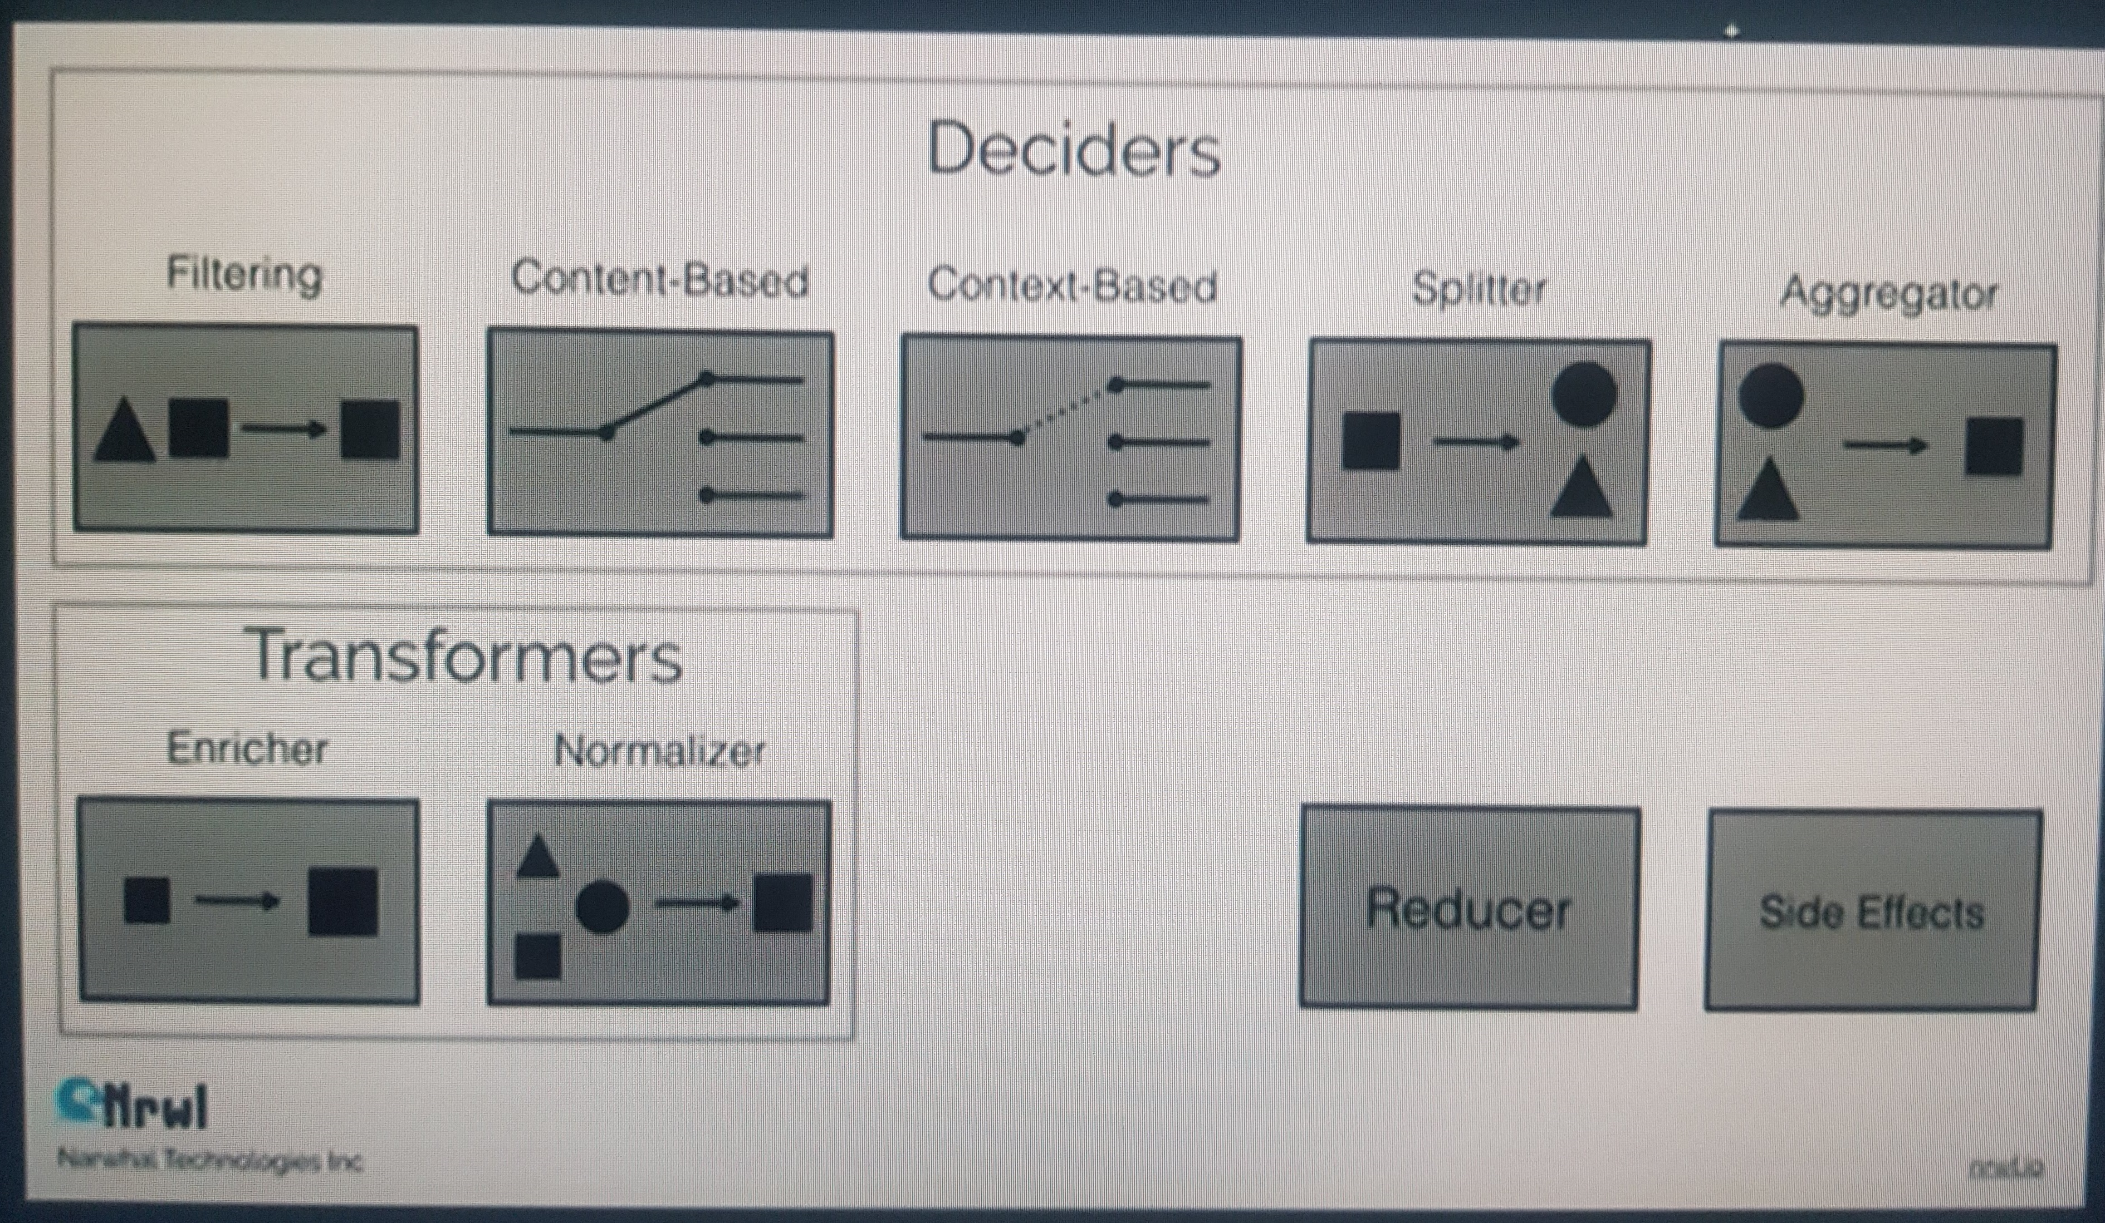
Reactive - RxJS | NgRx
Angular
RxJS
Reactive Extensions Lib for JS
Références : Link
Promise (One time)
Observable (Unicast)
Subject (multicasting)
Behavior, Async, Replay
Observer
Next(), error(), complete()
Subscription (rsult of .subscribe())
Finalize(), subscribe()
Operator
tap, .map, filter, of, first
switchMap, exhaustMap,
of(), first(),
NgRx
Implement Redux Pattern
Based on RxJS, Designed for Angular
Store | State
Action | Reducer | Selector | Effect,
Entity | Adapter
Router-store | Store-devtools
Actions. unique event sent by Serv° & Compo°
Reducer. fct° apply during state change
Selector. to select state
Effect. interaction with external src
Type of Effect in the Picture :

Slide 17
Web
03

Slide 18
HTML
Web
Concept
Element. <balise></balise>
Attribute / Value
DOM / Shadow DOM
Forms / Graphics / Media
Html validator
Reference
Common Element
<head>
<body>
<a>. Link
<p>. paragraph
<button>,
<video>…
Attribute
name
for
class
type

Slide 19
CSS
Web
Presentation
CSS (Cascading Style Sheets)
How HTML elts are displayed
Stored in .css files
Validator
Jigsaw
Design
Color. RGB, HEX, HSL
Background. (Color, Img…)
Box Model. border, margin, padding
Display. inline, block, flex / grid…
Container
Flex
Flex-direction,
wrap
grow
Concept
Selector
Property / value
Media Query
Breakpoint
Variables
Selector
Simple / Combinator
Attribute (HTML)
Id
Class
Pseudo-Elt (:)
Pseudo-class (::)
Universal : *
Grouping : ,
Units of length
Abs. cm, mm, in, pt, pc
Font-Size. em, ex, rem, ch
ViewPort. (s,d,l)vh, vw, vmin, vmax
Parent. px, %
Grid. fr
Grid
column,
row…
Pre-Process
Sass (scss), less, Stylus
??
??. euh
Rules
Specificity. The more precise has priority
!important. Make a style high priority

Slide 20
Javascript / Typescript
Web
Javascript
??
Typescript
Variable, type, enum
Function
Class, Object, Property
Cloner un objet
Interface & Héritage
Public | Privé
Modifiers (readonly, optionnal…)
Module
Decorator (~Annotation de classe)
…
Version 5.4 (readonly modifier / import type…)

Slide 21
Database
04

Slide 22
Database
MartenDb
Distributed as Nuget
Aim at use PostgreSQL as a DocDb
Provide a DocumentDatabase & EventSourcing
Expose Dapper
Expose Postgre RDBMS
ACID compliant

Slide 24
Technologie Envisageables
Annexe
Framework
Angular
React
Vue
Node.Js
.NET WebForms
.NET MVC
.NET Blazor
Spring
Langage
C
C++
C#
Java
JS
Kotlin
Groovy
Python
CSS.Pre-Processor
Less, Scss, Sass, Stylus, Postcss
Components
DevExtreme / DevExpress (~angular / material)
NgxBootstrap (bootstrap adapted for angular)
Bootstrap (impl ac class css)
Bulma
Syncfusion
Ionic
Telerik Ui Blazor
Données
EntityFramework
Dapper
OrmLite

