Slide 1
计算机图形学
Computer Graphics
授课班级：111161-2班
任课教师：罗忠文
E-mail：24035234@qq.com
主页：se.cug.edu.cn

Slide 2
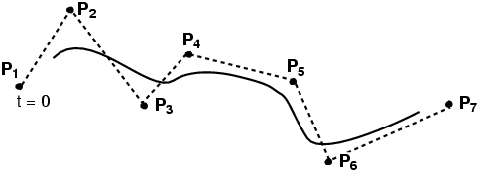
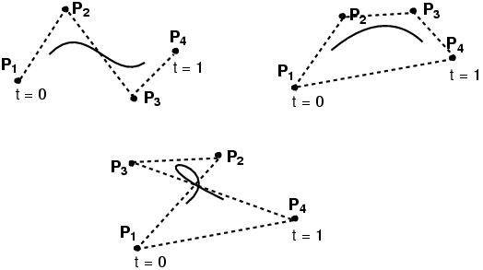
三次Bsplines（B样条）
≥ 4 控制点
局部三次
  三次多项式链在一起
曲线不经过任何控制点
B样条曲线同样由其控制点的闭包所包围
6.837 Fall 06 – Durand

Slide 3
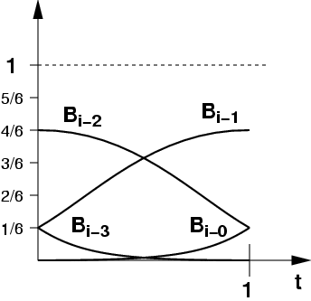
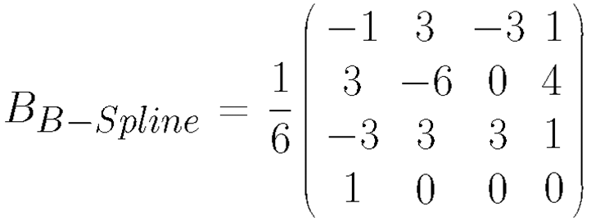
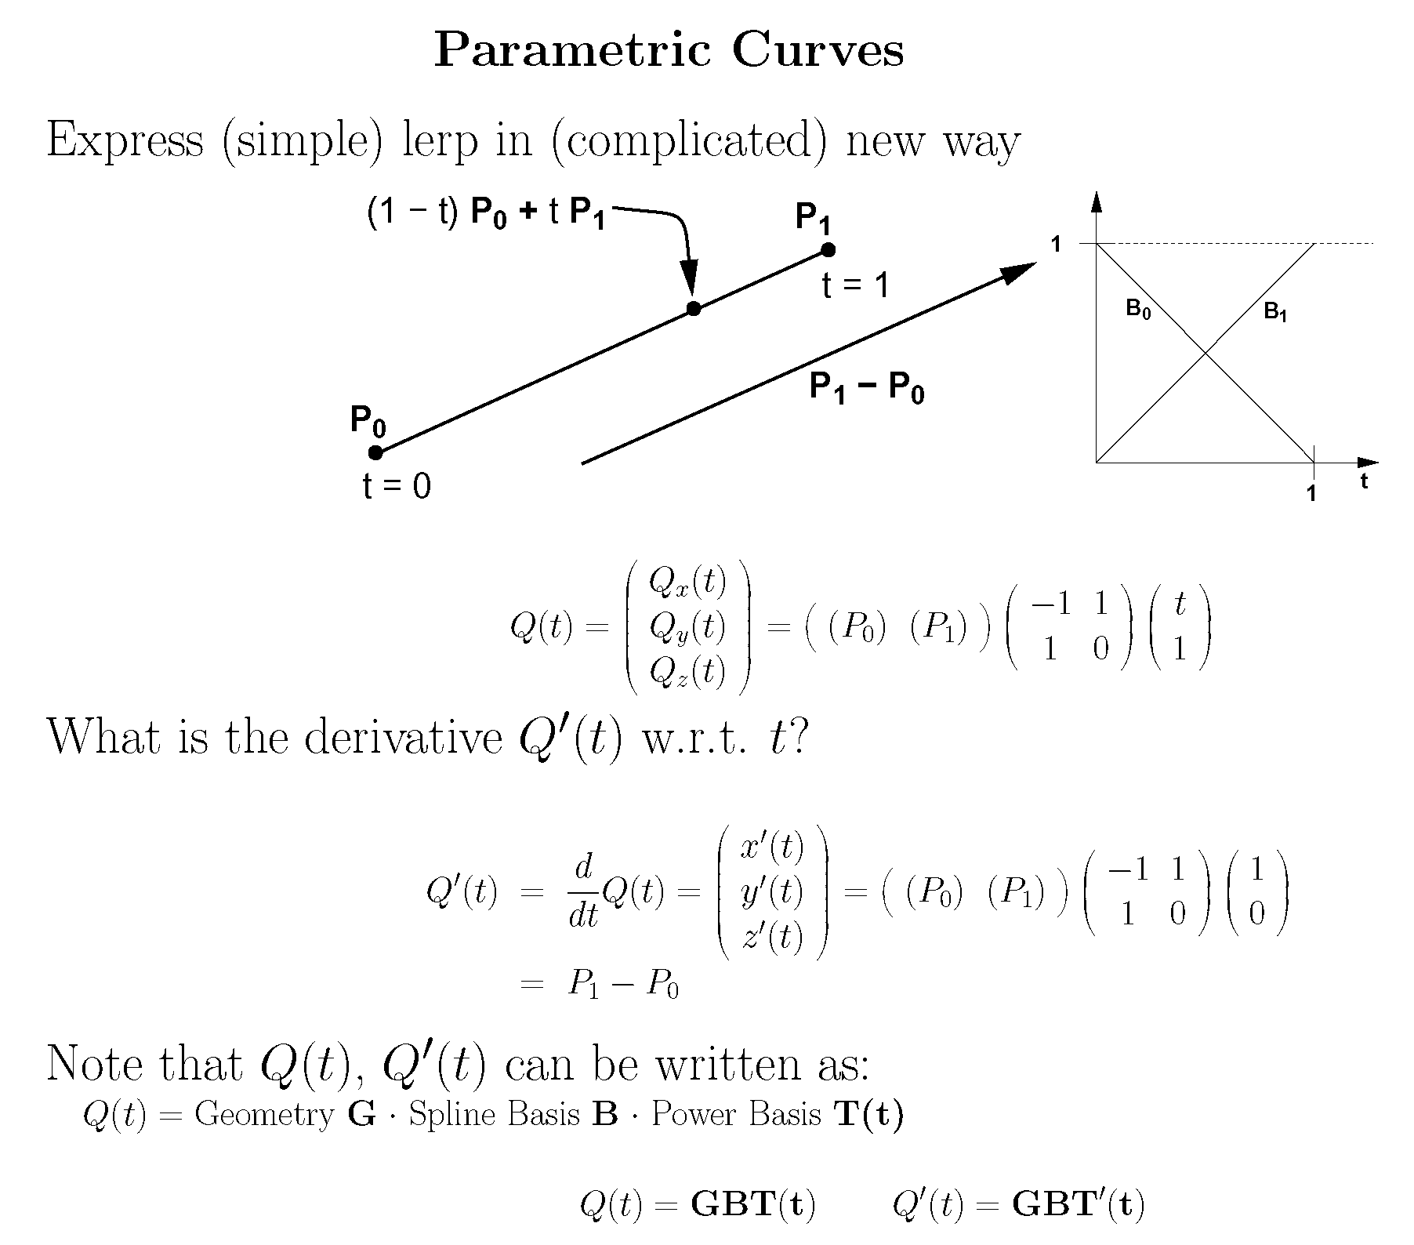
三次B样条: 基

Slide 4
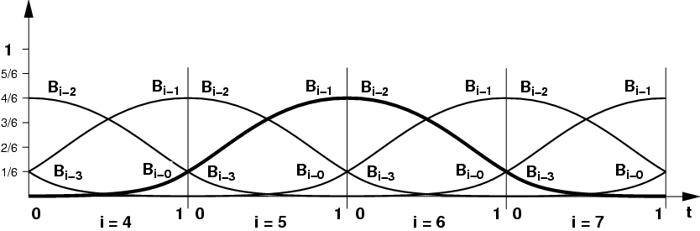
三次B样条曲线
可以连起来
能更好的控制 (窗口)局部图景

Slide 5
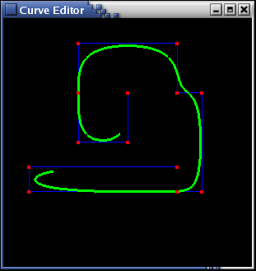
连接三次B样条曲线
二者关系？
  控制点个数
  三次B样条分段数

Slide 6

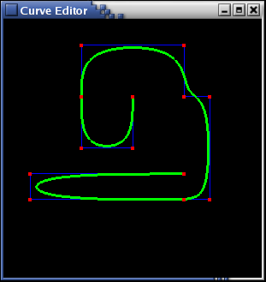
BSpline曲线控制点
缺省BSpline
非光滑的Bspline
经过端点的BSpline
复制内部控制点
复制端点

Slide 7
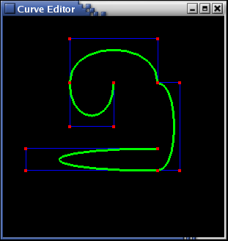
Bézier与B样条的差别
Bézier
B样条

Slide 8
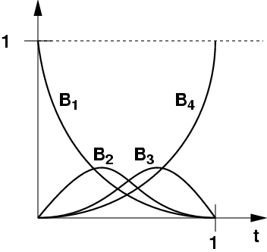
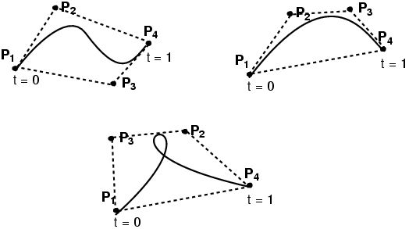
Bézier与B样条的区别
与控制点的关系不同
Bézier
B样条

Slide 9
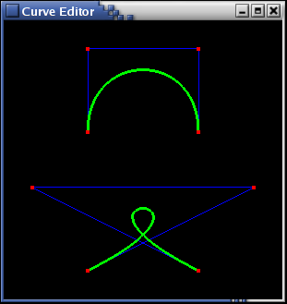
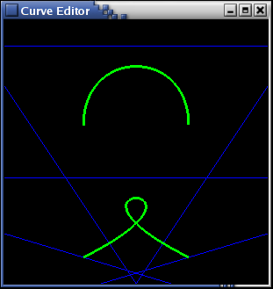
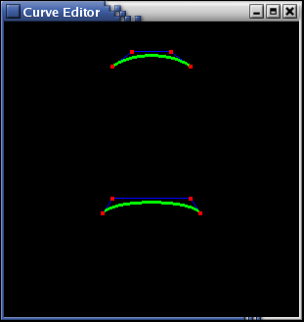
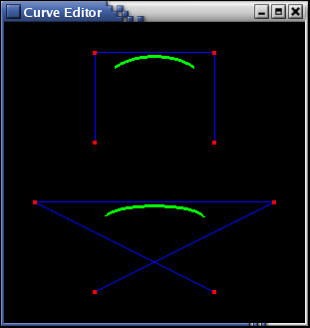
Bézier & BSpline互相转换
新的B样条控制点，可产生与 Bézier同样的曲线
Bézier曲线的原控制点
新的Bézier 控制点，可产生B样条同样的曲线
B样条的原控制点
6.837 Fall 06 – Durand

Slide 10
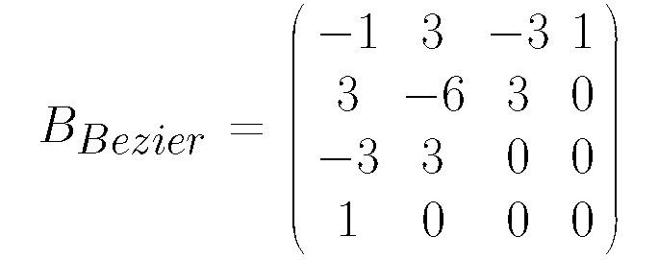
Bézier与B样条互相转换
使用基函数表示：

Slide 11
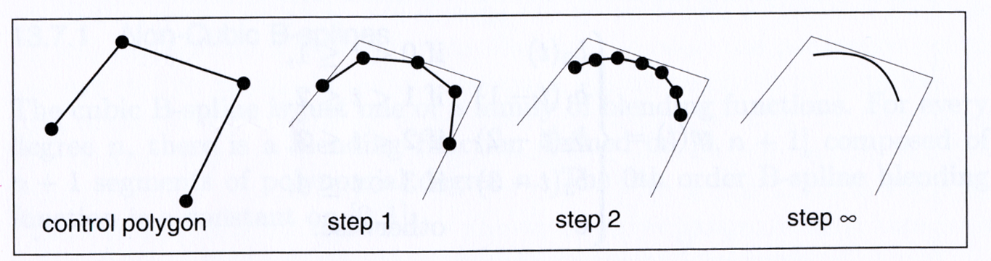
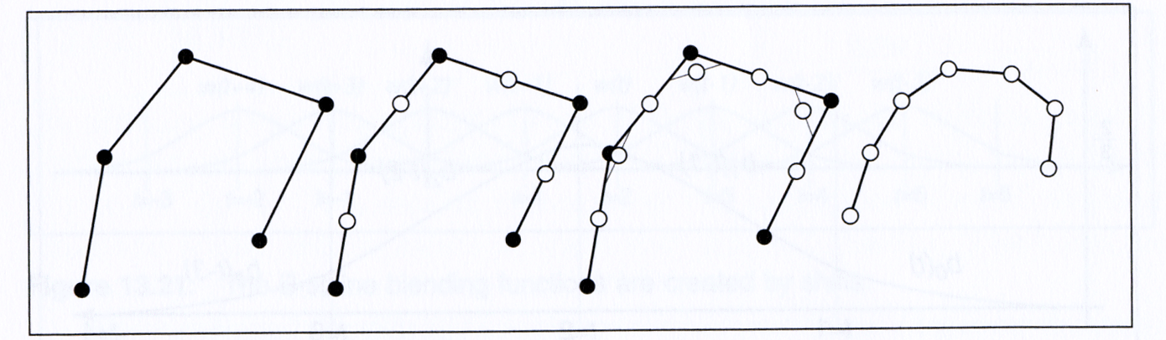
三次B样条
Iterative method for constructing BSplines

Slide 12
NURBS (更一般的B样条)
B样条: 均匀三次B样条
有理Bezier/三次
  使用齐次坐标(后面介绍)
NURBS: Non-Uniform Rational BSpline
  non-uniform = 混合函数间有不同的间距, 即节点间距不同
  rational = 多项式比率 (代替三次)

Slide 13
提问?

Slide 14
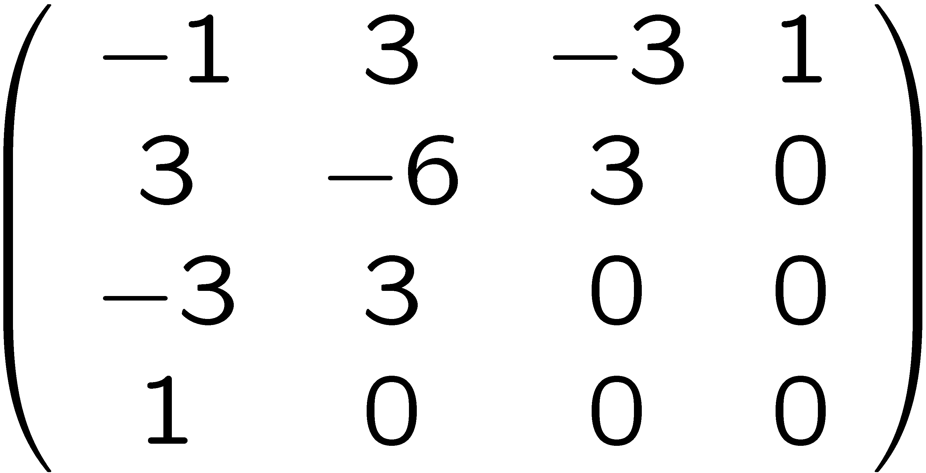
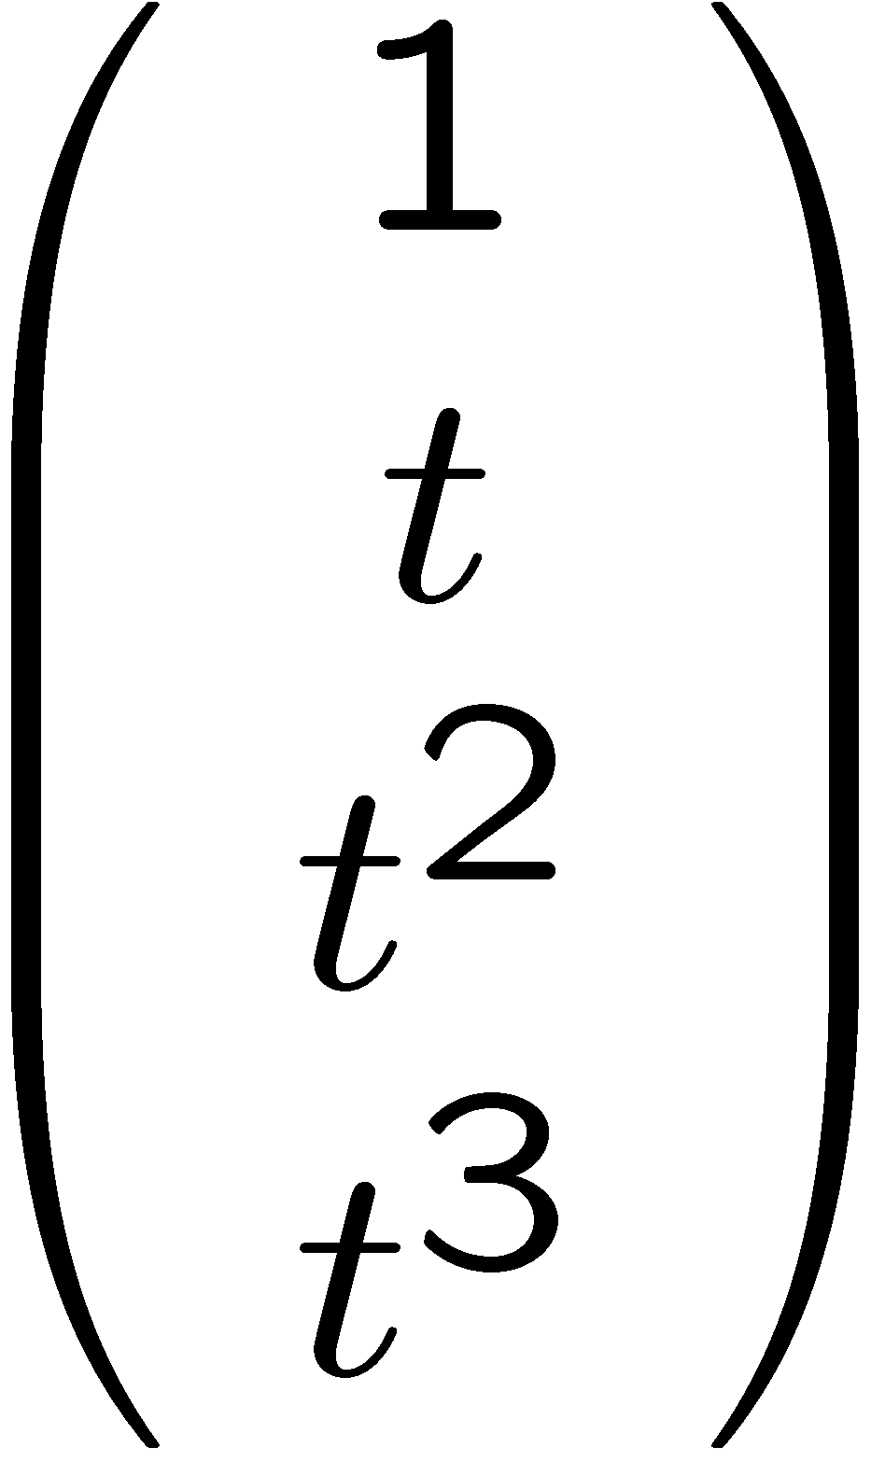
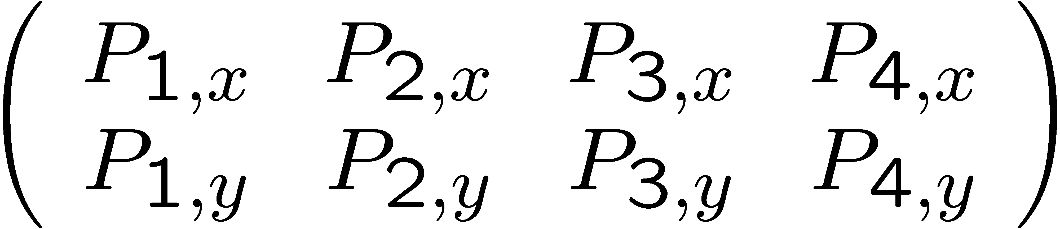
线性变换与样条
What happens when we transform the control points with a linear transform?
  Is it the same as transforming each point on the curve?
  Yes! Because everything is linear
P’(t)=
M
=
M

Slide 15
仿射变换与样条
E.g. translations? F(P) =P+V
  Remember, affine transforms are not linear!
We’re lucky, it still works.
  This is because the sum of the basis/influence is always one

Slide 16
仿射变换与样条
e.g. for Bezier where
P(t) = P₁B₁(t)+P₂B₂(t)+P₃B₃(t)+P₄B₄(t)
Let’s transform the control points:
F(P₁)B₁(t)+F(P₂)B₂(t)+F(P₃)B₃(t)+F(P₄)B₄(t)
= (P₁+V)B₁(t)+(P₂+V)B₂(t)+(P₃+V)B₃(t)+(P₄+V)B₄(t)
=P₁B₁(t)+P₂B₂(t)+P₃B₃(t)+P₄B₄(t)
+ V (B₁(t)+B₂(t)+B₃(t)+B₄(t) )
=P₁B₁(t)+P₂B₂(t)+P₃B₃(t)+P₄B₄(t) + V
=1

Slide 17
Big message of the day
Linearity makes life easy
If something’s linear, matrices are useful

Slide 18
Vectors spaces, matrices
Basis, cartesian coordinates
  Basis: set of vector that span the space
  That is, every vector is a linear combination of the basis vector
Special basis: orthonormal
Dot product
  Geometric: length of projection onto other vector
  In orthonormal basis: sum of product of coordinates
  In orthonormal basis: dot product with basis vectors provides coordinates
Cross product
  Provides orthogonal vector, length = product times sine, right-hand rule

Slide 19
Linearity
What characterizes a linear function/operator?
  Function over a vector space
  For two vectors V & W: f(V+W)=f(V)+f(W)
  For a scalar a f(aV)=af(V)
    Consequence f(0)=0
This is a fundamental property, makes life easy
使得我们只用关注基（基决定其他）
  f(xI+yJ)=x f(I) + y f(J)
6.837 Fall 06 – Durand

Slide 20
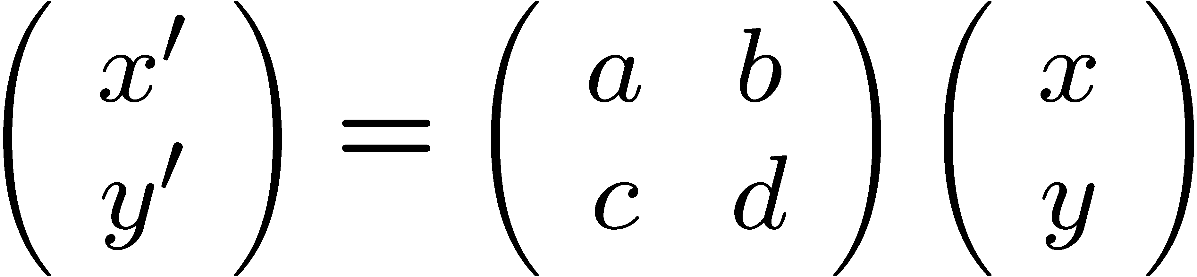
矩阵Matrices
Convenient notation for linear transforms
Means
x’=ax+by
y’=cx+dy
Matrices can be multiplied, transposed,
sometimes inverted
6.837 Fall 06 – Durand

Slide 21
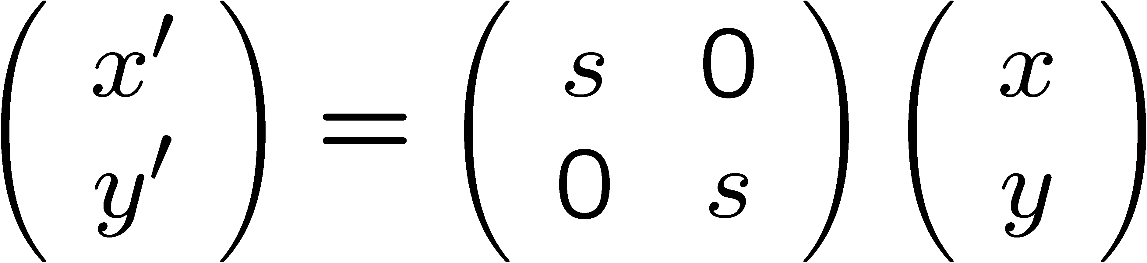
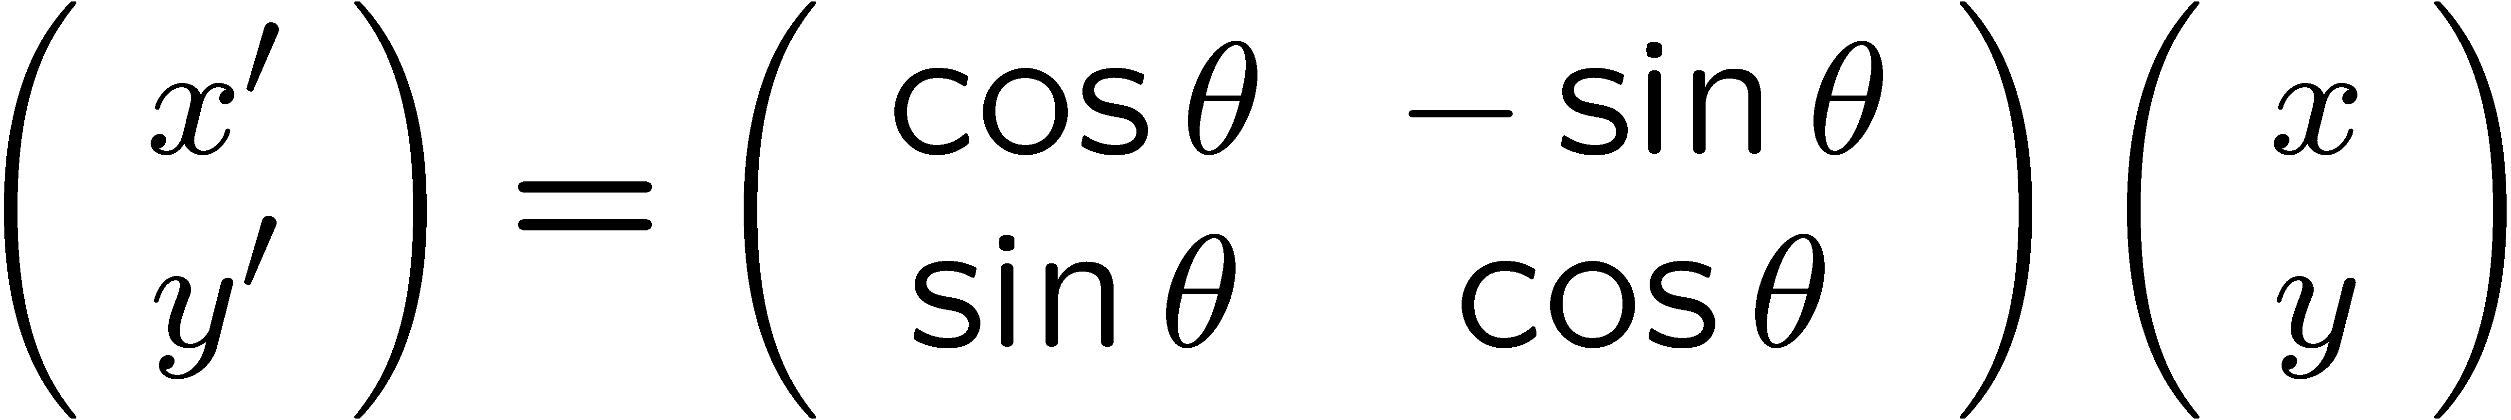
Example 2x2 matrices
Scale
Rotation
6.837 Fall 06 – Durand

Slide 22
Affine operators: add translation
Consider the transformation of R²
  F(x,y) = (x+t_{x}, y+t_{y})
It is not linear
  E.g. f(0, 0) is not 0
  F(x+x’, y+y’)=F(x, y)+f(x’, y’) + (t_{x}, t_{y})
Cannot (directly) be represented by a matrix
It’s kind of confusing, because from a polynomial perspective, we would say that F is a linear function.
6.837 Fall 06 – Durand

Slide 23
提问？

