Slide 1
计算机图形学
Computer Graphics
授课班级：111161-2班
任课教师：罗忠文
E-mail：24035234@qq.com
主页：se.cug.edu.cn

Slide 2
Plan
Hierarchical Modeling
OpenGL matrix stack
Scene graph
Forward kinematics
Inverse Kinematics
Interpolating rotations
Slide <number>

Slide 3




3维空间中方向插值
Critical in particular for camera animation
Rotation matrices
Given rotation matrices M_{i} and time t_{i},
find M(t) such that M(t_{i})=M_{i}
ux
vx
nx
uy
vy
ny
uz
vz
nz
u
v
n
Slide <number>

Slide 4
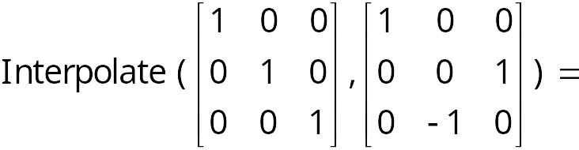
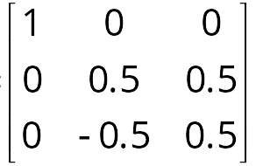
错误的解（Flawed Solution）
Interpolate each entry independently
Example: M₀ is identity and
M₁ is 90º around x-axis
Is the result a rotation matrix?
No, it does not preserve rigidity
(angles and lengths)
Slide <number>

Slide 5
3D旋转
3D方向有多少个自由度?
3个自由度:
  旋转方向和角度
  3欧拉角
Slide <number>
Notes:
问题：为什么旋转方向和角度是三个自由度

Slide 6
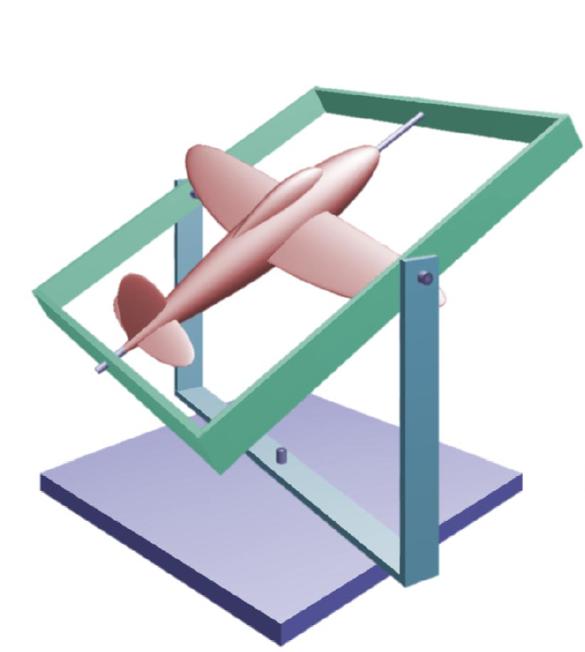
Euler Angles
An Euler angle is a rotation about a single axis.
Any orientation can be described by composing three rotations, one around each coordinate axis.
Roll, pitch and yaw
(perfect for flight simulation)
http://www.fho-emden.de/~hoffmann/gimbal09082002.pdf
Slide <number>

Slide 7
Interpolating Euler Angles
Natural orientation representation:
interpolate independently 3 angles for 3 degrees of freedom
However, leads to unnatural interpolation:
rotation of 90º around Z, then 90º around Y = 120º around (1, 1, 1)
But rotation of 30º around Z then 30º around Y ≠ 40º around (1, 1, 1)
b
a
a
b
a
b
=
a
c
a
c
c
c
b
c
b
b
b
b
a
a
a
c
c
c
Slide <number>
6.837 Fall 2006

Slide 8
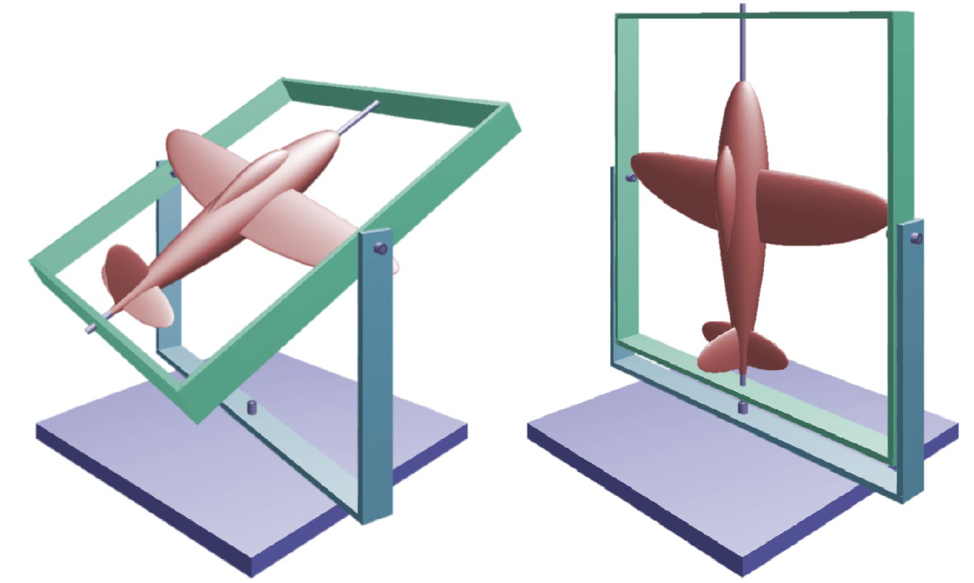
Gimbal Lock
Two or more axis align resulting in a loss of rotation degrees of freedom.
Slide <number>
http://www.fho-emden.de/~hoffmann/gimbal09082002.pdf

Slide 9
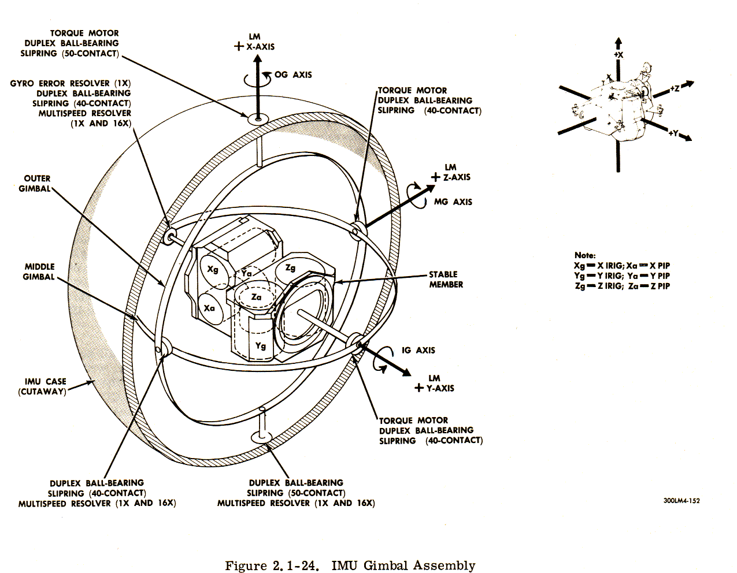
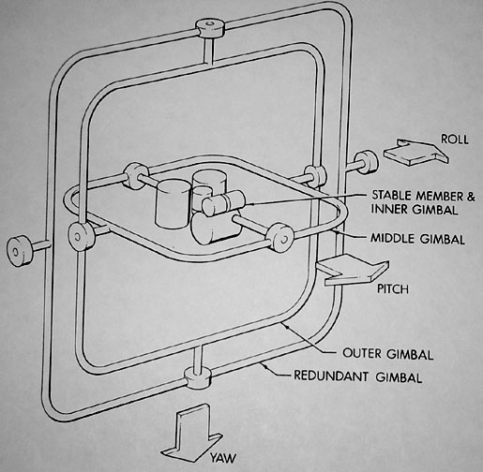
Euler Angles in the Real World
Apollo inertial measurement unit
To “prevent” lock, they added a fourth Gimbal!
http://www.hq.nasa.gov/office/pao/History/alsj/gimbals.html
Slide <number>

Slide 10
Questions?
Slide <number>
6.837 Fall 2006

Slide 11
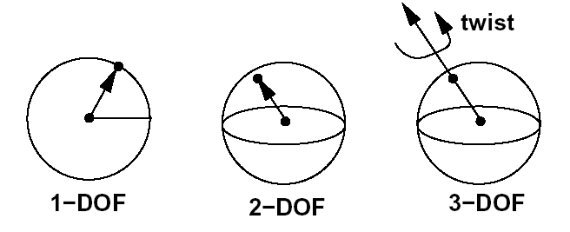
解: 四元数（Quaternion）插值
Interpolate orientation on the unit sphere in 4D
  Logical and easy, isn’t it?
By analogy:
1-, 2-, 3-DOF rotations as constrained points on 1, 2, 3-spheres in 2D, 3D and 4D
Slide <number>

Slide 12
1D 球和复平面
θ₁
1 angle
  由于模2π处理麻烦
解决方案:
  用圆上的点来表示旋转
  使用三维平面上的插值
  投影到球上
可以认为二维平面就是复平面
  方向 = 二元数（复数）定义的复角（complex argument ）
  不必非常严格的, 但很容易扩展到3D旋转
  有趣的是, 旋转的复合 ⬄ 复数相乘
    Trivial with exponential notation re^{iθ}
θ₀
Slide <number>

Slide 13
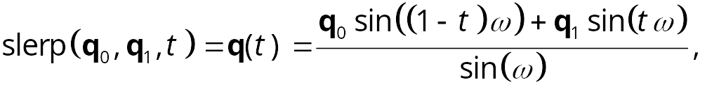

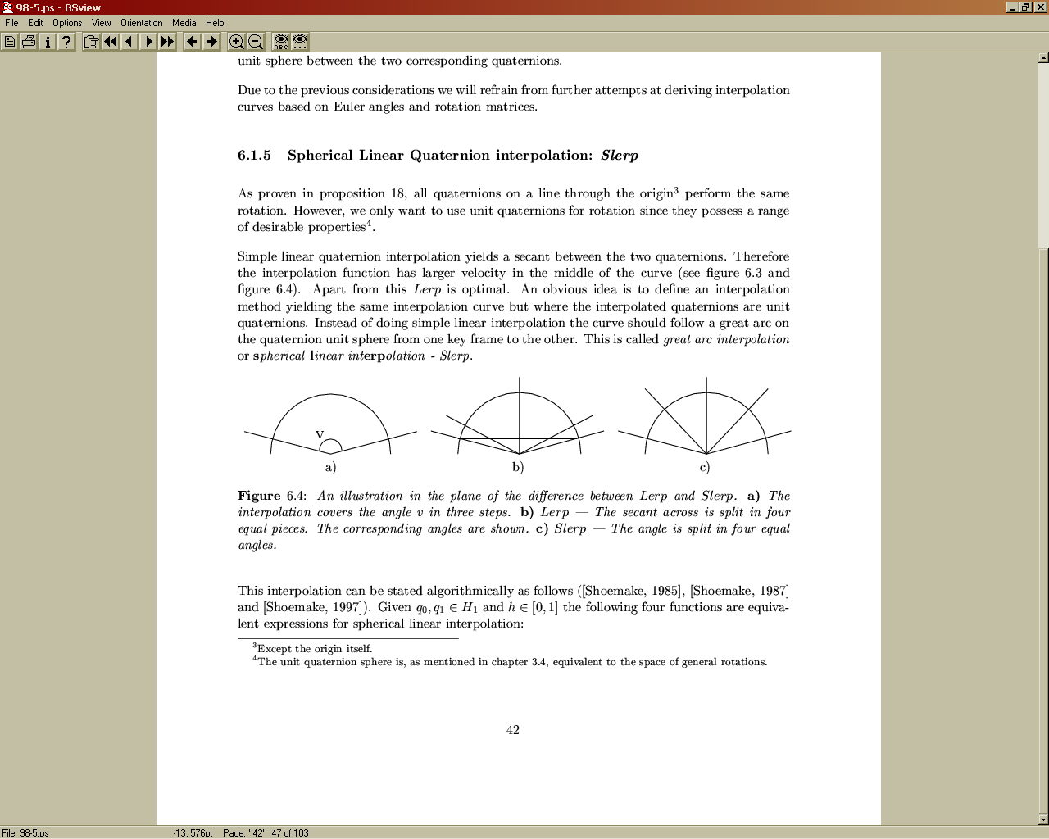


速度问题: lerp vs. slerp
Linear Interpolation (lerp) interpolates the straight line between the two orientations
→ lerp motion does not have uniform velocity:
Spherical Linear Interpolation (slerp) interpolates along the arc lines by adding a sine term:
interpolate along arc line rather than secant
Slide <number>
keyframes
lerp
slerp

Slide 14
2-角方向
2 角
  由于模2π处理麻烦
3D空间中嵌入2D球
在3D空间中使用线性插值
方向 = 投影到球上
Use slerp for velocity correction
  Note that velocity is still a 1D problem along the great circle
Slide <number>

Slide 15
3 角 – 四元数（Quaternions）!
同样原理
  在更高维空间中插值
  投影到单位球上
可能需要在4D空间中嵌入3D球
更复杂，更难可视化
Slide <number>

Slide 16
四元数（Quaternions）
Due to Hamilton (1843)
可和复数一样定义
  a+bi+cj+dk
乘法法则
  i² = j² = k² = -1
  ij = k = -ji
  jk = i = -kj
  ki = j = -ik
… More next time
Slide <number>

Slide 17
提问？

